Slide 1

Maya API Training
Naiqi Weng
Developer Consultant,
Autodesk Developer Network (ADN)

Slide 2

Maya Custom Command
Naiqi Weng
Developer Consultant,
Autodesk Developer Network (ADN)

Slide 3





Agenda
Custom Commands
API Command Utility Classes
API Code Error Handling
DAG Hierarchy
Image courtesy of Johan Vikström, Shilo, Ool Digital, Mikros Image
Notes:
We will also cover how to deal with errors in your code

Slide 4
Custom Commands
Image courtesy of Johan Vikström, Shilo, Ool Digital, Mikros Image

Slide 5
API extend Script functionality
Maya GUI
Custom Maya Command
Maya Commands
Maya API
Maya Core
OS
Notes:
when MEL commands provided by Maya don’t fit your need, you can use API to create your own command to meet your specific requirements.

Slide 6
Custom Command
Extend Maya Command
Core Class: MPxCommand
Functions that need to be implemented:
cmdCreator()
doIt()

Slide 7
cmdCreator() Function
The creator method is called to return a new instance of the command:
Static function: can have any name
def cmdCreator():
return OpenMayaMPx.asMPxPtr(myFirstCmd() )
Notes:
You can name it whatever you want, as long as when you register the command, you pass the corresponding command name

Slide 8
doIt() Function
Called when command is executed
Parse the “args” arguments and perform user-defined operation
This does all the work of this command

Slide 9
doIt() Implementation
Called when command is executed:
class myFirstCmd(OpenMayaMPx.MPxCommand):
def __init__(self):
OpenMayaMPx.MPxCommand.__init__(self)
def doIt(self,args):
print "Hello World! I am in the doIt() function!"

Slide 10
MPxCommand Registration
To register your custom command in Maya:
To deregister your custom command:
kPluginCmdName = “myFirstCmd"
def initializePlugin(mobject):
mplugin = OpenMayaMPx.MFnPlugin(mobject)
try:
mplugin.registerCommand(kPluginCmdName, cmdCreator)
except:
sys.stderr.write( "Failed to register command: %s\n" % kPluginCmdName )
def uninitializePlugin(mobject):
mplugin = OpenMayaMPx.MFnPlugin(mobject)
try:
mplugin.deregisterCommand( kPluginCmdName )
except:
sys.stderr.write( "Failed to unregister command: %s\n" % kPluginCmdName )

Slide 11
Custom Commands with Arguments
Image courtesy of Johan Vikström, Shilo, Ool Digital, Mikros Image

Slide 12
MEL Command Parameters
Users can specify parameters to a MEL command in two ways:
Command Flags and Flag Arguments
Command Arguments
Example: headsUpDisplay –s 0 –b 0 –label “myHUD” myHUD;
Basic command structure:
myCommand –myFlag <optionalFlagArg> <optionalCmdArg>
Can have multiple flags, flag arguments and command arguments.
Notes:
Let’s first take a look at some of the features of MEL commands, so that we get an idea of what implementation we need to do for our own command.
///////////////////////////////////////
The docs about “flag argument” and “command argument” is wrong in Msynatx part

Slide 13
Related Classes
MArgList:
Parses arguments into a sequence of strings and numeric values. No syntax checking is performed. No special handling of flags: they are treated as string arguments.
MArgParser:
Parses arguments according to a syntax you define. Does syntax checking and special handling of flags and their parameters for easier access.
MArgDatabase
Extends MArgParser by providing the ability to retrieve flag parameters, command arguments and command objects as selection lists.

Slide 14
Command with Arguments
Retrieve arguments from MArgList
This will NOT work if you want the flags be accessible when the command is used from within Python
myCmd -number 10;
def doIt(self, args):
index = args.flagIndex("n","number")
if OpenMaya.MArgList.kInvalidArgIndex != index:
//get the data following flag "n“
argData = args.asInt(index+1)
Notes:
When Maya pass this MArgList variable to you, it’s actually a list including all the flags and arguments
it is like a argument for your c++ command line executable program, without the name of the program included
Also there is no way to specify command argument.

Slide 15
Command with Arguments
custom syntax: more advanced and flexible way to define and parse arguments
Three types of arguments that can be specified via these syntax methods: flags arguments, command arguments, objects
MSyntax class represents a command syntax definition.
You are responsible to define a syntax constructing method that must be registered with Maya for your command.

Slide 16
MSyntax
Syntax registration:
mplugin.registerCommand( kPluginCmdName, cmdCreator, syntaxCreator )
Syntax definition:
cFlagShort = “-str”
cFlagLong = “-string”
def syntaxCreator():
syntax = OpenMaya.MSyntax()
syntax.addFlag( cFlagShort, cFlagLong )
return syntax

Slide 17
MSyntax
Retrieve Arguments:
MPxCommand::syntax()
def doIt(self, args):
argData = OpenMaya.MArgDatabase(self.syntax(), args)
if( argData.isFlagSet( cFlagLong) ) :
argString = argData.flagArgumentString(cFlagLong, 0)
if (argData.isFlagSet(cFlagShort)):
argString = argData.flagArgumentString(cFlagShort, 0)
Notes:
To retrieve the argument, you will need to call MPxCommand::syntax() function, (it is a special function) and then pass it to the constructor of a MArgDatabase object.

Slide 18
Help on Custom Command
Automatic Help
help myCmd;
Adding your custom help
helpFlagShort = “-h”
helpFlagLong = “-help”
helpText = “\nThe myCmd command is used to …..”
def syntaxCreator():
syntax = OpenMaya.MSyntax()
syntax.addFlag(helpFlagShort , helpFlagLong)
def doIt(self, args):
argData = OpenMaya.MArgDatabase(self.syntax(), args)
if argData.isFlagSet(helpFlagShort ) :
self.setResult( helpText )

Slide 19
Edit and Query Flags
Adding the built-in ability to query and edit previously set values in your commands.
The built-in query and edit flags are:
-q/query
-e/edit
You can edit multiple parameters at the same time.
You cannot query multiple parameters at the same time.
In the syntax object you need to specify that it accepts these flags, enableQuery and enableEdit.

Slide 20
Making Your Command Python-Compatible
MArgList does not contain flag information for commands executed from Python, so commands which use MArgList for parsing may not work properly when run from Python.
True regardless of whether command was written in Python or C++.
MArgParser and MArgDatabase do contain flag information, so use those instead, even if you are writing your command in C++.

Slide 21
Custom Commands with Undo/Redo
Image courtesy of Johan Vikström, Shilo, Ool Digital, Mikros Image

Slide 22
Maya Command Undo/Redo
Maya commands support an undo/redo framework
The undo/redo queue can be:
Turned off
Have a limited size
Have an infinite size
Defined in ‘Settings and Preferences’
While a command sits on the undo/redo queue, it retains all of its parameters, operations and data.
Has implications when creating your own custom commands, particularly for those that store data: The lifetime of a command and associated data is dependent on the settings of the undoQueue.

Slide 23
Maya Command Undo/Redo
Maya Command History
Undo Queue
Redo Queue
create a sphere
create a sphere
translate in x axis
scale in z axis
scale in z axis
scale in z axis
translate in x axis
translate in x axis
undo
undo
redo

Slide 24
Maya Command Undo/Redo
A command that alters the scene in any way MUST have undo and redo implemented.
If not it causes Maya state to be in limbo.
Undo must reverse the changes inflicted to the scene, as if the command was never executed.
The Undo queue only exists in the current Maya session, it is not saved with the scene.

Slide 25
Custom Command with Undo/Redo
doIt (const MArgList& args)
Called when command is executed. Parse the “args” arguments and perform user-defined operation
isUndoable()
Override this method to return True/False to denote if this command support undo/redo.
If isUndoable returns false, which is the default, the command cannot be undone and undoIt and redoIt are never called.
undoIt()
Called by “undo” command
redoIt()
Called by “redo” command

Slide 26
Example: nodeInfoCmd
In this exercise, we will implement a custom command nodeInfoCmd, with an option to specify a flag “-quiet”. By default, for all the selected nodes in the scene, it will print out all the node types and connected plugs information and also the node which is connecting to this selected node as a source. If “-quiet” is provided by user, the command will only print out the selected node type.
Important Classes: MPxCommand, MSyntax, MArgDatabase, MFnDependencyNode and MPlug

Slide 27
API Command Utility Classes
Image courtesy of Johan Vikström, Shilo, Ool Digital, Mikros Image

Slide 28
Utilities API: MGlobal
Query and set global settings (time, z-up, selection masks, etc..)
Query what is selected or highlighted
Display command warnings and errors
Interaction with script languages

Slide 29
Utilites API: MGlobal
Query and set global settings (time, z-up, selection masks, etc..)
MGlobal::mayaState(MStatus * returnStatus)
MGlobal::viewFrame ( const MTime & time )
MGlobal::setSelectionMode ( MGlobal::MSelectionMode mode)
MGlobal::setYAxisUp (bool rotateView)
Etc…

Slide 30
MGlobal & Selection List
MSelectionList: class representing a list of selectable MObjects
Used for more than just what is selected, e.g.
Highlight list
Query / Modify list membership
MItSelectionList:class for iterating over the items in an MSelection list. A filter can be specified so that only those items of interest on a selection list can be obtained.
MGlobal::getActiveSelectionList(MSelectionList &dest);
MGlobal::getSelectionListByName ( const MString & name, MSelectionList & list )
MGlobal::setActiveSelectionList( const MSelectionList & src, MGlobal::ListAdjustment )

Slide 31
MGlobal Selection
MGlobal::select ( const MDagPath & object, MGlobal::ListAdjustment listAdjustment )
add an object to the active selection list without creating an MSelectionList first
MGlobal::selectByName(const MString & name, MGlobal::ListAdjustment listAdjustment )
finds all objects matching a pattern and adds them to the active selection list
MGlobal::setActiveSelectionList ( const MSelectionList & src, MGlobal::ListAdjustment )
Set the active selection list. The selection items on the given list will update the contents
of the active selection list as indicated by the listAdjustment parameter.
MGlobal::selectCommand ( const MSelectionList & src, MGlobal::ListAdjustment )
Set the active selection list, by calling the built in Maya select command
MStatus MGlobal::selectFromScreen ( const short & x_pos, const short & y_pos, MGlobal::ListAdjustment, MGlobal::SelectionMethod )
Perform click-pick type selection. If an object intersects the click point then it is
selected according to listAdjustment.
Notes:
As you can see here, in MGlobal there are a lot of functions for you to select something or put something onto a selection list, and they are all static member function, so you don’t need to create an instance to call them, you can just call them directly. you can find all these methods in the API docs.

Slide 32
Utilities API: MGlobal
Display error/warning messages or general information to the user for custom command
void MGlobal::displayInfo ( const MString & theMessage )
void MGlobal::displayWarning ( const MString & theWarning )
void MGlobal::displayError ( const MString & theError )

Slide 33
Utilities API: MGlobal
Execute MEL script:
MGlobal::executeCommand(const MString &command)
MGlobal::sourceFile(const MString &fileName)
Execute Python Command:
MGlobal::executePythonCommand (const MString &command)
# execute mel command to create a nurbs sphere
OpenMaya.MGlobal.executeCommand( "sphere" );
# execute the specified mel script OpenMaya.MGlobal.sourceFile( "C:\\MyScripts\\testScript.mel" );
#execute python command to create a poly cube OpenMaya.MGlobal.executePythonCommand (“polyCube( sx=10, sy=15, sz=5, h=20 )”)

Slide 34
API Code Error Handling
Image courtesy of Johan Vikström, Shilo, Ool Digital, Mikros Image

Slide 35
OpenMaya Status Codes
Python API does not contain MStatus
Any method that would have returned a non-success
MStatus will raise an exception instead
Provides error checking that is more natural in Python
try:
mplugin.registerNode( kPluginNodeTypeName, sineNodeId,
nodeCreator, nodeInitializer )
except:
sys.stderr.write( "Failed to register node: %s" %
kPluginNodeTypeName )
raise

Slide 36
OpenMaya.kUnknownParameter
One gotcha with MStatus codes as exceptions
Some DG routines return MStatus::kUnknownParameter
(e.g. compute)
In Python, this DOES NOT map to an exception
MStatus::kUnknownParameter maps to the Python constant maya.OpenMaya.kUnknownParameter

Slide 37
OpenMaya.kUnknownParameter
Example
def compute(self,plug,dataBlock):
if ( plug == sineNode.output ):
dataHandle = dataBlock.inputValue( sineNode.input )
inputFloat = dataHandle.asFloat()
result = math.sin( inputFloat ) * 10.0
outputHandle = dataBlock.outputValue( sineNode.output )
outputHandle.setFloat( result )
dataBlock.setClean( plug )
return
return maya.OpenMaya.kUnknownParameter

Slide 38
DAG Hierachy
Image courtesy of Johan Vikström, Shilo, Ool Digital, Mikros Image

Slide 39



DAG(Directed Acyclic Graph)
DAG nodes are special dependency graph nodes that form a scene hierarchy (parenting).
Car
seats
frame
tires
Notes:
Where to find DAG node: Hypergraph: - DAG

Slide 40
DAG (Directed Acyclic Graph)
DAG Nodes are just DG Nodes!
Parenting is not dependency graph connection
DAG hierarchy
Node types containing transformation info:
joints (MFn::kJoint)
transforms (MFn::kTransform)
Other typical node types in a skeletal hierarchy:
shapes (nurbs, polys, …)
locators (MFn::kLocator)
Ik (MFn::ikHandle, MFn::ikEffector)
Notes:
As we said, DAG nodes are special DG nodes in the sense that they defines a parent-child relationship.
Parenting is not connection
///////////////////////
A DAG node is simply an entity in the DAG. It may have and know about parents, siblings, and children, but it does not necessarily know about transformations or geometry. Transforms and Shapes are two types of nodes derived from a DAG node. A transform node is a type of DAG node which handles transformations (translate, rotate, and scale), while a shape node is a type of DAG node which handles geometry. A shape node does not maintain transformation information, and geometry cannot be hung below a transform node. This means that any piece of geometry requires two DAG nodes above it, a shape node immediately above it, and a transform node above the shape node.

Slide 41
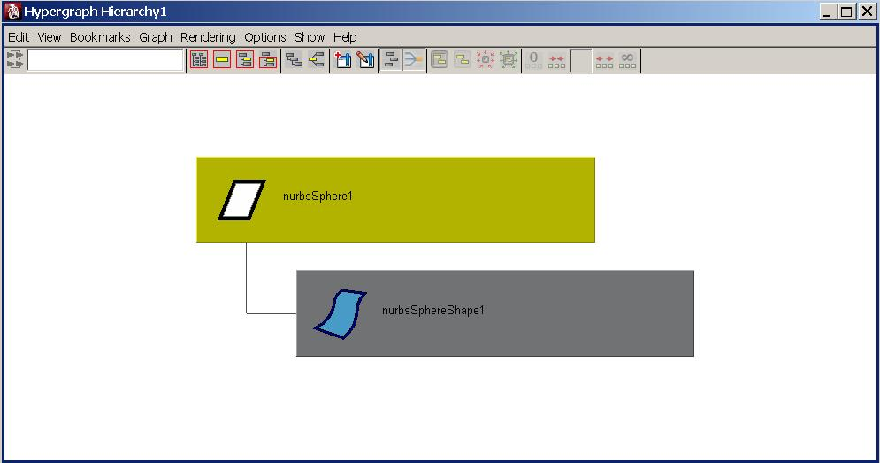
DAG Hierarchy
An Example: sphere

Slide 42

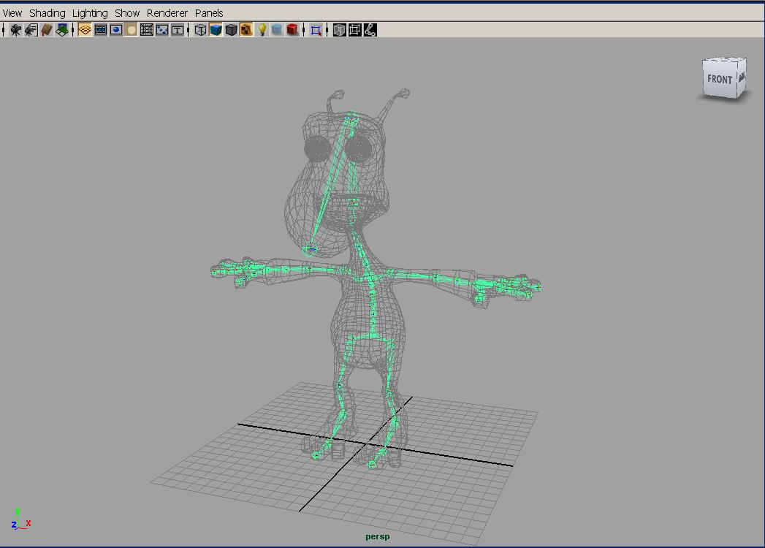
DAG Hierarchy
A More complex example: skeleton hierarchy

Slide 43
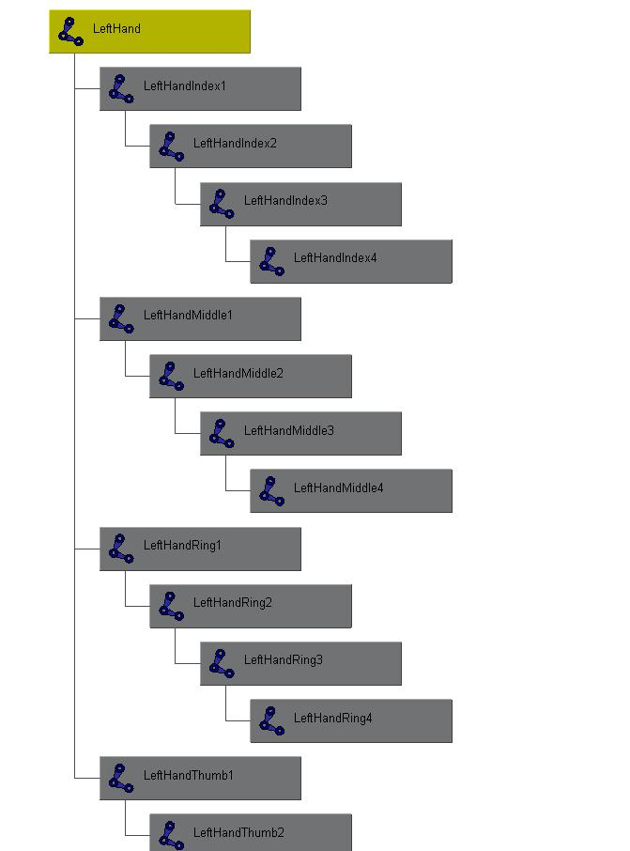
DAG Hierarchy
A More complex example: skeleton hierarchy
hip
spline
shoulder
arm
hand
Notes:
If you extend the idea, the hand will be parented under arm, arm parented shoulder, shoulder parented spline, and goes on…
When you have multiple parent transforms like this, the final position of the shape in world space is no longer defined by its immediate parent transform node, defined by all the parents along the hierachy.
It is the result of all the transform nodes that lie above a given shape.

Slide 44
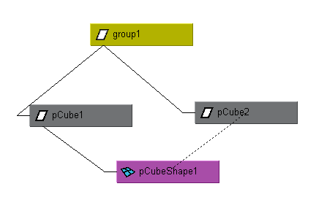
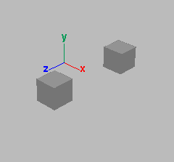
Instancing
A node may have more than one parent
A dagPath is used to identify instances
group1|pCube1|pCubeShape1
group1|pCube2|pCubeShape1
Notes:
Because of the fact that there is instancing, it means that when you have a node itself, you don’t know which instance you have, that’s the reason for this concept, DagPath
A dagpath is in the dag hierachy a list of nodes which uniquely identifies the location of a particular node or instance of a node.
For instanced nodes, there will be multiple paths which lead from the root node to the instanced node, one path for each instance.
/////////////////////////////////////////////////////
Transform nodes and shape nodes can also have multiple parent nodes—these nodes are “instanced”. Instancing can be useful to reduce the amount of geometry for a model. For example, if you model a tree, you could create a thousand unique leaves to populate the tree. This would make for a very data heavy model, since each leaf would have it’s own transformation nodes, shape nodes, and NURBS or polygon data. Instead, you can create a single leaf and instance it a thousand times to create a thousand identical leaves and position them independently around the branches of the tree. This way the shape node and NURBS or polygon data is shared.

Slide 45
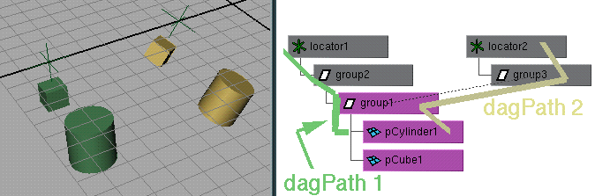
Dag Paths
used to find world space transformations
used to traverse up and down hierarchy
node names need not be unique if dagPaths are different (MDagPath fullPathName, partialPathName)
Notes:
//////////////
The use of the DAG path allows for object names to be reused. Object names can be reused as long as the same name does not appear on more than one DAG node with a common parent.

Slide 46
MObject VS. MDagPath
Many of the Maya API accept/return a MObject or a MDagPath
A MDagPath is a handle describing a path to a node
A MObject is a wrapper around a pointer to the internal Maya object
Generic class (represents all node / attribute)
Use apiType() / hasFn() to determine what it is or what you can do with it
Use isNull() to determine if it is a valid MObject
Do not store MObject

Slide 47
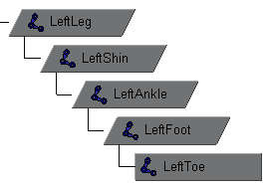
Important API methods
Traversal : MItDag iterator class
Depth in hierarchy: MDagPath::length, MItDag::depth
Getting the parent: MDagPath::pop
Local matrix: MFnTransform::transformation
World matrix: MDagPath::inclusiveMatrix, MDagPath::exclusiveMatrix …

Slide 48
Example: dagInfo
In this exercise, we will implement a custom command dagInfo. For all the selected DAG nodes in the scene, it will print out the instance information, dag path and also inclusive and exclusive matrix.
Important Classes: MFnDagNode, MDagPath MMatrix, MGlobal, MItSelectionList

Slide 49
Q & A

Slide 50
Autodesk

