Slide 1

Maya API Training
Naiqi Weng
Developer Consultant,
Autodesk Developer Network (ADN)

Slide 2

Miscellaneous Tools and Classes
Naiqi Weng
Developer Consultant,
Autodesk Developer Network (ADN)

Slide 3





Agenda
DG / DAG Operations
Maya Callback System
Software Shaders
Maya Locators
Image courtesy of Johan Vikström, Shilo, Ool Digital, Mikros Image

Slide 4
DG/ DAG Operations
Image courtesy of Johan Vikström, Shilo, Ool Digital, Mikros Image

Slide 5
DG/DAG Operations
MDGModifier / MDagModifier
Facilitate the creation or deletion of nodes and connections
Automatically provides undo/redo support
MDagModifier: dag node creation/parenting
Holds a list of operations. Operations are queued as they are called.
In general, MDGModifer will not perform these operations until MDGModifier::doIt() call is issued.

Slide 6
MDGModifier code structure
All these operations won’t get executed until dgMod.doIt()
To undo all these operations, dgMod.undoIt()
import maya.OpenMaya as OpenMaya
dgMod = OpenMaya.MDGModifier()
dgMod.createNode ( “transform”)
dgMod.commandToExecute(“sphere -n sphere1 -r 1;”)
dgMod.connect(.....)
.....
dgMod.doIt()

Slide 7
Example: setUpTransCircle
transCircle node
setUpTransCircle: In this example, we create a custom command, and simulate the same functionality of the MEL operations we used in “transCircleNode” project, which set up the transCircle node.
Here are the commands you need to simulate:
createNode transCircle -n circleNode1;
sphere -n sphere1 -r 1;
sphere -n sphere2 -r 2;
connectAttr sphere2.translate circleNode1.inputTranslate;
connectAttr circleNode1.outputTranslate sphere1.translate;
connectAttr time1.outTime circleNode1.input;

Slide 8
Maya Callback System
Image courtesy of Johan Vikström, Shilo, Ool Digital, Mikros Image

Slide 9
Maya Callback System
Maya callbacks allow the user to register functions against specific Maya events.
Maya callback classes:
MMessage: base class, remove callback, query callbacks
MDGMessage - node added, removed, connected
MNodeMessage - attribute callbacks
MSceneMessage - before/after: file open, import, export, etc.
MUiMessage - UI objects
MEventMessage - idle, timeChanged, undo, redo, etc.
MConditionMessage - specific conditions
MModelMessage - model related messages

Slide 10
MMessage and Callback Functions
MSceneMessage::addCallback (Message msg, MMessage::MBasicFunction , void * clientData)
OpenMaya.MSceneMessage.kAfterOpen
def afterFileOpenCallback (clientData)
OpenMaya.MSceneMessage.addCallback ( OpenMaya. MSceneMessage.kAfterOpen, afterFileOpenCallback)

Slide 11
MMessage and Callback Functions
MSceneMessage::addCallback (Message msg, MMessage::MBasicFunction , void * clientData)
def afterFileOpenCallback(clientData):
print “Come to this afterFileOpenCallback function\n”
def MyCmd_addCallback():
global cbid
OpenMaya.MSceneMessage.addCallback(OpenMaya.MSceneMessage.kAfterOpen, afterFileOpenCallback)
cbid =
def MyCmd_removeCallback():
OpenMaya.MMessage.removeCallback( cbid )

Slide 12
Abort operations
MSceneMessage::addCheckCallback (Message msg, MMessage::MCheckFunction func, void *clientData )
retCode: Result of the function. Provide programmer with options to abort current operations by return False through this variable.
In Python use OpenMaya.MScriptUtil.setBool(retCode, True) since python can’t handle pointer or reference.
OpenMaya.MSceneMessage.kBeforeOpenCheck
def beforeOpenCheckCallback(retCode, clientData)

Slide 13
Abort Operations
def beforeOpenCheckCallback(retCode, clientData):
#Do custom operations, for example, check file versions...
print “Error: file version is not correct, abort opening operations\n”
OpenMaya.MScriptUtil.setBool(retCode, False)
def MyCmd_addCallback():
OpenMaya.MSceneMessage.addCheckCallback(OpenMaya.MSceneMessage.kBeforeOpenCheck, beforeOpenCheckCallback)

Slide 14
Example: sceneMsgCmd
sceneMsgCmd: this example registers several callbacks for scene messages such as MSceneMessage::kBeforeOpen and MSceneMessage::kAfterNew, it also shows how to abort the operation by setting retCode.

Slide 15
Software Shaders
Image courtesy of Johan Vikström, Shilo, Ool Digital, Mikros Image

Slide 16
Shading Network and Software Shader
Different types of software shaders
Shading group
Custom Software Shader
Notes:
As we know, in Maya there are different types of shaders, we are using software shaders, mental ray shaders and also hardware shaders.

Slide 17
Software Shading Node
DG Nodes to form Shading Networks
Different Types of Software Shading Nodes:
Type | Frame
Textures | 2D Textures, 3D Textures Environment Textures
Materials | Surface Materials, Volumetric Materials Displacement Materials
Lights | Lights
Utilities | General Utilities Color Utilities Particle Utilities Image Planes Glow
Notes:
Shading nodes are nodes which are related with shading and rendering in Maya . You can find them in the hypershader window.
There are different types of software shading nodes:

Slide 18
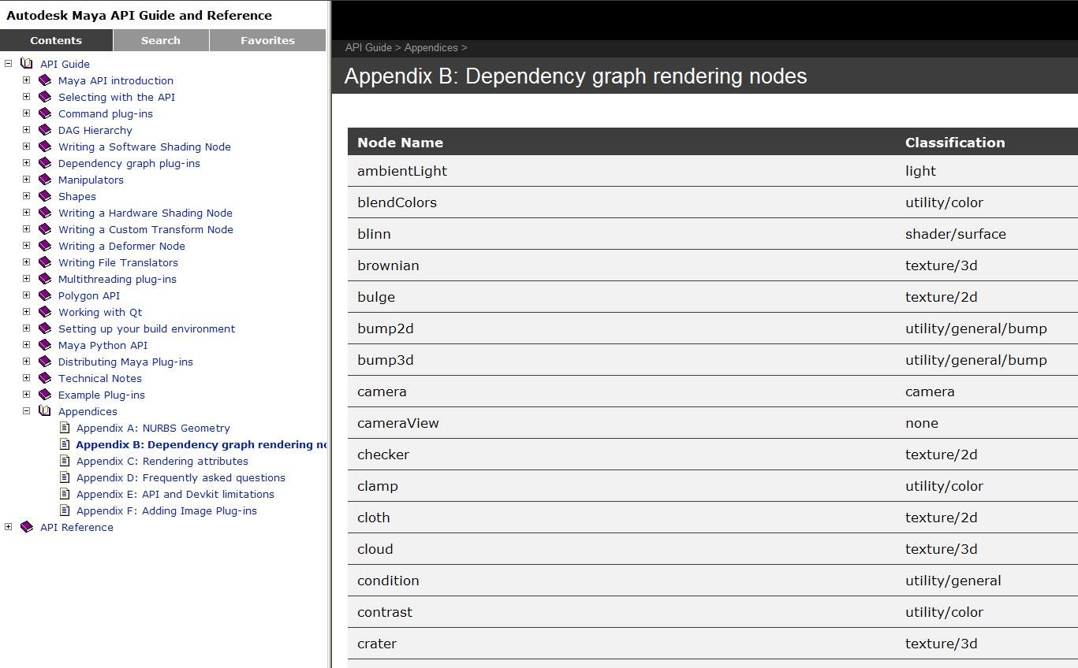
Shading Nodes List
API Guide -- Appendices – Appendix B: Dependency Graph rendering Nodes
Notes:
You can find the description and type of the nodes,

Slide 19
Shading Group
An Object Set
A logical grouping of an arbitrary collection of objects, attributes or component of objects
Membership is defined by connections:
whole object is in set:
node.instObjGroups → objectSet.dagSetMembers
A part of components are in set:
node.objectGroups → objectSet.dagSetMembers
MEL command for “objectSet” node
sets -e -add blinn1SG pCubeShape2;
sets –q -size blinn1SG;
Notes:
It is actually an object set.
Membership in a set is defined by establishing a connection between another node's attribute and one attribute of the objectSet node.
/////////////////////////////////////////
//NOT important:
Sets can be connected to any number of partitions. A partition is a node which enforces mutual exclusivity amoung the sets in the partition. That is, if an object is in a set which is in a partition, that object cannot be a member of any other set that is in the partition.

Slide 20
Shading Group (Renderable Sets)
Only renderable elements can be added into Shading Group
sets –q –renderable blinn1SG; //always return true
Every shader has to be connected with a shading group
Connection point between geometry and shader
shadingNode -asShader blinn;
// Result: blinn1 //
sets -renderable true -noSurfaceShader true -empty -name blinn1SG;
// Result: blinn1SG //
connectAttr -f blinn1.outColor blinn1SG.surfaceShader;
// Result: Connected blinn1.outColor to blinn1SG.surfaceShader. //
Notes:
Shading group is a kind of a special object sets in the sense that it can only contain renderable elements (such as lights and geometry)

Slide 21
Rendering Network
Pre-computed Input attribute
renderer
Shader
Output attribute requested by shading group
Shading Group
geometry
Geometry information
Notes:
Software shader is getting all the pre-computed input attributes from the Maya renderer and do its shading algorithm and caculate output attributes, for example, color, transparency and output them to the shading group.
Renderer basically walk through the shading network and talk to almost everything in the network, and the process is not a linear one-way process.
One thing to mention is that the dotted line are internal, you will never see in the DG. The white line is the actual connection you can see in HyperShade or DG.

Slide 22
Custom Shading Node
Registration:
MFnPlugin::registerNode ( const MString & typeName, const MTypeId & typeId, MCreatorFunction creatorFunction, MInitializeFunction initFunction, MPxNode::Type type = MPxNode::kDependNode, )
const MString * classification
Type | Frame | Classification String
Textures | 2D Textures, 3D Textures Environment Textures | “texture/2d” “texture/3d” “texture/environment”
Materials | Surface Materials, Volumetric Materials Displacement Materials | “shader/surface” “shader/volume” “shader/displacement”
Lights | Lights | “light”
Utilities | General Utilities Color Utilities Particle Utilities Image Planes Glow | “utility/general” “utility/color” “utility/particle” “imageplane” “postprocess/opticalFX”

Slide 23
Custom Shading Node
Code Structure:
myShaderId = OpenMaya.MTypeId(0x00001)
class myShader (OpenMayaMPx::MPxNode):
def __init__(self):
OpenMayaMPx.MPxNode.__init__(self)
def compute(self,plug,data):
# code ...
def myShader_creator():
return OpenMayaMPx.asMPxPtr( myShader() )
def myShader_initialize():
#Input attributes
# …….
#Output attributes
# …….

Slide 24
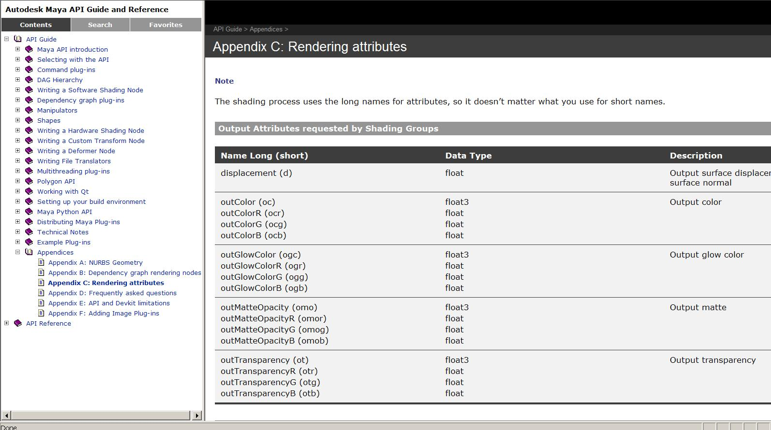
Software Shading Node
Rendering Attributes
Notes:
Those input attribute values have already pre-computed per sample, if you need its value, you just request it from the datablock.
So where to find the definition of these attributes?

Slide 25
Shading node icons for Hypershade
File format: 32x32 PNG, SVG
Plug-in name: lambertShader.mll
“Create bar”: preface "render_“: render_lambertShader.png
“HyperShade graph: lambertShader.png or lambertShader.svg
XBMLANGPATH: Put the icons in one of the directories specified in your XBMLANGPATH.
Notes:
For the Create bar, create 32x32 icons in PNG format. The icon name must have the preface "render_". For example, for the shader lambertShader.mll, name the icon render_lambertShader.png.
You can also supply an icon for the Hypershade graph. This icon can be in SVG or PNG format, and the icon name and the shader name should match. For example, for the shader lambertShader.mll, name the icon lambertShader.svg.
there are a lot of software shader examples in the devkit,
The complexity of a software shader doesn’t lie in the API class, it is the algorithm and all the rendering techniques or terminology you need to master to really make your shader work!!!

Slide 26
Maya Locators
Image courtesy of Johan Vikström, Shilo, Ool Digital, Mikros Image

Slide 27
What is a Locator?
A Maya locator is a small icon like an x-y-z axis that marks a point in space.
Image courtesy of Johan Vikström, Shilo, Ool Digital, Mikros Image
Notes:
People use locators a lot, a lot of times, it is used as a marker in 3d space

Slide 28
MPxLocatorNode
A class that allows users to draw 3D graphical elements in the Maya scene, which can be manipulated using Maya standard manipulators.
MPxLocatorNode Support
Drawing
Selection
Only in Maya viewport, NOT renderable
Notes:
This class allows you to draw three dimensional graphical elements in the Maya scene. And you can use Maya standard manipulators to manipulate this graphical element.

Slide 29
MPxLocatorNode
Override the following methods:
draw()
IsBounded()
boundingBox()
Methods are called during
Refresh
Selection

Slide 30
MPxLocatorNode::draw()
void MPxLocatorNode:: draw ( M3dView & view, const MDagPath & path, M3dView::DisplayStyle style, M3dView::DisplayStatus status )
Two usage of this function:
draw the node in current viewport
Maya determine whether the node is selected
It should leave OpenGL in exactly the same state it was before this function is called. (use glPushAttrib())
Draw in local object space
Notes:
Overriding this method allows user to draw custom geometry using OpenGL calls.
view current 3D view, where the locator is drawn
path this locator’s DAG path
style style to draw object: e.g. shaded or wireframed
Status : selection status of object
You draw() function should leave….
You can use OpenGL routine glPushAttrib and glPopAttrib to save and restore the current openGL graphics state.

Slide 31
OpenGL Basics
OpenGL: Open Graphics Library, developed by SGI(Silicon Graphics Inc.) in 1992
A standard specification defining an API for writing applications that produce 2D and 3D computer graphics.
Widely used in video games, virtual reality, CAD, etc…
Notes:
It is impossible to avoid talking about OpenGL if we want to draw something in Maya’s viewport.
We will cover OpenGL basics just enough for you to get around and write some simple drawing code, or just understand the code we put into the assignments.
It is a low-level cross-platform software interface to graphics hardware.
The interface consists of over 250 different function calls/ Commands, you can use these function calls to draw complex three-dimensional scenes from simple primitives.
widely used in CAD, virtual reality, scientific visualization, information visualization, and flight simulation.

Slide 32
OpenGL Basics: Draw Primitives
glColor3i (1, 1, 1);
glColor3d (1.0, 1.0, 1.0);
Multiple commands for the same operation with different types of arguments
glColor3f(1.0, 1.0, 1.0);
glBegin(GL_POLYGON);
glVertex3f(0.0, 0.0, 1.0);
glVertex3f(0.0, 3.0, 1.0);
glVertex3f(3.0, 3.0, 2.0);
glVertex3f(4.0, 1.5, 2.0);
glVertex3f(3.0, 0.0, 0.0);
glEnd();
State machine
Draw calls in between
Notes:
the glColor3f() command establishes what color to use for drawing objects
In openGL, depending on the type of your arguments, you can have multiple commands for the same operations with different types of the arguments
OpenGL is a state machine, meaning that in this openGL drawing system, there are various types of of states, and those states have corresponding state variables, state variables are actually parameters to describe the status of the whole system, for example, what’s the current color for drawing, what’s the background color, what’s the current projection transformation matrix,line drawing pattern etc.
.

Slide 33
OpenGL Basics
State Machine
Stack-based
Matrix Mode: GL_MODELVIEW, GL_PROJECTION
State Attribute
Double Buffer Drawing
swapBuffers
glMatrixMode(GL_MODELVIEW);
glPushMatrix();
…..
glPopMatrix();
glPushAttrib(GL_CURRENT_BIT)
……….
glPopAttrib()
Notes:
How do you save current value of the state variable? OpenGL is a stack-based system, so you can use push and pop to save the value.
OpenGL also supports Double buffer drawing……
/////////////////////////////////////////////////
There are several matrices you will come across when you do openGL drawing, but in our examples, you will come across
GL_CURRENT_BIT:
Current red, green, blue, alpha (RGBA) color
Current color index
Current normal vector
Current texture coordinates
Current raster position
To save a matrix, push it to a stack
Windows: SwapBuffers( view.deviceContext() );
Mac: ::aglSwapBuffers( view.display());
Linux: glXSwapBuffers( view.display(), view.window() );

Slide 34
OpenGL support
MGLFunctionTable
To acquire a reference to this class use the following code:
import maya.OpenMayaRender as OpenMayaRender
glRenderer =OpenMayaRender.MHardwareRenderer.theRenderer() glFT = glRenderer.glFunctionTable()
glFT.glPushAttrib(OpenMayaRender.MGL_CURRENT_BIT )
…

Slide 35
MPxLocatorNode::draw()
Store any OpenGL drawing code, call M3dView::beginGL() and push the current OpenGL state:
Call OpenGL drawing code, e.g. glVertex3f, etc… Can create variations depending on the drawing style and node status (which are passed into the method)
Once drawing is finished, pop the previous OpenGL state and call M3dView::endGL():
view.beginGL();
glFT.glPushAttrib(OpenMayaRender.MGL_CURRENT_BIT);
glFT.glPopAttrib();
view.endGL();

Slide 36
MPxLocatorNode::boundingBox()
If boundingBox() is overridden, isBounded() must return true
Highly recommended to implement these. Without them, Maya will have difficulty determining the exact size of the locator, e.g. “Frame All” and “Frame Selected” will not zoom correctly.
boundingBox() must be efficient since it is called each time the window refreshes.

Slide 37
MPxLocatorNode Registration
Specify kLocatorNode when registering the node in initializePlugin
import maya.OpenMayaUI as OpenMayaUI
OpenMayaMPx.MFnPlugin.registerNode( kPluginNodeTypeName, kPluginNodeId, nodeCreator, nodeInitializer, OpenMayaMPx.MPxNode.kLocatorNode )

Slide 38
Examples: arrowLocator
In this project, we will implement a custom locator, it has a unit attribute “windDirection”. This locator is drawn as a big arrow in the Maya viewport. You can change the direction of the locator by retrieving its “windDirection” attribute and rotating corresponding angles when drawing the locator node with OpenGL calls.

Slide 39
Q & A

Slide 40
Autodesk

