Slide 1
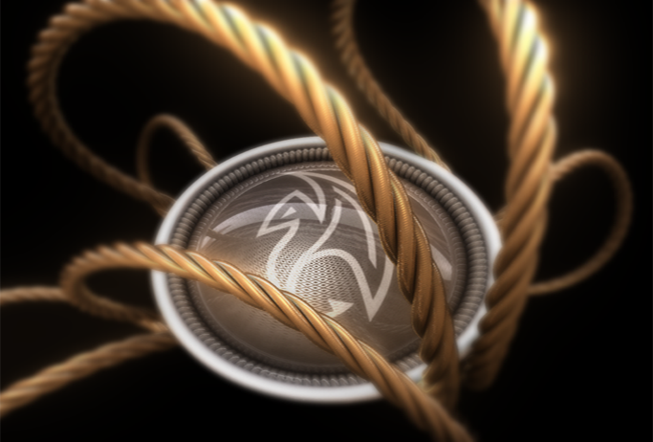
Maya API Training
Naiqi Weng
Developer Consultant,
Autodesk Developer Network (ADN)

Slide 2

Maya Manipulators
Naiqi Weng
Developer Consultant,
Autodesk Developer Network (ADN)

Slide 3

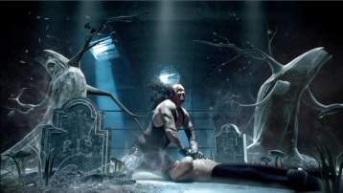



Agenda
Base Manipulators
Custom Manipulators
Limitations and new class MPxManipulatorNode
Image courtesy of Johan Vikström, Shilo, Ool Digital, Mikros Image

Slide 4
Maya Manipulators
What is a manipulator?
A node that draws itself using 3D graphical elements that respond to user events. An intuitive way to change a node’s attribute.
Examples: swissArmyManip
Notes:
A manipulator is a node that draws itself using 3D graphical elements, and also respond to user events.
Manipulators is more intuitive because users can interactively move or adjust a visual control, easier than typing them in the UI window and they can instantly see the visual feedback.

Slide 5
Base Manipulators & API class:
Maya Standard Manipulators: MFnManip3D
FreePointTriadManip: MFnFreePointTriadManip
RotateManip: MFnRotateManip
ScaleManip: MFnScaleManip
DirectionManip: MFnDirectionManip
DistanceManip: MFnDistanceManip
DiscManip: MFnDiscManip
PointOnCurveManip: MFnPointOnCurveManip
PointOnSurfaceManip: MFnPointOnSurfaceManip
CircleSweepManip: MFnCircleSweepManip
ToggleManip: MFnToggleManip
StateManip: MFnStateManip
CurveSegmentManip: MFnCurveSegmentManip

Slide 6
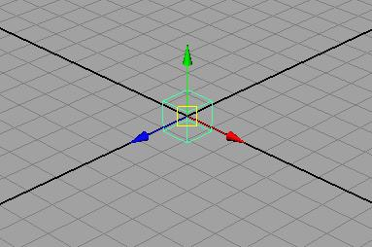
FreePointTriadManip

Slide 7
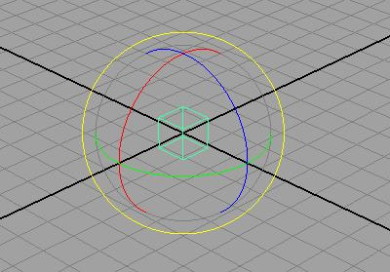
RotateManip

Slide 8
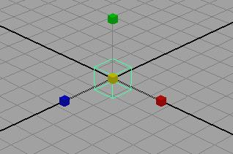
ScaleManip

Slide 9
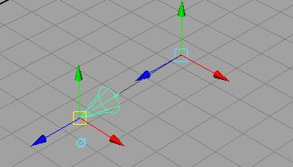
DirectionManip
Notes:
Spot light is using this manip

Slide 10
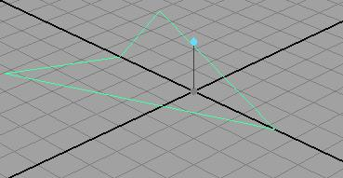
DistanceManip

Slide 11
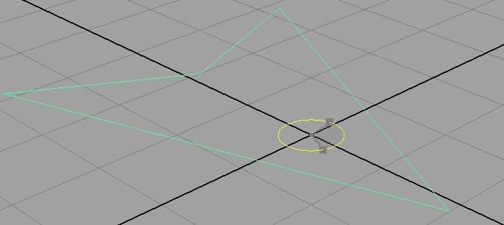
DiscManip

Slide 12
Custom Manipulator
Maya Standard Manipulators
Derived from MPxManipContainer
Container rather than a proxy manipulator
Can contain more than one base manipulator
Basic workflow:
add base manipulators to container
Set up associations between base manipulators and attributes
Notes:
Maya standard manipulators are quite limited because they individually only deal with one situation and one attributes on a node.
This MPxManipContainer class is NOT proxy manipulator class, it is actually a container, it allows you to add Maya base manipulators into it

Slide 13
MPxManipContainer
Specify kManipContainer when registering the node in initializePlugin
import maya.OpenMayaRender as OpenMayaRender
import maya.OpenMayaUI as OpenMayaUI
def initializePlugin(obj):
...
plugin.registerNode( "arrowLocatorManip", arrowLocatorManip.id, ManipNodeCreator,
ManipNodeInitializer, OpenMayaMPx.MPxNode.kManipContainer )
...
Notes:
How to implement your custom manipulator:
First you need to register your manipulator node, last argument you are telling Maya you are registering a manip container

Slide 14
Example: arrowLocatorManip.py
class arrowLocatorManip (OpenMayaMPx.MPxManipContainer):
def __init__(self):
OpenMayaMPx.MPxManipContainer.__init__(self)
def createChildren(self):
…...
def connectToDependNode(self, dependNode):
……
def draw(self, view, path, style, status):
……..
def ManipNodeInitializer():
OpenMayaMPx.MPxManipContainer.initialize()
def ManipNodeCreator():
return OpenMayaMPx.asMPxPtr( arrowLocatorManip() )
Notes:
In addition to the standard creator() and initialize() functions, there are several key functions you need to implement for this class

Slide 15
MPxManipContainer
Key functionalities:
add base manipulators:
MPxManipContainer::createChildren()
make associations between manipulators and attributes on nodes:
MPxManipContainer::connectToDependNode()
customize the drawing of your manipulator:
MPxManipContainer::draw()
Notes:
When base manipulators are added to a container manipulator, they are referred to as children of the container.
We need to override MPxManipContainer::createChildren() to add base manipulators.
draw method
It’s an optional method, you can use it to customize the drawing of your manipulator.

Slide 16
Add Base Manipulators
MPxManipContainer.createChildren()
def createChildren(self):
...
manipName ="angleManip"
angleName ="yRotation"
fDiscManip = self.addDiscManip(manipName,angleName)
startPoint = OpenMaya.MPoint(0,0,0)
startAngle = OpenMaya.MAngle(0.0,OpenMaya.MAngle.kDegrees)
fnDisc = OpenMayaUI.MFnDiscManip (fDiscManip)
fnDisc.setCenterPoint(startPoint)
fnDisc.setAngle(startAngle)
...
Notes:
Usually you also want to initialize some the properties of your manipulator after you create it, for example, you can set up starting position of your manipulator and also default value of different components on your manipulator.
////////////////////////
//initialize the angle and starting position of this manipulator
MPoint startPoint(0.0, 0.0, 0.0);
MAngle startAngle(0.0,MAngle::kDegrees);
MFnDiscManip fnDisc(fDiscManip,&status);
fnDisc.setCenterPoint(startPoint);
fnDisc.setAngle(startAngle);

Slide 17
Communications between Manipulators and Nodes
Container Manipulator
base manip
Converter
converterManipValue items
?
node
?
base manip
?
plug
manipValue
items
converterPlugValue items
Notes:
Internally Each container has one so-called “converter“, it is a very crucial part of the structure, because it is the interface between the container’s children manipulators and the plugs on the node that they affect. This converter is not a real object, it is just an Internal mechanism that manages the association between manipulator values and the plugs on the nodes.
set the values of those plugs,
Set values of different properties of manipulators
the items on the converter that are related to children manipulator values are called converterManipValue items,
the items on the converter that are related to the node plug values are called converterPlugValue items.
The items on the base manipulators are called manipValue items. This manipValue item describe different properties of the manipulator, for example, for a rotate manip, it can be angle of the manip, or location of the center of manipulator.

Slide 18
Communications between Manipulators and Nodes
Two types:
One-to-one association
Conversion functions
MPxManipContainer.connectToDependNode()
Notes:
The association between base manipulators and nodes can be done in two ways:
simple one-to-one associations, which means there is a direct correspondence between a manipulator value and the corresponding plug
If we want to set up more complex associations, we need to use conversion functions

Slide 19
Communications between Manipulators and Nodes
Container Manipulator
base manip
Converter
converterManipValue items
one-to-one association
node
base manip
plug
manipValue
items
converterPlugValue items
Notes:
the one-to-one associations is just connecting between a converterManipValue item and a converterPlugValue item

Slide 20
One-to-one Association
One-to-one associations are established through methods on the manipulator classes derived from MFnManip3D
Every standard manipulator has functions called “connectTo**Plug”
MFnFreePointTriadManip::connectToPointPlug
MFnDirectionManip::connectToDirectionPlug
MFnDistanceManip::connectToDistancePlug
MFnPointOnCurveManip::connectToCurvePlug
…
….
MFnScaleManip::connectToScaleCenterPlug
Notes:
Every standard manipulator function set class has some functions called “connectTo**Plug” method

Slide 21
Example: arrowLocatorManip.py
def connectToDependNode(self, dependNode)
#Connect the plug with manip
fnDepNode = OpenMaya.MFnDependencyNode (dependNode)
rotationPlug = fnDepNode.findPlug("windDirection”)
fnDisc = OpenMayaUI.MFnDiscManip (fDiscManip)
fnDisc.connectToAnglePlug(rotationPlug)
OpenMayaMPx.MPxManipulatorNode.finishAddingManips(self)
OpenMayaMPx.MPxManipulatorNode.connectToDependNode(self, dependNode)
Notes:
you get a hold of this object node and apply MFnDependencyNode function set onto this node and find the plug you want to connect to the manip.
One thing to note, after you make the connections (set up the association) between manipulators with plugs, at the end of the function, you need to call two additional methods.
MPxManipContainer::finishAddingManips
MPxManipContainer::connectToDependNode

Slide 22
Example: arrowLocatorManip
In this project, you will need to create a manipulator on the arrowLocator and set up the one-to-one relationship between the manipulator item value and the plug value on your node.

Slide 23
Communications between Manipulators and Nodes
Container Manipulator
base manip
Converter
converterManipValue items
one-to-one association
node
Conversion function (manipToPlug)
base manip
plug
Conversion function (plugToManip)
manipValue
items
converterPlugValue items
Notes:
So we use conversion functions to set relationship between converterManipValue items and converterPlugValue items.

Slide 24
Conversion Functions
Convert between manipulator values and plug values
Implemented as callback methods
Two kinds of conversion callbacks:
manipToPlug
addManipToPlugConversion (MPlug &plug)
plugToManip
addPlugToManipConversion (unsigned int manipIndex)
The converter must be implemented in the manipToPlugConversion() and plugToManipConversion virtual method of these classes
MManipData
converterManipValues
converterPlugValues
converterPlugValues
converterManipValues
Notes:
AddManipToPlugConversionCallback: This method adds a callback that calculates a converterPlugValue from converterManipValues
A plugToManip conversion callback is used to get the value of a converterManipValue item from various converterPlugValue items. This callback has access to all the converterPlugValue items and returns the value of a converterManipValue item.

Slide 25
Example:arrowLocatorManip.py
def connectToDependNode(self, dependNode):
….
fnDepNode = OpenMaya.MFnDependencyNode (dependNode)
rotationPlug = fnDepNode.findPlug("windDirection“, True)
fnDisc = OpenMayaUI.MFnDiscManip (fDiscManip)
fnDisc.connectToAnglePlug(rotationPlug)
centerPointIndex = fnDisc.centerIndex()
OpenMayaMPx.MPxManipulatorNode.addPlugToManipConversion (centerPointIndex)
….
Notes:
Let’s say in the arrowLocatorManip example, I want to add a functionality so that whenever my locator moves, the manipulator will update its position to be in the center of the locator.
Now what I want to do is to add plug to manip conversion callback, so that whenever the node moves in the scene, the manip moves along with it.
I need to call “addPlugToMainpConversionCallback” function.
The first argument is the index of the component you want affect, it should be the center point of the manipulator, the second argument is pointer to your callback function, the name of your callback function is centerPointCallback.

Slide 26
Example:arrowLocatorManip.py
def plugToManipConversion( self, manipIndex ):
try:
#Get parent transform node of the locator node
parentTransform = self.fNodePath.transform()
#Get the transform node DAG path
transformPath = OpenMaya.MDagPath()
OpenMaya.MDagPath.getAPathTo(parentTransform,transformPath)
#Retrieve world space translation
fnTrans = OpenMaya.MFnTransform(transformPath)
translation = fnTrans.getTranslation(OpenMaya.MSpace.kWorld)
numData = OpenMaya.MFnNumericData()
numDataValue = numData.create(OpenMaya.MFnNumericData.k3Double)
numData.setData3Double(translation.x,translation.y,translation.z)
manipData = OpenMayaUI.MManipData(numDataValue)
except:
sys.stderr.write("ERROR: arrowManip.plugToManipConversion\n")
raise
return manipData
Notes:
Here is how you would implement the conversion callback function.

Slide 27
MPxManipContainer::draw()
def draw(self, view, path, style, status):
OpenMayaMPx.MPxManipContainer.draw(self, view, path, style, status)
view.beginGL()
textPos = OpenMaya.MPoint (0, 0, 0)
distanceText = "Stretch Me!"
view.drawText(distanceText, textPos, OpenMayaUI.M3dView.kLeft)
view.endGL()
Notes:
The draw method is an optional method which can be used to customize the drawing of a container manipulator. If you are overriding the draw method, you should first call MPxManipContainer::draw to draw all the children.

Slide 28
Invoke manipulators
Show Manipulator tool
Manipulator named after node type name
arrowLocator → arrowLocatorManip
In custom node’s initialize(), call MPxManipContainer::addToManipConnectTable(MTypeId &id)
Custom Context
Notes:
There are two ways you can activate your mainpulators:
addToManipConnectTable: the argument is your custom node id, in this case, it should be the id of the custom locator class.
Another way is to use it within custom context
/////////////////////////////////////////
Note: Custom manipulators only appear when Construction History is turned on.
(Not necessary)
The object that the manipulator is attached to does not have to be a DAG node. Some manipulators, such as the Revolve manipulator, are attached to a dependency node upstream of the final shape. For example, for a sphere called nurbsSphereShape1, the revolve manipulator must be attached to the makeNurbsSphere1 node which is upstream relative to nurbsSphereShape1. Note :makeNurbsSphere1 is not a DAG node, and can be selected either in the Hypergraph or the Channel Box.
Other manipulators, such as the camera manipulator and the light manipulator, can be attached to either the transform or the shape of the light or camera.

Slide 29
Manipulators and Contexts
MPxManipContainer::newManipulator ( const MString & manipName, MObject & manipObject, MStatus * ReturnStatus = NULL )
MPxContext::addManipulator(const MObject &manipulator)
MPxContext::deleteManipulators()
MPxContext::toolOnSetup()
MPxContext::toolOffCleanup()
Notes:
The class MPxContext has two methods to support the management of manipulators: addManipulator and deleteManipulator.

Slide 30
Example: moveManip.py (devkit)
def toolOnSetup(self, event):
….
updateManipulators(self)
global id1
id1 = OpenMaya.MModelMessage.addCallback(OpenMaya.MModelMessage.kActiveListModified, updateManipulators, self)
….
def toolOffCleanup(self):
...
OpenMaya.MModelMessage.removeCallback(id1)
...
Notes:
In the devkit, there is this moveManip shows you how to connect a context tool with a manipulator

Slide 31
Example: moveManip.py (devkit)
def updateManipulators(clientData)
...
context = clientData
context.deleteManipulators()
...
# for each object selected
manipName ="moveManip"
manipObject = OpenMaya.MObject()
manipulator = OpenMayaMPx.MPxManipContainer.newManipulator(manipName,manipObject)
...
if manipulator is not None:
context.addManipulator(manipObject)
manipulator.connectToDependNode(dependNode)
...
Notes:
In the callback functions, it delete the old maniplator, and create the new one, by using MPxManipContainer::newManipulator

Slide 32
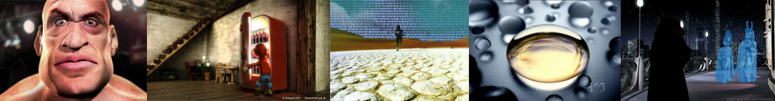
Major Limitation
Cannot create a custom manipulator that:
Plug-in draws itself
Maya performs selection on manipulator components
MPxManipulatorNode: openGL draw and selection
Autodesk Media & Entertainment
Notes:
Although MPxManipContainer has a draw(),but it is quite limited, you can add text onto the manipulator, but you can’t control the shape of the manipulator and how different components looks.
If you want to customize the drawing of your manipulator, and also selection of your manipulator, you will need to use this new class. Which is the real proxy manipulator class, it handles OpenGL draw and selection by itself.

Slide 33
Q & A

Slide 34
Autodesk

