Slide 1


A Closer Look at Dependency Graph
Module 7
© 2012 Autodesk
1

Slide 2
Autodesk Maya Python API Training
Kristine Middlemiss, Senior Developer Consultant
Autodesk Developer Network (ADN)
© 2012 Autodesk
2

Slide 3
Homework Review
© 2012 Autodesk
3

Slide 4

Agenda
• Dependency Graph Push-Pull Mechanism
• Data Storage
• Data Access
© 2012 Autodesk
4

Slide 5
Dependency Graph Push-Pull Mechanism
© 2012 Autodesk
5

Slide 6

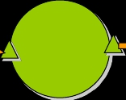
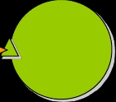
Dependency Graph
Dependency Graph and DG Nodes
A
B
C
© 2012 Autodesk
6

Slide 7
How DG works
Two step Push-Pull mechanism:
1. Dirty Propagation
2. Evaluation
© 2009 Autodesk
7

Slide 8
The Dirty Process
• Maya DG caches values
•
Uses dirty system to denote elements that require
updating:
•
•
Attributes
Connections
• MEL Commands:
•
•
dgDirty
isDirty
© 2009 Autodesk
8

Slide 9


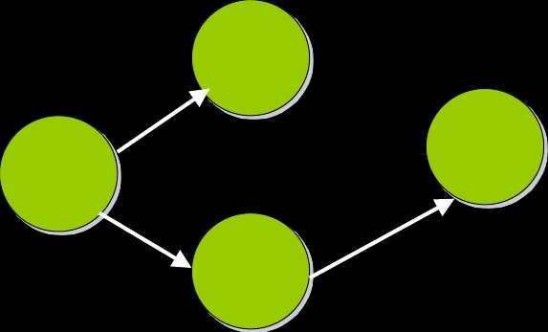
Data Flow Example
• Key
= clean connection,
B
A
D
= dirty connection
C
© 2009 Autodesk
9

Slide 10
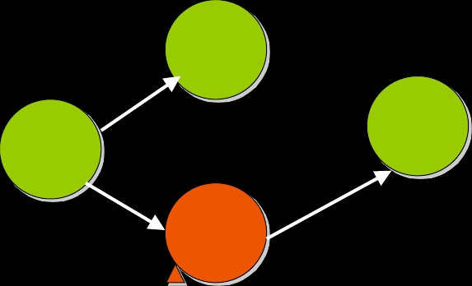
The Dirty Process
Initiated by value changes
B
C
A
D
setAttr D.r 5;
© 2009 Autodesk
10

Slide 11
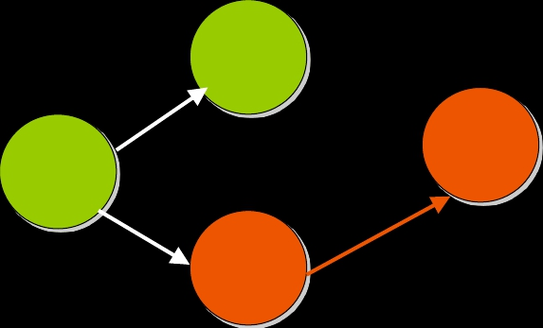
The Dirty Process
Dirty message propagates forward
B
C
A
D
© 2009 Autodesk
11

Slide 12
The Dirty Process
No evaluation has been requested. Data remains dirty.
B
C
A
D
© 2009 Autodesk
12

Slide 13
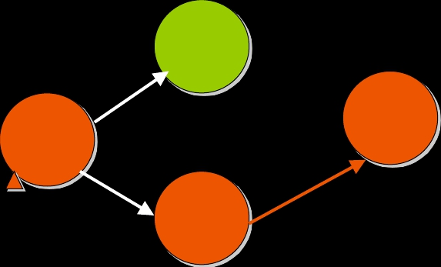
The Dirty Process
Now an input on A changes
B
C
A
setAttr A.aIn 6
D
© 2009 Autodesk
13

Slide 14
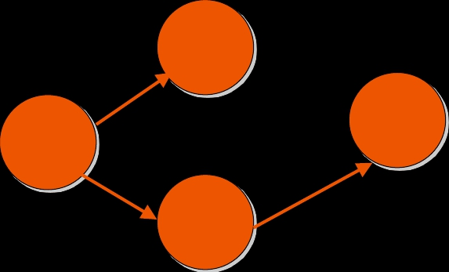
The Dirty Process
Dirty propagates out all outgoing connections
B
C
A
D
© 2009 Autodesk
14

Slide 15
The Dirty Process
B and D propagate dirty to affected attributes
C will not receive dirty message
•
•
Connection to C is already dirty
Helps performance
B
C
A
D
© 2009 Autodesk
15

Slide 16
The Evaluation Process
• Lazy Evaluation: On demand
• Evaluation is trigged when values are requested:
• Refresh
• Attribute editor
• Channel box
• Rendering
• getAttr command
• Etc…
• Evaluation is minimal
• Only requested values are computed
• Non-requested values are left dirty
© 2009 Autodesk
16

Slide 17
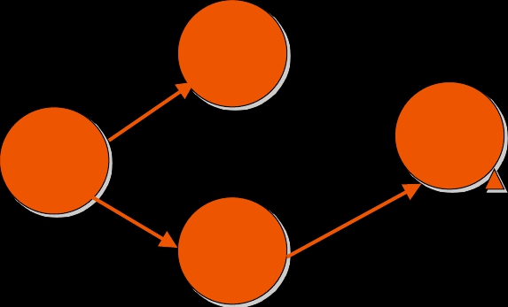
The Evaluation Process
Example: getAttr C.output
B
C
A
D
© 2009 Autodesk
17

Slide 18

The Evaluation Process
C computes: requests input value from connection
B
C
A
?
D
© 2009 Autodesk
18

Slide 19

The Evaluation Process
D computes.
D requests input value from connection
B
C
A
?
D
© 2009 Autodesk
19

Slide 20
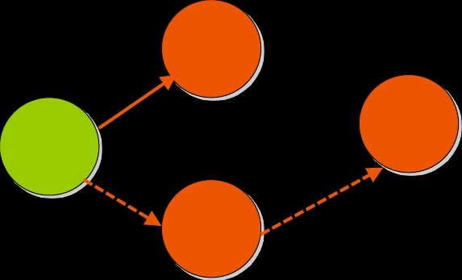
The Evaluation Process
A computes requested output
B
C
A
D
© 2009 Autodesk
20

Slide 21
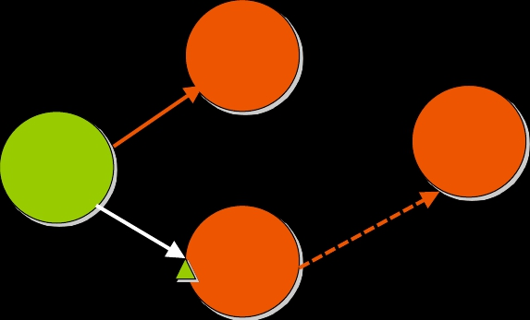
The Evaluation Process
Value copied forward to D’s input
B
C
A
D
© 2009 Autodesk
21

Slide 22
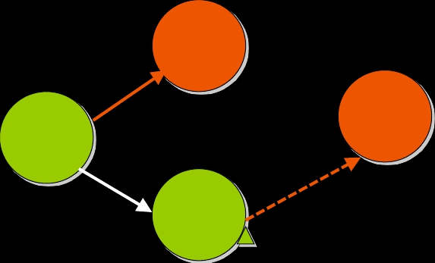
The Evaluation Process
D computes requested result.
D sets value in output.
B
C
A
D
© 2009 Autodesk
22

Slide 23
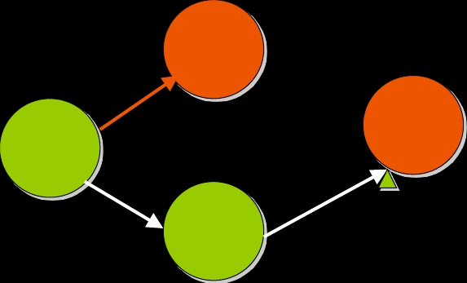
The Evaluation Process
Value is copied forward to C
B
C
A
D
© 2009 Autodesk
23

Slide 24
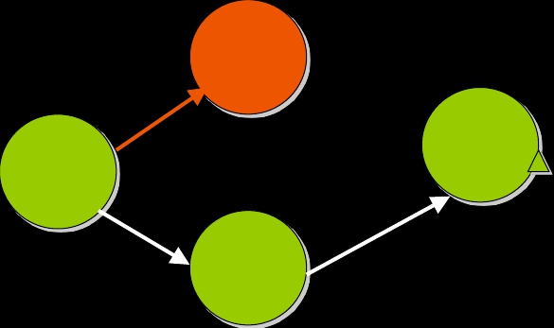
The Evaluation Process
C computes requested output.
B remains dirty.
B
C
A
D
© 2009 Autodesk
24

Slide 25
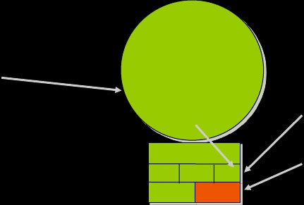
The Evaluation Process
Only requested outputs are computed, unless node’s
compute method does more than requested
C
input
output1
output2
© 2009 Autodesk
25

Slide 26
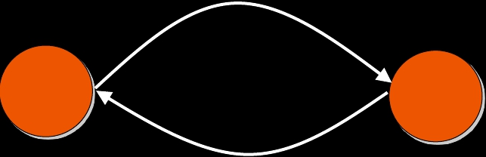
Data Flow: Cycles
•
•
Cycles are detected and avoided
A.a may follow B.b, or vice versa, but not usually
both; result is not guaranteed to be consistent
A.a
B.b
Autodesk Media & Entertainment
© 2009 Autodesk
26

Slide 27
File Operations
• File Open changes data flow
▪
▪
▪
▪
▪
▪
No dirty message propagation
No node evaluation until refresh
All connections assumed dirty
All setAttr values assumed clean
Unmentioned inputs are default (and clean)
Computed outputs are default (and dirty)
• File Save forces evaluation when required
Autodesk Media & Entertainment
© 2009 Autodesk
27

Slide 28
Black Box Rule
© 2009 Autodesk
28

Slide 29
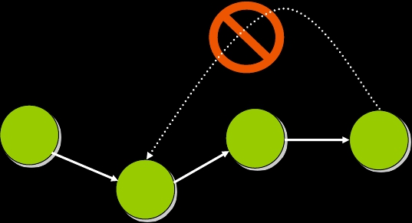
MPxNode::compute() Tips
• Get/set data only through datablock using data handles
• Avoid sending dirty messages, e.g.
• Don’t set data via plugs (i.e. MPlug::setValue)
• Don’t execute commands!
• Don’t get or set values on other nodes
A
C
D
B
© 2009 Autodesk
29

Slide 30
MPxNode::compute()
•
MDataBlock::inputValue(MPlug& plug) will:
•
•
Return a smart pointer to read a value from the data block
Cause an evaluation, if dirty. (and subsequently mark it clean)
•
MDataBlock::outputValue(MPlug& plug) will:
•
•
Retrieve a smart pointer to write a value to the data block
The value of that pointer is not guaranteed to be valid.
• Call MDataBlock::inputValue for all inputs affecting the
requested output to ensure they are cleaned, even if the
value itself is not necessary to compute the output.
attributeAffects() OR setDependentsDirty()
© 2009 Autodesk
30

Slide 31
Data Caching in Dependency Graph
© 2012 Autodesk
31

Slide 32
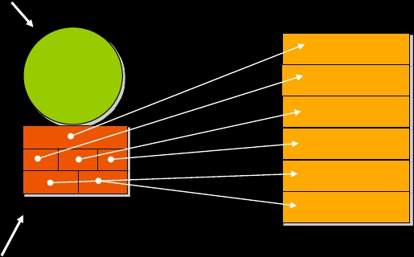

Data Caching
Node
Attribute
Datablock
© 2012 Autodesk
32

Slide 33
Data Caching
• Light data (numerical data)
•
•
duplicated in each datablock
converted as required (e.g. Int32 to Float)
• Heavy data (e.g. surfaces, curves, matrices)
•
•
reference counted
only duplicated when two nodes both want to modify it
• Message attributes contain no data, but evaluate the same
as other attributes
© 2012 Autodesk
33

Slide 34
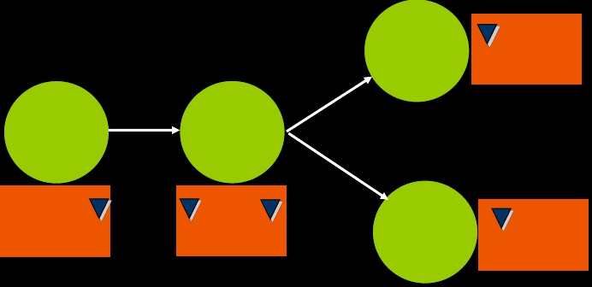
Light Data
During evaluation, numeric data is copied everywhere
C
A
B
D
© 2012 Autodesk
34

Slide 35
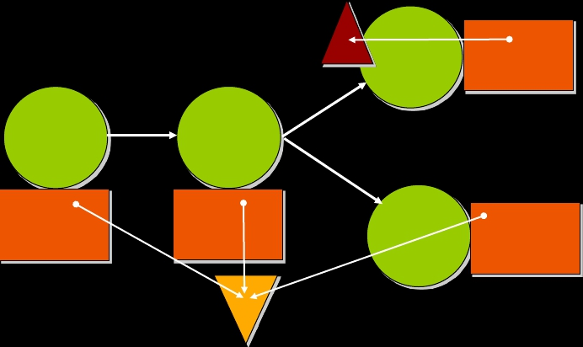
Heavy Data
During evaluation, copies of heavy data exist only at
attributes that are cached
C
A
B
D
© 2012 Autodesk
35

Slide 36
Data Access
© 2012 Autodesk
36

Slide 37
Data Access
Plug
• query a value
• set a value
•…
DataBlock & DataHandle
main functionality is to query/set a value on a node
© 2012 Autodesk
37

Slide 38
Data Access
MPxNode::compute()
MPlug::getValue()
MPlug::setValue()
MDataHandle::asXXX()
MDataHandle::setXXX()
© 2012 Autodesk
38

Slide 39
Data Access
Plugs vs. DataHandles
General rule:
•
•
DataHandles: set/get data during compute
plugs: set/get data outside of compute
Difference:
•
•
DataHandle set/get methods are more efficient
setting data via Plug propagates dirty, DataHandle does not
© 2012 Autodesk
39

Slide 40
Summary of API DG Classes
Nodes : MPxNode and derived classes
Plugs : MPlug
Attributes : MFnAttribute
Datablocks : MDataBlock
Eval Contexts : MDGContext
Data handles : MDataHandle, MArrayDataHandle, MArrayDataBuilder
Data : MFnData
Connections : no API access, use MPlug methods
© 2012 Autodesk
40

Slide 41
Workshop Session
© 2012 Autodesk
41

Slide 42
Example: retrieveWeight
retrieveWeight : In this example, we will create a custom
command “retrieveWeight”, it searches attribute “weight” on
blendShape node and since it is a multi attribute, it prints out
the number of elements in this array attribute and traverse
the array to print out plug data on every element.
© 2012 Autodesk
42

Slide 43
Autodesk
© 2012 Autodesk
43

