Slide 1
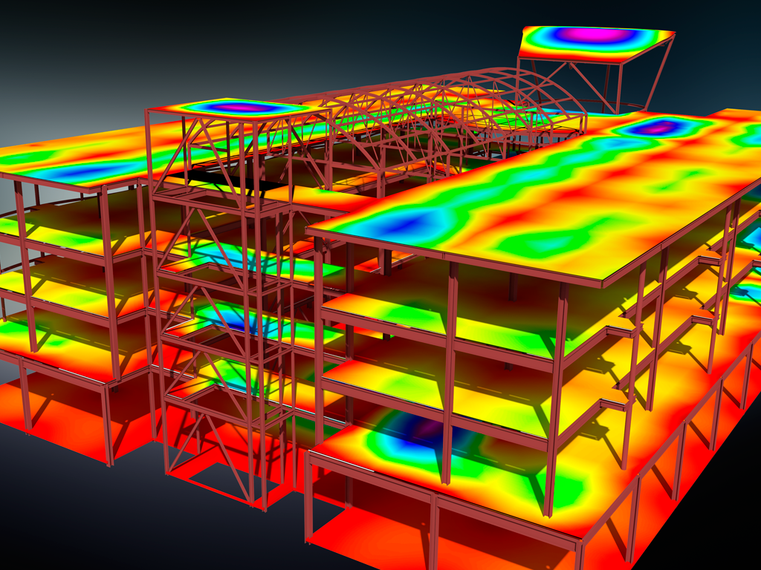
Code Checking for Revit
Notes:
Structural analysis of a steel and concrete structure. Created in Autodesk(R) Robot(TM) Structural Analysis Professional and Autodesk(R) Revit(R) Structure software products. Rendered in Autodesk(R) 3ds Max(R) software.
Expiration Date: 2099-01-01
No image credit required.

Slide 2
A Framework to support
Code Checking Workflow
In Revit
Notes:
Devision goals for UX and Dev

Slide 3
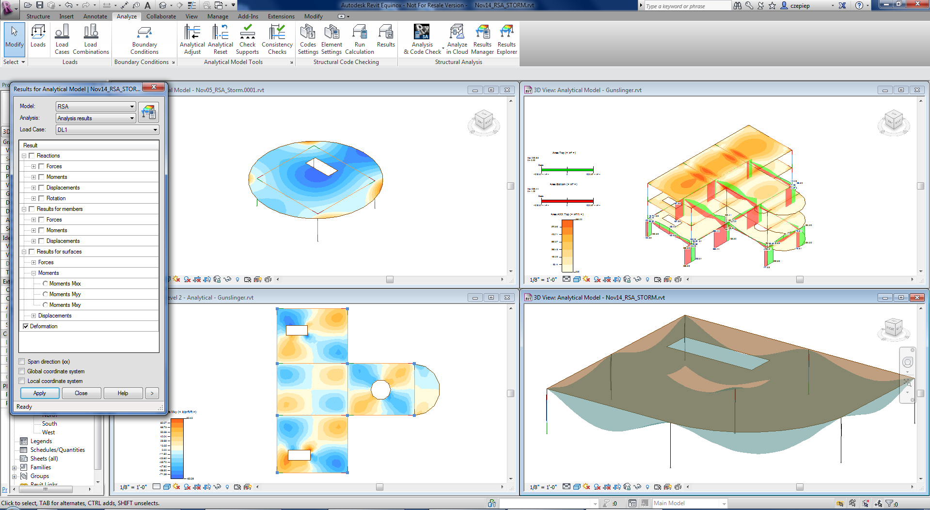
Analytical Results in Revit

Slide 4
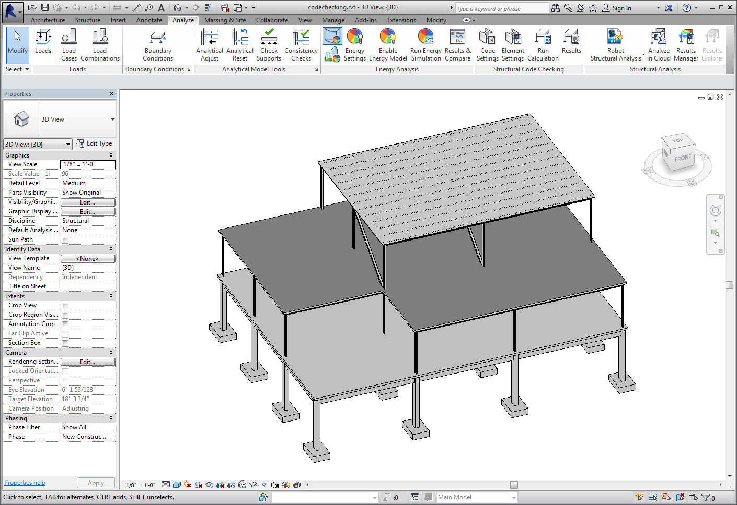
Physical and Analytical Model

Slide 5
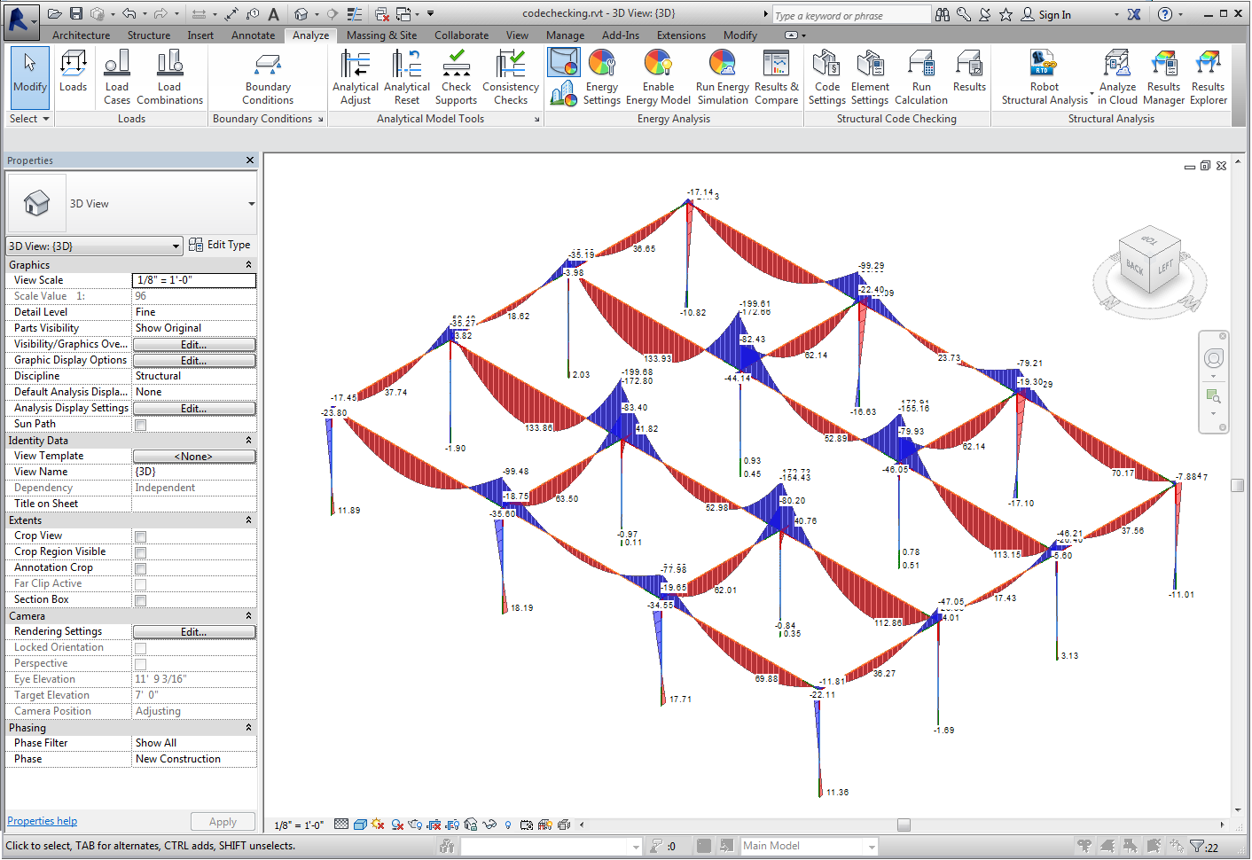
Analysis Results

Slide 6
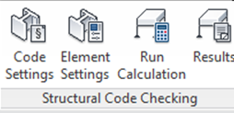
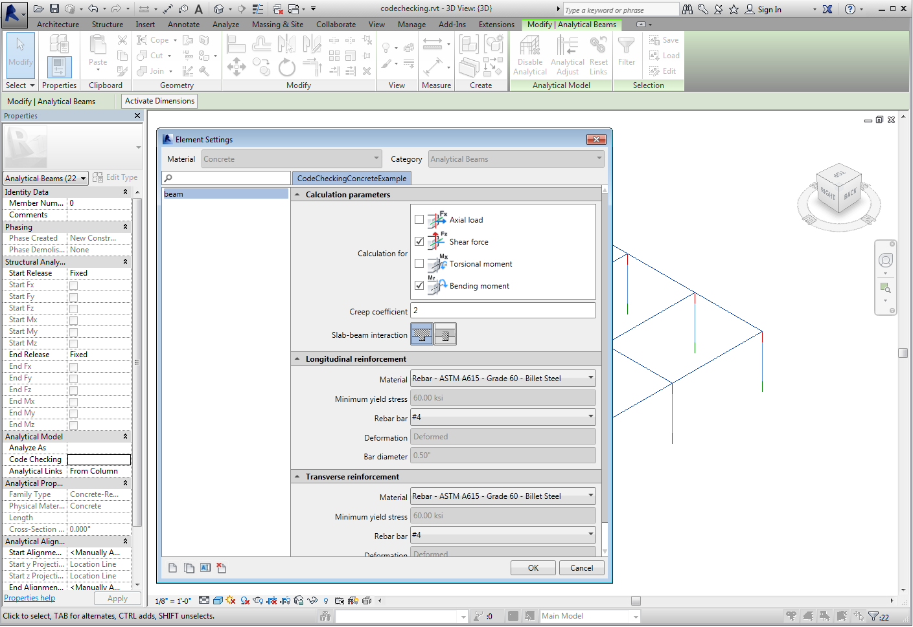
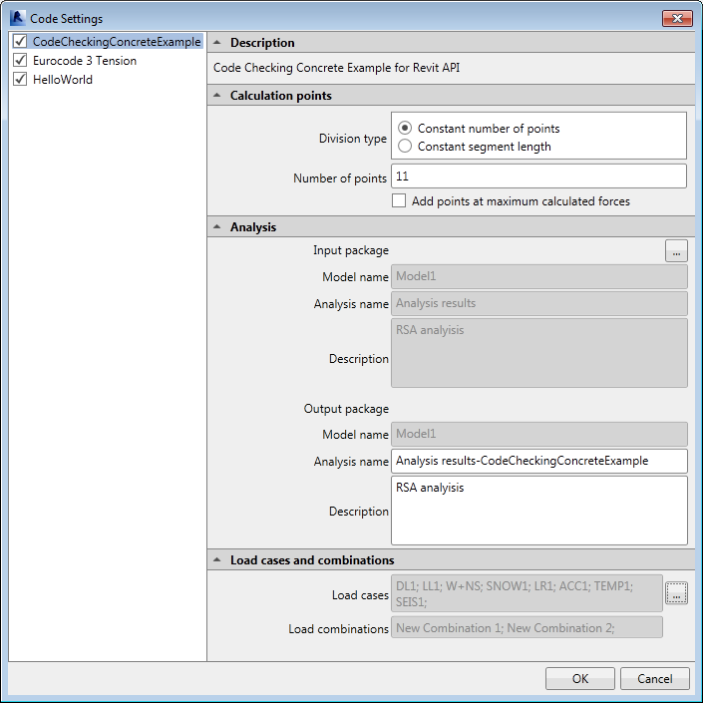
Step 1 - Code Parameters setting

Slide 7
Step 2 – Elements Types Parameters setting

Slide 8
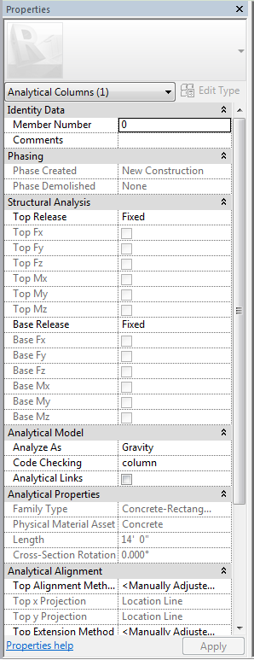
Step 3 – Types Parameters assignment to elements

Slide 9
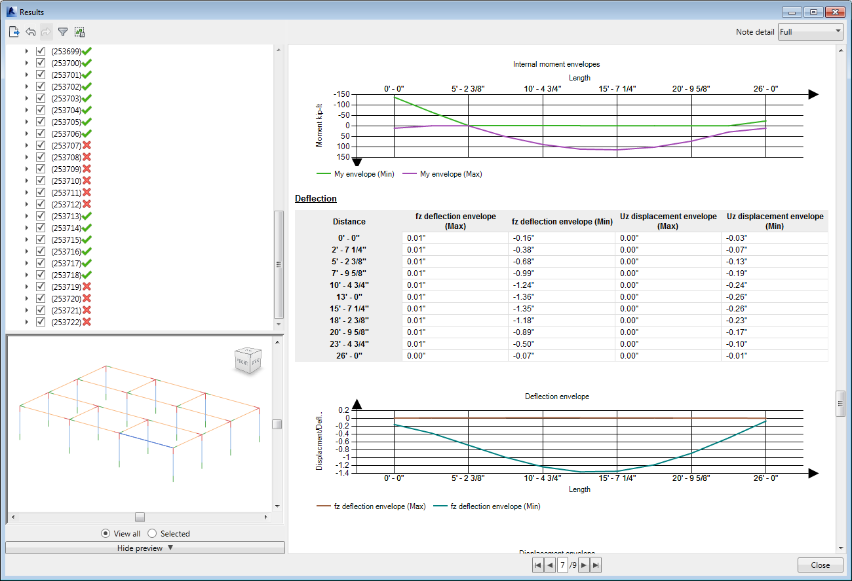
Step 4 - Execute and Explore Reports

Slide 10
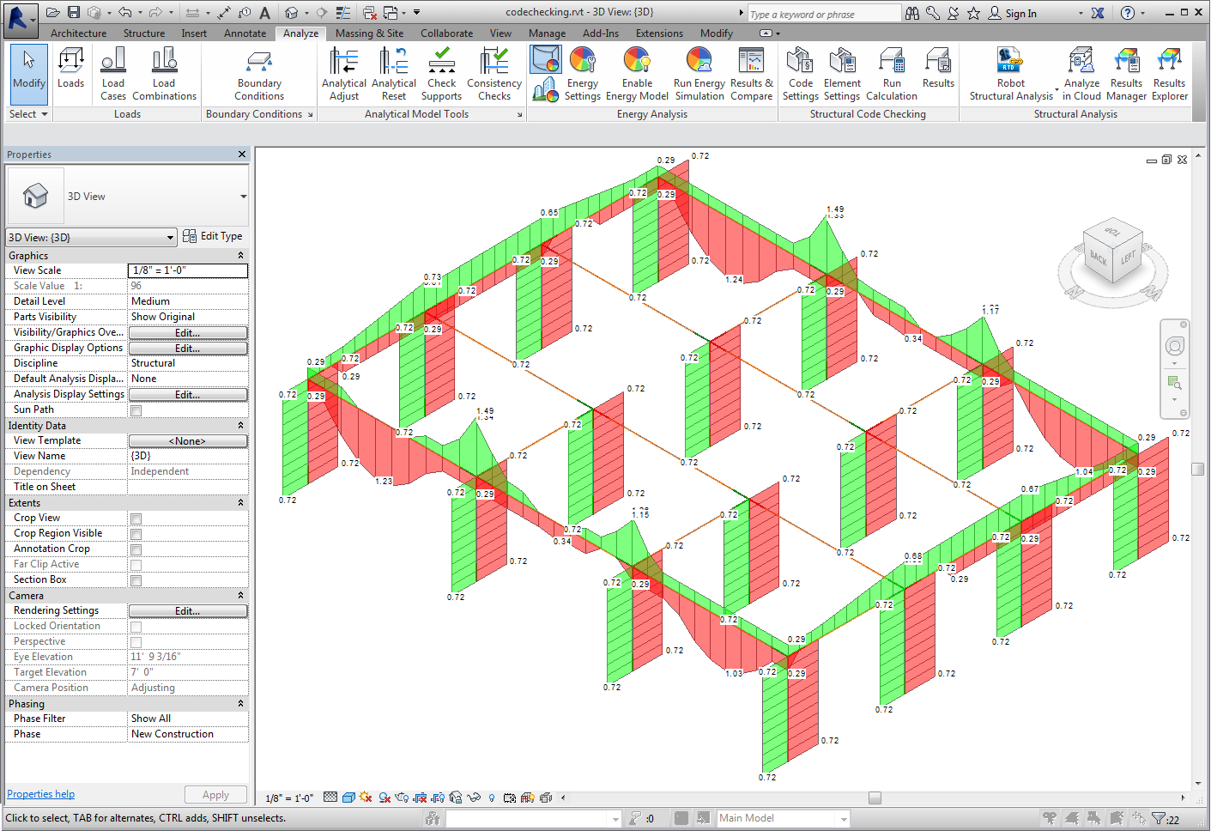
Step 5 - Explore Graphical Results

Slide 11


Collective Approach for a Code Checking Solution
RSA
Analysis
360
_{Calculation}
_{Reports}
Revit
Analytical, Physical models
Results
_{UI}
_{Framework}
_{Code Checking Design}
_{Solution}
+
+
=
_{Enginering}
_{Libraries}
_{SDK}
Code Checking
Platform
3rd party
Countryfication
_{Revit For Detailing}
Analysis
Partners

Slide 12
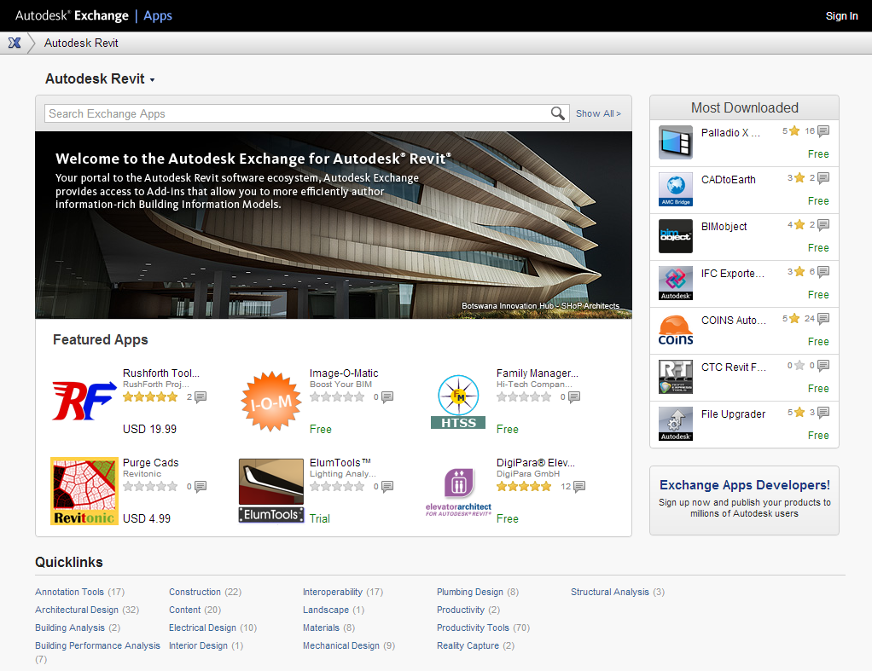
Exchange Apps

Slide 13
SDK for Code Checking
Notes:
Devision goals for UX and Dev

Slide 14
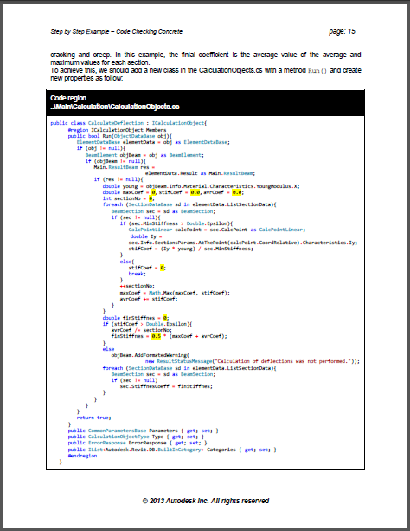
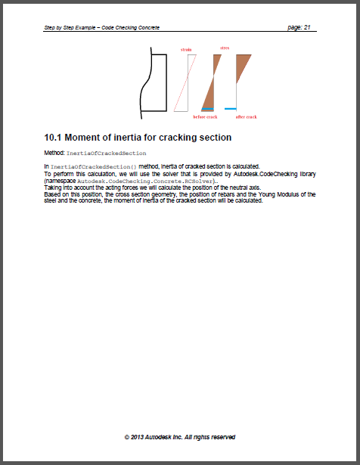
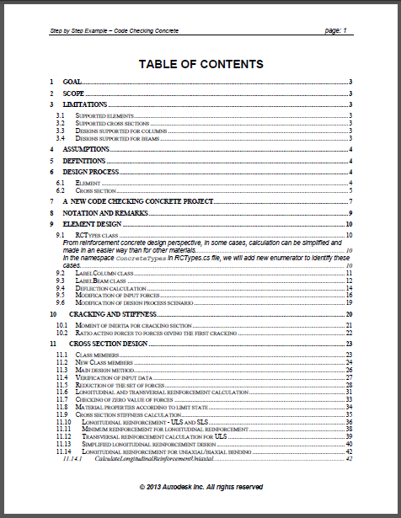
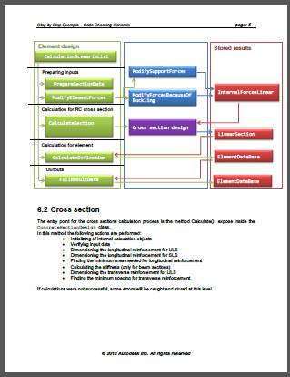
Software Development Kit for Code Checking
Documentation
Getting Started
Step by Step instructions
Samples
API documentation

Slide 15
Software Development Kit for Code Checking
Visual Studio tools (C#)
Data management
UI definition
Interactions
Report generation
Localization support

Slide 16
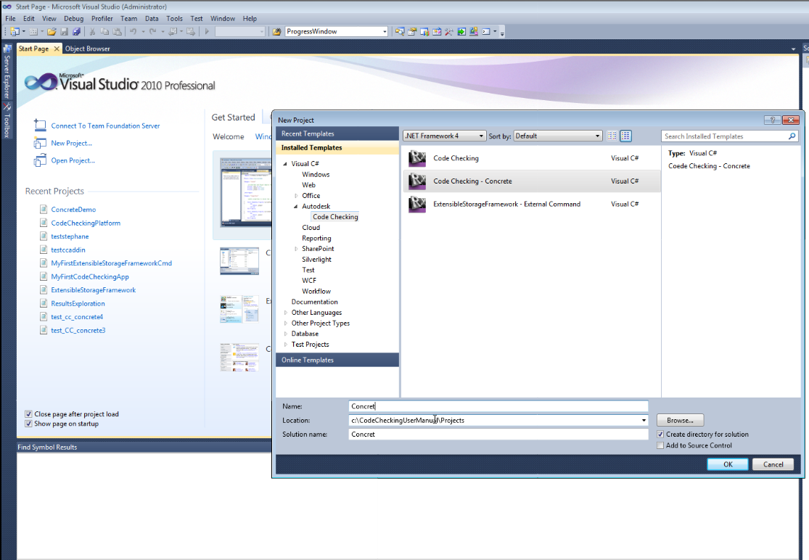

Slide 17
