Slide 1
Provita PURE Protein, pure life

Slide 2

The fitness nutrition challenge
Problem: Many fitness enthusiasts struggle to find high-quality, pure protein supplements without additives.
Solution: Our Whey Protein Isolate powder offers a clean, highly concentrated source of protein with zero fillers and with a minimal amount of carbs.

Slide 3

WHAT IS WHEY?

Slide 4
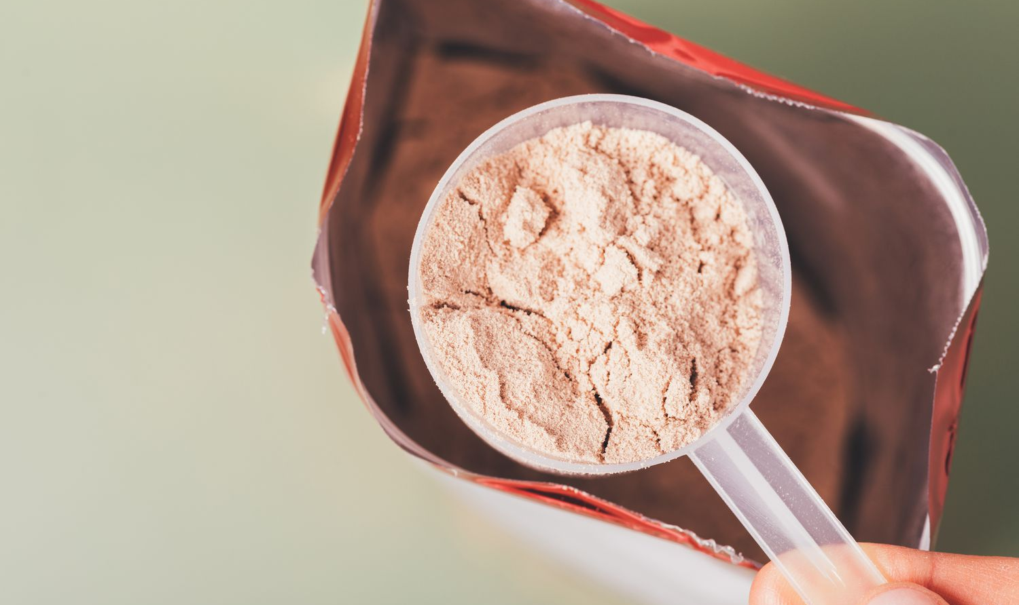
Pure, powerful, proven
100% Whey Protein Isolate with zero artificial ingredients.
Fast absorption for muscle recovery and growth.
Unmatched quality with lab-tested purity.

Slide 5
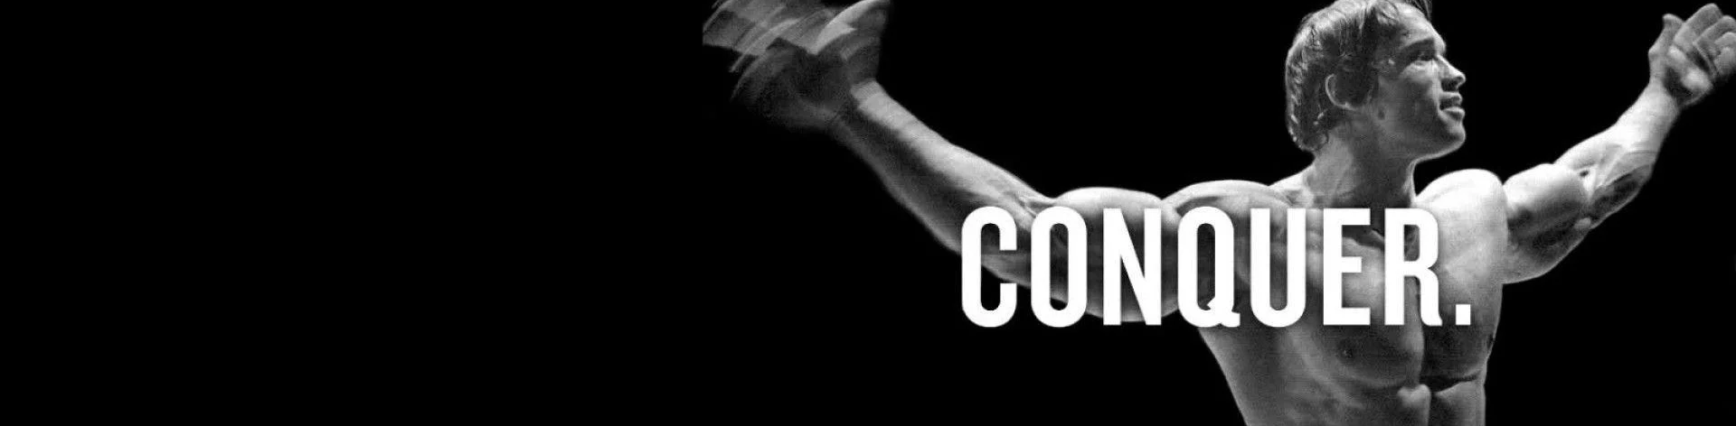
The Growing Demand for Clean Protein
The global protein supplement market is growing rapidly.
Our focus: athletes, bodybuilders, and health-conscious consumers.
Health-conscious consumers are on the RISE!

Slide 6
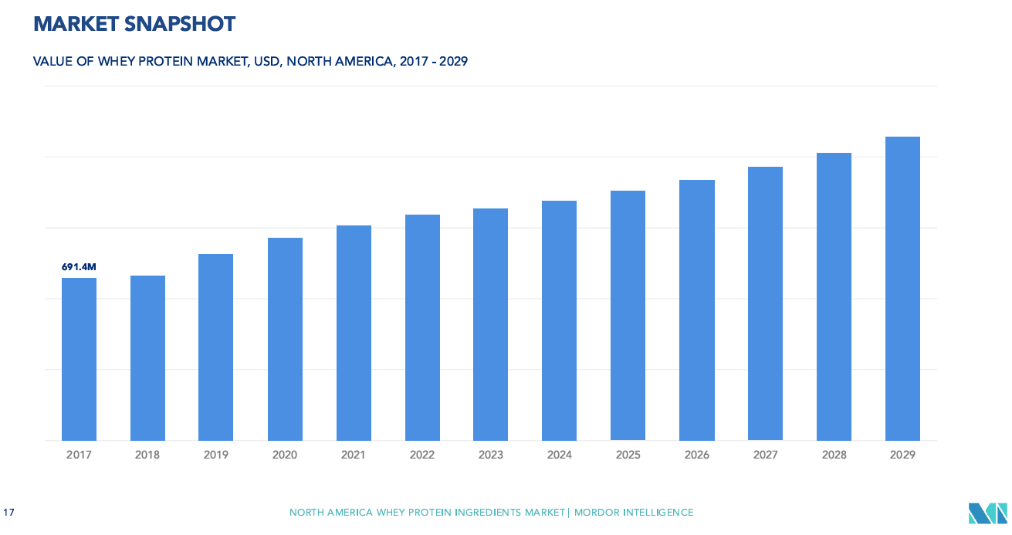
Market snapshot

Slide 7
Thank you! Please any questions are welcome!
Anthony Perez
773-226-1000
aperez@provita.com

