Slide 1

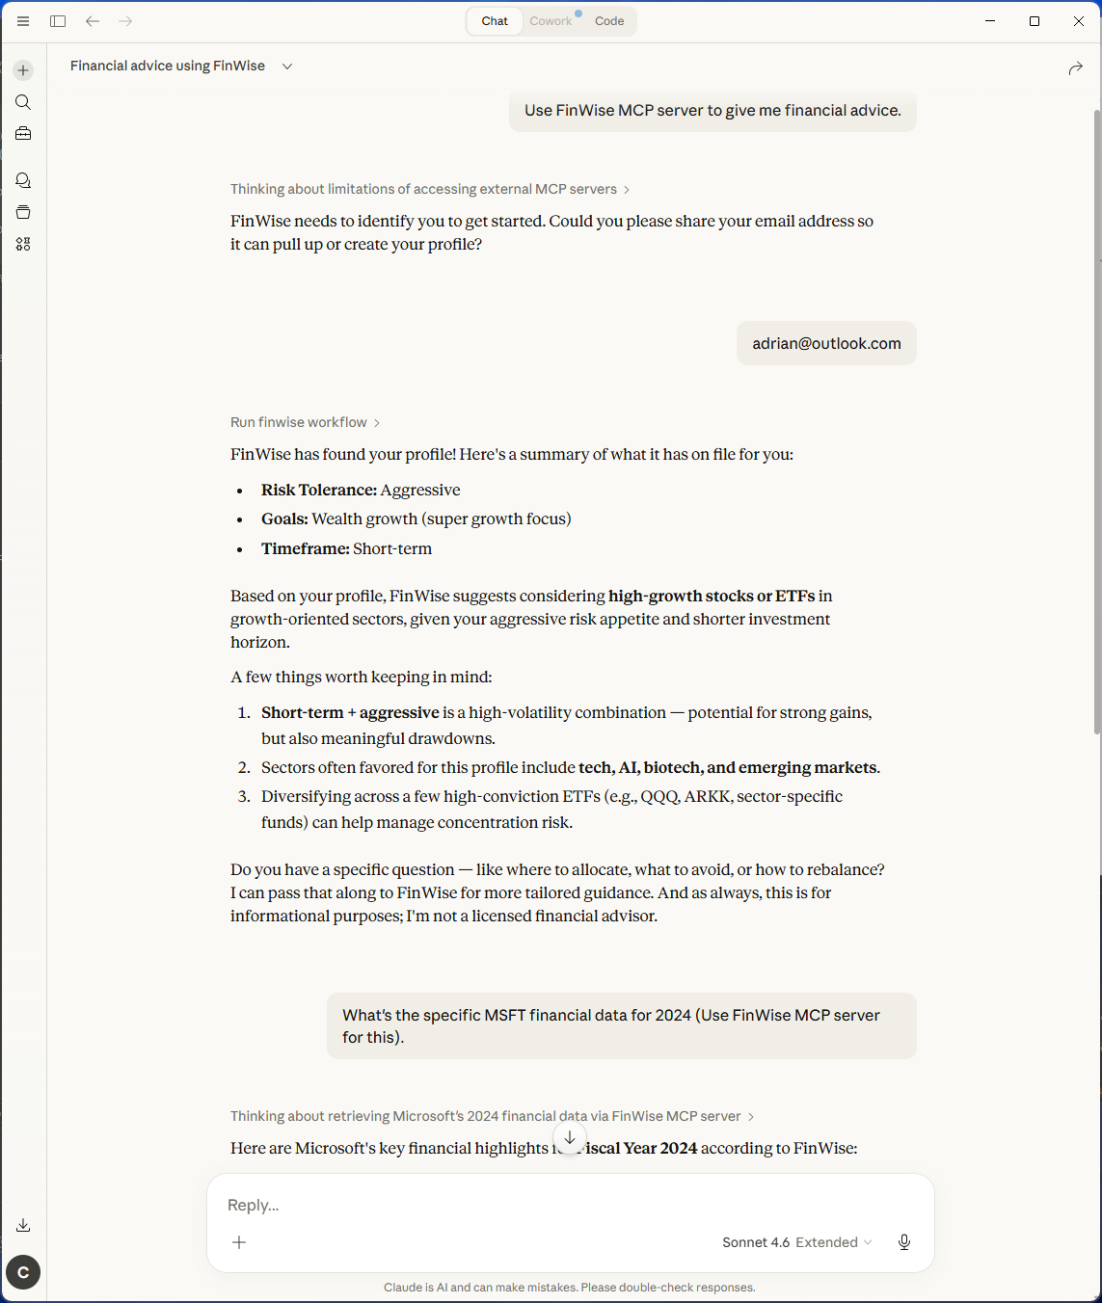
(MCP client app)

Slide 2
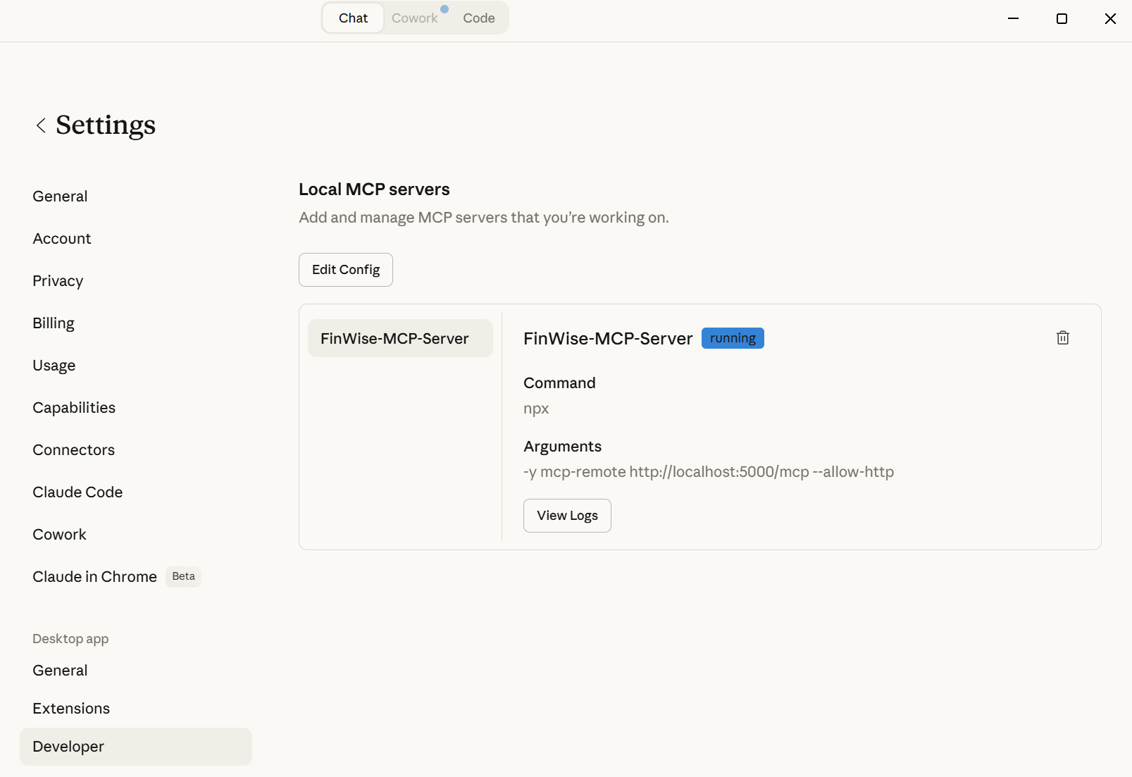
(Config of MCP client)
Client app config
Config file:
OS | Path
Windows | %APPDATA%\Claude\claude_desktop_config.json
macOS | ~/Library/Application Support/Claude/claude_desktop_config.json
"mcpServers": {
"FinWise-MCP-Server": {
"command": "npx",
"args": [
"-y",
"mcp-remote",
"http://localhost:5000/mcp",
"--allow-http"
]
}

