Slide 1


















Slide 2


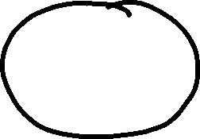




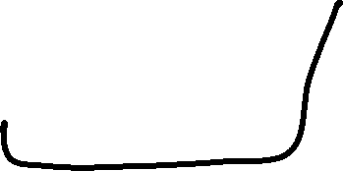
















Slide 3



Slide 4






Business Agentic application: FinWise (Personalized financial investment advisor)
Chat UI
FinWise
Claude
ChatGPT
Flexible and extensible multi-agent workflow of specialized agents for financial investment advice.
GitHub Copilot
MCP
protocol
Multi-Agent
Workflow
MCP client
Azure AI
Foundry

Slide 5

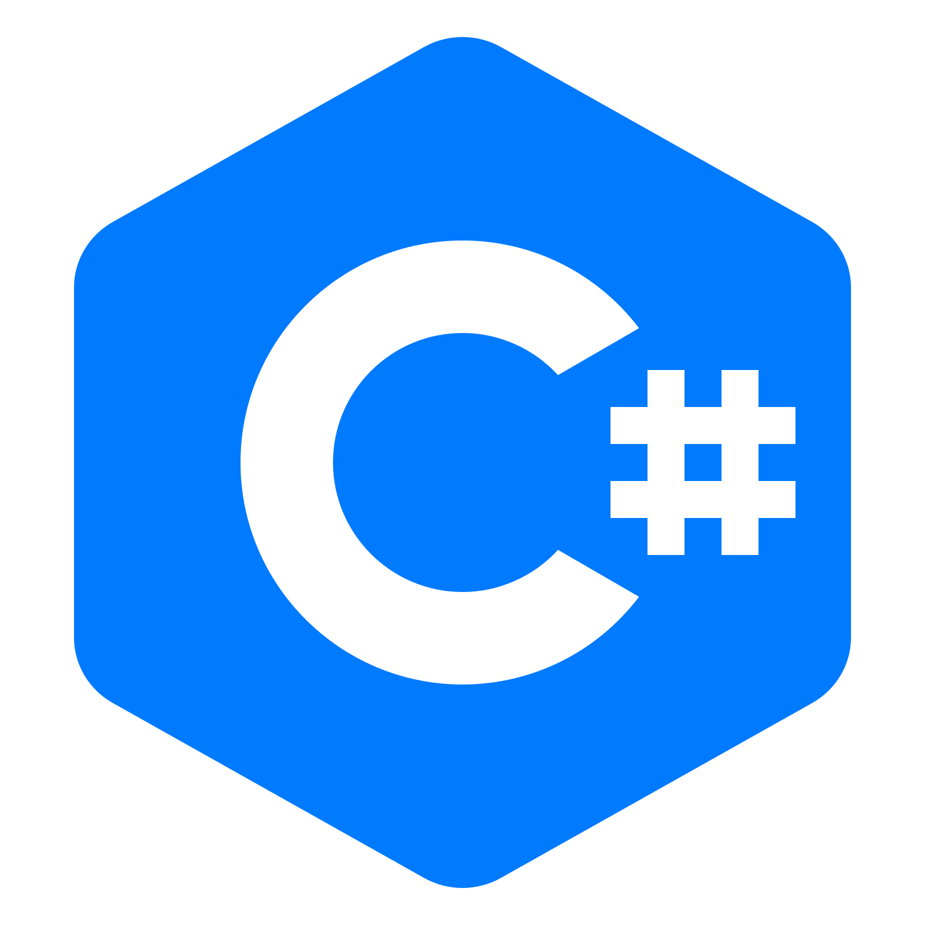







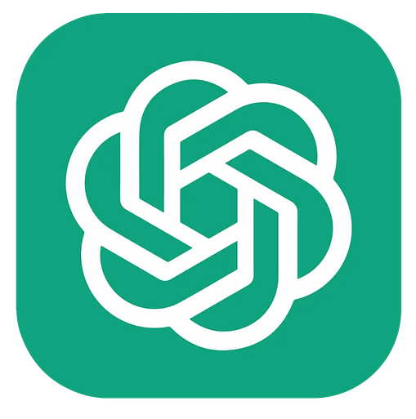
FinWise v0.1.0 – Architecture Diagram
Dev computer
MCP server / Http Service (Process)
Profile
AI Agent
MCPSession
(StatefulSessionManager)
AgentSessionManager
(In-Memory Agent Session Store)
IProfileStore
Interface
Chat UI
Claude, ChatGPT, GitHub CoPilot, Cursor, etc..
MCP Tools
Multi-Agent
Workflow
Orchestrator
AI Agent
Profile
In-Memory
Store
MCP SDK
For .NET
Hand-off
strategy
MCP
(Model-Context-Protocol
|
Http Streaming)
Advisor
AI Agent
MCP client
User
Azure Foundry
LLM

Slide 6
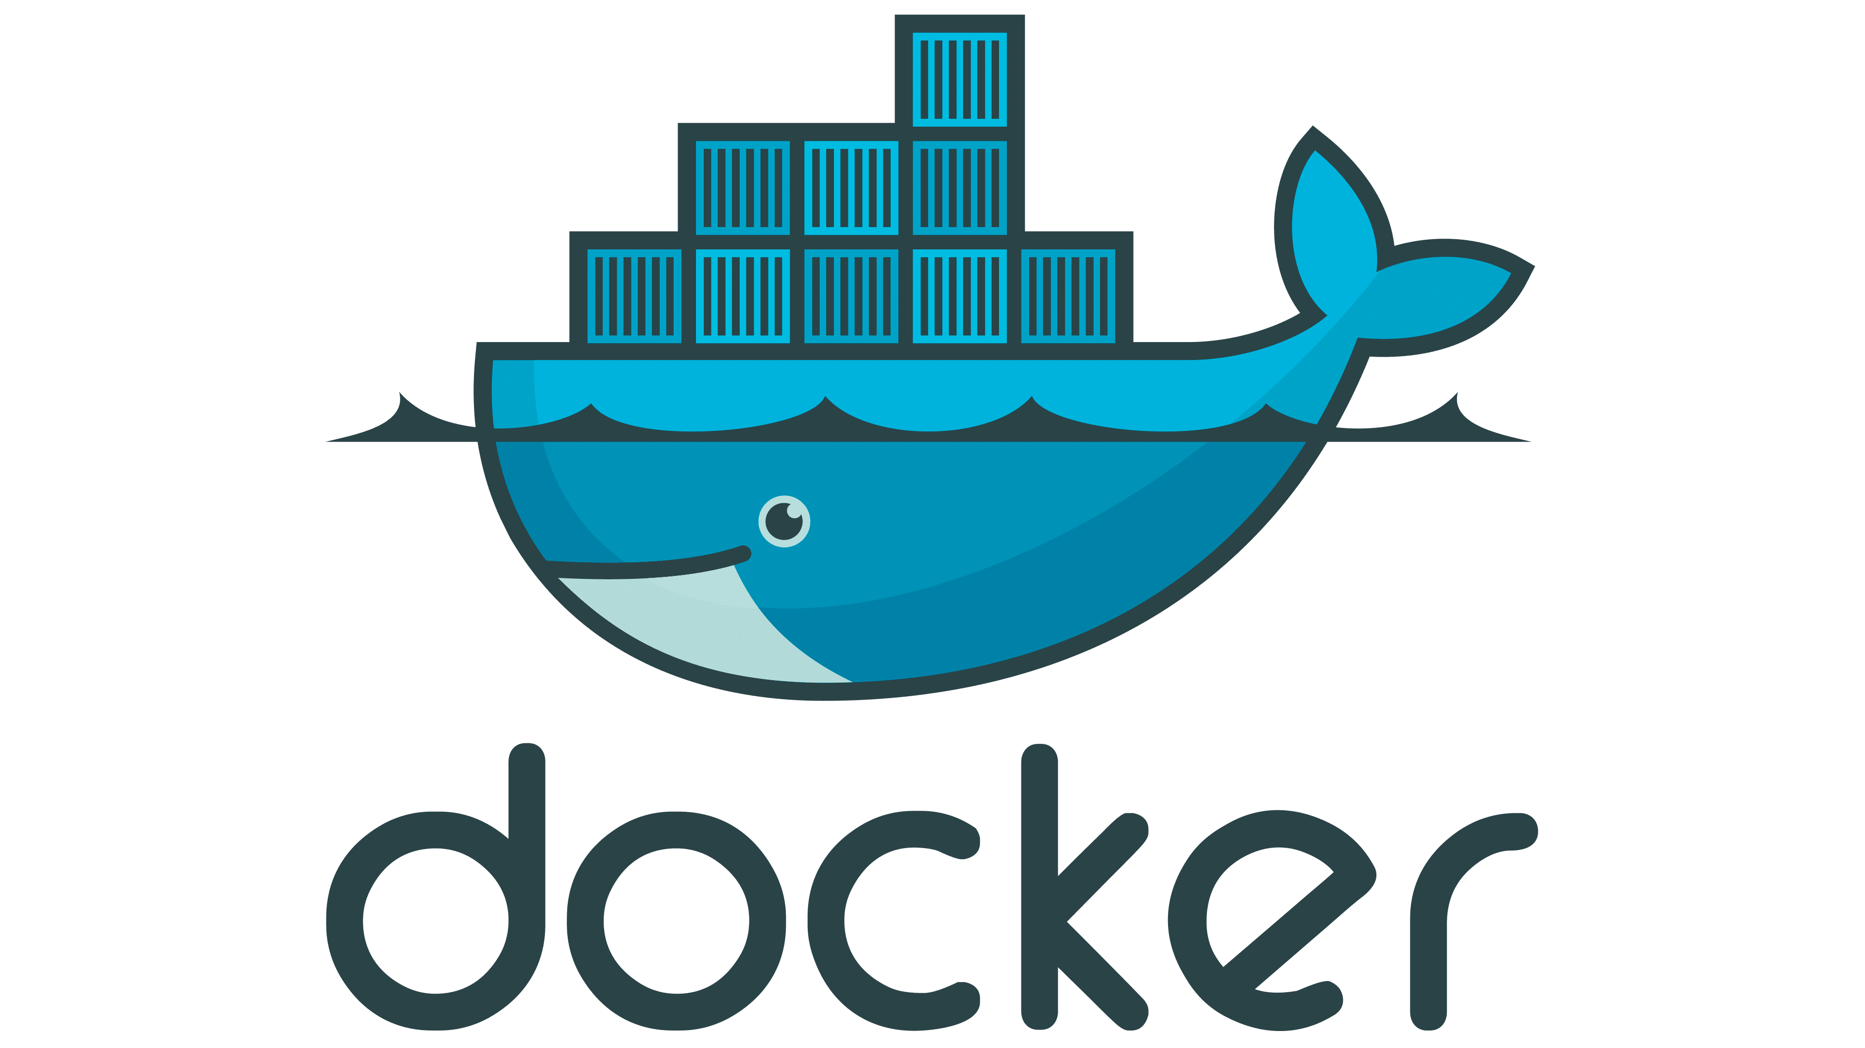

FinWise v0.1.1 – Architecture Diagram
Dev computer
Docker host
(Docker Desktop)
MCP server / Http Service (Process)
Profile
CosmosDB
Store
Azure Cosmos-DB
Emulator
(Docker container )
Profile
AI Agent
MCPSession
(StatefulSessionManager)
AgentSessionManager
(In-Memory Agent Session Store)
IProfileStore
Interface
Chat UI
Claude, ChatGPT, GitHub CoPilot, Cursor, etc..
MCP Tools
Multi-Agent
Workflow
Orchestrator
AI Agent
Profile
In-Memory
Store
MCP SDK
For .NET
Hand-off
strategy
MCP
(Model-Context-Protocol
|
Http Streaming)
Advisor
AI Agent
MCP client
User
Azure Foundry
LLM

Slide 7
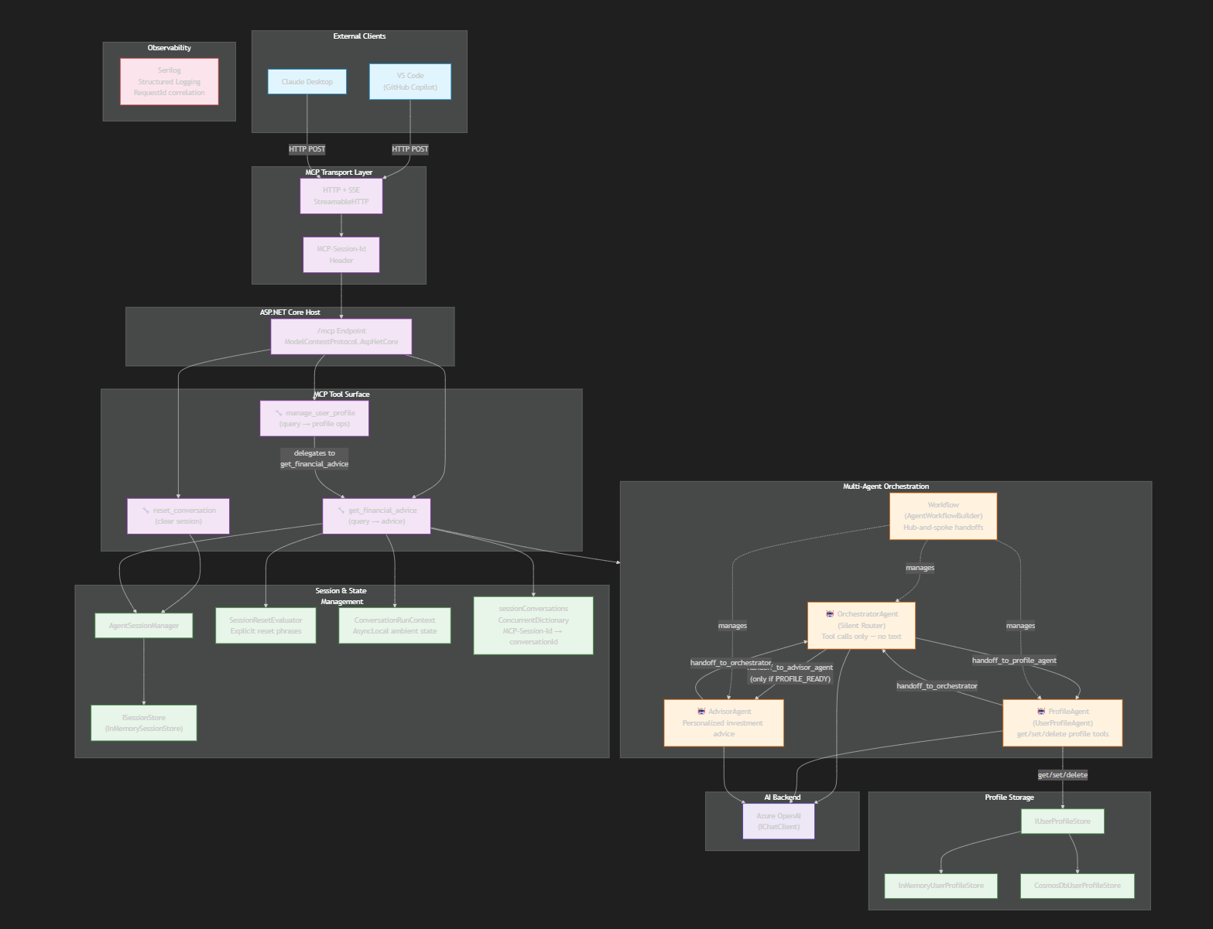
FinWise v0.1 – Architecture Diagram
Notes:
1. System Architecture Overview
Shows all layers: external MCP clients → HTTP transport → MCP tool surface → multi-agent orchestration (hub-and-spoke) → session/state management → profile storage → Azure OpenAI backend.
2. Request Lifecycle & Agent Handoff Sequence
Traces the full conversation flow: new user request → OrchestratorAgent routes to ProfileAgent → email/profile collection over multiple turns → PROFILE_READY marker emitted → subsequent requests route to AdvisorAgent for personalized advice.
3. Class & Component Diagram
Maps the code structure: Program.cs as composition root wiring AgentSessionManager, UserProfileAgent, SessionResetEvaluator, ConversationRunContext; interface/implementation pairs for ISessionStore and IUserProfileStore; key DTOs (SessionData, UserProfileDto, ConversationRunSnapshot).
Key architectural patterns captured:
Hub-and-spoke handoffs — all routing through OrchestratorAgent, no direct agent-to-agent
PROFILE_READY: gate — text marker in conversation history controls advisor access
Stateless agents — AgentSession holds all state; agents are recreated per request
Manual DI — Program.cs is the composition root, no DI container for agents
Message deduplication — BuildMessageSignature() prevents duplicates when merging workflow outputs

Slide 8
FinWise v0.2 (Decoupled) – Architecture Diagram
Dev computer
Docker host
(Docker Desktop)
MCP server (Process)
MCP server
Http service
(Project)
Multi-Agent Workflow
(.dll Class-Library Project)
Profile
CosmosDB
Store
Profile
AI Agent
Azure Cosmos-DB
Emulator
(Docker container )
MCPSession
(StatefulSessionManager)
AgentSessionManager
(In-Memory Agent Session Store)
IProfileStore
Interface
Chat UI
Claude, ChatGPT, GitHub CoPilot, Cursor, etc..
MCP Tools
Multi-Agent
Workflow
Orchestrator
AI Agent
Profile
In-Memory
Store
IChatClient
Injected
Dependencies
Hand-off
strategy
MCP
(Model-Context-Protocol
|
Http Streaming)
MCP SDK
For .NET
Advisor
AI Agent
MCP client
User
IChatClient
IChatClient
Azure Foundry
LLM

Slide 9
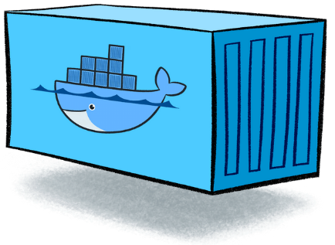
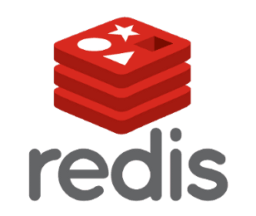
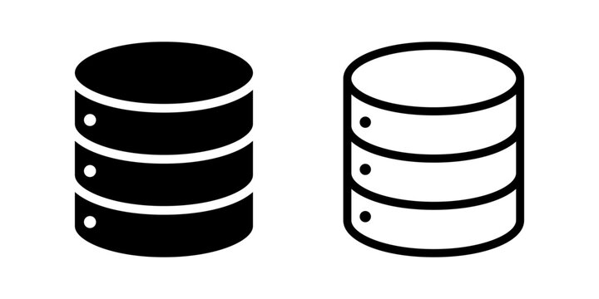




FinWise v0.3.0 – Architecture Diagram
Dev computer
MCP server (Process)
Docker host
(Docker Desktop)
MCP server
Http service
(Project)
Multi-Agent Workflow
(.dll Class-Library Project)
In-Memory
AgentSession
Store
AgentSessionManager
AgentSessionStore
(Abstract class)
Redis
AgentSession
Store
MCPSession
(Stateful Session Manager
or
ISessionMigrationHandler)
RedisSessionMigrationHandler
(Docker container)
In-Memory
UserProfile
Store
Persisted
Agent sessions
UserProfile
AI Agent
Docker
Host
Volumes
Persisted
MCP sessions
Chat UI
Claude, ChatGPT, GitHub CoPilot, Cursor, etc..
Http
service
(Kestrel)
ASP.NET Core
MCP Tools
Multi-Agent
Workflow
ChatClientAgent
IProfileStore
(Interface)
Persisted
User Profiles
Port
5000
Orchestrator
AI Agent
CosmosDB
UserProfile
Store
MCP
(Model-Context-Protocol
|
Http Streaming)
MCP SDK
For .NET
Injected
Dependencies
Hand-off
strategy
IChatClient
User
MCP client
ChatClientAgent
Advisor
AI Agent
Azure CosmosDB
Emulator
(Docker container)
FoundryAgent
IChatClient
ChatClientAgent
IChatClient
Finwise
App Registration
App secret
Azure Entra
Authorization
Stock
AI Agent
Azure Foundry
Service Principal
App secret
Grounded
Azure Foundry
Grounded
Stocks
reports
LLM
LLM

Slide 10
FinWise v0.3.1 – Architecture Diagram
Dev computer
FinWise
Docker container
Docker host
(Docker Desktop)
Ports 5000:5000
MCP server (Process)
MCP server
Http service
(Project)
Port
5000
Multi-Agent Workflow
(.dll Class-Library Project)
In-Memory
AgentSession
Store
AgentSessionManager
AgentSessionStore
(Abstract class)
Redis
AgentSession
Store
MCPSession
(Stateful Session Manager
or
ISessionMigrationHandler)
RedisSessionMigrationHandler
(Docker container)
UserProfile
AI Agent
In-Memory
UserProfile
Store
Persisted
Agent sessions
Chat UI
Claude, ChatGPT, GitHub CoPilot, Cursor, etc..
Docker
Host
Volumes
Persisted
MCP sessions
Http
service
(Kestrel)
ASP.NET Core
MCP Tools
Multi-Agent
Workflow
ChatClientAgent
IProfileStore
(Interface)
Persisted
User Profiles
Orchestrator
AI Agent
IChatClient
CosmosDB
UserProfile
Store
MCP
(Model-Context-Protocol
|
Http Streaming)
MCP SDK
For .NET
Injected
Dependencies
ChatClientAgent
Hand-off
strategy
User
MCP client
Advisor
AI Agent
FoundryAgent
IChatClient
ChatClientAgent
Azure CosmosDB
Emulator
(Docker container)
IChatClient
Finwise
App Registration
App secret
Authorization
Stock
AI Agent
Azure Foundry
Azure Entra
Service Principal
App secret
Grounded
Azure Foundry
Grounded
Stocks
reports
LLM
LLM

Slide 11
FinWise v0.4.0 – Architecture Diagram – Prod. Databases in Azure cloud
Dev computer
Docker host
(Docker Desktop)
FinWise
Docker container
Ports 5000:5000
MCP server (Process)
MCP server
Http service
(Project)
Port
5000
Multi-Agent Workflow
(.dll Class-Library Project)
In-Memory
AgentSession
Store
AgentSessionManager
AgentSessionStore
(Abstract class)
Redis
AgentSession
Store
Agent Sessions
MCPSession
(Stateful Session Manager
or
ISessionMigrationHandler)
RedisSessionMigrationHandler
MCP Sessions
UserProfile
AI Agent
In-Memory
UserProfile
Store
Chat UI
Claude, ChatGPT, GitHub CoPilot, Cursor, etc..
Http
service
(Kestrel)
ASP.NET Core
MCP Tools
Multi-Agent
Workflow
ChatClientAgent
IProfileStore
(Interface)
Persisted
User Profiles
Orchestrator
AI Agent
IChatClient
CosmosDB
UserProfile
Store
MCP
(Model-Context-Protocol
|
Http Streaming)
MCP SDK
For .NET
Injected
Dependencies
ChatClientAgent
Hand-off
strategy
Azure CosmosDB
User
MCP client
Advisor
AI Agent
FoundryAgent
IChatClient
ChatClientAgent
IChatClient
A2A
Finwise
App Registration
App secret
Authorization
Stock
AI Agent
Azure Foundry
Azure Entra
Service Principal
App secret
Grounded
Azure Foundry
Grounded
Stocks
reports
LLM
LLM

Slide 12
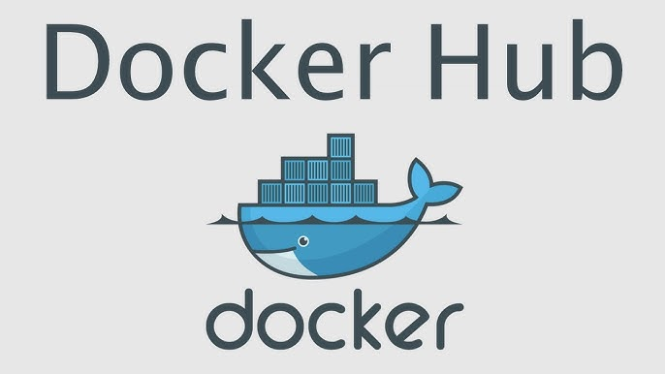

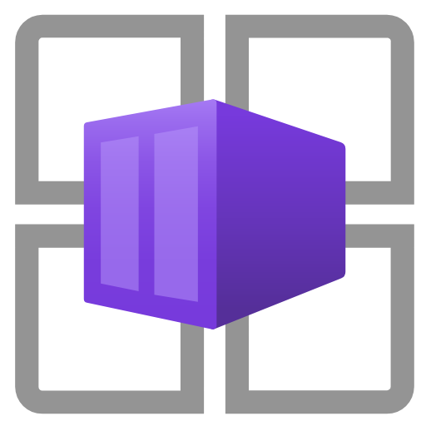


FinWise v1.0.0 – Deployed into Azure cloud – ‘Production Environment’
Container Images Registry
Users
FinWise image
Claude
ChatGPT
Azure Managed Redis
Chat UI
MCP client
Agent Sessions
MCP
(Model-Context-Protocol
|
Http Streaming)
Azure Container Apps
MCP Sessions
MCP
protocol
(Instance ‘n’)
Thousands of users
(Instance 2)
Load
Balancer
FinWise
Docker container
(Instance 1)
Persisted
User Profiles
Azure CosmosDB
Claude
ChatGPT
App secret
Chat UI
MCP
(Model-Context-Protocol
|
Http Streaming)
MCP client
Azure Entra
Azure AI
Foundry
Business/Stock
MCP tools
Finwise
App Registration
Authorization
Grounding
Service Principal
App secret
Agents
LLMs
Grounding

Slide 13
Appendix

Slide 14
Docker host
(Docker Desktop)
UserProfile
AI Agent
In-Memory
UserProfile
Store
Docker
Host
Volumes
Persisted
User Profiles
ChatClientAgent
IProfileStore
(Interface)
CosmosDB
UserProfile
Store
Azure CosmosDB
Emulator
(Docker container)
Docker host
(Docker Desktop)
In-Memory
AgentSession
Store
Docker
Host
Volumes
Persisted
Agent sessions
AgentSessionManager
AgentSessionStore
(Abstract class)
Redis
AgentSession
Store
(Docker container)

Slide 15


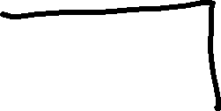









TCP Ports in single machine

Slide 16


























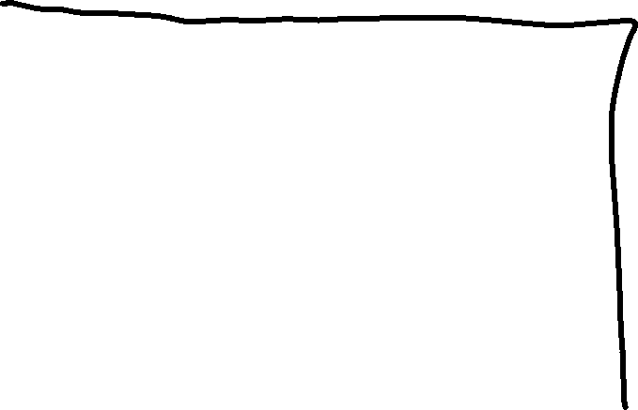















TCP Ports in Docker host

Slide 17
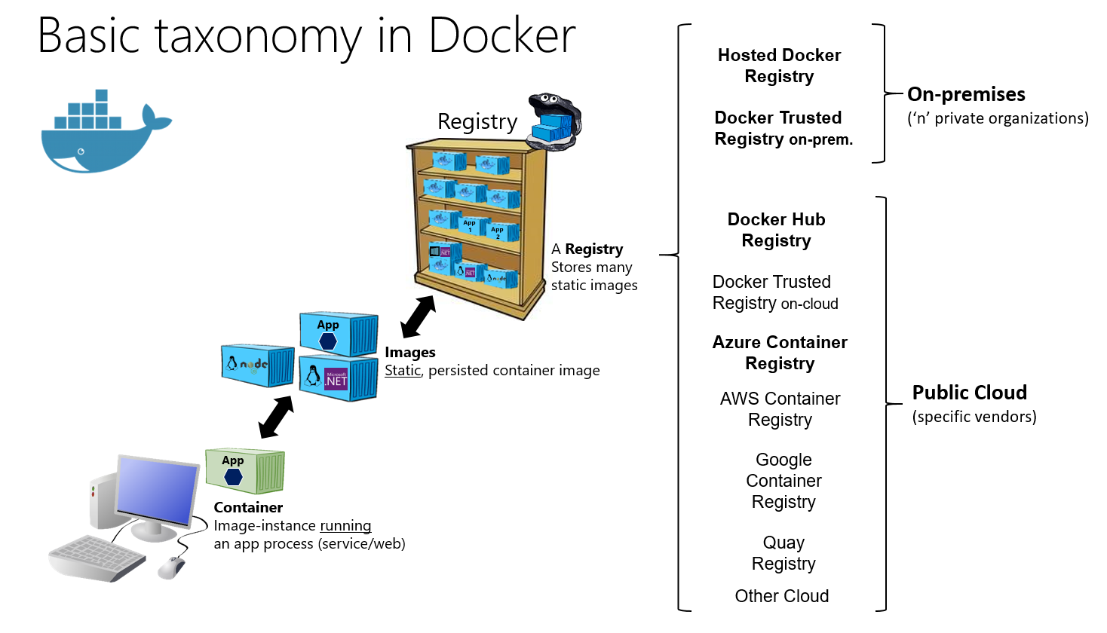
Docker 1/2
.NET Microservices. Architecture for Containerized .NET Applications - .NET | Microsoft Learn

Slide 18
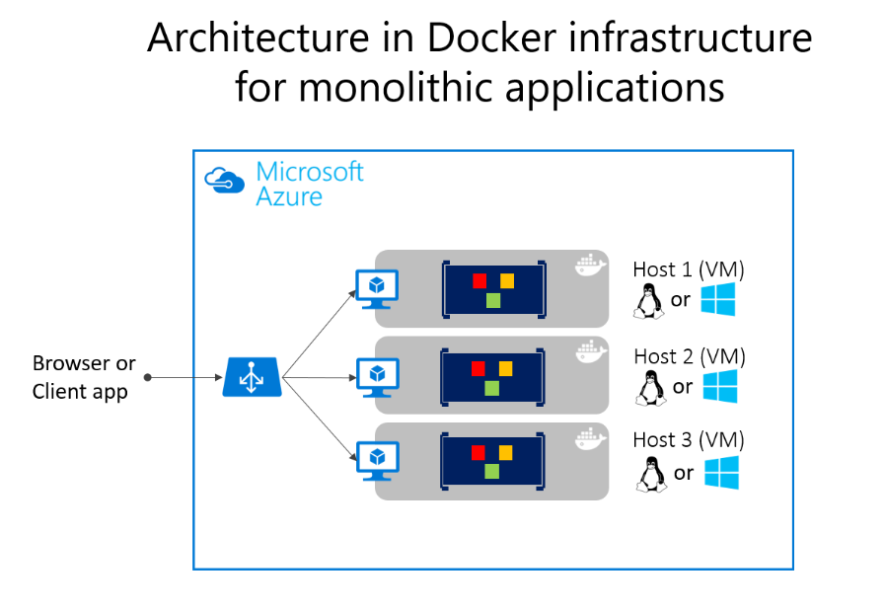
Docker 2/2
User

