Slide 1
BypassRT
Adarsh bellamane 241it004
Harshith vellapha 241it033
K v akash 241it036

Slide 2
Introduction to Kernel Bypass Networking
Traditional networking goes through the Linux kernel networking stack
High-performance systems (like trading systems, load balancers, 5G, CDN) use:
Kernel bypass networking frameworks like DPDK
Context switching
System calls
This involves
Interrupt handling
Kernel buffer copies
This adds latency and overhead

Slide 3

Problem statement
How can we design a lightweight user-space networking runtime that bypasses the kernel for faster packet processing?

Slide 4
Comparisons / Drawbacks
Modern applications require:
Low latency (< 10 microseconds)
High throughput (millions of packets/sec)
Predictable performance
Traditional kernel stack causes:
Multiple memory copies
Context switches
Interrupt overhead
Kernel locking bottlenecks

Slide 5

objectives
Design a mini kernel-bypass runtime
Implement:
User-space packet buffers
Polling-based packet processing
Lock-free ring queues
Zero-copy packet handling (basic version)
Provide a minimal API for sending and receiving packets
Compare performance with traditional socket-based approach

Slide 6
Pre requisites / research
A) Linux Networking Stack
Socket API
System calls (send, recv)
Kernel buffers
Interrupt handling
B) DPDK
Poll Mode Driver (PMD)
Hugepages
Memory pools
Lockless rings
C) Zero-Copy Mechanism
Avoid copying packets multiple times.
Traditional: NIC → Kernel → User
Kernel bypass: NIC → User (direct memory)
C) Lock-Free Data Structures
Ring buffer
Circular queue
Atomic operations

Slide 7
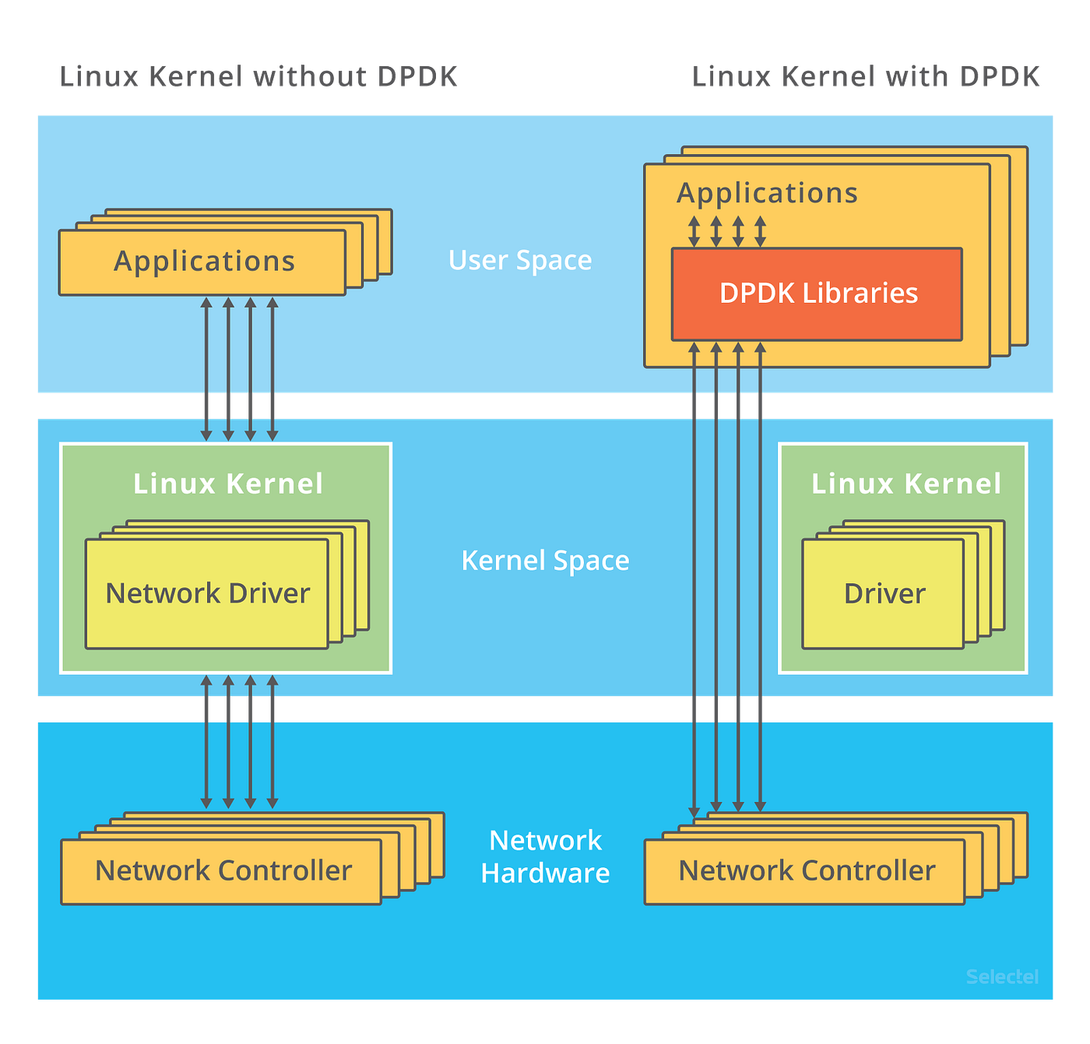
Solution architecture
The key difference is where packet processing happens
With DPDK-style networking, packet processing happens entirely in user space.
Linux networking stack is bypassed.
Applications interact directly with network hardware without using the operating system’s networking stack.
Source

Slide 8
Advantages of our solution
Traditional kernel stack causes:
Multiple memory copies
Context switches
Interrupt overhead
Kernel locking bottlenecks
Instead of using sockets, modern applications use DPDK APIs for packet processing
High throughput (millions of packets/sec)
Improves latency predictability
Reduced TLB misses.
Faster packet buffer allocation.
Avoids expensive malloc() calls
Eliminates interrupt overhead

Slide 9
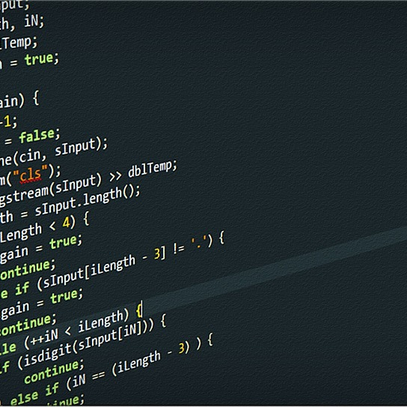
Tools and technologies used
Programming language: C
POSIX THREADS
ATOMIC OPERATIONS
LOCK FREE QUEUES
MEMPOOLS/ PACKET BUFFERS
Linux
RAW SOCKET / AF_PACKETS
TCPDUMP
WIRESHARK

Slide 10
progress
Research
Detailed analysis of traditional architecture
Recognition
Recognizing drawbacks of the traditional networking stack
Execution
Building the actual prototype

Slide 11

THANK YOU

