Slide 1
A New Revenue Stream:
Healthcare Insurance Cross-Selling
Predicting Customers Most Likely to Accept a Vehicle Insurance Cross-Selling Offer

Slide 2
TABLE OF CONTENTS
01
02
03
04
Executive Summary
Actionable Insights
Introduction and Overview
Insights into the Data
Metrics and Impact
Recommendations
Next Steps
Business Metrics and Impact
Recommendations on Next Steps and Call-To-Action

Slide 3
Executive Summary
Opportunity to Generate $12.6M - $67M
New revenue stream from cross-selling vehicle insurance to existing customers.
Problem
Health insurance market share has matured and saturated. Client needs to find new streams of revenue.
Why Now?
Client must execute before its competitors take market share in the vehicle insurance space. Latency between marketing campaign execution and revenue stream.
Solution
Project Budget: $1M
Project Duration: 3-4 Months
Staff: 5 Data Scientist/Marketer
Data Mining models to target customer most likely to buy vehicle insurance when cross-sold to.
Potential ROI
$561 min. Coverage - $3309 full coverage
Models predict about 7.5% accept and signup
~ 12x+ Return for the 1st Year

Slide 4
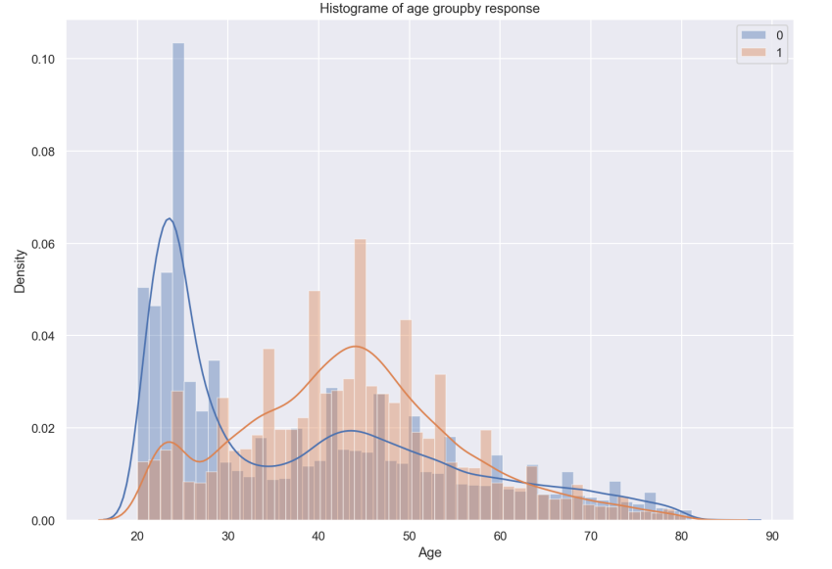
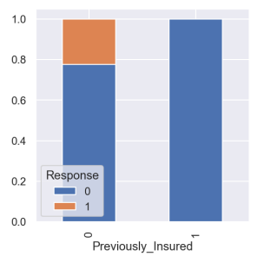
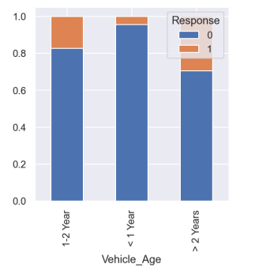
Actionable Insights
Identify & Market to Customers Likely to Accept
Most Frequent Gender
Male
Most Frequent Vehicle Age
1-2 Years
Previous Vehicle Damage
Yes
Avg. Age
42

Slide 5
Metrics & Impact
TEST DATASET
127,000 Customers
$12.6 - $67M
MODELING RESULTS
15% of Customers Likely to Accept Offer
Top 50% of Those Customers Meets 100% Gains
Potential Annual Revenue
ROI = ~12x+
MODELING PERFORMANCE
F1 Score of 84% meaning….
Of the customer the model predicts will sign-up for vehicle insurance, at what rate does the model predict correctly?
(Conservative Estimate for the First Year Alone!)
Avg. Customer Churn Rate
20% Annual
Avg. Vehicle Insurance Costs
$561 Minimum Coverage
$3309 Full Coverage
Avg Cost of Customer Acquisition
$487 - $900 per customer
$0 Client’s Current Customer Base

Slide 6
Recommendations & Next Steps
SECURE BUDGET & RESOURCES
Budget: $1M
Duration 3-4 Months
Team of 5: 2 Data Scientists, 1 Business Expert, 2 Marketers
Cost: $300/mo. Email marketing software to send 22,500 emails of 300,000 customer base
Project Deliverables Agreement with Client’s Marketing Department
PROJECT DELIVERABLES
Model Refinement: Exploration of new sales channels (ie social media)
Performance Improvements: Prediction Criteria, New Sets of Customers

Slide 7
References/Citations
Insurtechs Need to Ace Customer Acquisition Cost (CAC) Optimization. (2022, January 6). Daily Fintech. Retrieved October 17, 2022, from https://dailyfintech.com/2022/01/06/insurtechs-need-to-ace-customer-acquisition-cost-cac-optimization/
Livingston, A. (2020, June 1). Improve customer retention with the power of APIs. Coverager. Retrieved October 17, 2022, from https://coverager.com/improve-customer-retention-with-the-power-of-apis/

