Slide 1
System Architecture
MediaPipe
Driver UI
Long & VATS
Drowsy & Impairment
Caution
Warning
MRM
Camera issue
Camera
Score > 50
Score > 70
Parameter freeze > 2s
VLM(Qwen3-VL)
Unconscious
Blocked camera
Foggy lens
Vehicle
No response from driver
Brake haptic nudge

Slide 2
MediaPipe – Drowsy & Impairment
Drowsy
Perclos (눈감김 정도)
Eyes closed
Pitch & Roll movement
단방향, 반복적 행동
Impairment
Iris jitter (시선 떨림 정도)
Yaw & Roll movement
불규칙 행동
Logic
Score > 50
Warning pop up
Score > 70
Warning sound
Check pop up
MRM (if no response)

Slide 3
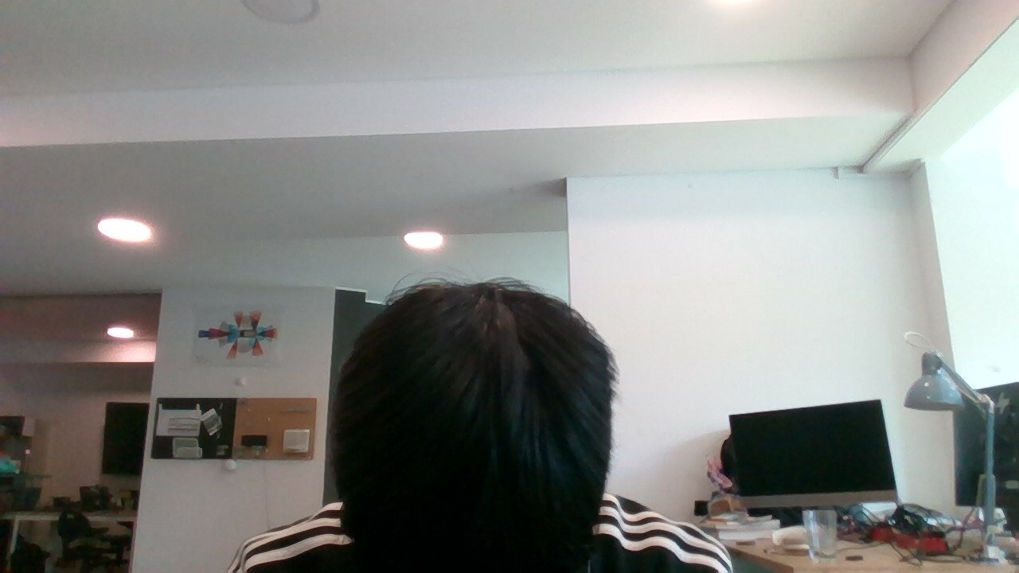

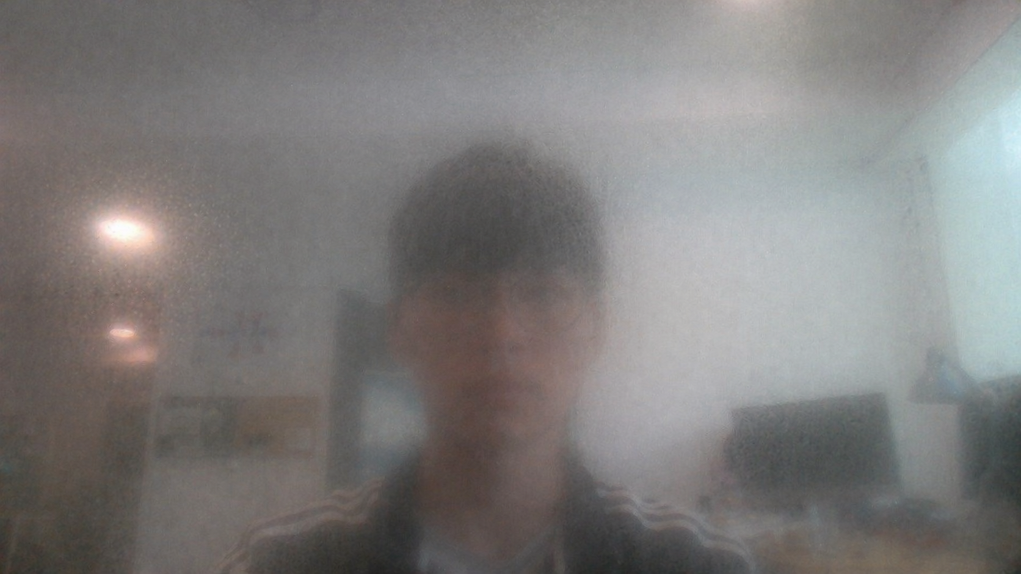
VLM
Unconscious
Blocked Camera
Foggy Lens
MRM
POP UP
POP UP

