Slide 1
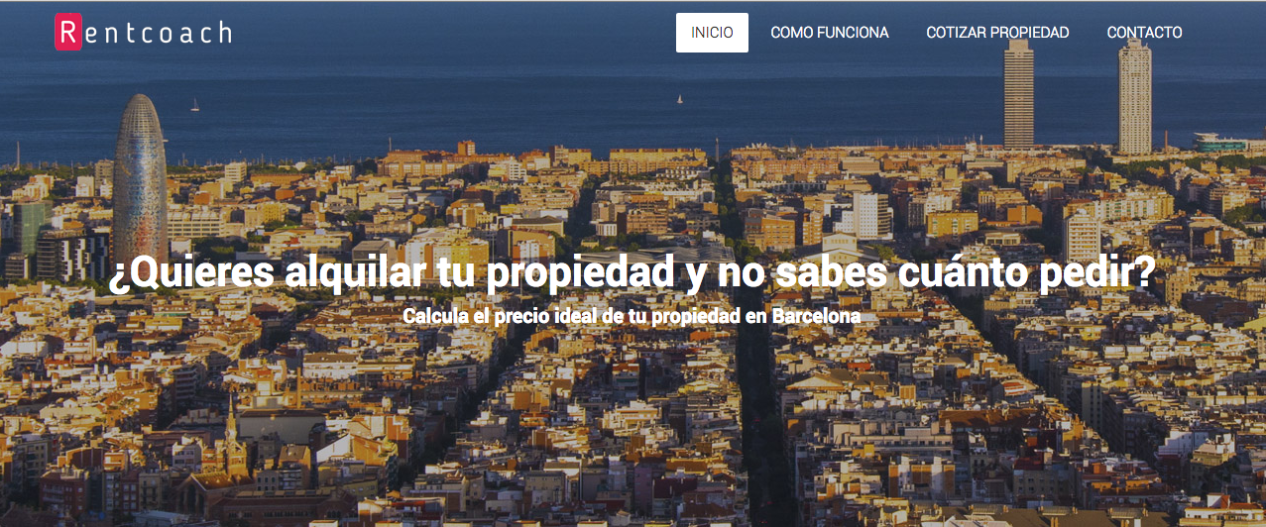
Web Application
Staging and Production Environments using Django

Slide 2
Stages
1. Development
Finding the right host.
Python Notebooks vs App Environment
Containers.
Frameworks.
Integration
Building a MVP (Minimum Viable Product)

Slide 3
2. Staging
Installing Django
Creating Models
Set up web containers/frameworks.
Deploying
Testing
Debugging

Slide 4

3. Production
Deployment
Launching our MVP
Tracking
www.rentcoach.us

