Slide 1
Bayes and Naive Bayes classifier
10/20/19

Slide 2
Please get materials from GitHub

Slide 3
Topics
Probability Recap
Law of total Probability
Bayes Theorem
Binary Hypothesis Testing
Naive Bayes

Slide 4
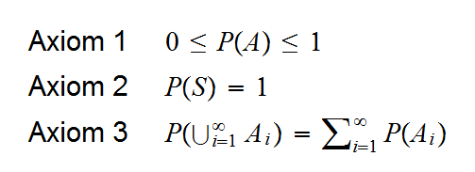
Probability Recap
Axioms of probability:
Image Courtesy: http://academic.uprm.edu/wrolke/esma6600/graphs/prob11.png

Slide 5
Probability Recap
Let x be the event where a fair dice when rolled results in an even number
Let y be the event where a fair dice when rolled results in a number <4
P(x) = # of cases when x occurs / Total # of cases
P(y) = # of cases when y occurs / Total # of cases
What about P(x) when we know y occured ?
P(x|y) = ?

Slide 6
Probability Recap: Conditional Probability
Primary definition (Kolmogorov Definition) p(x|y) = p(x ∩ y)/ p(y)
Gives us a method to relate p(x|y) and p(x ∩ y)
Going back to the previous question
P(x|y) = ?

Slide 7
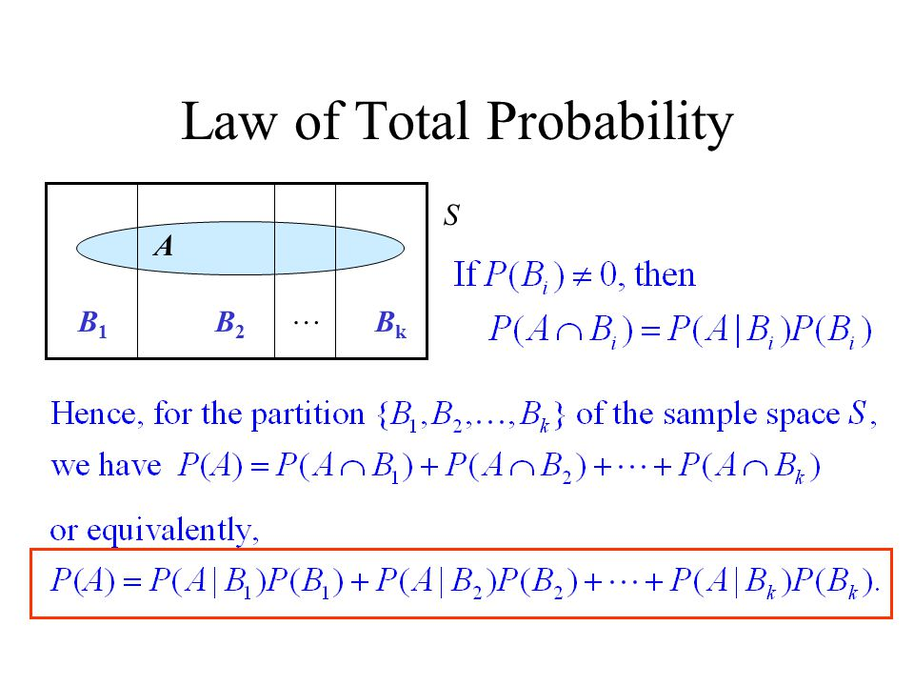
Probability recap: Law of total Probability
Image Courtesy: https://slideplayer.com/slide/4347748/14/images/16/Law+of+Total+Probability.jpg

Slide 8
Bayes Theorem
Bayes theorem in the simplest of terms gives us a relation between the conditional probabilities of two different events ( ie. P(A|B) and P(B|A) ).
Statement: P(A|B) = P(B|A)∗P(A) / P(B)

Slide 9
Binary Hypothesis Testing
Let us have two hypotheses available and let them be :
H₀ - Absence of signal
H₁ - Presence of signal
Given an observation of some characteristic variable X how do we decide which hypothesis is true.
In the simplest of terms if X takes the value x. we can have two conditional probabilities which are known to us . P(X=x| H₀ ) which is the probability of observing X to be x given if H₀ is true, and we have the same for H₁

Slide 10
Binary Hypothesis Testing
The most obvious way to decide between which one is true is to go with whichever has a higher value as the chances of observing a value is higher for one of the classes and thus choosing that makes more sense. Because it maximizes the probability to observe the current situation X=x. This method s called maximizing the likelihood of the observation ( ML ).
Another method of choosing is where the we know the prior probabilities of the two classes H₀ and H₁ which are π₀ and π₁ these are probabilities assumed before an observation is made and are thus called priors.

Slide 11
Binary Hypothesis Testing
This rule is called the MAP rule where we declare hypothesis H₁ true when π₁p ₁ > π₂p ₂ , (symmetric for other classes).

Slide 12
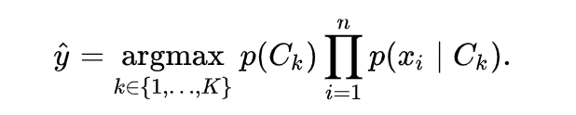
Naive Bayes Classifier
Main assumption:
All features x_{i} are independent of the other.
Assume we have M classes and N features
Now instead of modeling joint distribution p(x,y) as p(x|y)p(y) for feature vector x
We can work on product of p(x_{i}|y) over i = 0->N rather than on the joint distribution of p(x|y)

