Slide 1
K-Nearest Neighbors

Slide 2
Topics
KNN : Overview
KNN: Distance Functions
KNN: Pros & Cons
KNN: Optimisations
KNN: With KMeans
KNN: With PCA

Slide 3
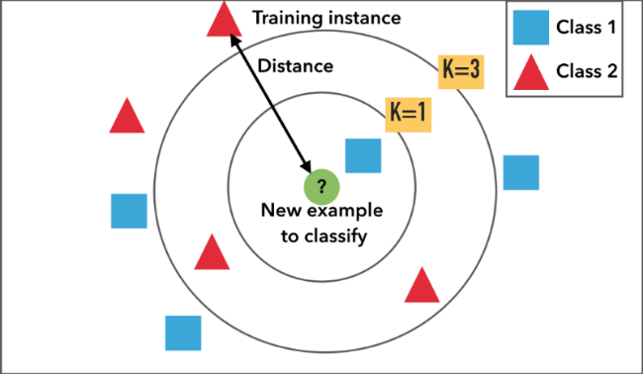
KNN: Overview
An algorithm that classifies a data point based on the classes of the majority of k-closest data points
“Closest” depends on what distance metric we use
E.g. A bank deciding to give a customer a loan can check if the characteristics of this person are closer to people that default on their loan or don’t default.

Slide 4
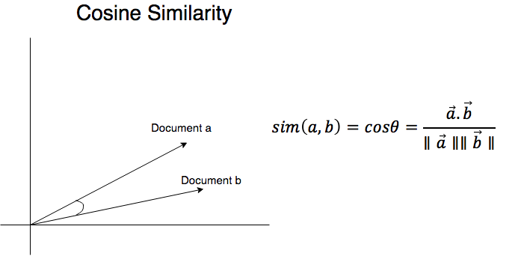
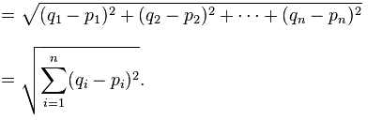
KNN: Distance Functions
Two types of distance functions we will be covering
Euclidean Distance
Cosine Similarity

Slide 5
KNN: Pros & Cons
Pros:
Simple to implement
Works well for most datasets
No assumptions about data - useful for nonlinear data
Good accuracy
Can be used for classification or regression
Cons:
Doesn’t handle missing data well - the distance will be undefined for those attributes
Doesn’t handle high dimensional data well
Bias-Variance tradeoff - KNN has low bias but high variance so it is sensitive random noise in the model and can overfit
High memory requirement

Slide 6
KNN: Optimisations
One of the major issues faced by KNN is the curse of dimensionality, for example in the cases when we are working with pictures in megapixels
Two methods to optimize our algorithm:
Reduce the number of data points by clustering each class into lesser number of datapoints
Reduce the dimensionality of the data using some dimensionality reduction algorithm

Slide 7
KNN: With KMeans
KMeans: An unsupervised algorithm to cluster a dataset into K clusters
Goal: Reduce number of datapoints in dataset to make the computation more feasible
How: Assuming our class has N classes with A number of datapoints. We call KMeans on each class individually and cluster them into K clusters thus representing A data Points now with K cluster centers.(K<<A)
Advantage: We now have lesser data points to actually calculate distance to/from thus making our computation more feasible

Slide 8
KNN: With PCA
PCA: Principal Component Analysis.
Goal: To reduce the dimensionality of the dataset and make it more sufficient to work on datasets where the curse of dimensionality makes KNN unfeasible.
How: Assuming our dataset to be a matrix of dimensions N,d we want to find an orthogonal matrix W which maps the original matrix to a new set of features where each dimension is uncorrelated to the other and the first k rows of W capture majority of the variance present in the original dataset
Advantage: Reduce the complexity of computation for the dataset by reducing dimensionality

