Slide 1
Machine Learning: A brief overview
Sunday 3rd February, 2019

Slide 2
Prerequisites
Two major prerequisites
Comfort with one or more programming languages
Basic understanding of probability and linear algebra

Slide 3
Where to get the materials ?
ADSA GitHub

Slide 4
Tools
“Coding without appropriate tools or version control is like shooting yourself in the foot….. twice”
- Rohan Tikmany

Slide 5
Tools
The three major tools we will assume everyone is familiar with are
Python
Git
Jupyter Notebooks / Google Collab

Slide 6
Machine Learning an overview
So what really is Machine Learning ?
Is it :
Getting a computer to act or think like humans ?
Getting a computer to evolve and learn from experiences themselves ?
Getting a computer to parse lots of data and learn something from it?
All of the above ?
https://www.techemergence.com/what-is-machine-learning/

Slide 7
Types of Machine learning
Machine Learning can be categorized into three major types:
Supervised Learning
Un-supervised Learning
Reinforcement Learning

Slide 8
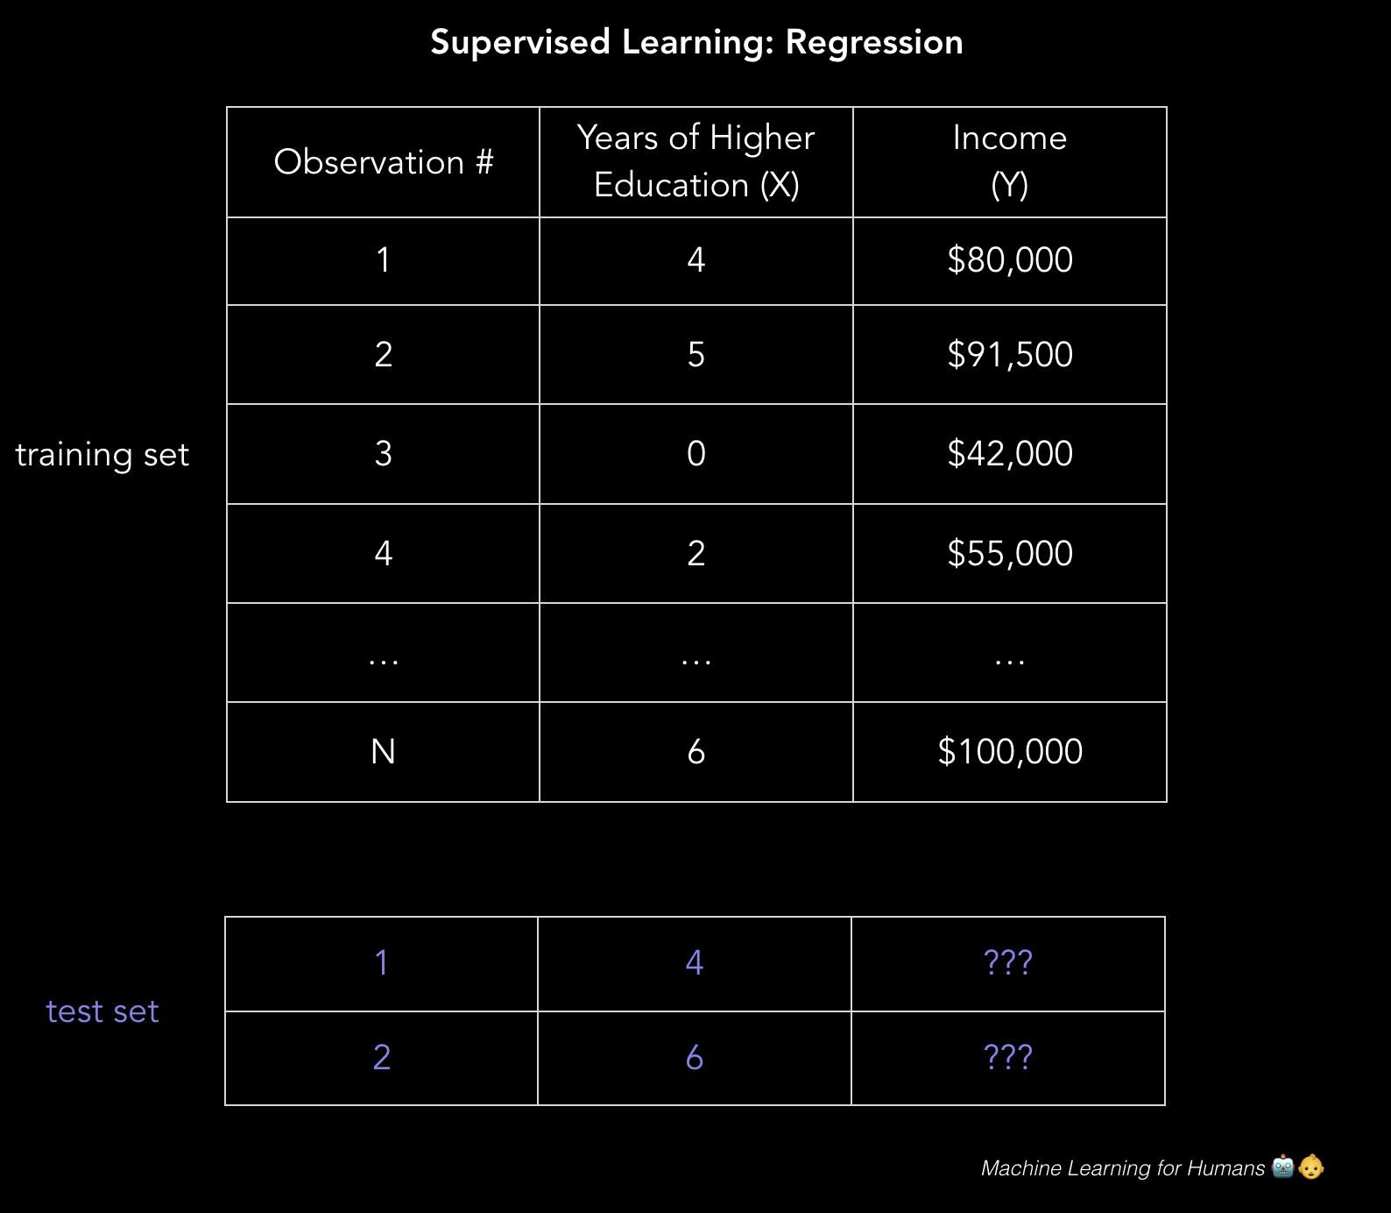
Supervised Learning
A type of learning that uses a ground truth
This means that our training data comes with a set of correct labels for each sample
Classification or Regression
Some common examples of supervised learning are:
Naive Bayes
Logistic Regression
Random Forests
Example: predicting annual income based on years of education
Engineering a solution: income = ($5,000 * years_of_education) + baseline_income
Learning a solution: use linear regression

Slide 9
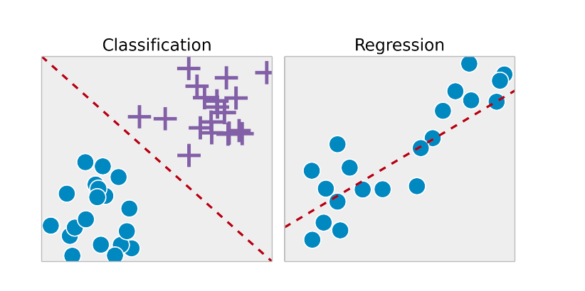
Types of Supervised Learning
Regression:
Predicts a continuous target variable Y based on input X
Prediction of a quantity
E.g. “Given the size of a house, predict the price”
Linear Regression, Random Forest, etc
Classification:
Maps a function F, from input variables X to an output variable Y
Data is classified into one of two or more classes
E.g. “Is this a cat or a dog”
Decision Trees, KNN, etc

Slide 10
Unsupervised learning
Mama bird to baby bird “GO FLY”
*Kicks baby bird out of the net*

Slide 11
Unsupervised Learning
Data is expensive.
Tagging a million images as car present or not present is not easy or cheap
Unlike supervised learning there is NO GROUND TRUTH.
Some Types of unsupervised learning algorithms:
Clustering ( KMeans etc)
Anomaly Detection

