Slide 1
Requset-level GPU Sharing on vLLM
Tao Li, Zhuoyuan Li, Chuanyi Liu

Slide 2
Planning and Tracking List
Task | Schedule | Task Owner | 11.12 Status | Last Week Status | Current Status
Deploy serverlessLLM on k8s | 11.4-8 | Tao&Zhuoyuan | Complete | Complete | Complete
Profile key metrics of LLMs under different configurations | 11.4-8 | Chuanyi | Complete | Complete | Complete
Implement MPS on serverlessLLM | 11.8-15 | Chuanyi | On track | Complete | Complete
Dynamic resource allocation based on model popularity | 11.15-20 | Tao& Zhuoyuan | On track | Complete | Complete
Independent scheduling for prefill and decode phases | 11.19-26 | Chuanyi Liu | - | - | On track
Parameter-sharing for multiple requests of the same model | 11.19-26 | Tao& Zhuoyuan | - | - | Complete (vLLM)
Model
level
Requestlevel

Slide 3
Part1: Parameter-sharing for multiple requests of the same model

Slide 4
Part1.1: GPU memory sharing among processes

Slide 5
Why Sharing Parameters?
Instances of one model reside on the same GPU
Scenario 1: Multiple instances can utilize GPU better than single one
Scenario 2: Disaggregate prefill and decode phases (Part 2)
Multiple replicas of parameters bring about memory waste
Each redundant replica wastes space of ~GB
Node
Node
Inst 1
Inst 1
Inst 2
Higher utilization
&
Lower latency
v.s.
one instance
two instances

Slide 6
Underlying support: CUDA Runtime
Mechanism
IpcMemHandle from CUDA Runtime
Allows different processes to access the same memory
Usage
Owner: Expose an address as a handle
User: Read the handle and restore it to memory address
handle = cudart.cudaIpcGetMemHandle(data_ptr1)
data_ptr2 = cudart.cudaIpcOpenMemHandle(handle)

Slide 7


Underlying support: CUDA Runtime
An example
Owner
User
data_ptr1 = tensor.data_ptr()
status, handle = cudart.cudaIpcGetMemHandle(data_ptr1)
memory_handle_str1 = base64.b64encode(handle.reserved).decode('utf-8’)
with open(memory_handle_file, 'w') as f:
f.write(memory_handle_str)
with open(memory_handle_file, 'r') as f:
cuda_memory_handle_b64 = f.read()
handle = cudart.cudaIpcMemHandle_t()
handle.reserved = base64.b64decode(cuda_memory_handle_b64)
data_ptr2 = cudart.cudaIpcOpenMemHandle(handle,cudart.cudaIpcMemLazyEnablePeerAccess)
tensor = torch_tensor_module.create_gpu_tensor
(data_ptr2, dims, dtype)

Slide 8
Underlying support: CUDA Runtime
An example
Owner
Python tensor is not fit for pointer
Create tensor with C++ and integrate into python as torch_tensor_module
User
data_ptr1 = tensor.data_ptr()
status, handle = cudart.cudaIpcGetMemHandle(data_ptr1)
memory_handle_str1 = base64.b64encode(handle.reserved).decode('utf-8’)
with open(memory_handle_file, 'w') as f:
f.write(memory_handle_str)
with open(memory_handle_file, 'r') as f:
cuda_memory_handle_b64 = f.read()
handle = cudart.cudaIpcMemHandle_t()
handle.reserved = base64.b64decode(cuda_memory_handle_b64)
data_ptr2 = cudart.cudaIpcOpenMemHandle(handle,cudart.cudaIpcMemLazyEnablePeerAccess)
tensor = torch_tensor_module.create_gpu_tensor
(data_ptr2, dims, dtype)

Slide 9
Part1.2: Parameter-sharing on vLLM

Slide 10
Overview
Params-sharing daemon and Inference processes
Inference processes share parameters but have a separate kv cache address space
Params-sharing
daemon
Inference
process 1
Inference
process 2
Inference
process 3
Parameters
KV cache
KV cache
KV cache
embed_tokens.weight
KV
KV
KV
KV
KV
KV
KV
KV
KV
KV
KV
KV
memory handler
embed_positions.weight
KV
KV
KV
KV
KV
KV
KV
KV
KV
KV
final_layer_norm.weight
KV
KV
KV
KV
KV
KV
KV
KV
final_layer_norm.bias
memory handler
KV
KV
KV
KV
...
Memory Handler Pool

Slide 11
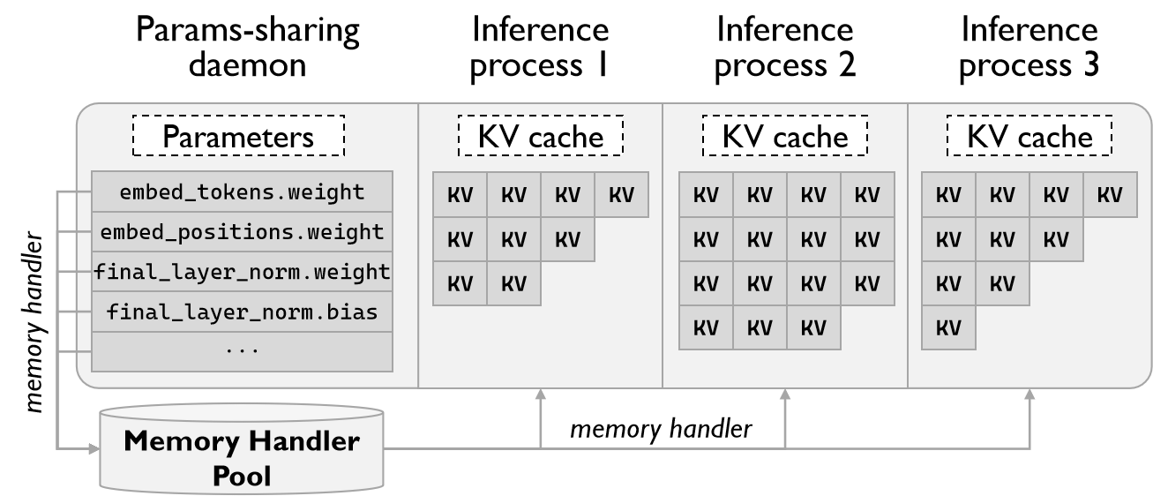
Overview
Params-sharing daemon and Inference processes
Inference processes share parameters but have a separate kv cache address space

Slide 12
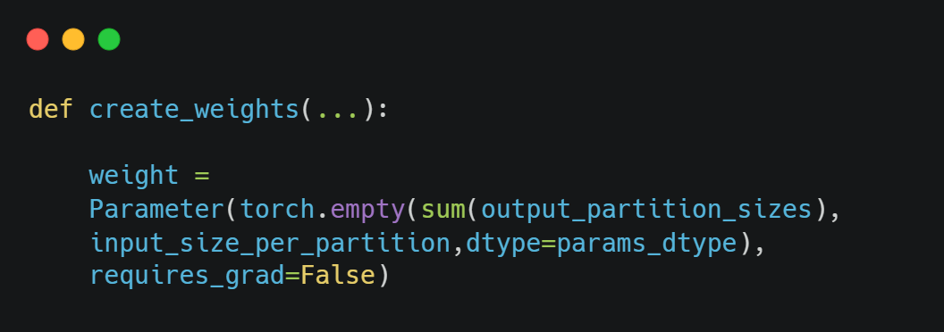
Weights loader of vLLM
Weights initialization
Weights loading
#linear.py
create_weights(...)
#loader.py
_initialize_model(...)
#vocab_parallel_embed#ding.py
create_weights(...)
#loader.py
load_weights(weights)
#opt.py
load_weights(weights):
# get initialized params
params_dict = dict(self.named_parameters(...))
# load weights
for name, loaded_weight in weights: weight_loader(...)
weights
#loader.py
_get_all_weights(...)

Slide 13
Weights loader of params-sharing daemon
Save memory handles when loading the weights
#opt.py
load_weights(weights):
# get initialized params
params_dict = dict(self.named_parameters(...))
# load weights
for name, loaded_weight in weights: weight_loader(...)
device_buffer_ptr = params_dict[name].data_ptr()
err, ipc_mem_handle = cudart.cudaIpcGetMemHandle(device_buffer_ptr)
handler_dict[name] = {
"handler": ipc_mem_handle,
"offset": offset,
"dims": dims,
"dtype": "float16"
}

Slide 14
PyTorch memory management and allocation
PyTorch memory management
At block granularity
cudart.cudaIpcGetMemHandle(data_ptr) returns block base address, not data address
PyTorch memory allocation
Allocate 2MB for size less than 1MB;
Allocate 20MB for size 1MB ~ 10MB;
Allocate { size rounded up to a multiple of 2MB } MB for size >= 10MB
Handle
pointer
Data
pointer
Tensor1
Tensor2
Tensor3
Tensor4
Tensor5
Block 1
Block 2
Block 3

Slide 15
Record offset
Record the address of the handle: addr(handle)
offset = addr(data) - addr(handle)
Handle
pointer
Data
pointer
Tensor1
Tensor2
Tensor3
Tensor4
Tensor5
Block 1
Block 2
Block 3

Slide 16
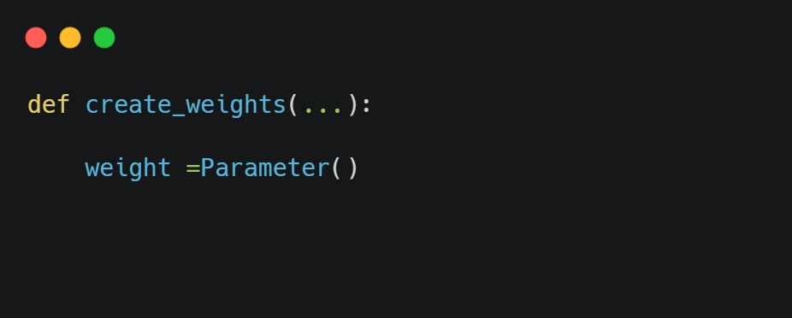
Weights loader of inference processes
Weights initialization
weight = empty()
#linear.py
create_weights(...)
#loader.py
_initialize_model(...)
#vocab_parallel_embed#ding.py
create_weights(...)
weight <= empty()
#linear.py
create_weights(...)
#loader.py
_initialize_model(...)
#vocab_parallel_embed#ding.py
create_weights(...)

Slide 17
Weights loader of inference processes
Weights loading: load weights from memory handles
#opt.py
load_weights(weights):
# get initialized params
params_dict = dict(self.named_parameters(...))
# load weights
for name, shared_weight in handles:
# Gets memory pointers from handles
err, devPtr = cudart.cudaIpcOpenMemHandle(
shared_weight['handler'], cudart.cudaIpcMemLazyEnablePeerAccess)
# Get weights by memory pointers
params_dict[name].data = torch_tensor_module.create_gpu_tensor(devPtr + shared_weight["offset"], shared_weight['dims'], shared_weight['dtype'])

Slide 18
Part2: Prefill and decode phases disaggregating

Slide 19
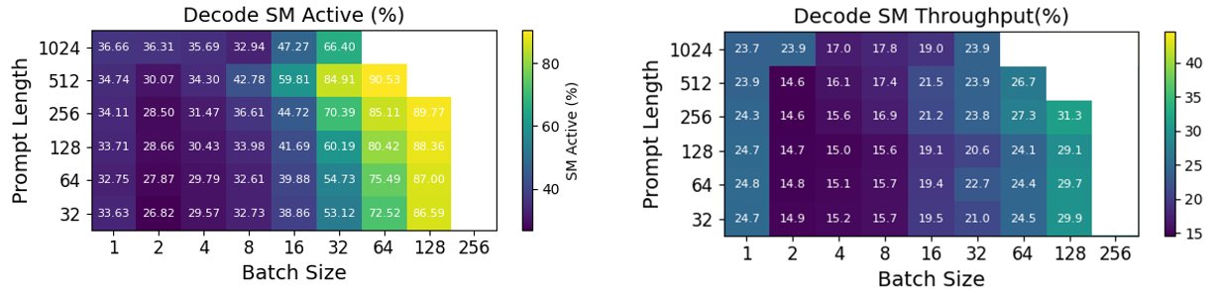
Overview
Why do we need to disaggregate prefill and decode stages?
Address low GPU utilization caused by mismatched resource demands
Leverage GPU Sharing to further raise resource utilization
Challenges
How to combine prefill-decode disaggregation with MPS?
How to disaggregate prefill and decode stages in vLLM?
[1] DistServe: Disaggregating Prefill and Decoding for Goodput-optimized Large Language Model Serving. OSDI’24
[2] MuxServe: Flexible Spatial-Temporal Multiplexing for Multiple LLM Serving. ICML’24

Slide 20


Disaggregate prefill and decode
Architecture of Muxserve^{[1]}
Scheduler
Workload
SMs
resource
inference requset
Store manager
Profiler
Unified KV
Cache
Activation
launch
prefill proc for model B
. . . . . .
launch
prefill proc for model A
launch
decode proc for model A
read/write kv cahce
Model Weights
Muxserve_server
(prefill)
Muxserve_server
(decode)
. . . . . .
LLMRuntime
LLMRuntime
write kv cahce
[1] MuxServe: Flexible Spatial-Temporal Multiplexing for Multiple LLM Serving. ICML’24

Slide 21
Disaggregate prefill and decode
Current idea
Launch two subprocesses for prefilling and decoding to utilize MPS for each request
Do not maintain a unified KV cache, decoding process shares memory with prefilling process or deepcopy
Write our own LLMEngine atop vLLM
TODO
Implement the schduling algorithm for prefill and decode stages
Share KV cache between prefill and decode processes
More flexible dynamic allocation
Fine-grained memory management
To combine with vLLM

Slide 22
Planning and Tracking List
Task | Schedule | Task Owner
Implement prefill-decode disaggregated instances | 11.26-12.03 | Chuanyi
Independent scheduling policy for prefill and decode phases | 11.26-12.03 | Tao
Implement parameter-sharing on serverlessLLM | 11.26-12.03 | Zhuoyuan

Slide 23
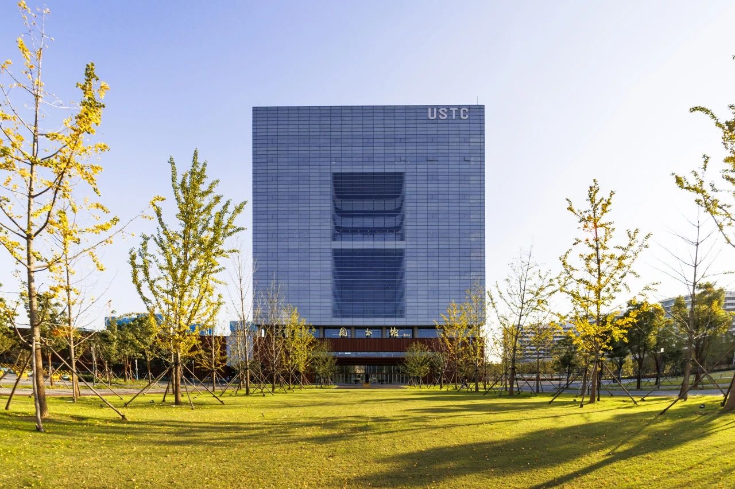

Slide 24
Thanks for your attention

