Slide 1
Code Analysis of vLLM and ServerlessLLM
Tao Li, Zhuoyuan Li, Chuanyi Liu, Chenye Wang
[1] https://kserve.github.io/website/latest/
[2] ServerlessLLM: Low-Latency Serverless Inference for Large Language Models. OSDI’24
[3] Efficient Memory Management for Large Language Model Serving with PagedAttention. SOSP’23

Slide 2
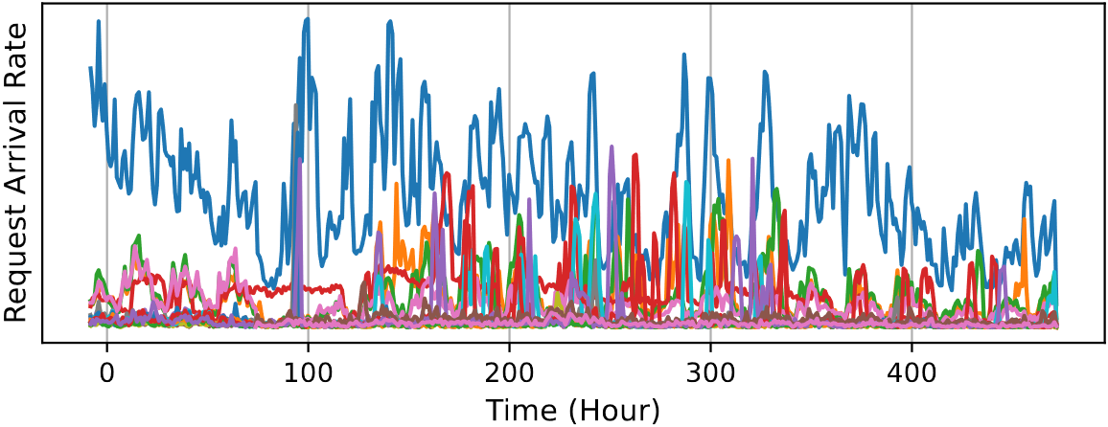
Preface
Goal
Goodput-oriented Serverless Inference Framework for Multiple LLMs Serving
Backgroud
Multiple LLMs serving^{[1,2,3,4,5]}
Bursty workloads: real traffic observed by ShangHai AI Lab in 20 days
Improve
GPU utilization
[1] MuxServe: Flexible Spatial-Temporal Multiplexing for Multiple LLM Serving. ICML’24
[2] ServerlessLLM: Low-Latency Serverless Inference for Large Language Models. OSDI’24
[3] dLoRA: Dynamically Orchestrating Requests and Adapters for LoRA LLM Serving. OSDI’24
[4] AlpaServe: Statistical Multiplexing with Model Parallelism for Deep Learning Serving. OSDI’23
[5] PetS: A unified framework for Parameter-Efficient transformers serving. ATC’22

Slide 3



Preface
Goal
Goodput-oriented Serverless Inference Framework for Multiple LLMs Serving
Backgroud
Serverless inference
Easy to use
High elasticity
Fine-grained billing

Slide 4
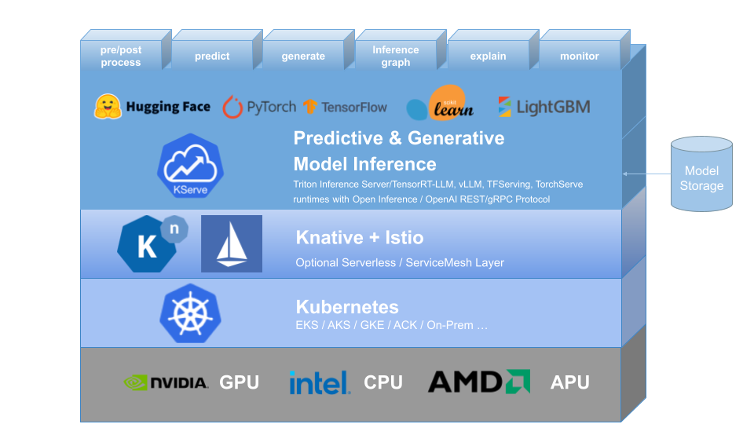
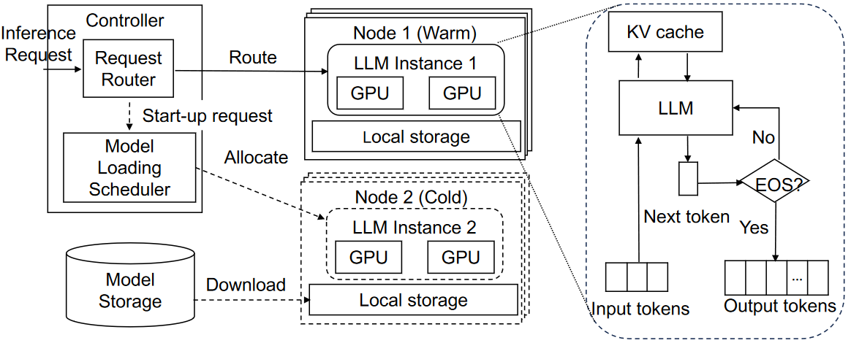
Preface
Goal
Goodput-oriented Serverless Inference Framework for Multiple LLMs Serving
Backgroud
SOTA serverless LLM serving framework: KServe and ServerlessLLM
KServe Framework
ServerlessLLM Framework

Slide 5
Preface
Goal
Goodput-oriented Serverless Inference Framework for Multiple LLMs Serving
Backgroud
KServe : Highly scalable and standards based Model Inference Platform on Kubernetes
Built on K8s for high scalability
Provide performant, standardized protocol
across ML frameworks
Support serverless with GPU autoscaling
Developed by Google, IBM, Bloomberg, and
Microsoft (Github stars: 3.5k)

Slide 6
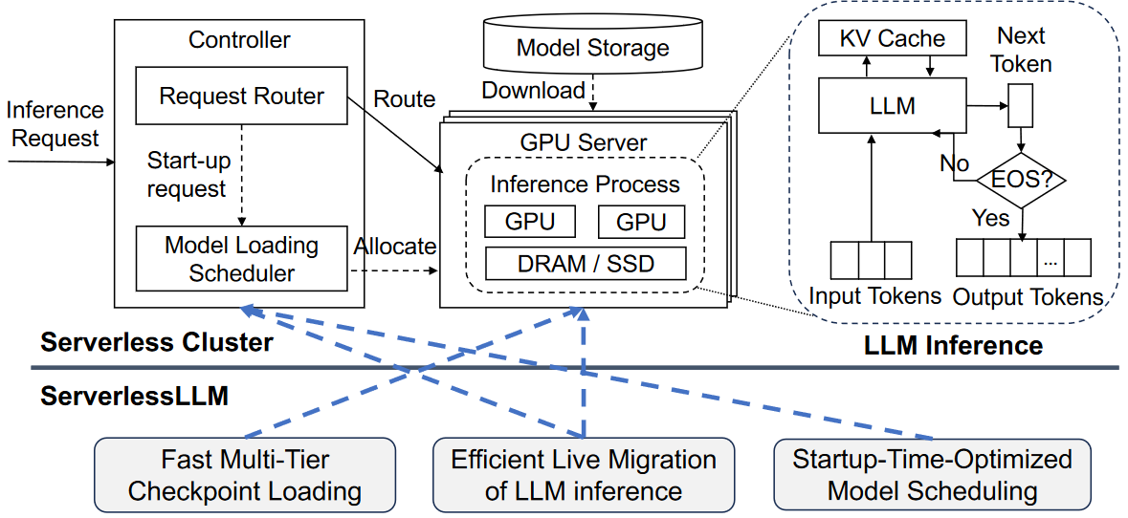
Preface
Goal
Goodput-oriented Serverless Inference Framework for Multiple LLMs Serving
Backgroud
ServelessLLM : Low-latency serverless inference framework for LLMs
Leverage near-GPU storage to accelerate model downloading and loading

Slide 7
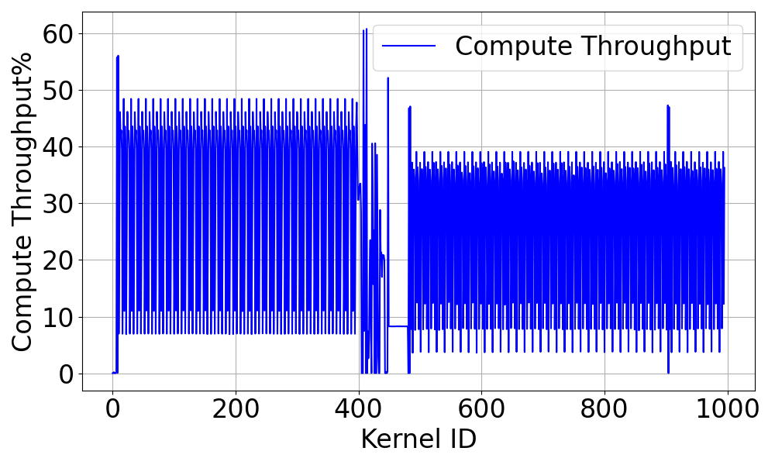
Preface
Goal
Goodput-oriented Serverless Inference Framework for Multiple LLMs Serving
Motivation: Limitations of KServe and ServelessLLM
ServerlessLLM: NO GPU sharing → Low utilization
Testbed:
instance: AWS g5.12xlarge
GPU: 4 x A10 [24GB]
model: OPT-6.7B
10% ~ 50% during prefill phase
10% ~ 40% during decode phase
Init&Prefill
Decoding
Single request on OPT-6.7B

Slide 8
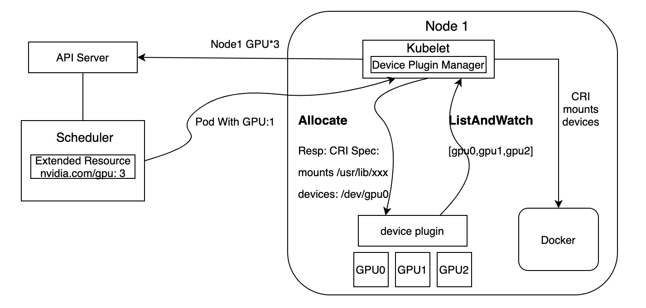
Preface
Goal
Goodput-oriented Serverless Inference Framework for Multiple LLMs Serving
Motivation: Limitations of KServe and ServelessLLM
KServe: utilize nvidia-device-plugin for GPU sharing
Discover and report the available GPUs on a node
Handle device assignment and lifecycle management
Support Time-Slicing and MPS
Note:
Time-slicing and MPS are mutually exclusive

Slide 9
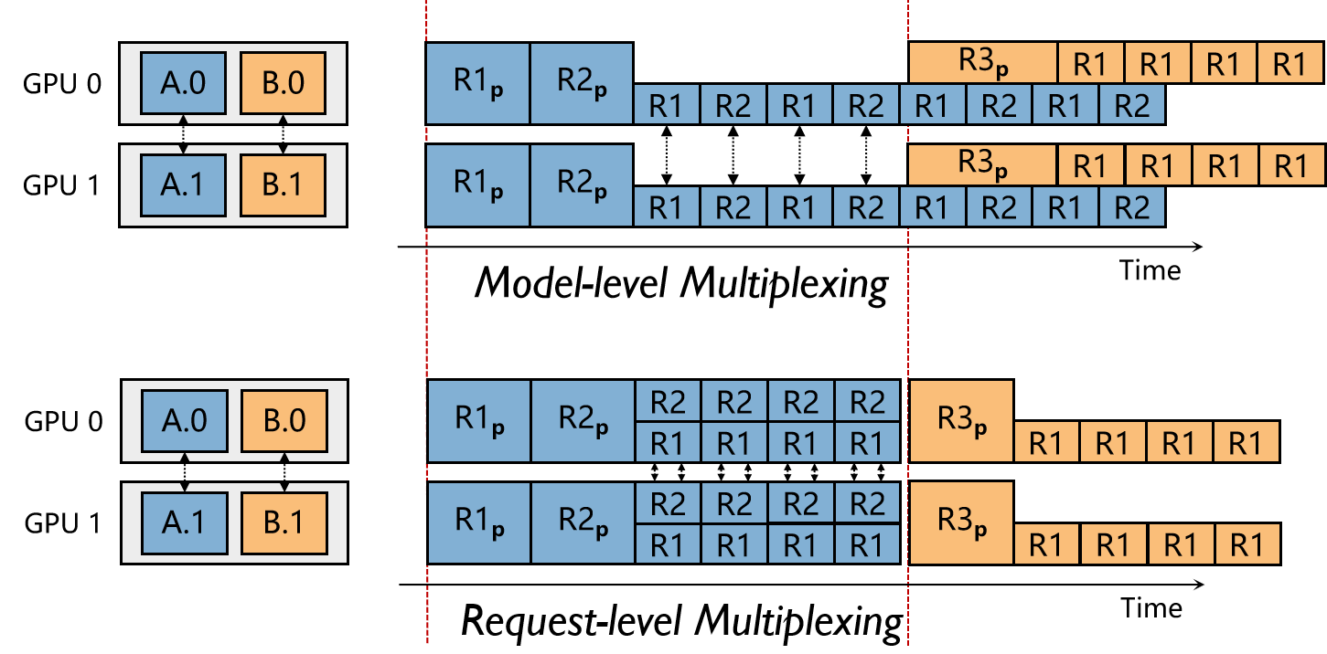
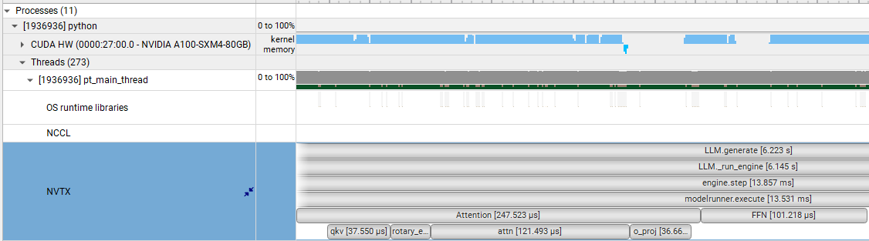
Preface
Main idea: Fine-grained multiplexing
Request-level GPU sharing
Technique：MPS
Challenges
Trade-off between SLO and
resource utilization
Communication overhead
Kernel-level GPU sharing
Technique：CUDA streams
Challenges
The number of CUDA
streams

Slide 10
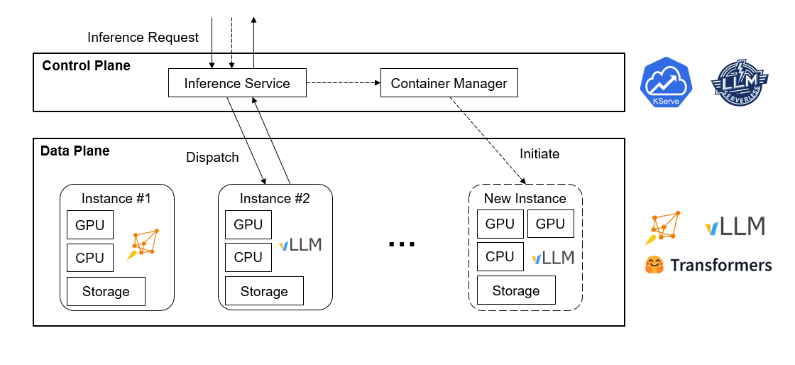
Overview on Serverless Inference
Control plane(schedule framework): KServe, ServerlessLLM
Data plane(inference engine): vLLM, Transformers, Pytorch...

Slide 11
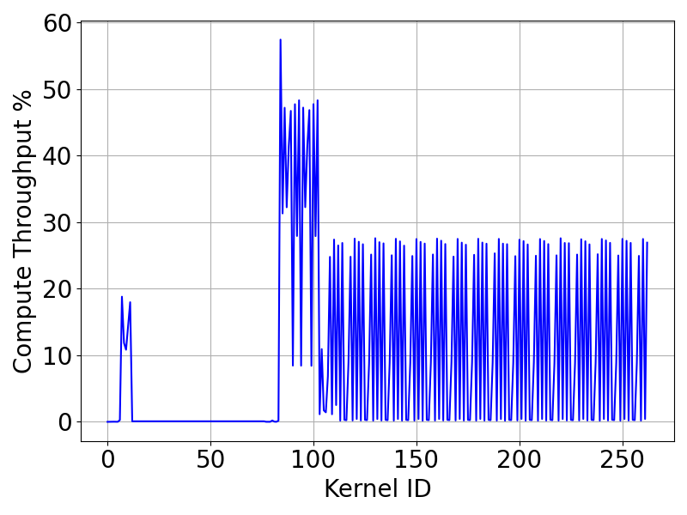
vLLM Breakdown
Two-phase lifecycle --- an offline programming example
llm = LLM(“/path/to/model”) # Init
outputs = llm.generate(prompts, sampling_params) # Generate
Init
Generate
Single request on LLaMA-7b (max_tokens=16)

Slide 12
vLLM Call Stack
Code structure of vLLM
Init
LLM
llm = LLM(“/path/to/model”)
LLM.init
LLMEngine
LLMEngine.init
Scheduler
Executor
①
②
③
*.init
init_kvcache
Scheduler.init
Worker
①
②
ModelRunner
CacheEngine
load_model
profile_run
CacheEngine.init
Model
Notes:
Engine：初始化kv_caches | 调度器 | 输出处理器
Executor：确认可用的blocks | 初始化kv_cache
Worker：加载和执行模型的部分 | 初始化和更新kv_cache

Slide 13
vLLM Call Stack
Code structure of vLLM
Generate
LLM
outputs = llm.generate(prompts)
LLM.generate
LLMEngine
LLM.run_engine
Scheduler
Executor
LLMEngine.step
schedule
Worker.execute
Worker
Worker.’swap’
ModelRunner.execute
ModelRunner
CacheEngine
model_executable
Model
Notes:
Engine：初始化kv_caches | 调度器 | 输出处理器
Executor：确认可用的blocks | 初始化kv_cache
Worker：加载和执行模型的部分 | 初始化和更新kv_cache

Slide 14


ServerlessLLM
Overview
Controller
Inference
request
Deploy
model
Sllm_CLI
Request Router
Store Manager
Sllm_CLI
Add to queue
Scheduler
Download model
Create Instance & generate
Worker Nodes
Backend
Model Downloader

Slide 15
ServerlessLLM
ServerlessLLM deploy models
sllm_cli
SllmController.
register(model_config)
not local model
ModelDownloader.
download_model(model_config)
StoreManager.
register(model_config)
SllmLocalStore.
register_model(model)
deploy successfully

Slide 16
ServerlessLLM
ServerlessLLM inference
sllm_cli
SllmRouter.
generate(request)
SllmScheduler.
allocate_resource(requirement)
SllmScheduler.
control_loop(loading_queue)
Backend.
generate(request)
vLLM / Transformers
generated_text

