Slide 1

Key Metrics Profiling of LLMs under Different Configs
Tao Li, Zhuoyuan Li, Chuanyi Liu

Slide 2
Factors and Metrics
Factors
Inference phase: prefill and decode
Batch size [1,2,4,8,16,32,64,128,256]
Prompt length [32,64,128,256,512,1024]
Metrics
TTFT (time to first token)
TPOT (time per output tokens)
Token throughput
SM throughput
Memory throughput
SM active
Platform
AWS g5.12xlarge
GPU: 4 x A10 [24GB]
Model
OPT-1.3B
Serving Framework
vLLM
(latest version)
user
perspective
cloud
perspective

Slide 3
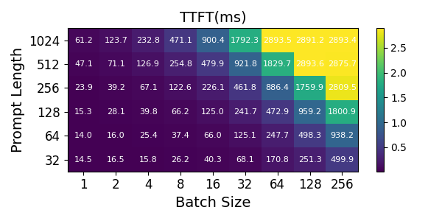

TTFT
Evaluation
Analysis
Showing diagonal equality, TTFT is determined by the number of total tokens
When the prompt length is shorter, SLO has a higher tolerance for the batch size
SLO ratio = 3

Slide 4
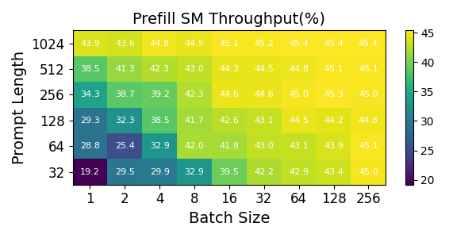
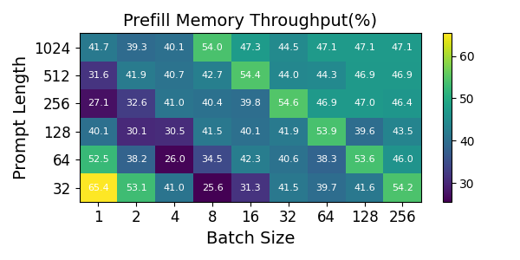
TTFT
Evaluation
Analysis
Showing diagonal equality, TTFT is determined by the number of total tokens
Less number of tokens can saturate GPU, but sm throughput and memory throughput is low ???

Slide 5
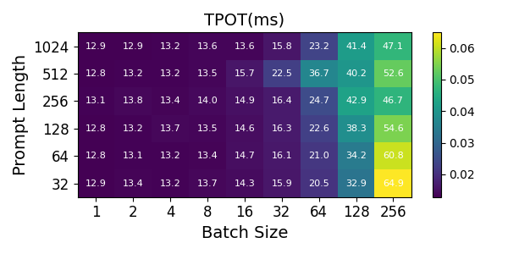
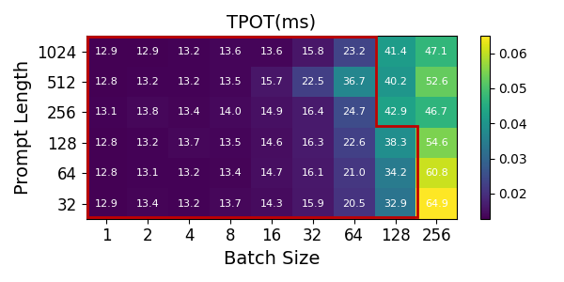
TPOT
Evaluation
Analysis
Insensitive to batch size as long as KV cache does not exceed a certain threshold
SLO ratio = 3

Slide 6
TPOT
Evaluation
Analysis
Insensitive to batch size as long as KV cache does not exceed a certain threshold
The slo of TPOT has higher tolerance for prompt length and batch size than that of TTFT
SLO ratio = 3
SLO ratio = 3

Slide 7
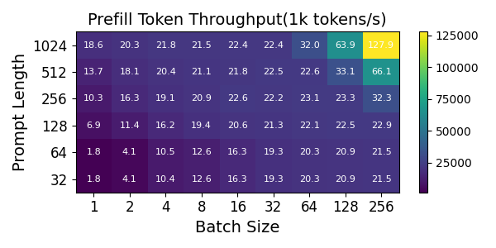
Token throughput
Evaluation
Analysis
There is a throughput limit during the prefill stage
A larger batch size increases decoding throughput, while the memory bandwidth of the KV cache can limit throughput at high token counts
SLO ratio = 3

Slide 8
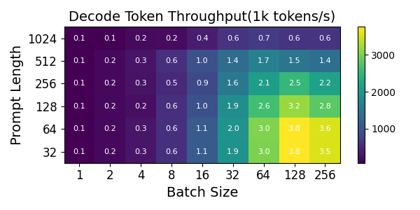
Token throughput
Evaluation
Analysis
There is a throughput limit during the prefill stage
A larger batch size increases decoding throughput, while the memory bandwidth of the KV cache can limit throughput at high token counts
SLO ratio = 3

Slide 9
Prefill utilization
Evaluation
Analysis
Prefill is compute-bound
Memory throughput shows a wavy shape ???

Slide 10
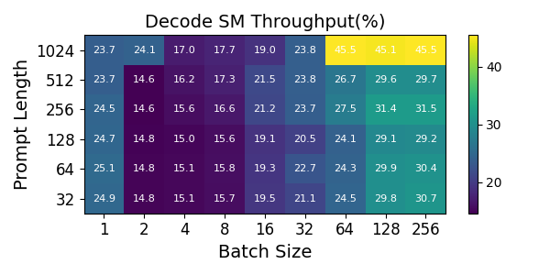
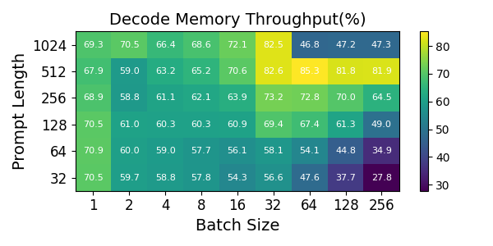
Decode utilization
Evaluation
Analysis
Decode is memory-bound
SM throughput is bounded, but memory throughput has decreased

Slide 11
A tricky question
Prompt length=32, batch size=1
SM throughput: 24.9%
Memory throughput: 70.5%
Concern: memory bandwidth becomes a bottleneck before computing

Slide 12
A tricky question
Prompt length=32, batch size=1~256
SM throughput is bounded, but memory throughput has decreased

Slide 13
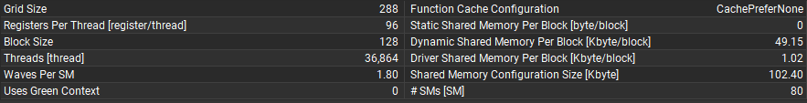
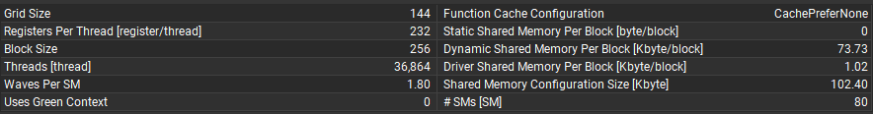
A tricky question
Prompt length=32, batch size=1~256
As the batch size varies, the launched kernel function also adjusts accordingly
Batch size=32：cutlass_80_tensorop_f16_s16816gemm_relu_f16_64x64_32x6_tn_align8
Batch size=128：cutlass_80_tensorop_f16_s16816gemm_relu_f16_64x128_32x6_tn_align8

Slide 14
A tricky question
Prompt length=32, batch size=1~256
As the batch size varies, the number of registers and the size of shared memory assigned to each thread increase correspondingly
Batch size=32：cutlass_80_tensorop_f16_s16816gemm_relu_f16_64x64_32x6_tn_align8
Batch size=128：cutlass_80_tensorop_f16_s16816gemm_relu_f16_64x128_32x6_tn_align8

Slide 15
A tricky question
Prompt length=32, batch size=1~256
The number of registers assigned to each thread increase
The size of shared memory allocated to each thread increase
The occupancy of SM is limited
The SM throughput is bounded
Global memory access decreases
The memory throughput decreases

Slide 16
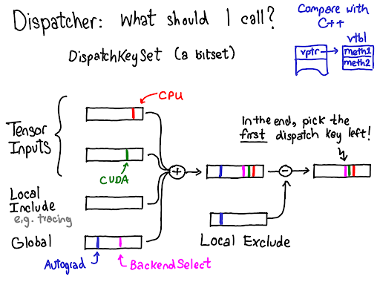
A tricky question
Pytorch dispatcher
Automatically select the launched kernel function based on the input and device
Adjusting the number of registers nd the size of shared memory allocated by kernel functions a might improve the computational utilization, but that's another topic

