Slide 1

Key Metrics Profiling of LLMs under Different Configs
Tao Li, Zhuoyuan Li, Chuanyi Liu

Slide 2
Factors and Metrics
Factors
Inference phase: prefill and decode
Batch size [1,2,4,8,16,32,64,128,256]
Prompt length [32,64,128,256,512,1024]
Metrics
TTFT (time to first token)
TPOT (time per output tokens)
Token throughput
SM throughput
Memory throughput
SM active
Platform
AWS g5.12xlarge
GPU: 4 x A10 [24GB]
Model
OPT-1.3B
Serving Framework
vLLM
(latest version)
user
perspective
cloud
perspective

Slide 3
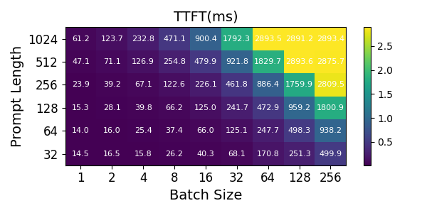

TTFT
Evaluation
Analysis
SLO ratio = 3

Slide 4
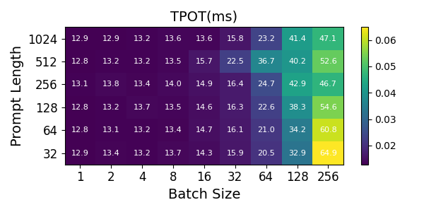
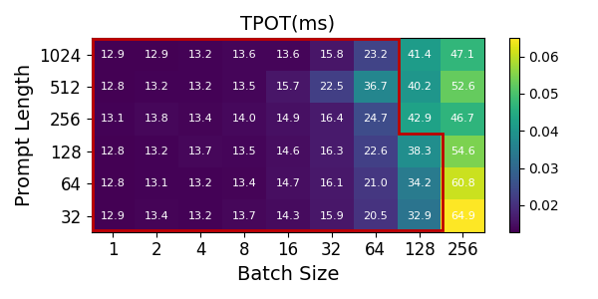
TPOT
Evaluation
Analysis
SLO ratio = 3

Slide 5
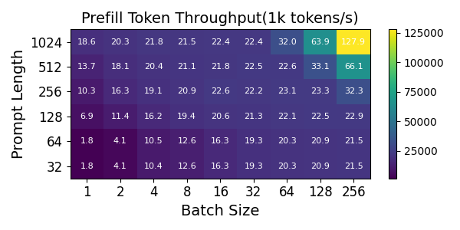
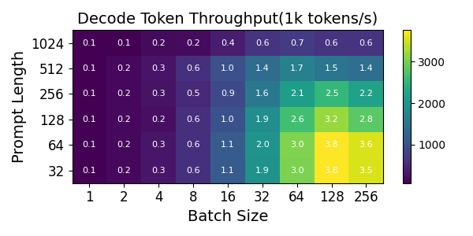
Token throughput
Evaluation
Analysis

Slide 6
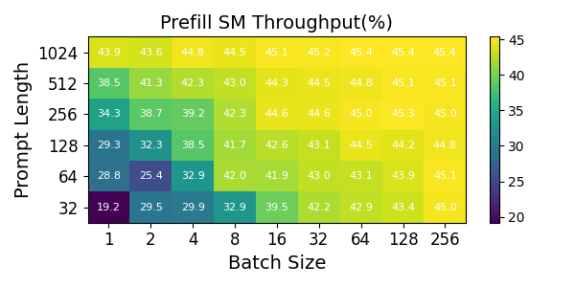
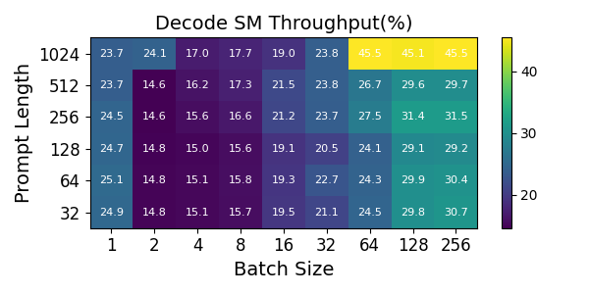
SM throughput
Evaluation
Analysis

Slide 7
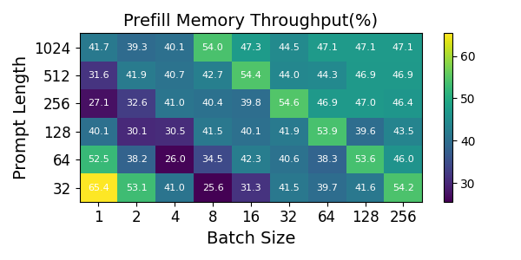
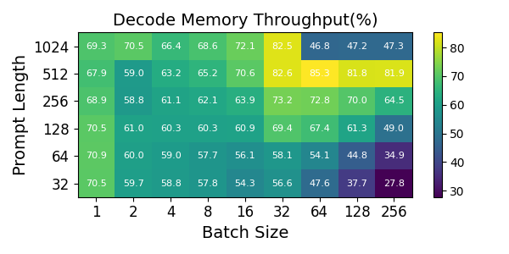
Memory throughput
Evaluation
Analysis

Slide 8
A tricky question
Prompt length=32, batch size=1
SM throughput: 24.9%
Memory throughput: 70.5%
Concern: memory bandwidth becomes a bottleneck before computing

Slide 9
A tricky question
Prompt length=32, batch size=1~256
SM throughput is bounded, but memory throughput has decreased

Slide 10
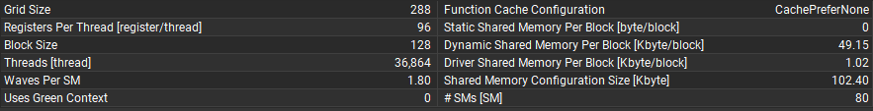
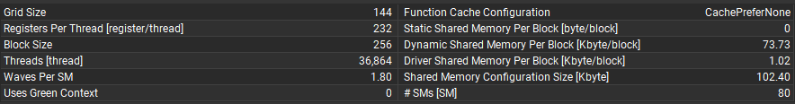
A tricky question
Prompt length=32, batch size=1~256
As the batch size varies, the launched kernel function also adjusts accordingly
Batch size=32：cutlass_80_tensorop_f16_s16816gemm_relu_f16_64x64_32x6_tn_align8
Batch size=128：cutlass_80_tensorop_f16_s16816gemm_relu_f16_64x128_32x6_tn_align8

Slide 11
A tricky question
Prompt length=32, batch size=1~256
As the batch size varies, the number of registers and the size of shared memory assigned to each thread increase correspondingly
Batch size=32：cutlass_80_tensorop_f16_s16816gemm_relu_f16_64x64_32x6_tn_align8
Batch size=128：cutlass_80_tensorop_f16_s16816gemm_relu_f16_64x128_32x6_tn_align8

Slide 12
A tricky question
Prompt length=32, batch size=1~256
The number of registers assigned to each thread increase
The size of shared memory allocated to each thread increase
The occupancy of SM is limited
The SM throughput is bounded
Global memory access decreases
The memory throughput decreases

Slide 13
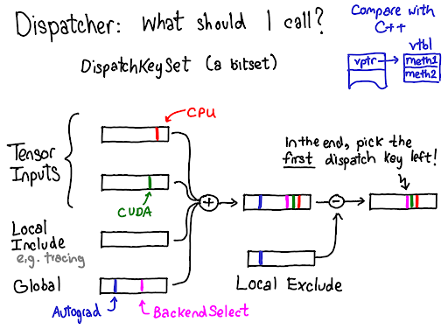
A tricky question
Pytorch dispatcher
Automatically select the launched kernel function based on the input and device
Adjusting the number of registers nd the size of shared memory allocated by kernel functions a might improve the computational utilization, but that's another topic

