Slide 1
Preface
Investigation of serverless LLM serving frameworks
KServe^{[1]}
ServerlessLLM^{[2]}
Deployment and evaluation of LLM serving frameworks
vLLM^{[3]}
ServerlessLLM^{[2]}
Nsight Systems^{[4]} & Nsight Compute^{[5]}
[1] https://kserve.github.io/website/latest/
[2] ServerlessLLM: Low-Latency Serverless Inference for Large Language Models. OSDI’24
[3] Efficient Memory Management for Large Language Model Serving with PagedAttention. SOSP’23
[4] https://developer.nvidia.com/nsight-systems
[5] https://developer.nvidia.com/nsight-compute

Slide 2
Q1: What are the SOTA serverless LLM serving frameworks? Q2: What is the GPU utilization for an inference request?
Tao Li, Zhuoyuan Li, Chuanyi Liu
[1] https://kserve.github.io/website/latest/
[2] ServerlessLLM: Low-Latency Serverless Inference for Large Language Models. OSDI’24
[3] Efficient Memory Management for Large Language Model Serving with PagedAttention. SOSP’23
[4] https://developer.nvidia.com/nsight-systems
[5] https://developer.nvidia.com/nsight-compute

Slide 3
Q1: What are the SOTA serverless LLM serving frameworks? A : KServe and ServerlessLLM

Slide 4
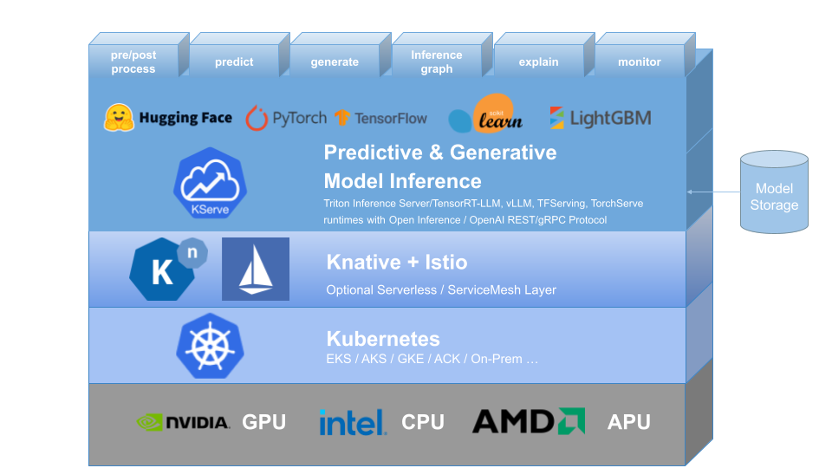
KServe
What KServe?
Highly scalable and standards based Model Inference Platform on Kubernetes
for Trusted AI
Why KServe?
Built on K8s for high scalability
Provide performant, standardized protocol
across ML frameworks
Support serverless with GPU autoscaling
Simple and Pluggable production serving

Slide 5
KServe
Development organizations
Google, IBM, Bloomberg, and Microsoft
Github stars
3.5k
Cited by
Fair Multilingual Vandalism Detection System for Wikipedia. KDD’23
ServerlessLLM: Low-Latency Serverless Inference for Large Language Models. OSDI’24

Slide 6
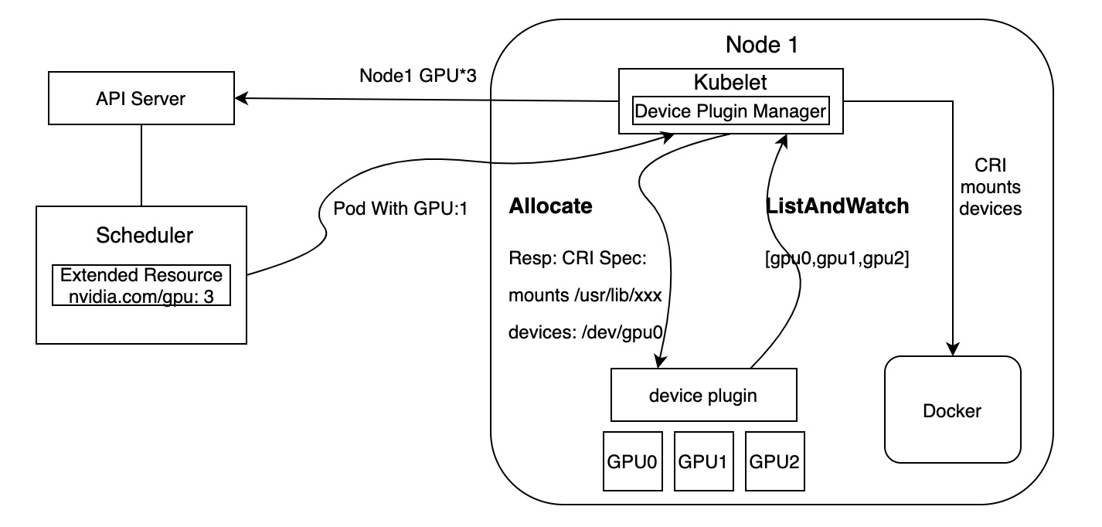
KServe
GPU Sharing Mechanism: Nvidia-device-plugin
Discover and report the available GPUs on a node
Handle device assignment and lifecycle management
Support Time-Slicing and MPS
Note:
Time-slicing and MPS are mutually exclusive

Slide 7
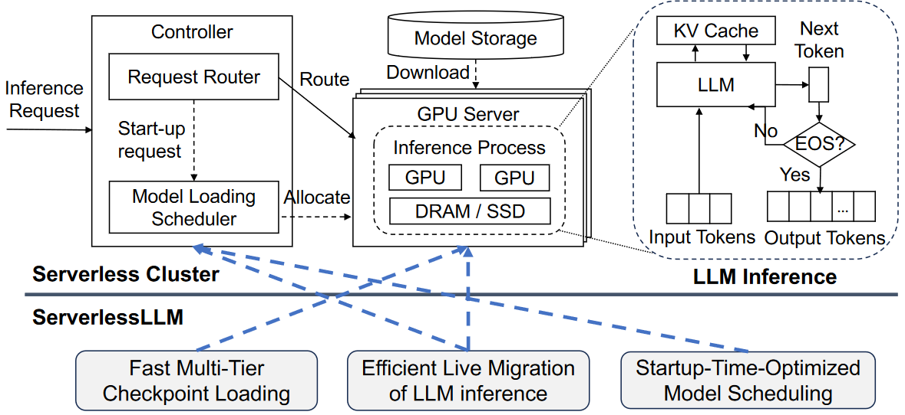
ServerlessLLM
What ServerlessLLM?
Low-latency serverless inference framework for LLMs
Leverage near-GPU storage to accelerate model downloading and loading
Design of ServerlessLLM
Fast multi-tier checkpoint loading
Efficient live migration of LLM inference
Startup-time-optimized model scheduling

Slide 8
ServerlessLLM
GPU Sharing Mechanism: None
Note1: ServerlessLLM assigns entire GPU devices to a single container
Note2: Throughput under SLO constraints has emerged as a key metric that determines serving systems’ performance
[1] ServerlessLLM: Low-Latency Serverless Inference for Large Language Models. OSDI’24

Slide 9
Q2: What is the GPU utilization for an inference request? A : vLLM and ServerlessLLM

Slide 10
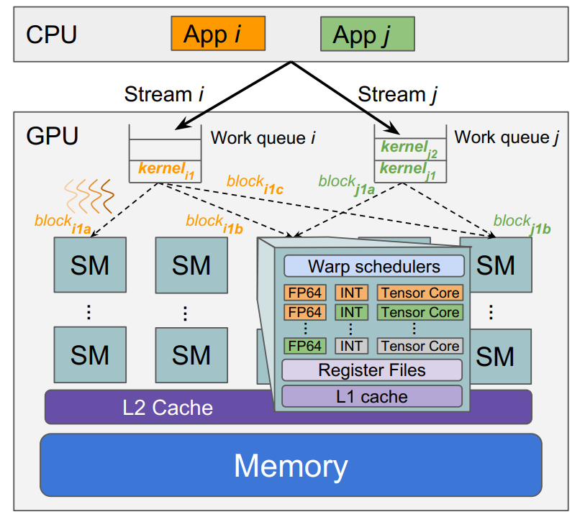
Testbed
Platform
Instance: AWS g5.12xlarge
GPU: 4 x A10 [24GB] ; vCPU: 48; DRAM: 192 GiB; NVMe: 3800GB
Bill: ~2000CNY
Model
LLaMA-7B
OPT-6.7B
Serving Framework
vLLM
ServerlessLLM
Metrics
SM active
SM throughput

Slide 11
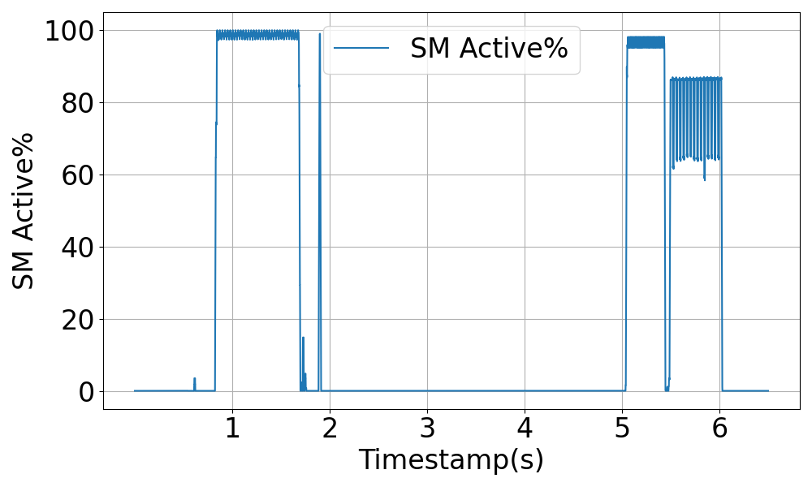
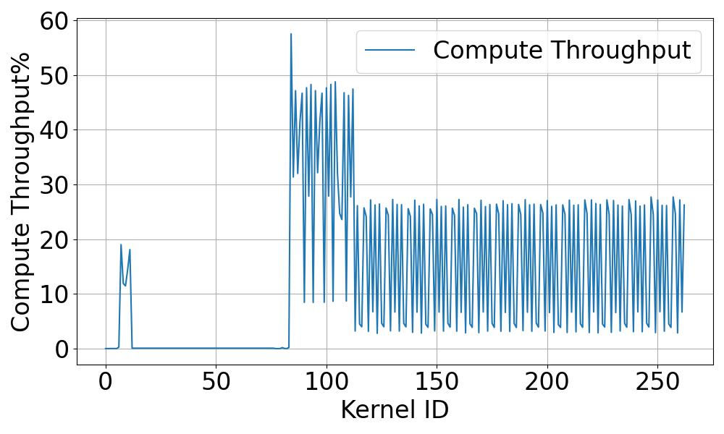
vLLM
SM active
95 ~ 100% during prefill phase
60% ~ 90% during decoding phase
SM throughput
30 ~ 50% during prefill phase
0% ~ 30% during decoding phase
Init
&
Prefill
30% ~ 60% underutilized
Init
&
Prefill
Loading
Decoding
Decoding
Loading
Single request on LLaMA-7b with max_tokens=16

Slide 12
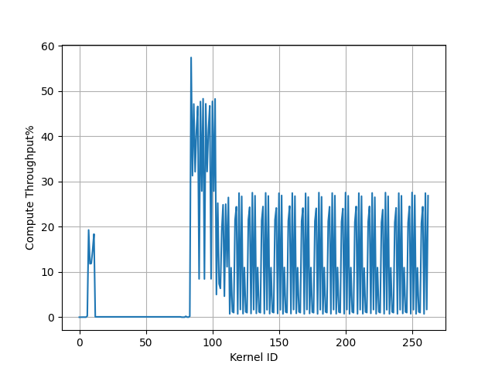
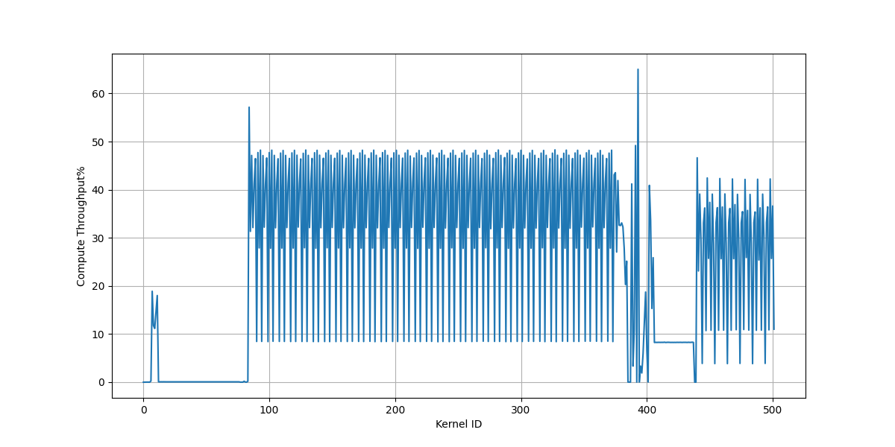
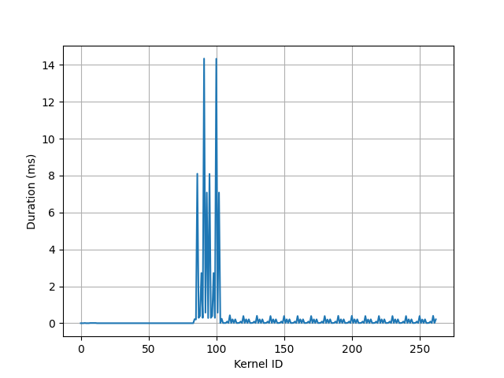
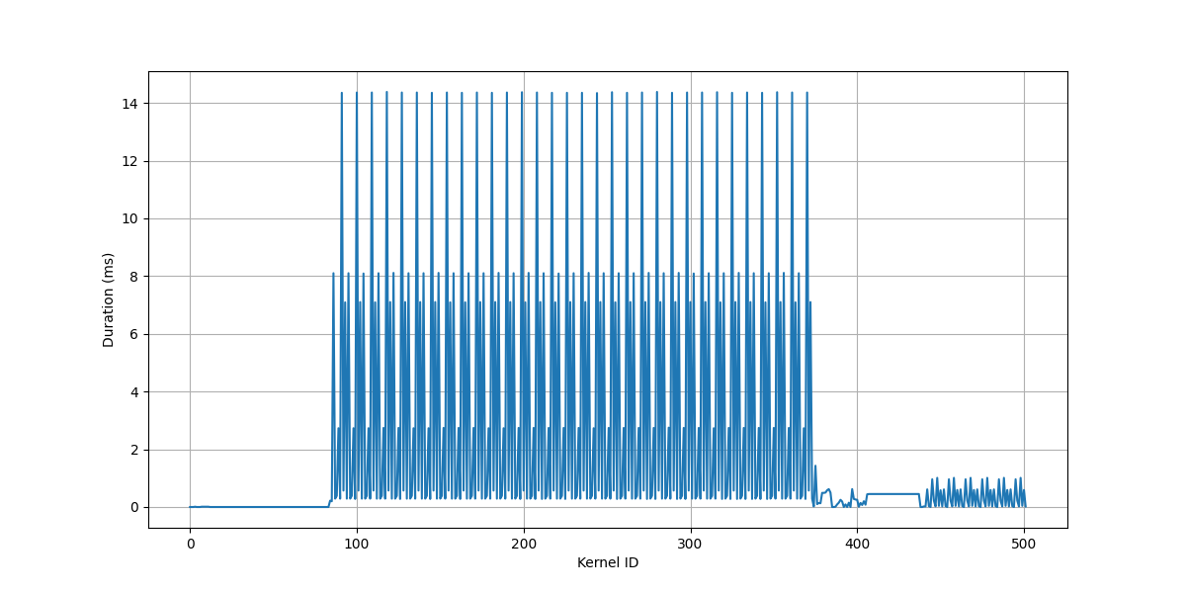
vLLM
Profiling with different max_tokens
max_tokens=16
max_tokens=512
288 kernels
20 kernels
Compute thpt. %
Duration (ms)
Single request on LLaMA-7b

Slide 13
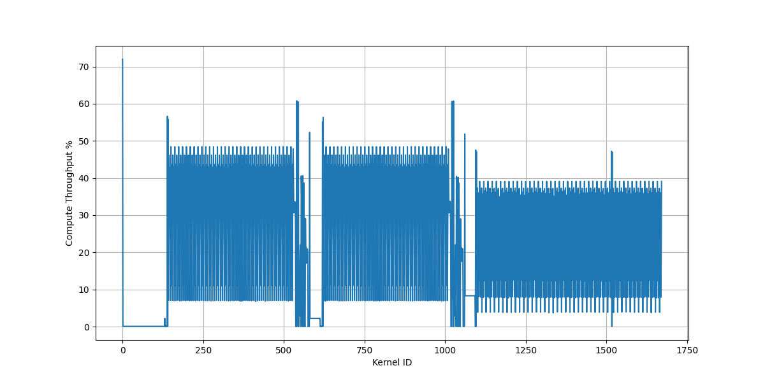
ServerlessLLM
SM throughput
10% ~ 50% of computing units are literally busy during loading phase
10% ~ 40% of computing units are literally busy during prefill phase
Init
prefill
Single request on OPT-6.7B

