Slide 1
Goal
Method
Training Trick
Result / Analyze
Task-oriented Dialogue System for Automatic Disease Diagnosis via Hierarchical Reinforcement Learning
20201203
钟诚

Slide 2
PART 01
Goal

Slide 3
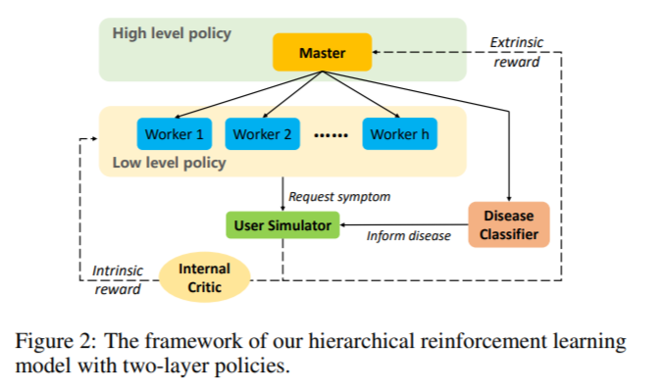
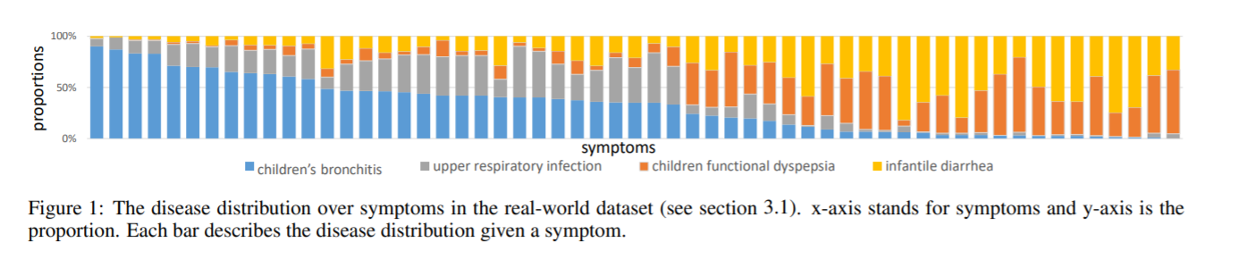
Goal
· Question: When the number of diseases increases, the action space is inevitably large.
Existing approaches (Flat RL policy) has significant challenges
· Solution:
Hierarchical policy of two levels
High level policy (master) : Triggering a model in low level / Active Disease classifier
Low level policy (worker) : Several symptom checkers / classify disease
Among them, each worker acts like a doctor from a specific department, while the master acts like a
committee that appoints doctors to interact with this patient

Slide 4
PART 02
Method

Slide 5
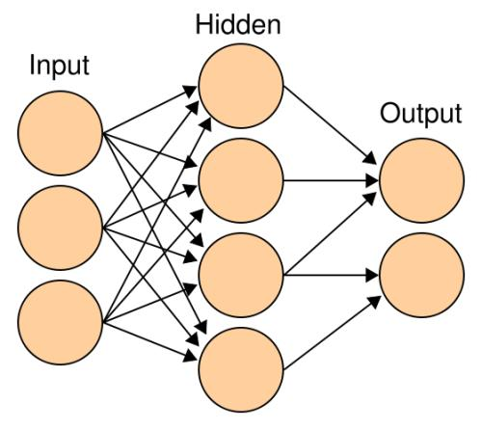
Master
Optimize
Active
Worker 1
Master
(MLP)
Worker 2
Reward
State presentation
Return
New State
Worker n
Disease classifier

Slide 6




Master
· Formulated as a Semi-Markov Decision Process (SMDP)
· The extrinsic rewards returned will be accumulated as the immediate rewards for master
Worker
Disease Classifier
· Optimize

Slide 7
Worker
Optimize
Accumulate
Reward
Return to
Master
Request 1
Worker
(MLP)
Request 2
Y
Reward
State presentation
User Return
Terminate？
New State
N
Request n-1
Request n

Slide 8
Worker (Disease Classifier)
Optimize
Return to
Master
Disease Prob 1
Worker
(MLP)
Disease Prob 2
State presentation
Max Prob
User Return
Reward
Disease Prob n-1
Disease Prob n

Slide 9
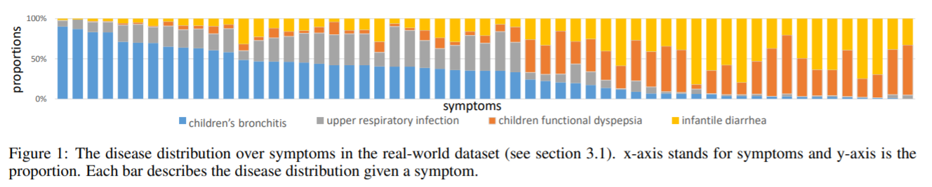

Worker
· Divide all the diseases into h subsets, their union set is empty and their intersection is the universal set.
· Each worker is responsible for collecting information about symptoms of one subset.
· Optimize

Slide 10
PART 03
Training Trick

Slide 11

Trick 1: State Representation / Reward
· State Representation
Symptom I : [ True, False, UNK ] $∈ \{$0，1}
· Internal Critic
+1 ------ Request a symptom that the user suffers
-1 ------- Repeat actions / The number of subtask turns reach its maximum
0 ------- Otherwise
· Subtask Terminal
Successful ------ User respond true to the symptom requested
Fail ------ Repeat actions / The number of subtask turns reach its maximum

Slide 12

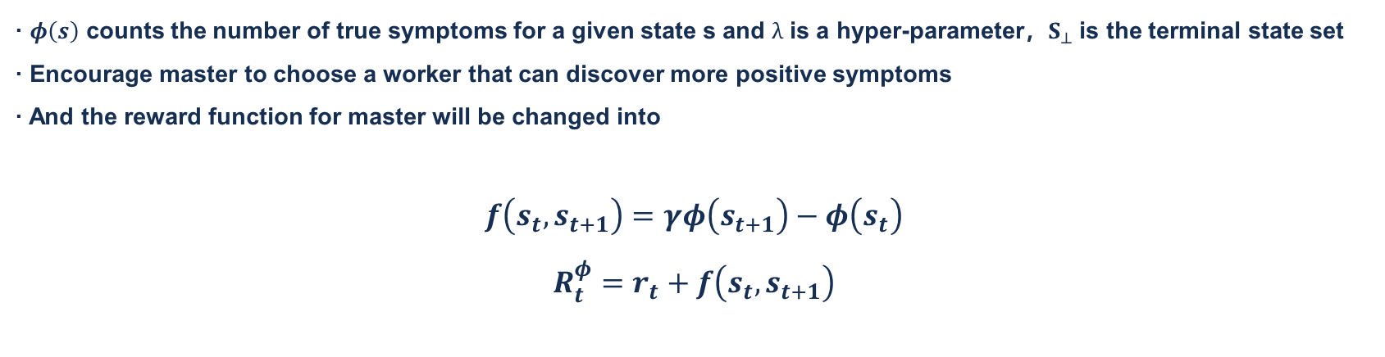
Trick 2: Reward Shaping
· The number of symptoms a patient suffers from is much less than the size of symptom
· Sparse feature space → Hard for agents to locate the true symptoms.
· $φ\left(s\right)$ counts the number of true symptoms for a given state s and $λ$ is a hyper-parameter，$S_{⊥}$is the terminal state set
· Encourage master to choose a worker that can discover more positive symptoms
· And the reward function for master will be changed into
$$f\left.\left(s_{t}, s_{t+1}\right.\right)=γφ\left.\left(s_{t+1}\right.\right)−φ\left.\left(s_{t}\right.\right)$$
$$R_{t}^{φ}=r_{t}+f\left.\left(s_{t}, s_{t+1}\right.\right)$$

Slide 13
PART 04
Result & Analyze

Slide 14
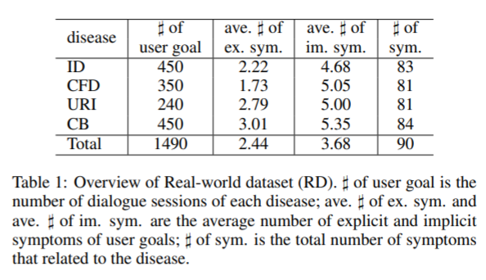
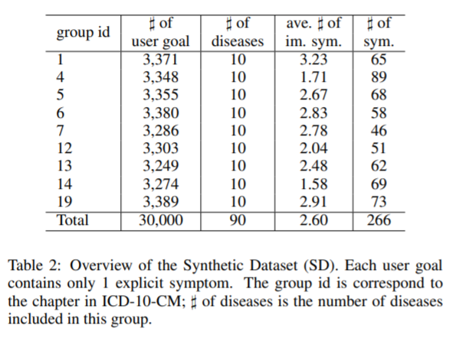
Dataset / Model
· Real-world Dataset (RD) :
upper respiratory infection (URI),
children functional dyspepsia (CFD),
infantile diarrhea (ID), children’s bronchitis (CB)
· Synthetic Dataset (SD) :
Based on symptom-disease database called SymCat
For each related symptom, sample the label for the symptom
A symptom is chosen randomly from the set of all true symptoms to be the explicit one (same as symptoms extracted from self-report in RD) and rest of true symptoms are treated as implicit ones

Slide 15
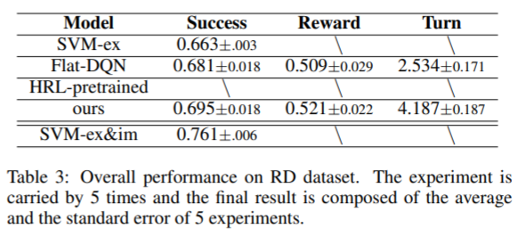
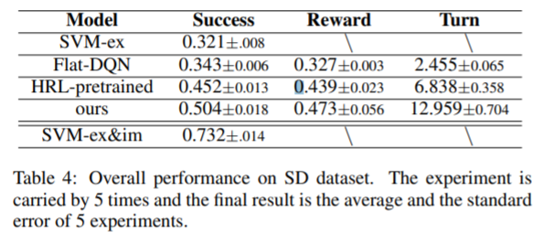
Dataset / Model
· Model:
Flat-DQN: This is the agent which has one layer policy and an action space including both symptoms and diseases.
HRL-pretrained: This is a hierarchical model. The setting is similar to ours, however, the low level policy is pre-trained first and then the high level policy is trained. Besides, there is no disease classifier for disease diagnosis specially and the diagnosis is made by workers.
SVM-ex&im: Both explicit and implicit symptoms are used as input and SVM is used for classification. Upper Bound of RL-based models
SVM-ex: Only explicit symptoms as input and use SVM for classification. It can be treated as the baseline of RL-based models.

Slide 16
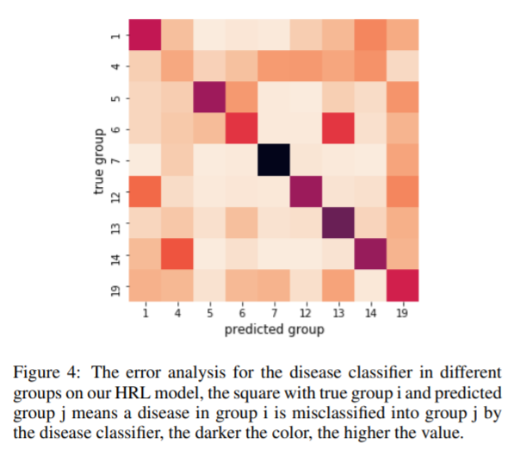
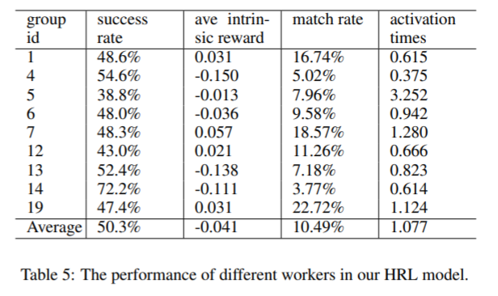
Performance analyze
· Disease classifier
· Different Workers
· Most of wrong informed user goals are informed the disease in the same group
· The more implicit symptoms a worker has requested
from the user, the better of its performance.

Slide 17
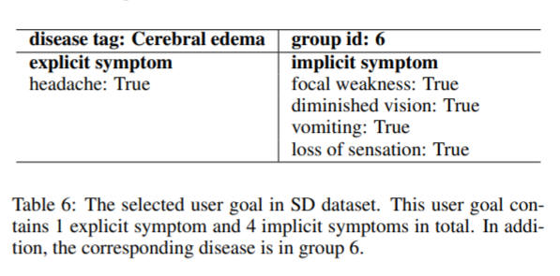
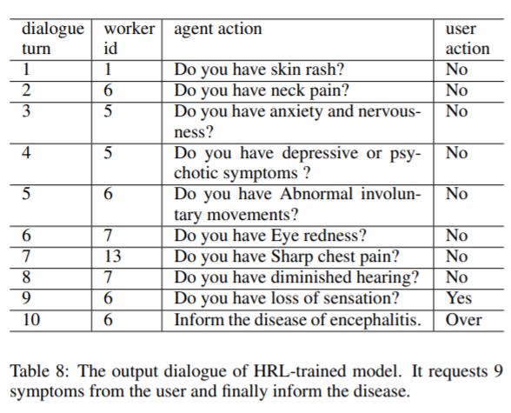
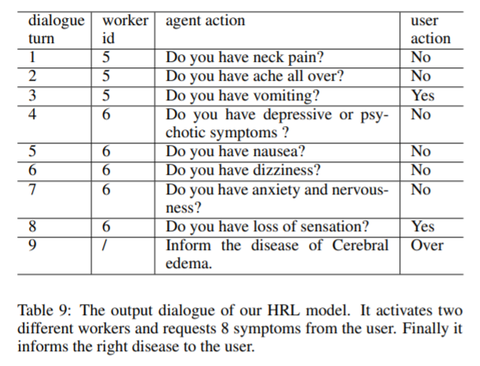
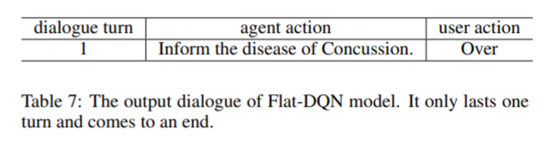
Comparation
Flat DQN
HRL-trained model
Our HRL model

Slide 18
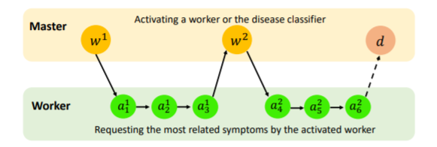
Take home message
· Question: When the number of diseases increases, the action space is inevitably large.
Existing approaches (Flat RL policy) has significant challenges
· Model:
HRL-DQN: Master-Worker structure, MLP network
· Trick
State representation: [True, False, UNK]
Reward shaping： Encourage master to choose a worker that can discover more positive symptoms
Experience replay
· Result
Outperform Flat-DQN (Existing approaches) in both real world and synthetic dataset.
Most of wrong informed user goals are informed the disease in the same group
The more implicit symptoms a worker has requested from the user, the better of its performance

