Slide 1
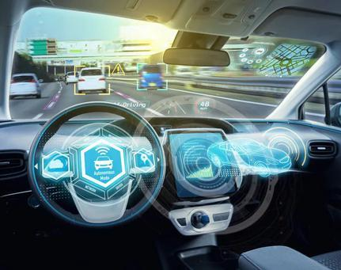
Autonomous Driving Testing Discussion

Slide 2
Motivation
To learn the development and approaches of ADSs, how the autonomous vehicle organizations test their ADSs, what problems they meet during the testing, and how they improve their testing workflow utilizing the latest research in academia.
This work will help us understand the current development of ADS testing in the industry and academia. It will extract meaningful future research direction to resolve urgent problems in the industry.

Slide 3

Discussion Goal
We will have at least three discussions. Our ultimate goal is to:
Understand the practitioners' expectations.
The gap between industry and research on ADS testing.
Future research directions.

Slide 4

Rights
Please follow your organization's confidentiality requirements. Do not discuss current confidential work or future confidential plans. You can refuse to answer if you think any topic or question is sensitive.

Slide 5

Discussion 1 – Basic Understanding
Background.
Please simply introduce your
background in ADS testing.
Organization
Position
Working experience

Slide 6
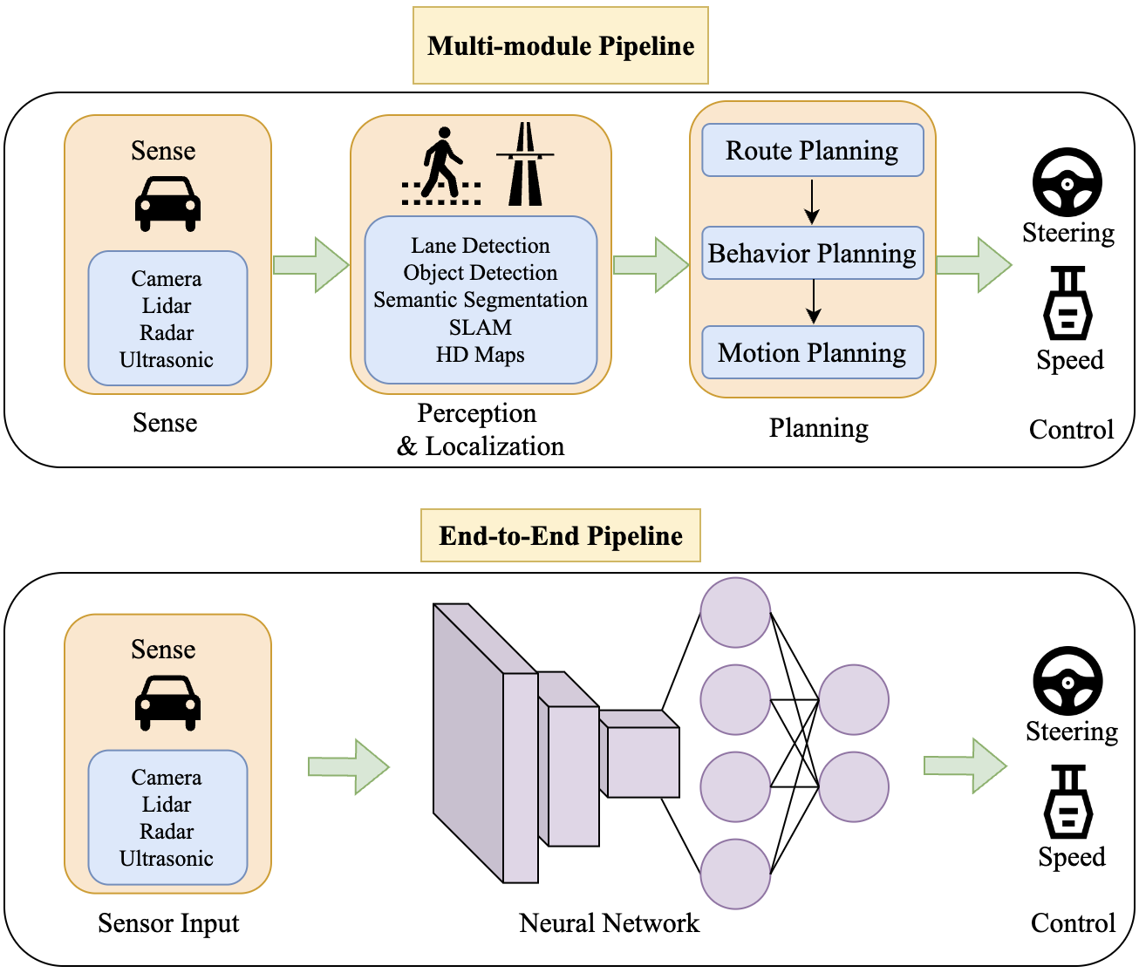
Discussion 1 – Basic Understanding
2. Practice.
Please simply make
identification first, and then
introduce your experience in
ADS testing.
Basic Information
ADS Structure
Datasets
Sensor
Other…

Slide 7
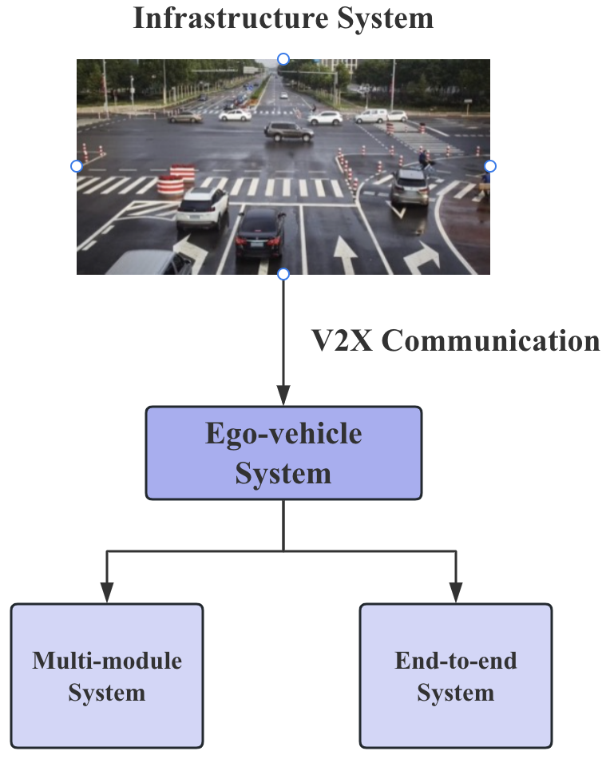
Discussion 1 – Basic Understanding
2. Practice.
Please simply make identification first
and introduce your experience in ADS
testing.
B. V2X
ADS Structure
Data Transmission
Sensor
Testing
Other…

Slide 8

Discussion 1 – Basic Understanding
2. Practice.
Please simply make identification first and
introduce your testing experience on these
approaches.
C. Testing Approaches
Knowledge-based
Search-based
Data-driven
Other…

Slide 9
Discussion 2 – ADS Testing Practice
1. ADS Testing Structure.
Please simply make identification first
and introduce your testing experience.
Modular Testing
Module-level Testing
System-level Testing
End-to-End Testing

Slide 10
Discussion 2 – ADS Testing Practice
1. ADS Testing Structure.
Please simply make identification first
and introduce your testing experience (tasks,
methods, techniques).
Modular Testing
Module-level Testing
Sense
Perception & Localization
Planning
Control
Other…

Slide 11

Discussion 2 – ADS Testing Practice
1. ADS Testing Structure.
Please simply make identification first
and introduce your experience.
Modular Testing
System-level Testing
Sensor
Output Actions
Testing
Techniques
Methods
Other…
Other…

Slide 12

Discussion 2 – ADS Testing Practice
2. Foundation Models.
Please simply make identification first
and introduce your experience.
Large Language Model
Vision Foundation Model
Multimodal Model
Other…

Slide 13
Discussion 2 – ADS Testing Practice
2. Foundation Models.
Please simply make identification first and introduce your
experience, then discuss the relevant pros and cons.
FMs for ADS Testing
Generate Critical Scenarios
Retraining ADS
Other…
FMs-based ADS
Natural language interaction
Other…

Slide 14
Discussion 3 – Attack and Defense
Attacks and Defenses.
Please simply make identification
first and introduce your testing.
Attacks
Adversarial Attack
Cyber Attack
Sensor Attack
Replay Attack
Other…

Slide 15

Discussion 3 – Attack and Defense
Attacks and Defenses.
Please simply make identification first
and introduce your testing experience.
B. Defenses
Adversarial Training
Secure Protocol
Multi-sensor fusion
Tools
Clever-Hans
TF-Defense
Other…
Other…

Slide 16
Anything else you’d like to introduce…

Slide 17
Thank you for your participant!

