Slide 1
Introduction to Amazon Web Services
Alexey Konokhov
DevOps Engineer at Innovecs
a.konokhov@gmail.com

Slide 2
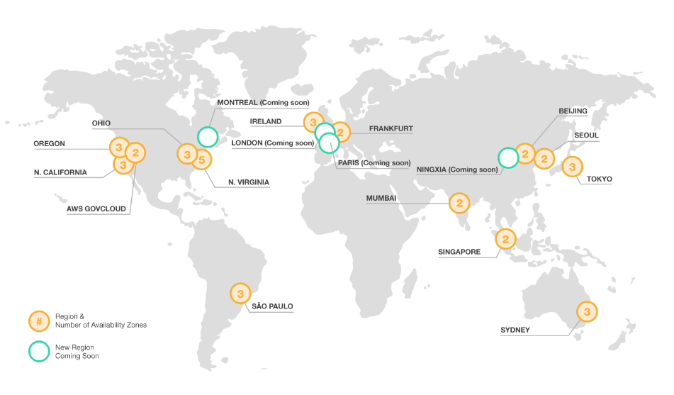
More than 70 services
38 Availability Zones
14 geographic Regions
9 more Availability Zones coming
4 more Regions coming
More than 1 million active customers every month in 190 countries
nearly 2000 government agencies and 5000 education institutions
more than 17,500 nonprofits.
$2.57 billion Q1 2016 revenue
$604 million net income
Biggest cloud market share
https://aws.amazon.com/about-aws/global-infrastructure/

Slide 3
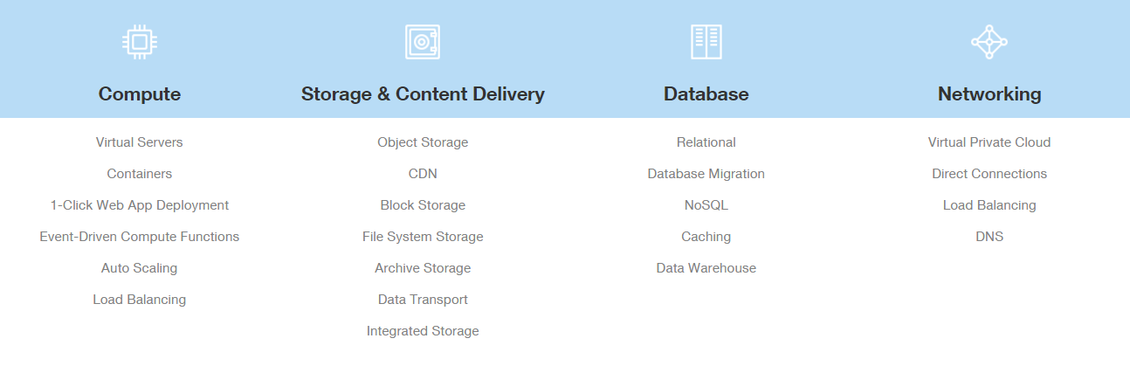
https://aws.amazon.com/products/

Slide 4
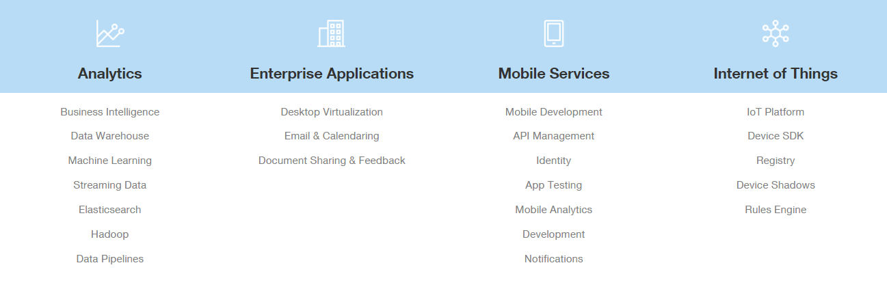
https://aws.amazon.com/products/

Slide 5
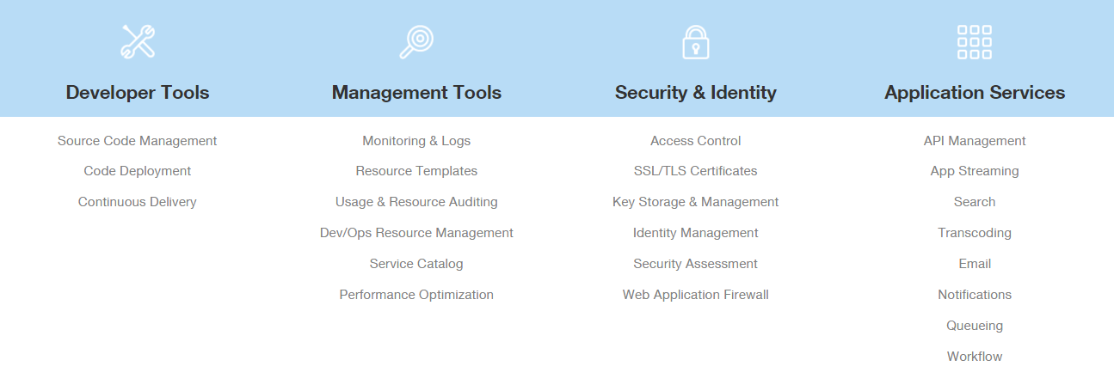
https://aws.amazon.com/products/

Slide 6
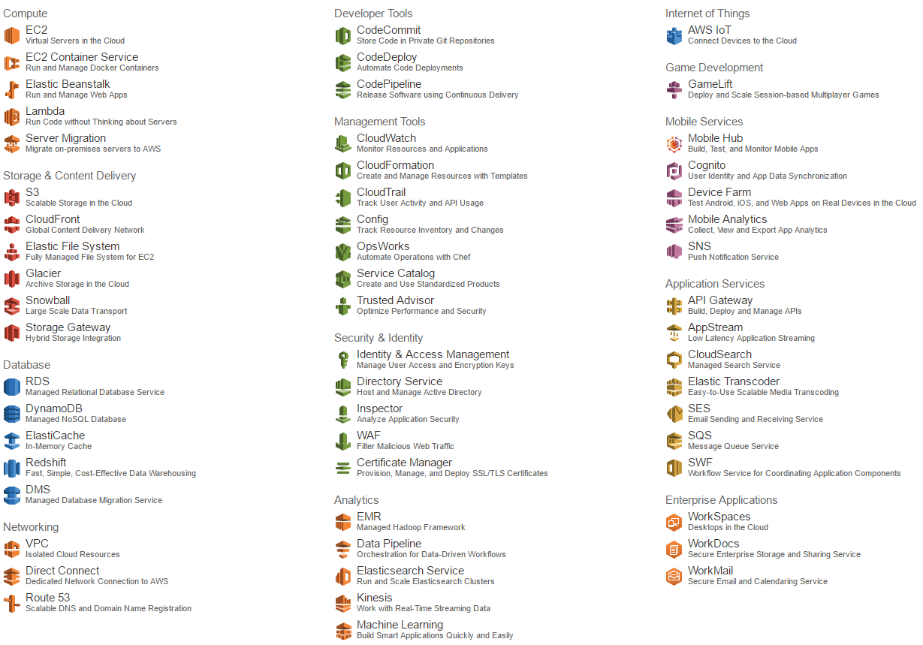
https://console.aws.amazon.com/

Slide 7
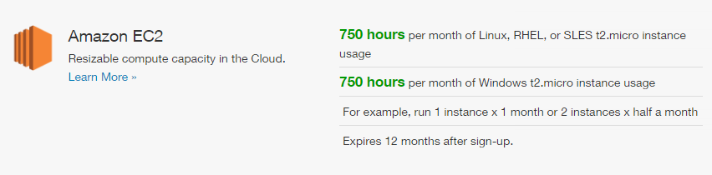
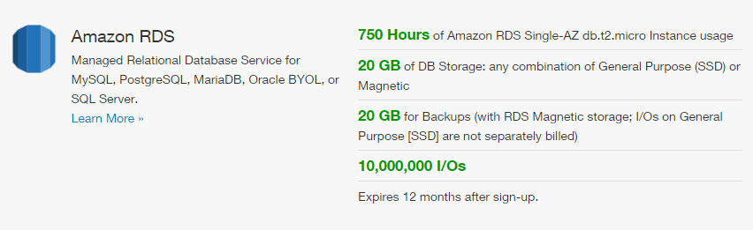
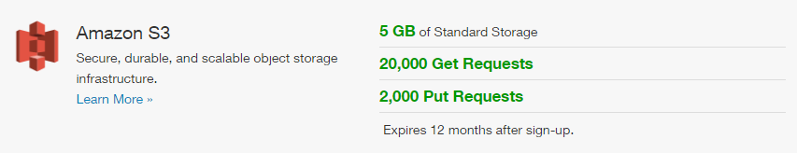
https://aws.amazon.com/free/

Slide 8
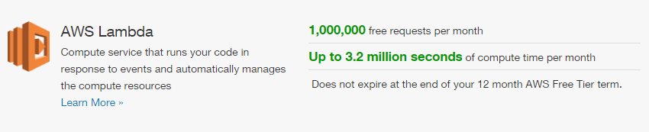
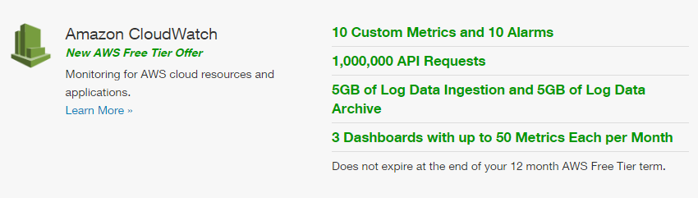
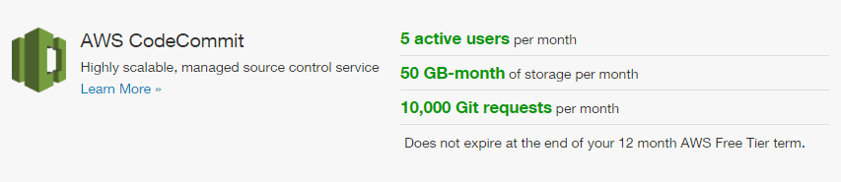
https://aws.amazon.com/free/

Slide 11
Thanks for your attention!
Code used in presentation is available here:
https://github.com/akonokhov/presentation-innovecs-aws
Diagrams were created using
https://www.draw.io

