Slide 1
RiseLab
Presented By:
Amit Pingale 001898697
Himani Solanki 001899580
Shubham Patel 001899476

Slide 2
What is RISELab?
UC Berkeley’s Computer Science Division has an ongoing tradition of 5-year collaborative research labs.Closed AMPLab in Fall’16 and started RISELab.
Real-time Intelligent Secure Explainable (RISE) aims to develop technologies that enable applications to make LOW-LATENCY decisions on live data with strong SECURITY.
Difference between RISElab and AMPlab, is the focus shifting from BATCH processing to REAL-Time decision making at scale.
Many projects were running parallely like CLIPPER, DRIZZLE, FIREBOX, JARVIS, OPAQUE, PYWREN, RAY, WAVE, etc.

Slide 3
Topic to cover:
BLINK
OPAQUE
CLIPPER

Slide 4
Blink

Slide 5
Blink
Efficiently training large deep learning models requires scaling, training across a number of GPUs
Available hardware like NVIDIA-DGX1 introduce support for high bandwidth NVLinks across GPUs and software libraries like NCCL that provides inter GPU collective communication using RING-based protocol
To achieve better link utilization and consequently faster transfer, blink is used
It uses a broadcast based data transfer scheme and leverage fully connected groups of GPUs to achieve better efficiency

Slide 6
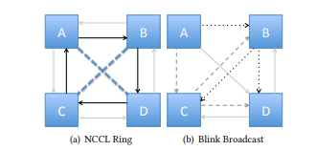
NCCL Ring v/s Blink Broadcast

Slide 7
Opaque

Slide 8
Opaque
Opaque is a package for Apache Spark SQL that enables strong security for DataFrames using Intel SGX trusted hardware.
Intel Software Guard Extensions(SGX) is a set of central processing unit (CPU) instruction codes from Intel that allows user-level code to allocate private regions of memory, called ENCLAVES, that are protected from processes running at higher privilege levels.
The aim is to enable analytics on sensitive data in an untrusted cloud.
Opaque allows encrypting the contents of a DataFrame. Subsequent operations on them will run within SGX enclaves.
GitHub for Opaque.

Slide 9
Clipper

Slide 10
Clipper
Clipper is a prediction serving system that sits between user-facing application and a wide range of commonly used machine learning models and frameworks.
Clipper does:
Simplifies integration of machine learning techniques
Simplifies model development and helps reduce common bugs by using same tools and libraries used in model development
Improves throughput and ensures reliable millisecond latencies by batching, caching and straggler mitigation techniques
Improves prediction accuracy

Slide 11
Clipper Installation
Latest Version of Docker
Python 2
pip install clipper_admin
Pip install redis
http://clipper.ai
https://github.com/ucbrise/clipper
https://www.youtube.com/watch?v=LdQ4mkPIIVM

Slide 12
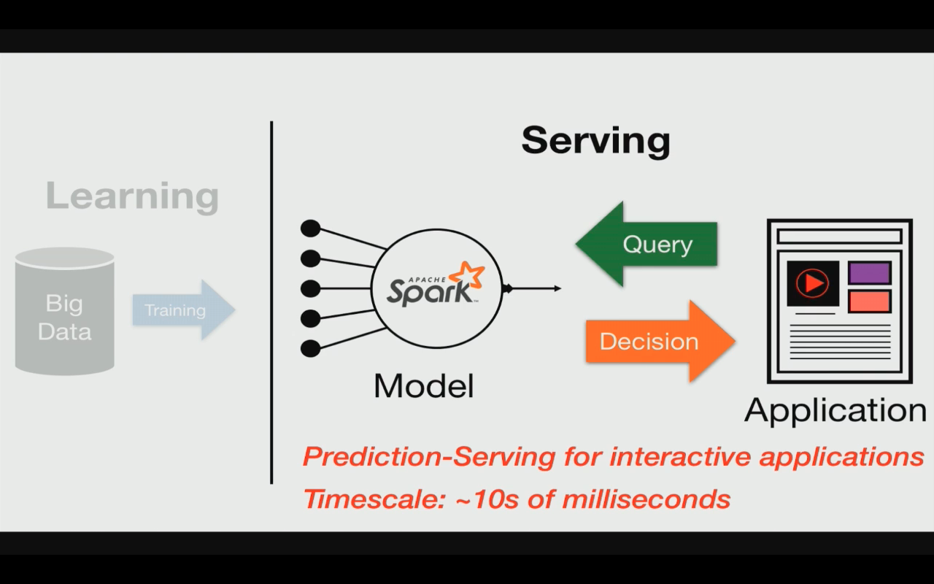
Problem with current real-time system
Expensive to build, compute & maintain
Models are built to serve particular purpose
Tightly coupled model and application
Only supports single ML framework

Slide 13
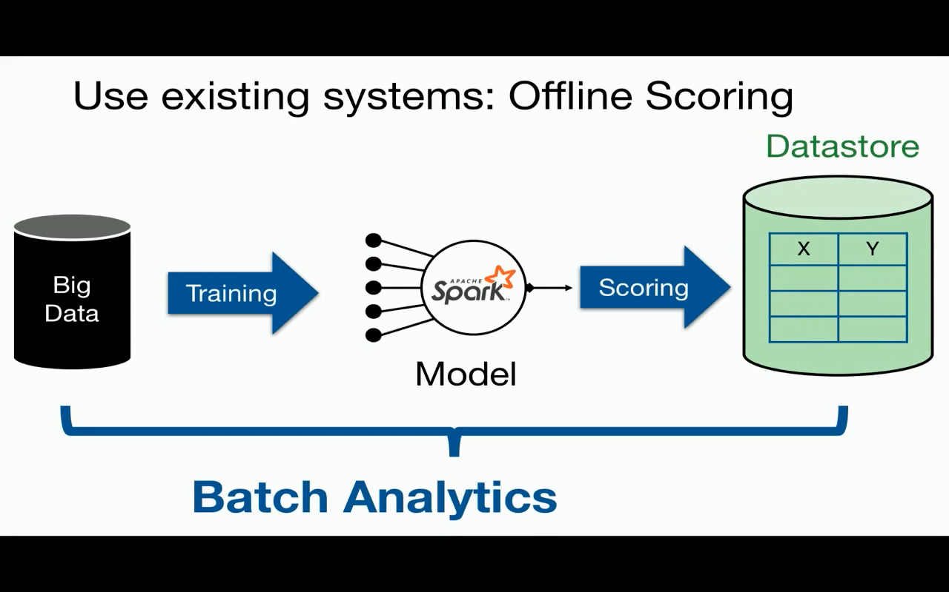
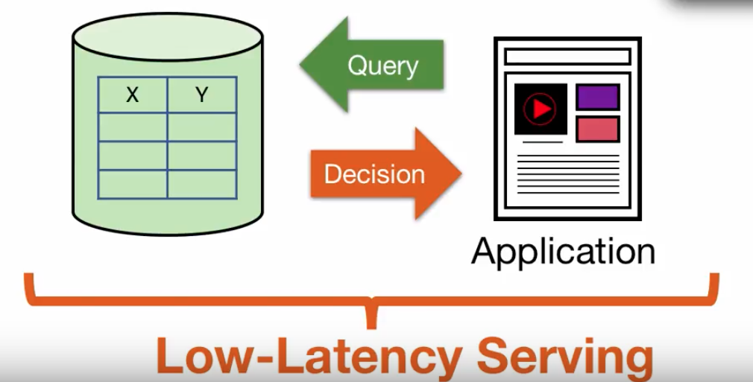
Batch processing prediction systems

Slide 14
Problem with batch processing
Requires full set of queries ahead of time
Wasted computation and space
Costly to update

Slide 15
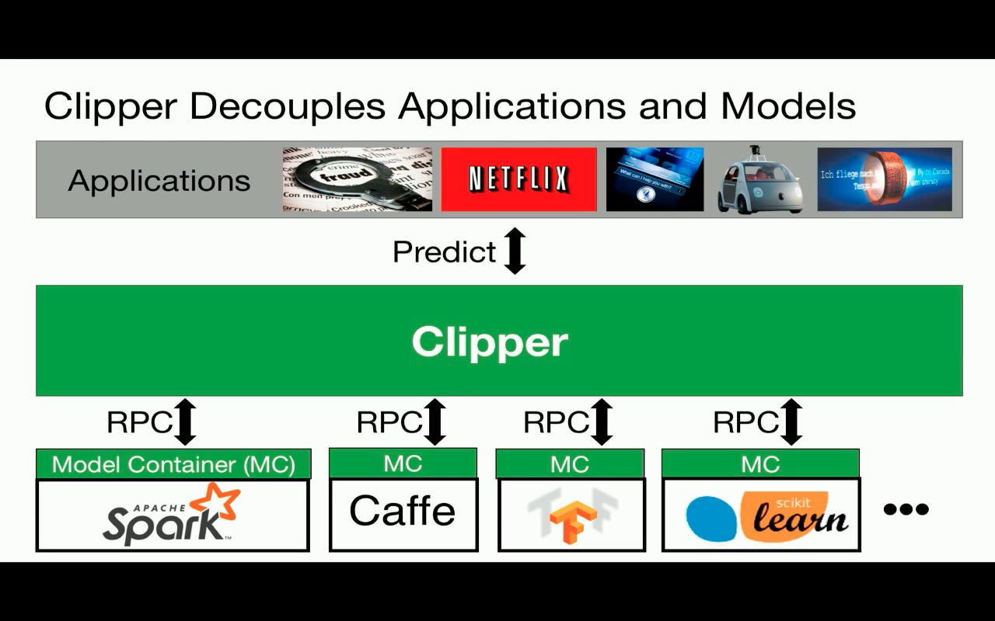
Clippers approach for solving this problem
Core system written in C++
Open source

Slide 16
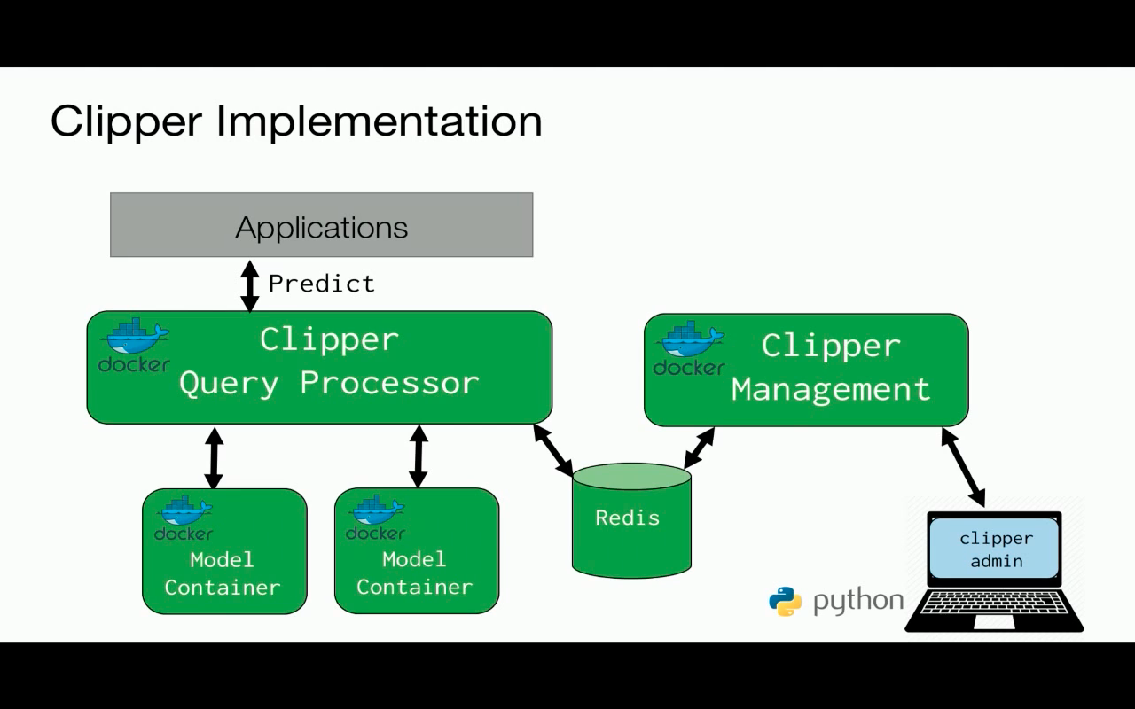
Clipper Implementation

Slide 17
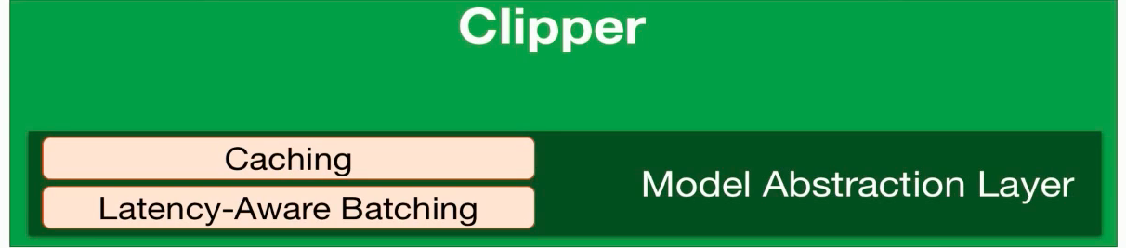
Technology inside clipper
Containerized frameworks: Unified abstraction and isolation
Cross-framework caching and batching process : Optimize throughput and latency

Slide 18
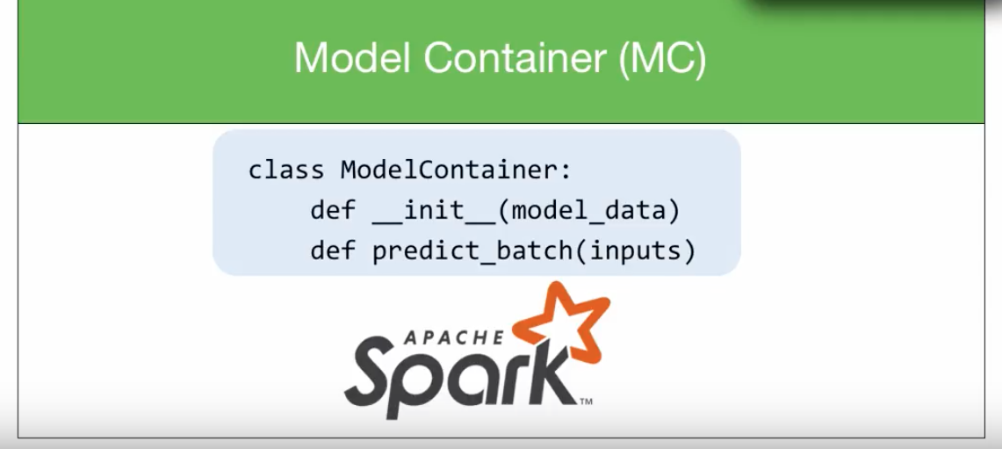
Implementation of containers
Class ModelContainer:
def __init__(model_data)
---> Load data from disk
def predict_batch(inputs)
---> Take inputs and produces output
Dependencies

Slide 19
Problem with current real-time system
Expensive to build, compute & maintain
Models are built to serve particular purpose
Tightly coupled model and application
Only supports single ML framework

Slide 20
Demo

