Slide 1
ADTPro:
Apple Old Skool
David Schmidt
October, 2007 - Updated November, 2009

Slide 2
Introduction to ADTPro
ADTPro has two roles in life:
  Bootstrapping Apple ][s and ///s with no software
  Transferring virtual/real floppy disk images
Written in Java and 6502 Assembly
  Client runs on "old" Apple computers
  Server runs on "modern" computers
  Connections can be serial, Ethernet or audio
ADTPro is open source software
Notes:
http://adtpro.sourceforge.net

Slide 3
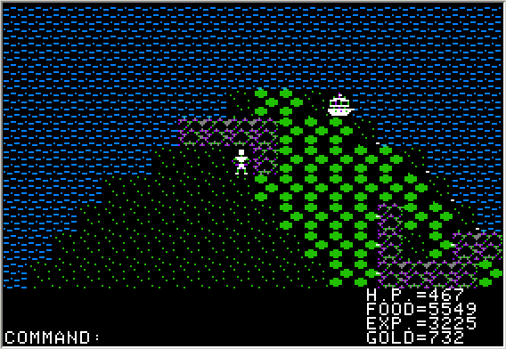
Why Would I Want to Do This?
Do you really need to ask?
Notes:
Because of very important business reasons, of course!

Slide 4
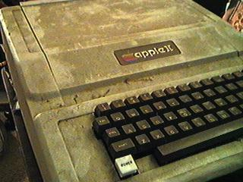
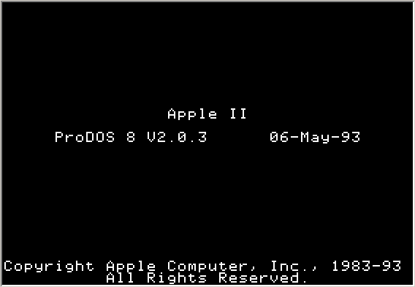
Of Chickens and Eggs
So you got your Apple out of the closet, eBay, or dumpster… but no disks!
???
???
Notes:
How do you get started, when your Apple is just bare hardware – no disks?
We'll talk about reason for existence #1: bootstrapping Apples out of oblivion, without diskettes!

Slide 5
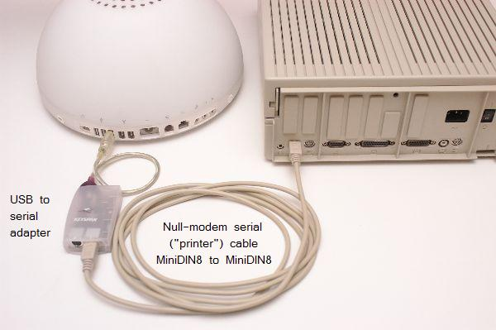
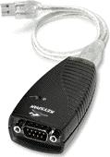
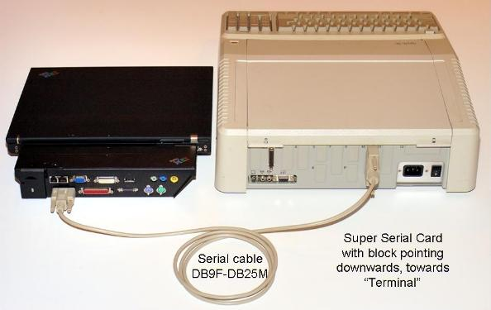
Step 1: Connect Serial Ports
More examples:
http://adtpro.sourceforge.net/connectionserial.html
Notes:
For the bootstrapping process, you can use either serial ports or audio connections. We'll do serial live, but both methods are detailed on the ADTPro website, http://adtpro.sourceforge.net.

Slide 6
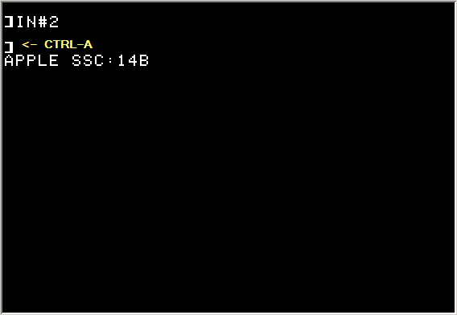
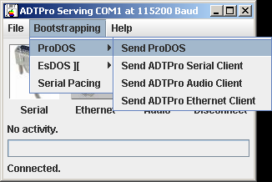
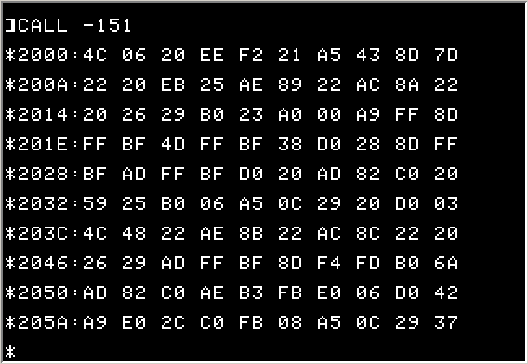
Step 2: Send Software
Notes:
Once things are connected, tell the ADTPro server software to get to work: first, send the operating system, then the ADTPro client. Make sure the Apple is receptive (IN#2, <Ctrl-A>14B) before each send. The dialog boxes in ADTPro will remind you.

Slide 7
Intermission: Platform Support
OSX, Linux, Windows, OS/2
Any Apple with 64k (or more) of memory
  Non-plus, +, //e, IIc, IIGS, ///, Laser 128, Franklin
Serial Connections
  Apple: Super Serial Card, built-in serial ports
  Host: Native serial ports, USB dongles
UDP with A2RetroSystems' Uthernet Card
Audio via cassette in/out
Notes:
http://adtpro.sourceforge.net

Slide 8
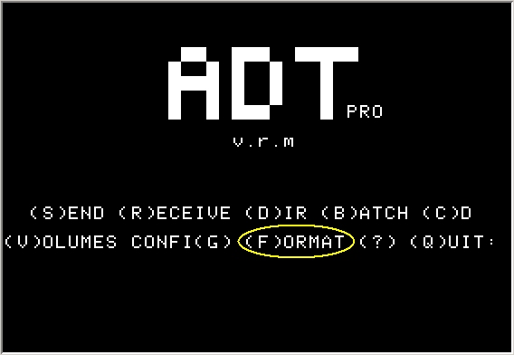
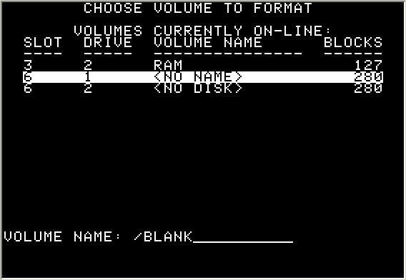
Step 3: Format a Floppy
Notes:
Now that ADTPro is running on the bare metal, format a floppy.

Slide 9
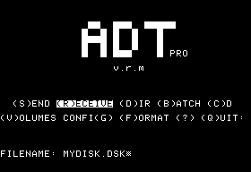
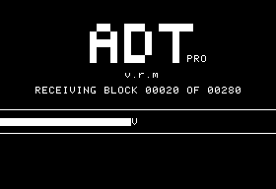
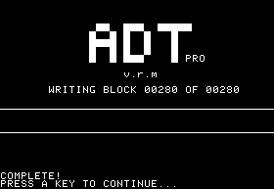
Step 4: Make ADTPro Disk
Notes:
Now that we have a ProDOS formatted floppy… receive the ADTPro client diskette.
Up until now, all that software had been floating around in the Apple's memory – with no permanent record of it! Time to write it down.

Slide 10
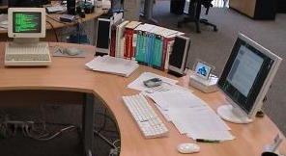
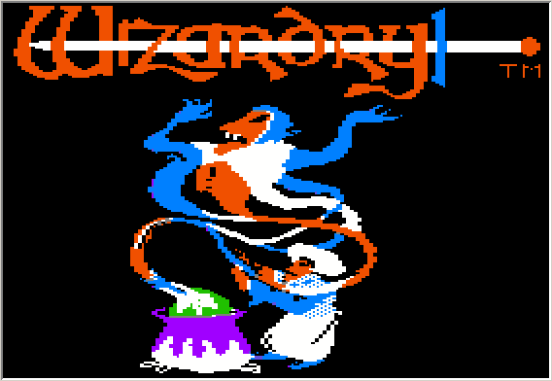
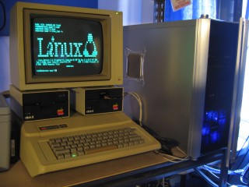
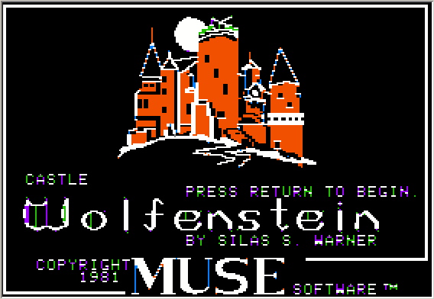
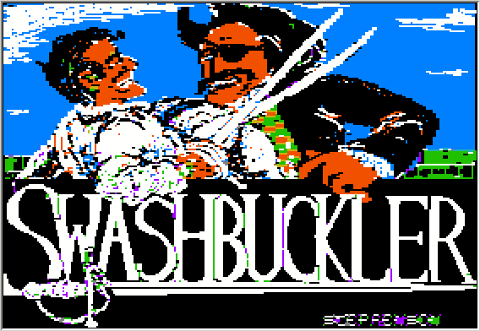
Step 5: Transfer, Relish Victory
Download disk images from the internet
Transfer to Apples, and play!
Archive your aging diskettes!
Notes:
There are many uses for your oldest apple! Serial terminal to OSX, Linux, what have you. Or there's always games…

Slide 11
Review: Bootstrapping 101
Connect serial (or audio!) ports
Send ProDOS kernel memory image
Send ADTPro program memory image
Format a floppy
Send full ADTPro disk image
Reboot – relish the victory!

Slide 12
Resources
ADTPro project page: walkthroughs, etc.
  http://adtpro.sourceforge.net
Using an Apple ][ as a terminal:
  http://www.dataswamp.net/apple2eserialterm/
Super Serial Cards for sale:
  http://retrofloppy.com/products.html#SSC

Slide 13
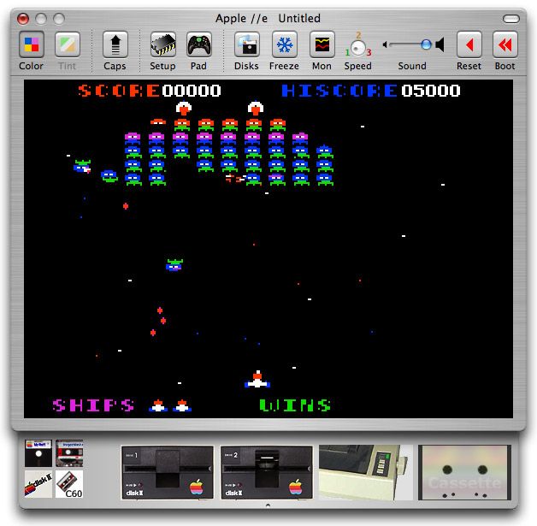
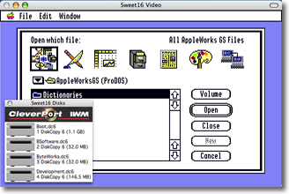
Emulators on Mac
Virtual ][: http://www.virtualii.com/
Sweet 16: http://www.sheppyware.net/software-mac/sweet16/

Slide 14
