Slide 1
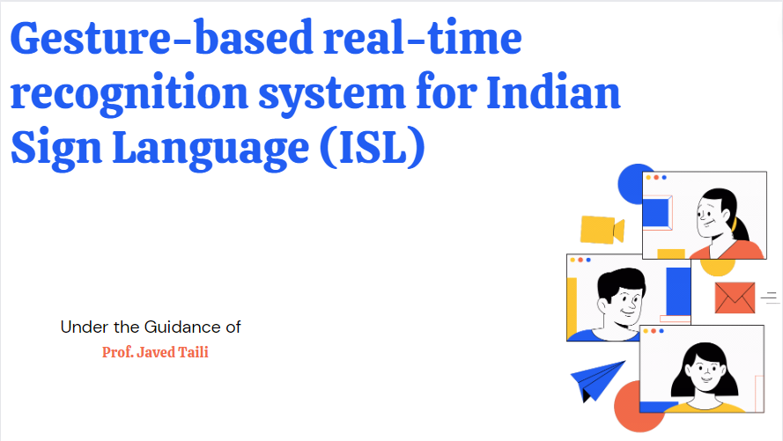
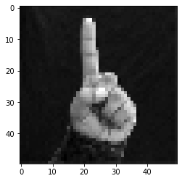
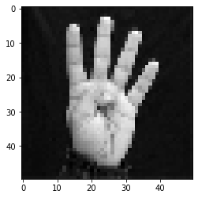
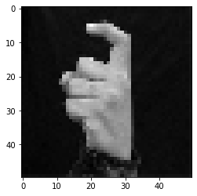

Slide 2

M. H. Saboo Siddik College of Engineering
University of Mumbai
2022 - 2023
Group member details :-
4119006
4119007
4119008
ADVAIT GURUNATH CHAVAN
4119009
AAKASH NANKHURAM GUPTA
HAMZA SHAKEEL ANSARI
TAJ MOHAMMED SHAH

Slide 3
Abstract
This project presents a system that can recognize Indian Sign Language (ISL) hand poses and gestures performed by deaf and dumb people in real time and interpret/translate them into them English text readable to normal people for better and efficient communication within the society.
The existing solutions are either of high cost of purchase and maintenance which cannot be afforded by most of the deaf and dumb people of India in particular. Also, the existing solutions have a low accuracy and low speed of operation which will have an effect on the real-time analysis, interpretation and translation of the sign language to a language which shall be understandable by the physically normal people.
Our proposed system has the ability to overcome both the above-mentioned problems i.e. Accurate Results and Time Factor. It can identify 35 ISL gestures along with some hand poses.

Slide 4
Problem Statement
Understanding the exact context of symbolic expressions of deaf and dumb people is the challenging job in real life until and unless it is properly specified.
To fill the bridge between the communication process between the deaf and dumb people and normal people using the most effective, fast and low-cost method.

Slide 5
Literature Review
There has been considerable work in the field of Sign Language Recognizer with
Novel approaches towards Gesture Recognition.
Different methods such as use hardware components of Gloves or Microsoft Kinect sensor for tracking hand, etc.
2.1 Literature Review on Sign Language Recognizer (SLR) using hardware
A Microsoft Kinect sensor is used in [1] for recognizing sign languages. The sensor creates depth frames; a gesture is viewed as a sequence of these depth frames. But, the sensor of Microsoft Kinect used is almost for 150$ (INR 4342) which is not affordable by most of the dumb and deaf people in India.
T.Pryor et al [2] designed a pair of gloves, called SignAloud which uses embedded sensors in gloves to track the position and movement of hands, thus converting gestures to speech, But, it is not feasible and affordable for the dumb and deaf people in India.
R. Hait-Campbell et al [3] developed MotionSavvy, a technology that uses Windows tablet and Leap Motion accelerator AXLR8R to recognize the hand, arm skeleton.

Slide 6
2.2 Literature Review on Sign Language Recognizer (SLR) using software
For software-based solutions, there are colored glove based and skin color-based solutions.
R. Y. Wang et al [6] have used multi-colored glove for accurate hand pose reconstruction but the sign demonstrator, while demonstrating the sign language, has to wear this each time.
Skin color-based solutions may use RGB color space with some motion cues [7] or HSV [8,9], YCrCb color space for luminosity invariance.

Slide 7
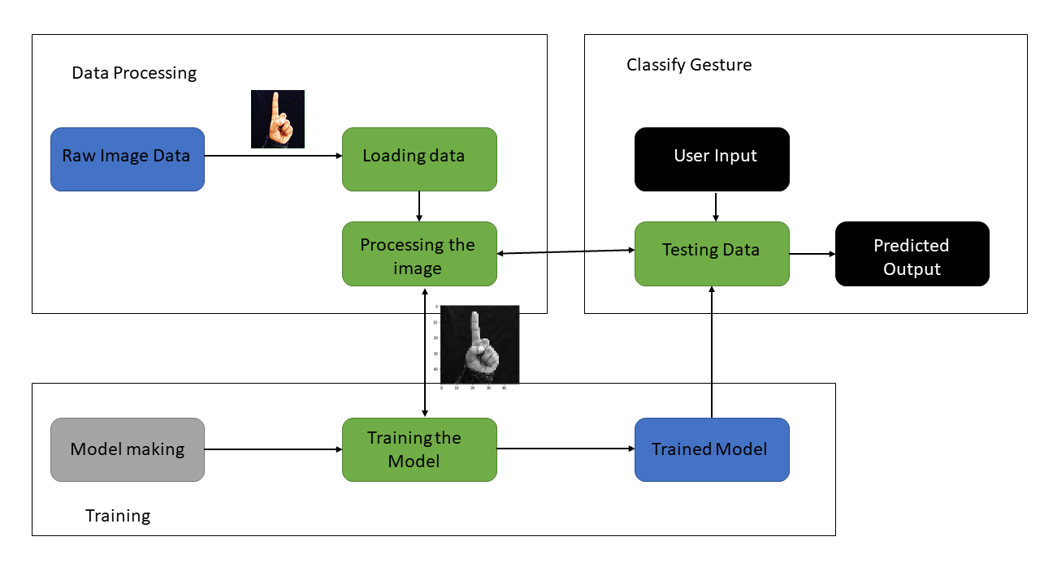
Design Methodology / Block Diagram

Slide 8
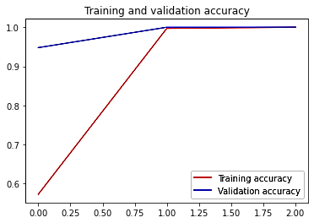
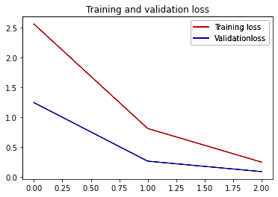
Simulation and Experimental Results
The Graphs for Training and Validation Accuracy along with Training and Validation Loss were plotted for the model which is being trained using InceptionV3 Convolutional Neural Network model which is used for Image Analysis and Object Detection.

Slide 9
References
[1] A. Agarwal and M. K. Thakur, “Sign Language Recognition using Microsoft Kinect,” Sixth International Conference on Contemporary Computing (IC3), September 2013.
[2] MailOnline, ‘'SignAloud gloves translate sign language gestures into spoken English,” 2016. [Online]. Available: http://www.dailymail.co.uk/sciencetech/article-3557362/SignAloudgloves-translate-sign-language-movements-spoken-English.html. . [Accessed: 25- Sept- 2022].
[3] Alexia. Tsotsis, “MotionSavvy Is A Tablet App That Understands Sign Language,” 2014. [Online]. Available: https://techcrunch.com/2014/06/06/motionsavvy-is-a-tablet-app-thatunderstands-sign-language/. [Accessed: 10 – Oct- 2022].

Slide 10
[4] R. Y. Wang and J. Popovic, “Real-Time Hand-Tracking with a Color Glove,” ACM transactions on graphics (TOG), vol. 28, no. 3, 2009.
[5] F. S. Chen, C. M. Fu and C. L. Huang, "Hand gesture recognition using a real-time tracking method and hidden Markov models", Image and vision computing, vol. 21, pp. 745-758, 2003.
[6] M. A. Rahaman , M. Jasim, M. H. Ali and M. Hasanuzzaman, “RealTime Computer Vision-Based Bengali Sign Language Recognition,” 17th International Conference on Computer and Information Technology (ICCIT), 2014.
[7] S. Padmavathi, M. S. Saipreethy and V. Valliammai, “Indian Sign Language Character Recognition using Neural Networks,” IJCA Special Issue on Recent Trends in Pattern Recognition and Image Analysis RTPRIA, 2013.
[8] A. Chaudhary, J. L. Raheja and S. Raheja, “A Vision based Geometrical Method to find Fingers Positions in Real Time Hand Gesture Recognition,” JSW, pp. 861-869, 2012.

Slide 11
Thankyou…..

