Slide 1
Multi-Contact Planning
Paolo Ferrari

Slide 2
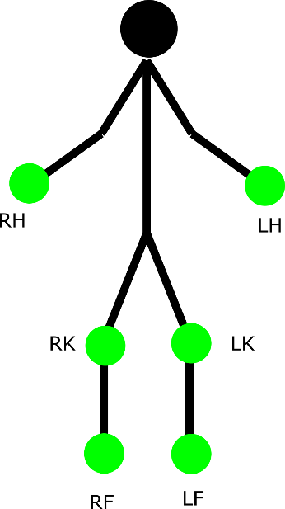
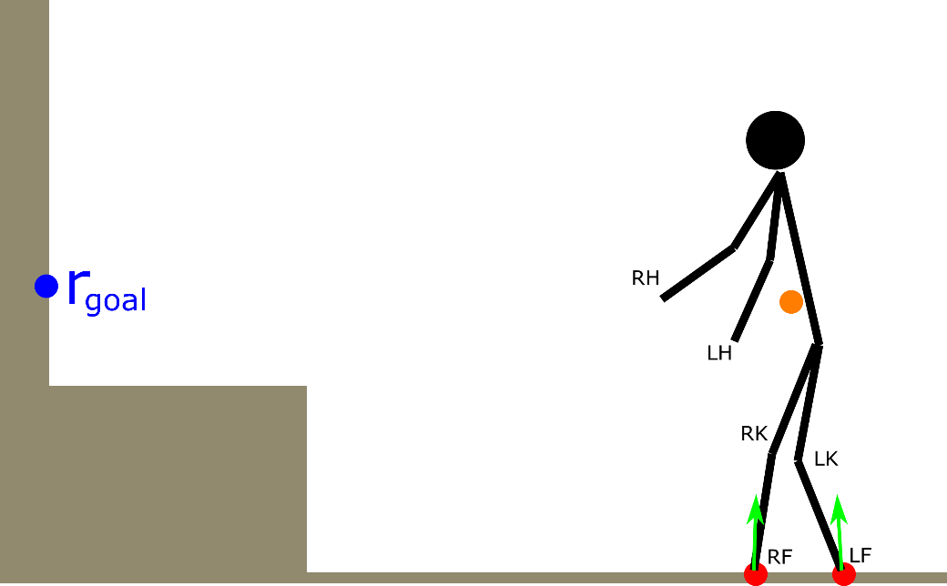
problem formulation
points of the robot that can be in contact with the environment (end-effectors)
assigned task: put RHand in contact at r_{goal}
$$P=\{RHand, LHand, RKnee, LKnee, RFoot, LFoot\}$$

Slide 3
possible ways to expand the tree
the generic iteration of the algorithm tries to expand the tree in one of the following three ways (note: these are not explicitly shown in Algorithm 1, but they automatically result from the random choices made by the algorithm)
exploration (r_{rand} randomly chosen) + add a contact (f = ADD)
exploration (r_{rand} randomly chosen) + remove a contact (f = REMOVE)
exploitation (r_{rand} chosen as r_{goal}) + add a contact (f = ADD)

Slide 4
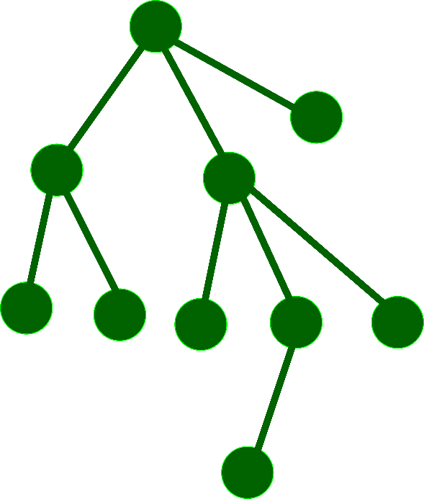
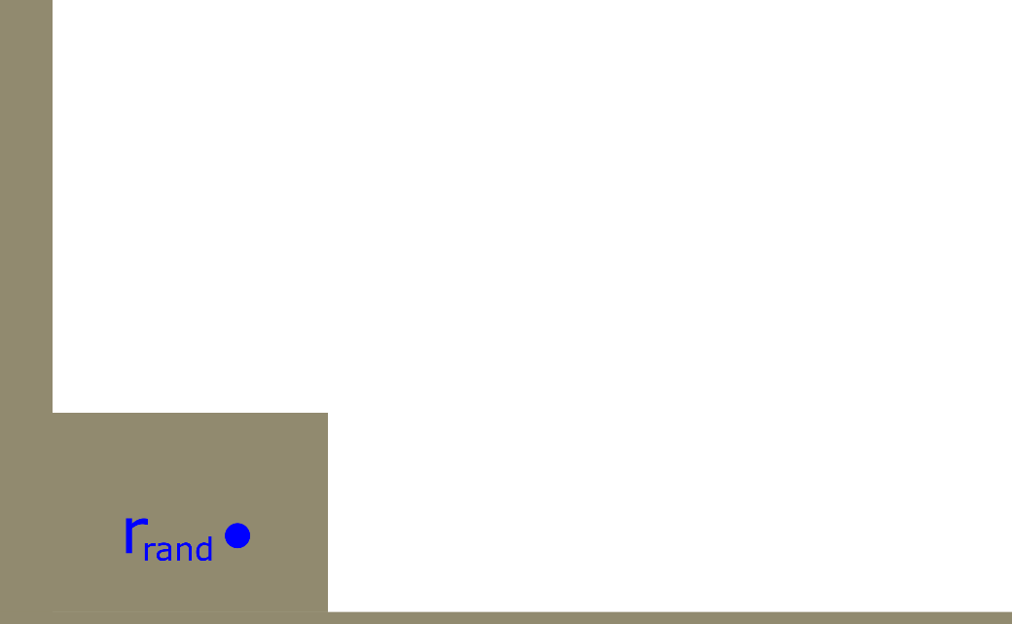
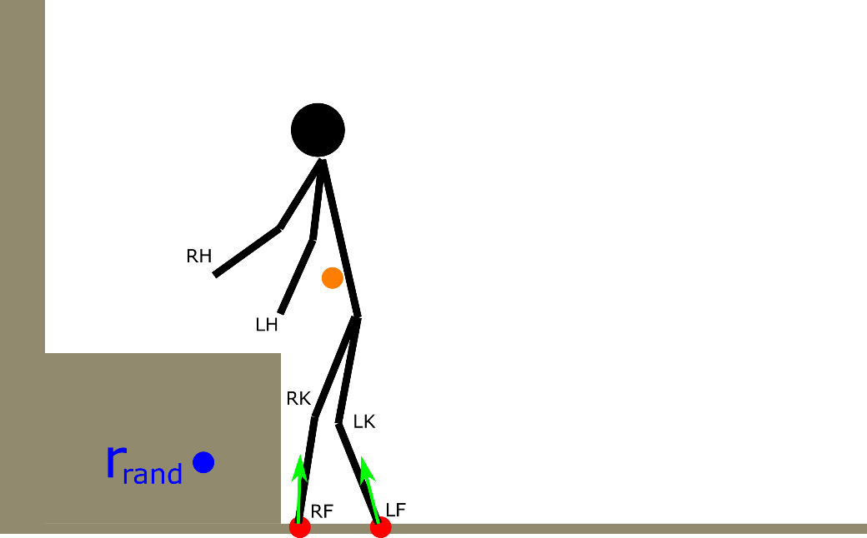
generic iteration: exploration, adding a contact
A) generate the random sample
B) select the nearest vertex
line 4
lines 5-7

Slide 5
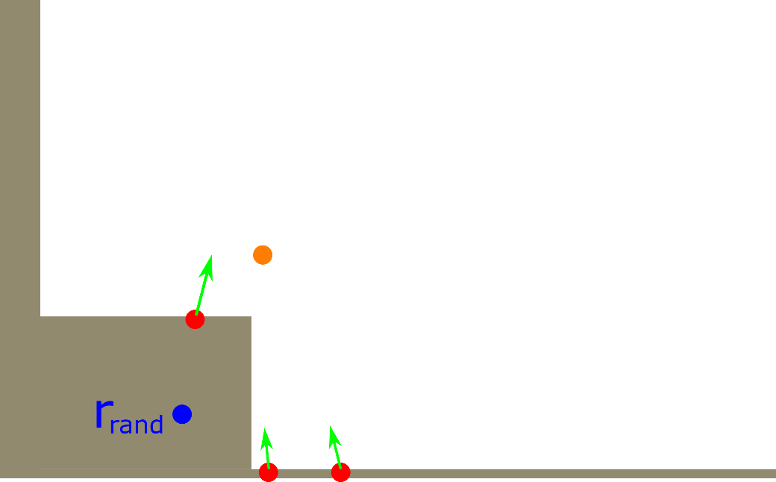
generic iteration: exploration, adding a contact
C) choose ADD or REMOVE and the corresponging end-effector
D) generate candidate contacts
f = ADD
p_{k} = LHand
lines 8-15
lines 16-18

Slide 6
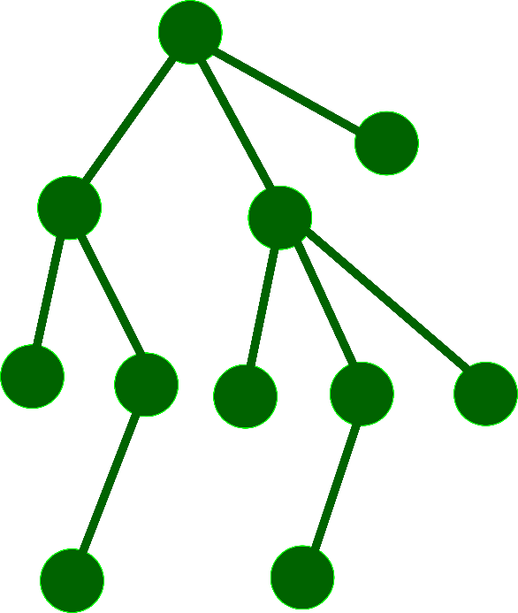
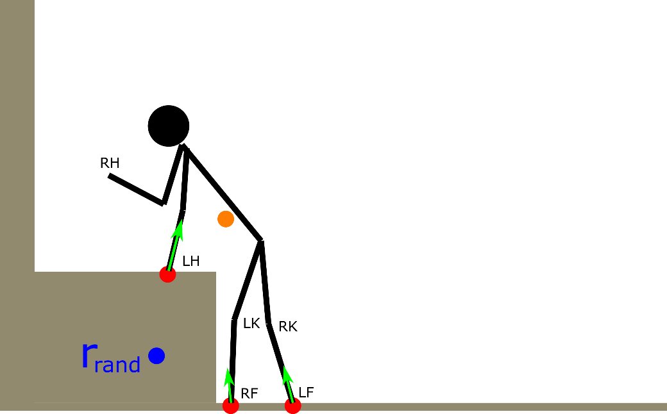
generic iteration: exploration, adding a contact
E) find a feasible IK solution
F) add new vertex in the tree
line 19
lines 20-23

Slide 7
generic iteration: exploration, removing a contact
A) generate the random sample
B) select the nearest vertex
line 4
lines 5-7

Slide 8
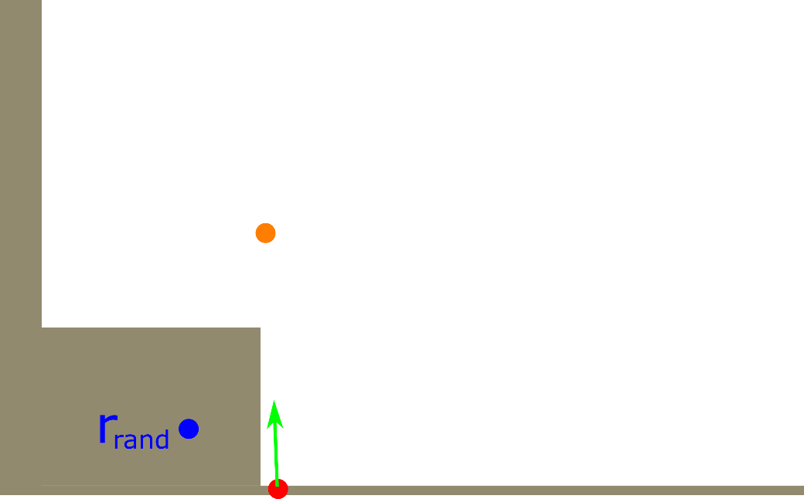
generic iteration: exploration, removing a contact
C) choose ADD or REMOVE and the corresponging end-effector
D) generate candidate contacts
f = REMOVE
p_{k} = LFoot
lines 8-15
lines 16-18

Slide 9
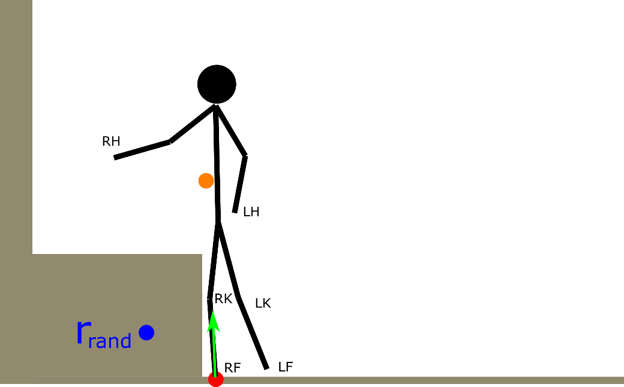
generic iteration: exploration, removing a contact
E) find a feasible IK solution
F) add new vertex in the tree
line 19
lines 20-23

Slide 10
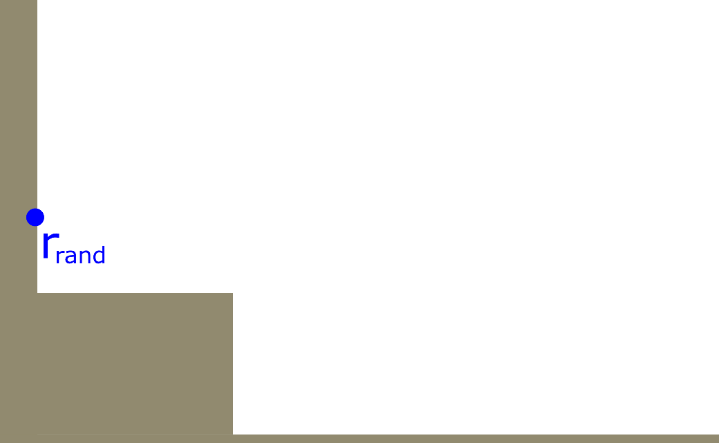
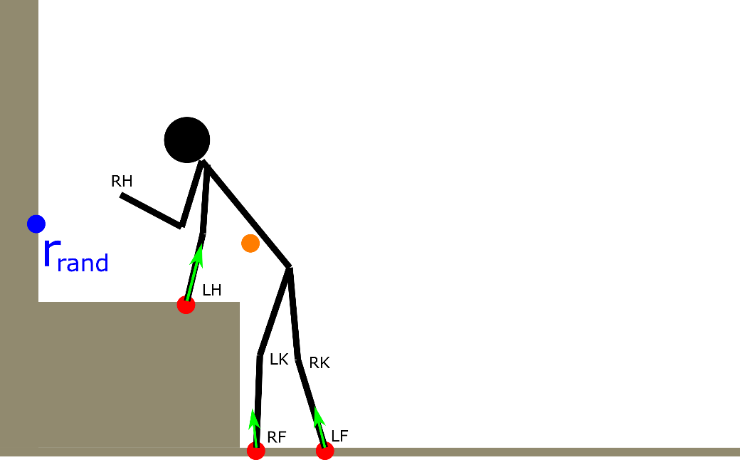
generic iteration: exploitation, adding a contact
A) generate the random sample
B) select the nearest vertex
line 4
lines 5-7

Slide 11
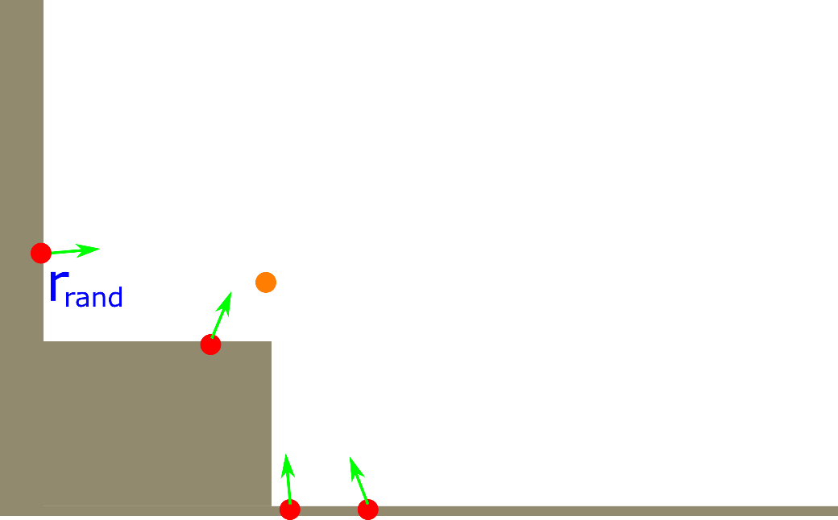
generic iteration: exploration, adding a contact
C) choose ADD or REMOVE and the corresponging end-effector
D) generate candidate contacts
f = ADD
p_{k} = RHand
lines 8-15
lines 16-18

Slide 12
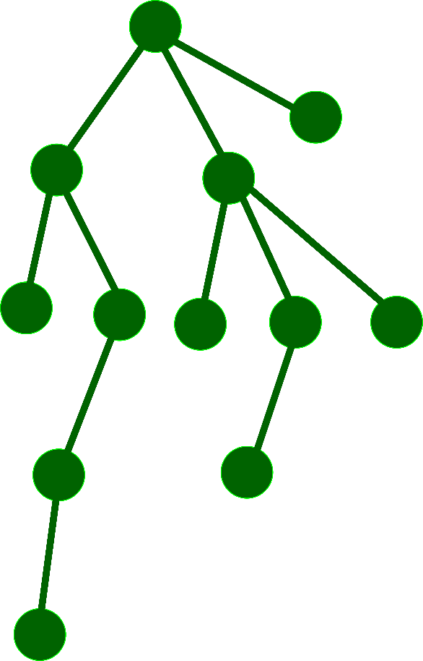
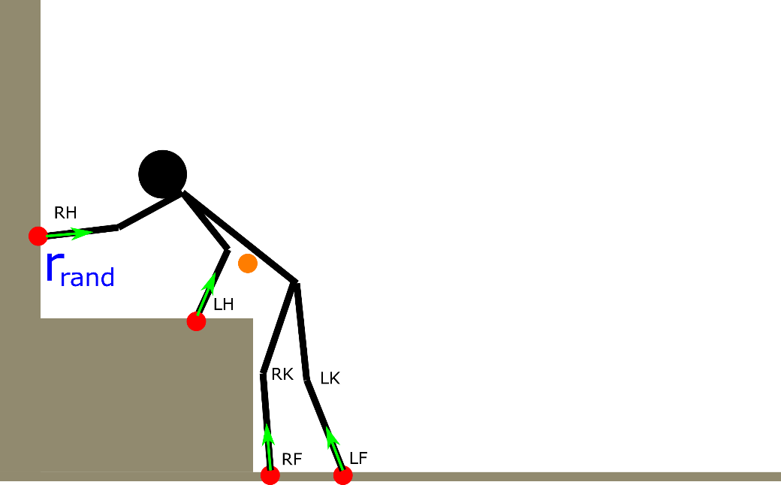
generic iteration: exploration, adding a contact
E) find a feasible IK solution
F) add new vertex in the tree
line 19
lines 20-23

