Slide 1



D. Y. PATIL INSTITUTE OF MANAGEMENT & TECHNOLOGY
Affiliated to Aryabhatt Knowledge University
REPRESENTED BY ROYAL GROUP
Advanced Database Design Concepts (ADDC)

Slide 2

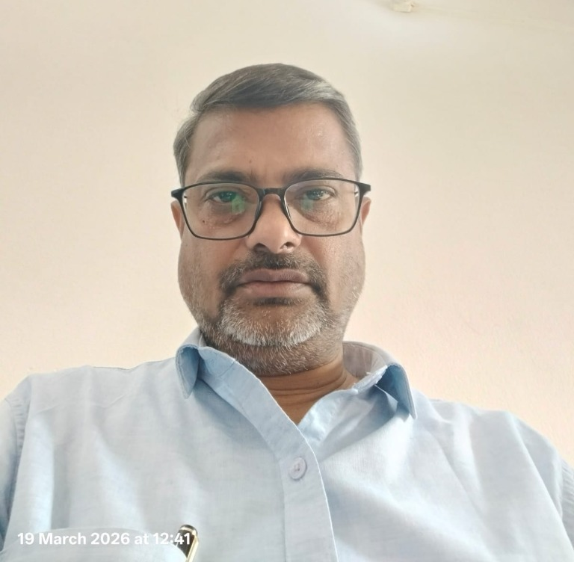
Acknowledgement
We express our sincere gratitude to Dr. Sachin Bhaskar, Principal of D. Y. Patil Institute of Management and Technology, for his visionary leadership, continuous encouragement, and unwavering support throughout the course of this work.
His guidance and inspiring academic environment have played a pivotal role in enabling us to explore, design, and present these Advanced Database Design Concepts (ADDC).
Dr. Sachin Bhaskar
Principal, D. Y. Patil Institute of Management & Technology
D. Y. PATIL INSTITUTE OF MANAGEMENT & TECHNOLOGY | REPRESENTED BY ROYAL GROUP

Slide 3
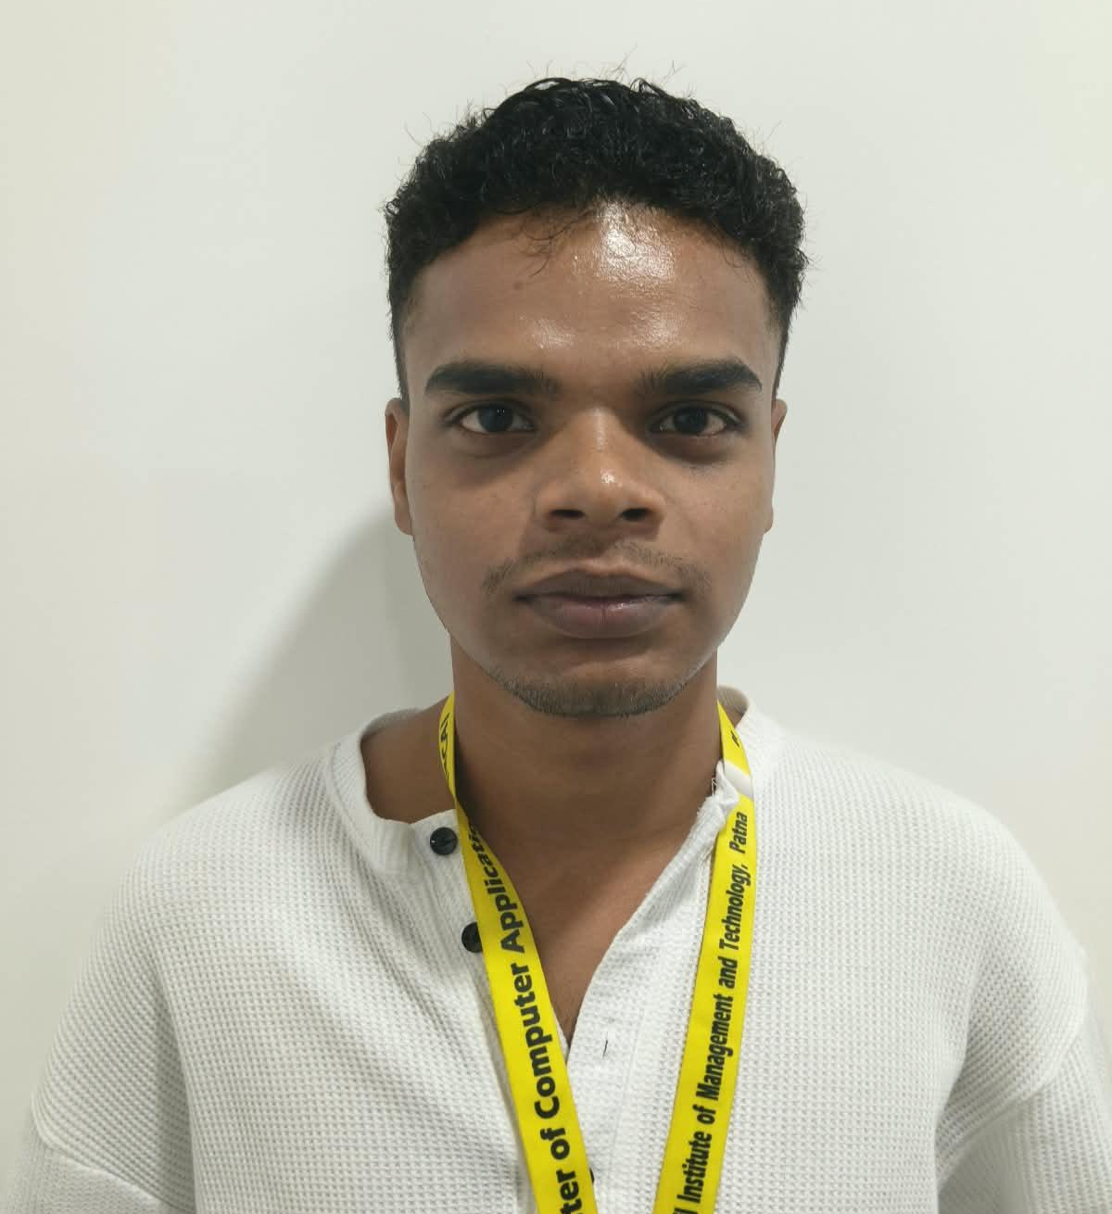
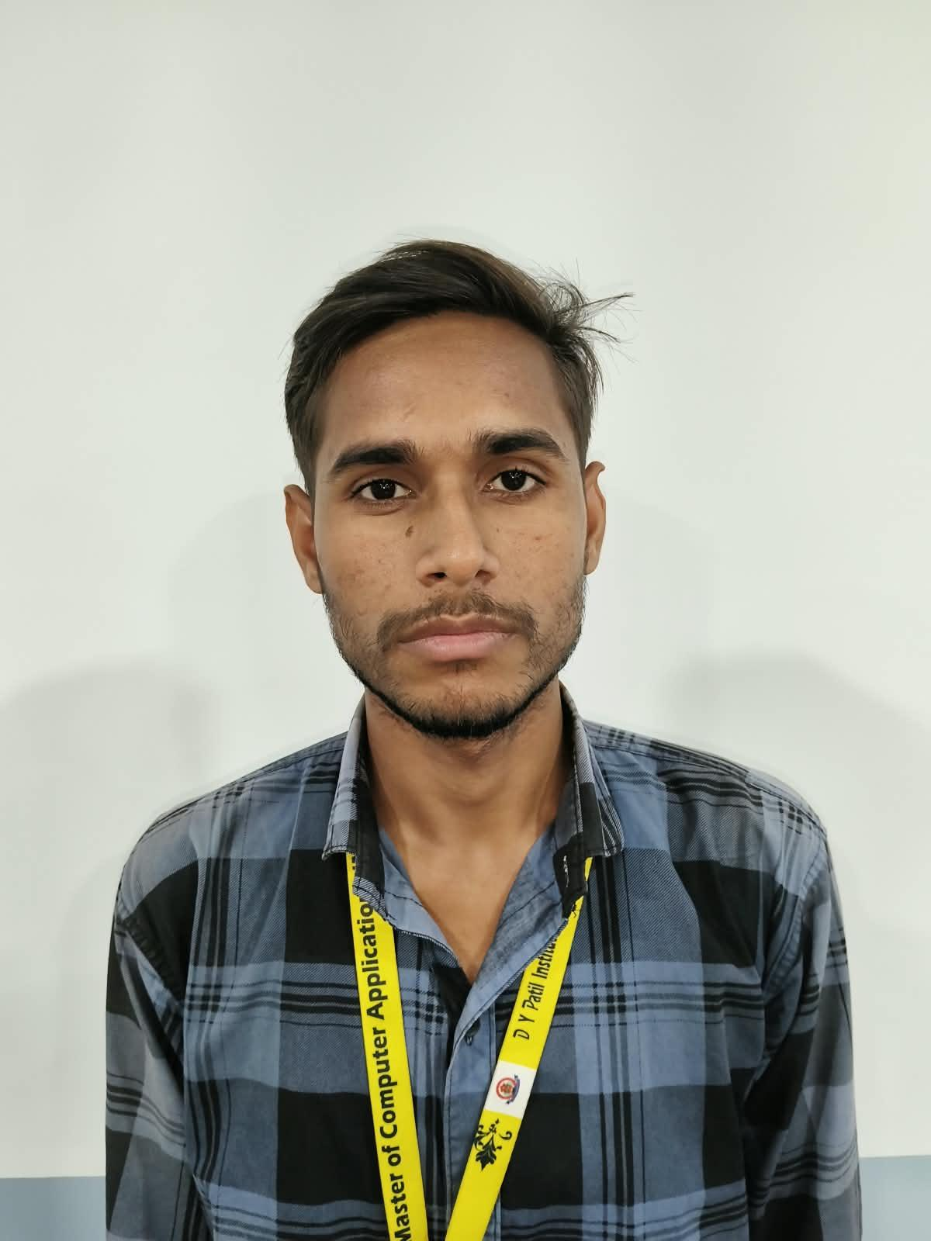
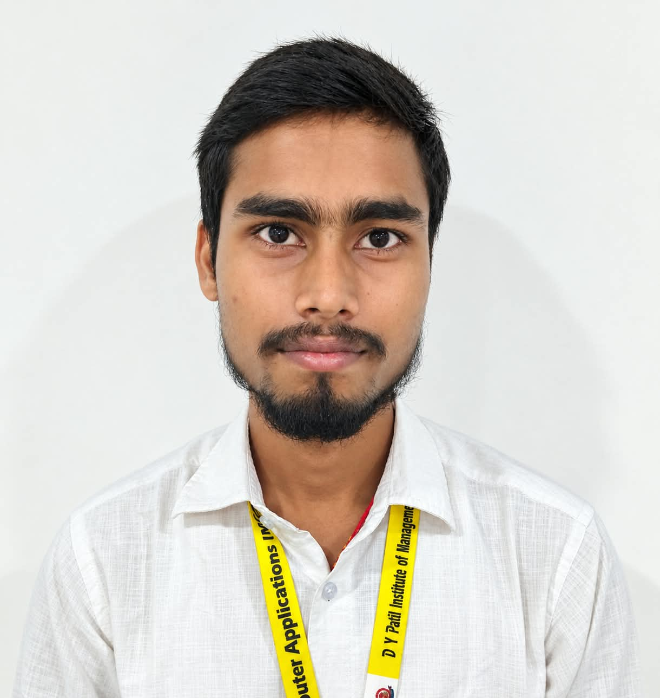
PRESENTING TEAM
Suraj Kumar
Rohit Ranjan
Anukalp Kumar
Roll No: 32600426
Roll No: 32600126
Roll No: 32601026
Graphic & Animation
Data & Database Context
Representation
D. Y. PATIL INSTITUTE OF MANAGEMENT & TECHNOLOGY | REPRESENTED BY ROYAL GROUP

Slide 4




What is ADDC?
Imagine an app with 10 users vs 10 crore users. Regular DBMS designs crash under heavy load. ADDC is the architectural superpower to build databases that never crash.
Massive Scalability
Splits data across 100+ servers so no server gets tired.
Zero Data Loss (High Reliability)
Even if power cuts out, transactions remain 100% safe.
Lightning Speed Queries
Answers requests in milliseconds using smart indexing.
D. Y. PATIL INSTITUTE OF MANAGEMENT & TECHNOLOGY | REPRESENTED BY ROYAL GROUP

Slide 5
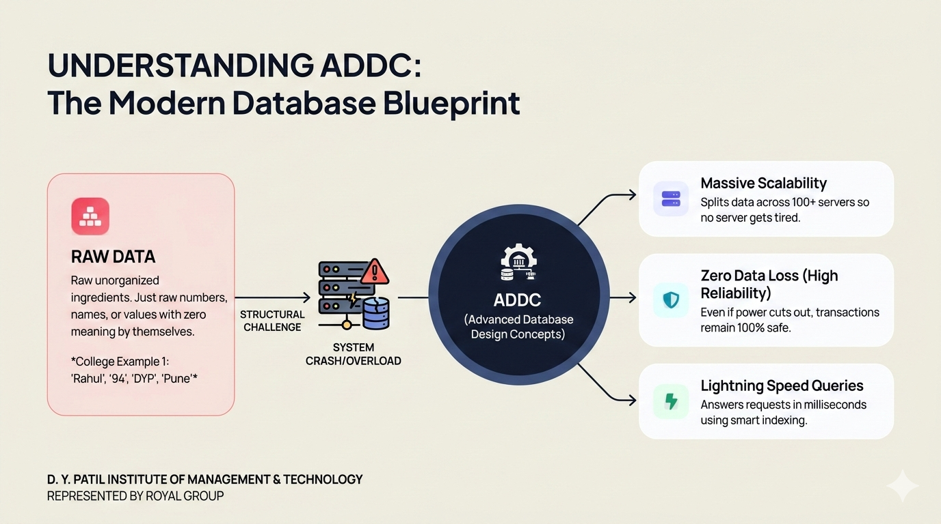
D. Y. PATIL INSTITUTE OF MANAGEMENT & TECHNOLOGY | REPRESENTED BY ROYAL GROUP

Slide 6



Data vs Database
1. What is DATA?
2. What is DATABASE?
Raw unorganized ingredients. Just raw numbers, names, or values with zero meaning by themselves.
The cooked dish! An organized digital container that connects raw data logically for quick searching.
STRUCTURED
COLLEGE EXAMPLE:
COLLEGE EXAMPLE:
"Rahul" , "94" , "DYP" , "Pune"
"Student Rahul scored 94 marks at DYP!"
(Who is 94? Marks? Age? We don't know!)
Stored in MCA Student Marks Record.
D. Y. PATIL INSTITUTE OF MANAGEMENT & TECHNOLOGY | REPRESENTED BY ROYAL GROUP

Slide 7




Classification of Data
1. Quantitative
2. Qualitative
3. Discrete
4. Continuous
Numbers you can measure & calculate.
Words that describe qualities & traits.
Exact whole items (no decimals).
Changing metrics with decimals.
Ex: ₹65,000 Fees, 85% Marks
Ex: Grade "A+", "Eligible"
Ex: 3 Members in Royal Group
Ex: Laptop temp 42.6°C
D. Y. PATIL INSTITUTE OF MANAGEMENT & TECHNOLOGY | REPRESENTED BY ROYAL GROUP

Slide 8

Classification of Databases
A. By Physical Location
B. By Workload Type
1. Centralized Database
1. OLTP (Online Transactions)
Easy to manage, but if it dies, all stop!
Ex: Google Pay & PhonePe UPI transfer
All files on one computer in the college lab.
Super fast debit/credit queries in real time.
2. Distributed Database
2. OLAP (Online Analytics)
Zero downtime! (E.g. WhatsApp, Netflix)
Ex: Amazon Big Billion Day sales analysis
Copies spread across Mumbai, Delhi, & Cloud.
Deep reports analyzing past 5 years data.
D. Y. PATIL INSTITUTE OF MANAGEMENT & TECHNOLOGY | REPRESENTED BY ROYAL GROUP
Source - geeksforgeeks.org

Slide 9


Major Types of Modern Databases
Relational (RDBMS)
Document (NoSQL)
Graph Database
In-Memory (Cache)
Organized into rows and columns with fixed tables.
Stores JSON docs without fixed table rules.
Connects friend circles & followers instantly.
Superfast RAM storage for OTPs & logins.
MySQL, Oracle
MongoDB
Neo4j, Social Apps
Redis Cache
D. Y. PATIL INSTITUTE OF MANAGEMENT & TECHNOLOGY | REPRESENTED BY ROYAL GROUP

Slide 10
Evolution: How Databases Became Smart
STEP 01 (1960s) IBM IMS era
STEP 02 (1980s) Oracle, SQL Server
STEP 03 (2000s) MongoDB, Cassandra
STEP 04 (TODAY) CockroachDB, Pinecone
Flat Files & Trees
The SQL Revolution
NoSQL & Web Big Data
NewSQL & Vector AI
Simple punch-cards & text files with severe data duplication.
Tables, Primary Keys, and ACID guarantees. Clean and safe.
Built for social media feeds, posts, and petabytes of data.
Global multi-region cloud + AI Embeddings for ChatGPT.
Source - geeksforgeeks.org
D. Y. PATIL INSTITUTE OF MANAGEMENT & TECHNOLOGY | REPRESENTED BY ROYAL GROUP

Slide 11


Structured vs Unstructured
Structured Data
Unstructured Data
Neatly organized in rows & columns like an Excel sheet or SQL table. Easy to search with queries.
No rows, no predefined format. Huge in volume and needs AI or special tools to understand.
FIGURE: MCA STUDENT TABLE
FIGURE: MEDIA EXAMPLES
Roll No
Student
Group
101
Sameer
Royal
Exam PDFs
Lectures
Audio Notes
WhatsApp
D. Y. PATIL INSTITUTE OF MANAGEMENT & TECHNOLOGY | REPRESENTED BY ROYAL GROUP

Slide 12
DBMS Languages
DDL: Data Definition Language
DML: Data Manipulation Language
DCL: Data Control Language
DQL: Data Query Language
TCL: Transaction Control Language
D. Y. PATIL INSTITUTE OF MANAGEMENT & TECHNOLOGY | REPRESENTED BY ROYAL GROUP

Slide 13
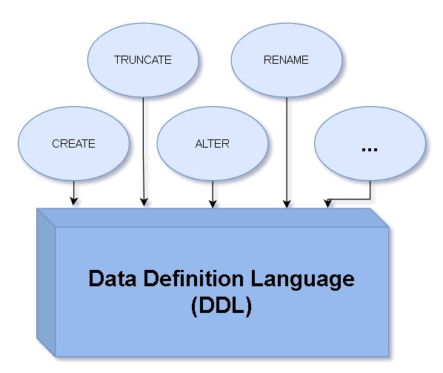



DDL: Data Definition Language
DDL acts as the Civil Engineer of the database. It defines the structure, skeleton, or blueprint—not the inner data values.
CREATE
Constructs a brand-new table or database from scratch.
ALTER
Adds, renames, or modifies columns in an existing table.
DROP & TRUNCATE
Deletes the entire structure completely or empties all rows instantly.
Analogy: Building the rooms of a house before putting furniture inside.
D. Y. PATIL INSTITUTE OF MANAGEMENT & TECHNOLOGY | REPRESENTED BY ROYAL GROUP

Slide 14

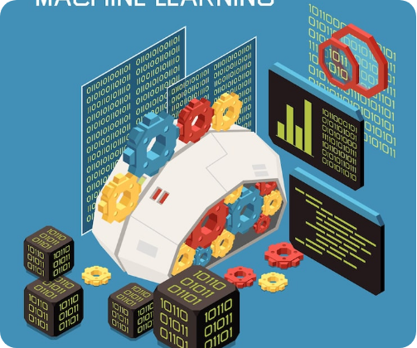



DML: Data Manipulation Language
DML manages the actual content inside existing tables. It allows inserting, updating, and removing individual student or customer records.
INSERT
Adds new rows of information into an existing table.
UPDATE
Modifies current data (e.g., updating a student's mobile number).
DELETE
Removes specific rows using targeted conditions (WHERE clause).
Analogy: Arranging, replacing, or discarding items stored inside wardrobe shelves.
D. Y. PATIL INSTITUTE OF MANAGEMENT & TECHNOLOGY | REPRESENTED BY ROYAL GROUP

Slide 15




DCL: Data Control Language
DCL is the Security Guard of the database. It controls who is granted permission to view or edit sensitive database records.
GRANT
Ex: Giving MCA faculty write access to upload marks.
Provides read or write permissions to designated users.
REVOKE
Ex: Revoking access after an employee or student departs.
Takes back previously granted user permissions.
Analogy: Handing a digital keycard to enter a private room, then deactivating it when access expires.
D. Y. PATIL INSTITUTE OF MANAGEMENT & TECHNOLOGY | REPRESENTED BY ROYAL GROUP

Slide 16
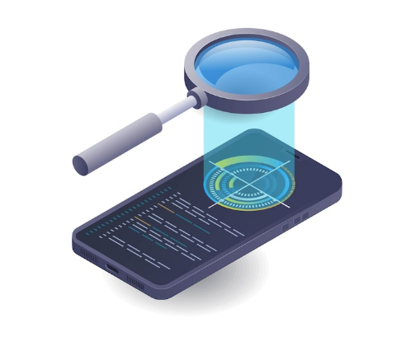

DQL: Data Query Language
DQL is the Detective / Search Engine of SQL. It reads and fetches requested data records without modifying or altering them.
The SELECT Command
Retrieves exactly the rows and columns requested by filtering with conditions.
SELECT name, roll_no FROM students WHERE group_name = 'Royal';
Zero Side Effects
Instant Filtering
Data is read-only; records remain unchanged.
Filters millions of rows in milliseconds.
D. Y. PATIL INSTITUTE OF MANAGEMENT & TECHNOLOGY | REPRESENTED BY ROYAL GROUP

Slide 17




TCL: Transaction Control Language
TCL acts as the Safety Net & Checkpoint Manager for database transactions, ensuring ACID compliance during online payments or multi-step operations.
COMMIT
Permanently writes and saves all transaction changes to storage.
ROLLBACK
Undoes changes if an error or crash occurs before completion.
SAVEPOINT
Sets temporary checkpoints to allow partial rollback within complex tasks.
UPI Example: If money is deducted from Account A but Account B fails to receive it, ROLLBACK automatically restores the balance.
D. Y. PATIL INSTITUTE OF MANAGEMENT & TECHNOLOGY | REPRESENTED BY ROYAL GROUP

Slide 18
At a Glance: Key Comparisons
Feature | Structured Database | Unstructured Database
Data Layout | Tables (Rows & Columns) | Files, Videos, Blobs, Texts
Schema Freedom | Strict & Fixed upfront | Flexible / Dynamic schema
Searching Speed | Extremely fast via SQL Index | Uses AI & Vector Embeddings
Popular Systems | PostgreSQL, MySQL, Oracle | MongoDB, Hadoop, Amazon S3
D. Y. PATIL INSTITUTE OF MANAGEMENT & TECHNOLOGY | REPRESENTED BY ROYAL GROUP
Source - geeksforgeeks.org

Slide 19

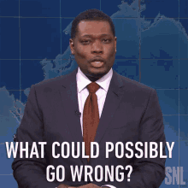

Questions & Answers
Have any doubts? We are happy to clear them up!
Presented by Royal Group • Department of MCA • DY Patil Institute of Management & Technology

Slide 20
Thanking You!
Regards - Suraj Kumar, Anukalp Kumar, Rohit Ranjan

