Slide 1
WTW2 DAY19

Slide 2
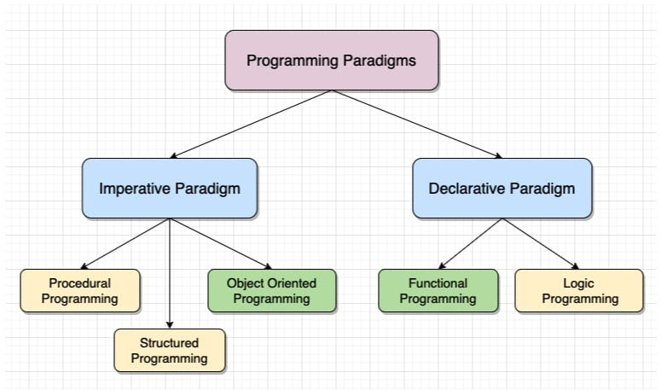
FUNCTIONAL PROGRAMMIG

Slide 3
Imperative Programming
Type of programming paradigm that describes how the program executes.
Developers are more concerned with how to get an answer step by step. It comprises the sequence of command imperatives. In this, the order of execution is very important and uses both mutable and immutable data

