Slide 1
Web technology workshop 2 Day 9

Slide 2
JAVASCRIPT
Lightweight: JavaScript is a lightweight programming language, which means that it can run on almost any device without requiring a lot of memory or processing power
Cross – platform
Object oriented
Dynamic
Interactive

Slide 3
JAVASCRIPT IS SCRIPTING LANGUAGE
All scripting languages are programming languages.
The scripting language is basically a language where instructions are written for a run time environment. They do not require the compilation step and are rather interpreted.
NODE JS , PYTHON, RUBY,PEARL
Scripting languages are used in web applications.
It is used in server side as well as client side.
Server side scripting languages are: JavaScript, PHP, Perl etc.
Client side scripting languages are: JavaScript, AJAX, jQuery etc.

Slide 4
JavaScript Versions
JavaScript was invented by Brendan Eich in 1995, and became an ECMA standard in 1997. (a standard for scripting languages)
ECMAScript is the official name of the language.
ECMAScript versions have been abbreviated to ES1, ES2, ES3, ES5, and ES6(MODERN JS).
Since 2016, versions are named by year (ECMAScript 2016, 2017, 2018, 2019, 2020)
VanillaJS is a name to refer to using plain JavaScript without any additional libraries like jQuery back in the days.

Slide 5
BASIC BUILDING BLOCK
VARIABLE
DATA TYPES
STATEMENTS
FUNCTIONS

Slide 6
VARIABLE
Variables are identifiers used to store the data and information
Variables can be defined using the below keywords:
let
Const
Var
let: This is the recommended way of defining variables that remain
valid in the block in which it is defined, and its value can be changed
and reassigned.
let name;
let age;
let num1,num2,num3;
const: This is used whenever the containing value is constant and will
not undergo change. This is also block scoped. const pi=3.14;
var: This is the traditional way of defining variables in JS, which is
not block scoped but function scoped.
var dummy;

Slide 7
Scopes
Scope in JavaScript tells us which variables will be accessible at a given point.
There are two kinds of scope – global scope and local scope.
Global scope
Any variable which is declared outside any function is accessible anywhere in the code, even in the functions and is in the global scope.
const global = 'Hi! I am Global';
Local scope
Function scope: When a variable is declared within a function, it is accessible only within the function. You can't access this variable once you are out of the function.
function HelloWorld () {
const hello = 'Welcome to JS!';//this is function scoped
console.log(hello);}
HelloWorld (); //'Welcome to JS!'
console.log(hello);// This will give error hello is not defined

Slide 8
Block scope: When a variable is declared using the const or let keyword, within a block of curly brace ({}), it is accessible only within that curly brace.
{
const hello = 'Welcome to JS!';//this is block scoped
console.log(hello);
}
console.log(hello);// This will give error hello is not defined

Slide 9
QSN
Var a=28;
Var b=john; // let
{
Var b =“this” //let
c.l(b);
}
c.l(b)
//output

Slide 10
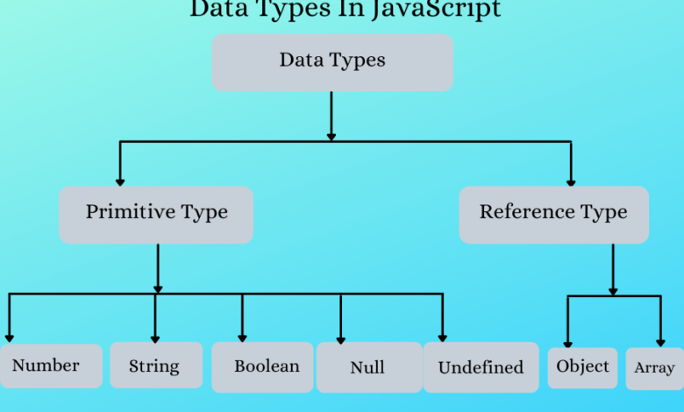
DATA TYPES

Slide 11
QSN
Create a variable of type string and try to add a number to it.
Use typeof operator to find the datatype of the string in last question.
Create a const object in js , can you change it to hold a no. later?
Try to add a new key to the const object in qsn 3 , were you able to do it?
Write a js program to create a word meaning dictionary of 5 words.
Use logical operators to find whether the age of a person lies between 10 and 20?
Demonstrate the use of switch case statements in js.
Write a js program to find whether a number is divisible by 2 and 3.
Write a js program to find whether a number is divisible by 2 or 3.
Print “you can drive “ or “you can’t drive” based on age being greater than 18 using ternary operator.s

