Slide 1
Wi-Fi Introduction
Version | Author | Date
1.0 | Mao-Chun | 2018.09.25

Slide 2
Agenda
SPEC Overview
Concept & Basic Functionalities
Important Technologies

Slide 3
SPEC Overview

Slide 4
Wi-Fi SPEC Generation History
Generation | Freq. | Support Bandwidth | Max Stream number | Max Rate per stream | Generation Upgrade | Representative Function
802.11b (1) | 2.4G | 20MHz | 1 | 11Mbps | 2.4G Origin
802.11a | 5G | 20MHz | 1 | 54Mbps | 5G Origin
802.11g (2) | 2.4G | 20MHz | 1 | 54Mbps | 2.4G Traffic Upgrade
802.11n (3) | 2.4G + 5G | 20MHz | 4 | 72.2Mbps | .Integration of 2.4G & 5G .Traffic Extension .Multi-Stream Support | MIMO
 |  | 40MHz |  | 150Mbps
802.11ac -wave 1 (4) -wave 2 (5, MU-MIMO) | 2.4G + 5G | 20MHz | 8 | 87.6Mbps | .Traffic Upgrade .Multi-User Support | MU-MIMO (DL) 256QAM
 |  | 40MHz
 |  |  |  | 200Mbps
 |  |  |  | 433.3Mbps
 |  | 80MHz
 |  |  |  | 866.7Mbps
 |  | 160MHz
802.11ax (6) | 2.4G + 5G | 160MHz | 8 | 1000Mbps | Large Number of User | OFDMA MU-MIMO (DL+UL) TWT 1024QAM

Slide 5
Security History
Security Category | Encryption Method (Key Length, note) | Authentication | SPEC | Note
WEP | RC4 (1~255, Cracked) | NA | 802.11 Origin | Phase out
WPA | .TKIP (128, traffic reduce) .AES (128/192/256) | .802.11x (Server) .PSK (Local) | 802.11i (temp ver.)
WPA2
WPA3 |  |  |  | 2018.06 Announce
WAPI | .SM4 (128) .AES (128/192/256) | NA | NA | Chinese Standard

Slide 6
Concept & Basic Functionalities

Slide 7


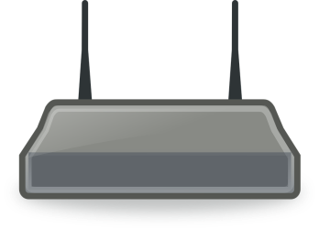

Topology
Wireless
Wired
Internet
Wi-Fi Direct
(Negotiation for Server/Client role)
Hotspot
(Server Role on Client Device)
Ad-Hoc
(P2P)
Router
Infrastructure
(Server-Client)
Switch
AP
User Device

Slide 8
Service Set
BSS (Basic Service Set)
ESS (Extended Service Set)
SSID (Service Set Identifier)
A name human defined to a AP for user to identify.
BSSID (Basic SSID)
The Link-Layer MAC address of AP
ESSID (Extended SSID)
A name human defined to a set of BSS for roaming.
HESSID
The MAC address choose from one of the BSSID in the ESS

Slide 9
ESS-1
ESSID: RoamingSet1
HESSID: 00:02:FF:FF:FF:10
BSS-1
SSID : For_Employee
BSS-2
SSID : For_Customer
BSS-3
SSID : MyWLAN
User
User
User
User
User
User
AP1
BSSID: 00:02:FF:FF:FF:10
AP1
BSSID: 00:02:FF:FF:FF:22

Slide 10
Connection Step 1: Scan (Find AP)
Active Scan
Probe Request (SSID = NULL)
Probe Response (SSID = XXX)
Passive Scan
Beacon (SSID = XXX)
(Periodically Send by AP)

Slide 11
Connection Step 2: AUTH/ASSOC (Connect to AP)
Authentication 1 (AUTH Request)
Authentication 2 (AUTH Response)
Association 1 (ASSOC Request)
Association 2 (ASSOC Response)

Slide 12
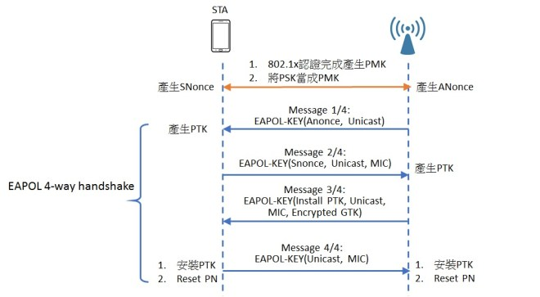
Connection Step 3 : 4-way Hand-Shake (Get Decryption Key)
Note!!
These are data packets,
NOT control packets

Slide 13
ROAMING
When User move from AP1 to AP2 & signal of AP1 is too weak, roaming to AP2

Slide 14
Some Data Path Functionalities
RTS Threshold
The data length threshold to use RTS/CTS mechanism
Fragmentation Threshold
The data length threshold to do fragmentation.
Channel
The Central Frequency of Wi-Fi
Bandwidth
The width of channel

Slide 15
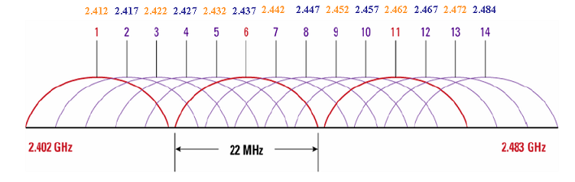
Channel & Frequency (2.4G)
2.4G channel bandwidth overlap with the others, so there is more interference than 5G channel.
The channel 1/6/11 is the suggested settings when multiple 2.4G Wi-Fi coexist in a same area. (Reduce interference and get max channel number)

Slide 16
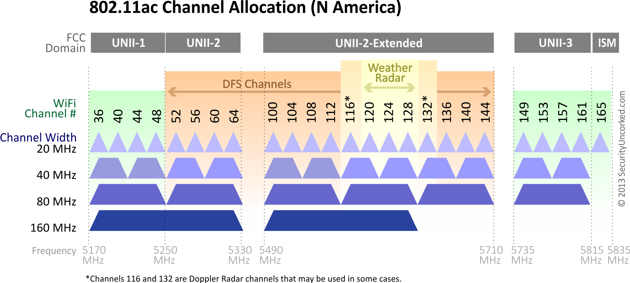
Channel & Frequency (5G)
其中UNII-2跟UNII-2e為DFS頻道，先前已有說明因為DFS頻道還用於軍用設備和氣象雷達，如果AP選擇使用這些頻道時，在偵測到雷達的訊號時必須自動切換頻道，所以無線區域網路設備要使用這些DFS頻道必須通過NCC檢驗(UNII-2只限室內使用)，以確定它們能確實按照規範要求，提供自動迴避及遵循使用前的靜默期等待時間，以避免干擾雷達的運作，從總體數量來看，DFS頻道占了目前開放的5GHz的一半以上，即使目前的國際趨勢是朝向開放更多的5 GHz頻段，但這些計畫中可以開放的頻段還是以DFS為主。

Slide 17
Technologies

Slide 18
WPS
WPS (Wi-Fi Protected Setup) 是Wi- Fi 聯盟推動的一個協定，主要目的是為了簡化用戶在無線安全性方面的設定，當AP進入WPS模式之後，使用者只需在Client端按下一個按鈕便可以成功連線，無須再做繁瑣的安全性設定。
PIN碼連線方式
PBC模式(Push-Button Connection)

Slide 19
STBC/LDPC/Beamforming
STBC (Space–time block coding)
Use on multiple antenna
transmit multiple copies of a data stream
improve the reliability of data transfer.
LDPC (Low-density parity-check)
For Data Correction
Often used with Beamforming together.
Beamforming
Make the signal to be directional.
Could use more power and transfer through the wall
Increase the transmit coverage and reduce the interference.

Slide 20
MIMO/MU-MIMO/DBDC
MIMO
(4 stream example)
MU-MIMO
(2+1+1 stream example)
DBDC
(1+2 stream example)
AP
AP
AP
2.4G
5G
2.4G or 5G
2.4G or 5G
STA
STA
STA
STA
STA
STA

Slide 21
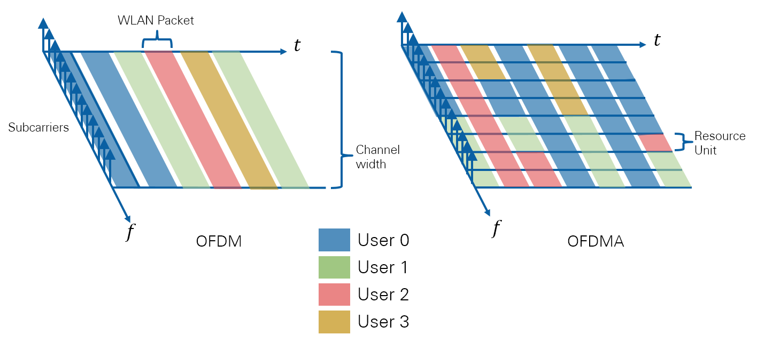
OFDM/OFDMA

Slide 22
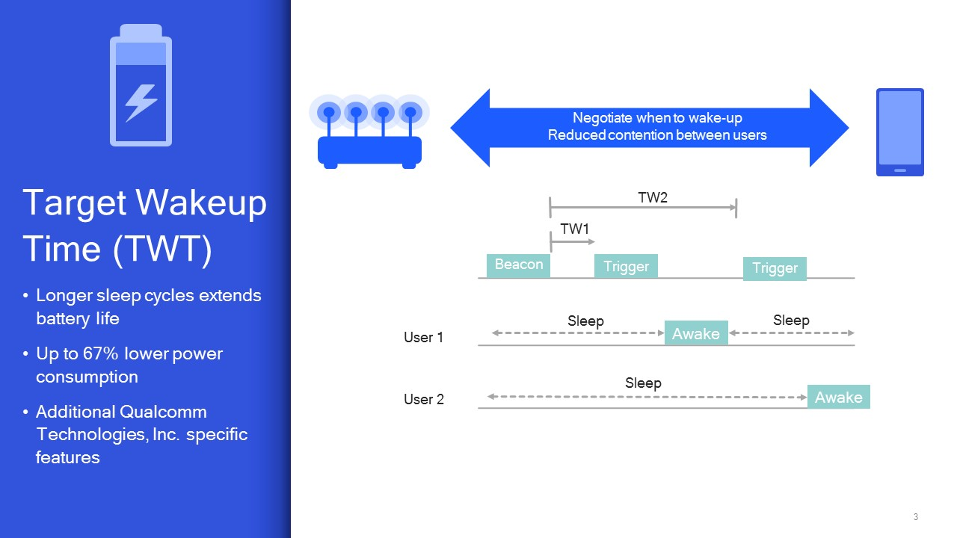
TWT

Slide 23
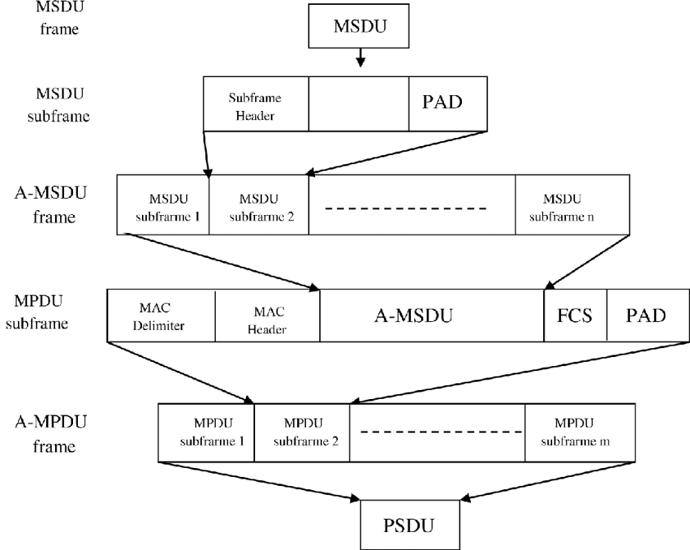
Aggregation
https://www.researchgate.net/figure/The-generation-of-A-MSDU-and-A-MPDU-frames-in-two-level-aggregation_fig3_305954949

