Slide 1
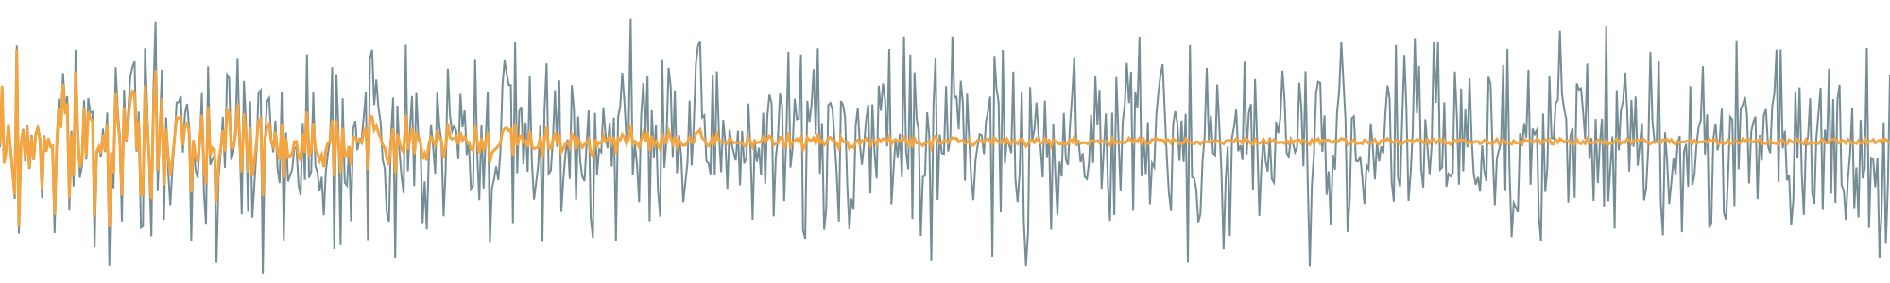
ULLAP
A bit-exact, processor-free FPGA adaptive noise canceller: LMS, NLMS and divider-free NLMS-Shift on the Terasic DE2-115
Satvik Garg · Aditya Gupta
Guide: Prof. Jaffino G · SENSE, VIT Vellore · October 2026
Notes:
ULLAP is a complete adaptive noise canceller on a low-cost Cyclone IV FPGA board. Three algorithms on one core, compared fairly, and shown on the board to compute exactly what the simulation computes. The grey trace is noisy input; the amber trace is the filter output as it converges.

Slide 2



Cancelling noise needs a reference and an adaptive filter
e[n] drives the weight update
Reference mic
x[n]: noise only
Adaptive FIR filter
w[n], 32 taps
y[n]
−
Primary mic
d[n] = s[n] + h∗v[n]
+
Σ
Output e[n] = d − y
≈ clean speech s[n]
Sample by sample, fixed latency
LMS is cheap but level-sensitive
NLMS needs a division per sample
A dedicated FPGA datapath answers 37 clock cycles (0.74 µs) after each input, with no processor or OS.
One fixed step size is too slow when the noise drops or too noisy when it rises.
Normalising by input power fixes the level problem, but a hardware divider costs logic and cycles.
Notes:
Classic Widrow noise canceller. The reference mic hears only noise; the primary mic hears speech plus the noise after an acoustic path h. The filter learns h so that its output y matches the noise in d; subtracting leaves the speech. The question: how much does each algorithm gain and cost on a small FPGA, compared fairly?

Slide 3
Three algorithms share one update equation
y[n] = w^{T}[n] x[n] e[n] = d[n] − y[n] w[n+1] = w[n] + μ[n] · e[n] · x[n]
LMS
NLMS
NLMS-Shift
μ[n] = μ
μ[n] = μ / (P[n] + ε)
μ[n] = 2^−(⌊log₂(P+ε)⌋ + 1 + K)
Fixed step, μ = 0.25
P[n] = ‖x[n]‖², restoring divider
Leading-one detector + barrel shift
Smallest: 1,792 logic elements
73 busy cycles per sample
Step is right for only one input level
Level-independent adaptation
130 busy cycles per sample
Divider runs one iteration per bit
Keeps NLMS's level-independence
72 busy cycles per sample
Step within ×0.5 to ×1 of NLMS
Not claimed as new: power-of-two normalisation of NLMS was used by Garrett et al. (ISLPED 2002). Our contribution is the fair comparison, the bit-exact chain to hardware and the analysis.
Notes:
All three use the same filter and error. They differ only in the step size. LMS uses a constant; NLMS divides by the window power; NLMS-Shift replaces the division by the next power of two above P+eps, which is a leading-one detector and a shift. The shift idea is old (Garrett 2002) — we don't claim it.

Slide 4
A complete audio system on the DE2-115, no processor
Cyclone IV E · 50 MHz
8.138 kHz
WM8731
audio codec
I²C config
(11 registers, ACK-checked)
codec master, 12.5 MHz clock, 1536 fs
anc_core
1 multiplier, 3-stage pipe
32 weights × 12 bit
divider | LOD + shift
37 cycles
I²S receiver
input-to-output latency (0.74 µs); 35 for LMS
I²S transmitter
+ bypass mux
72 / 6,144
busy cycles per sample period for NLMS-Shift: about 1% of the time
LINE IN: x, d
LINE OUT: e
Switches & reset
2-flop synchronisers
GPIO test points
+ Signal Tap
0
SW[0] bypass · SW[1] freeze · KEY[0] reset
processors or vendor IP blocks: plain Verilog
Notes:
The FPGA configures the codec itself at reset over I2C, receives the two channels over I2S, runs the core once per sample, and sends e back to the DAC. Switches give bypass and freeze (weights held, filtering continues). The core shares one multiplier: 32 cycles for the filter, then the error, then 32 weight updates. At 8 kHz the core is idle about 98% of the time.

Slide 5

One chain of evidence: model, RTL, silicon
Float model
Python, algorithm design and tuning
Integer model
exact Q1.11 widths, saturation, rounding
RTL simulation
Icarus + Questa, golden vectors
On the board
Signal Tap captures of real codec data
Suite | Tests | Result
Core golden vectors (W 8–31, L 2–32, saturation, freeze) | 68 | all bit-exact
Protocol corner cases | 4 | pass
Freeze hold / toggle variants | 3 | pass
Top level with codec model (T1–T10) | 11 | pass
Python unit tests | 53 | pass
Verilator lint (-Wall) | – | 0 unwaived warnings
On-board Signal Tap captures | 25 | all bit-exact
On-board freeze, DAC word, 10-min soak | 4 | pass
Tests that can fail
Mutation tests inject faults into the RTL and confirm the testbenches catch them, so a pass means something.
Notes:
Every stage is checked against the one before. The integer model mirrors every bit width, so RTL outputs are compared sample by sample, not with a tolerance. 86 RTL regression tests pass in both Icarus and Questa. The last two rows are on the real board.

Slide 6
Tuned fairly, NLMS-Shift ties NLMS and beats LMS on steps
Set-up
4 scenarios, 16,000 samples at 8 kHz: stationary, amplitude steps (×3 then ×0.25), path switch, recorded chord
Step sizes tuned on seeds 101–103 with one criterion for all
Reported on seeds 1–20, 95% CI, paired TOST (±0.5 dB)
LMS μ = 0.25 · NLMS μ = 0.25, ε = 1 · Shift K = 3, ε = 0.25
+1.8 to +2.0 dB for both normalised variants over LMS on amplitude steps (p < 10⁻⁷). Every NLMS-Shift vs NLMS difference is inside ±0.5 dB.
Notes:
An earlier version of this work showed a 5.7 dB advantage for the shift variant; it disappeared once NLMS was regularised fairly. So all three are tuned on held-out seeds with the same criterion. Result: on stationary noise everything ties. On amplitude steps LMS's single step can't be both fast and quiet, so it is about 2 dB behind. On the tonal chord NLMS-Shift is 0.2–0.3 dB worse.

Slide 7

On real noise and speech, the speech is the limit
MS-SNSD noise, 0 dB SNR | NR (dB) | STOI | PESQ (NB)
Air conditioner | 11.7–12.0 | 0.78 → 0.95 | 1.54 → 2.30–2.34
Vacuum cleaner | 14.3–14.9 | 0.73 → 0.98 | 1.39 → 2.81
Copy machine | 14.0–14.6 | 0.69 → 0.98 | 1.36 → 2.73–2.75
Babble | 12.0–12.4 | 0.72 → 0.96 | 1.48 → 2.47–2.48
Same noise, speech removed
18.5–31.9 dB
With speech
11.7–14.9 dB
Range over LMS, NLMS and NLMS-Shift; 20 seeds each. NLMS leads LMS by 0.4–0.6 dB, NLMS-Shift sits between them.
Speech enters e[n], which drives the update, and costs 6.4–17.9 dB. Freezing adaptation during speech (a voice-activity detector on the freeze input) is the known remedy; not evaluated here.
Mic placement matters more than the algorithm. With −20 dB of speech leaking into the reference, NR drops 2.3–4.6 dB and PESQ by 0.25–0.6.
Notes:
Real noises from the MS-SNSD dataset, ten utterances, random 16-tap acoustic paths. The filter roughly doubles PESQ and brings STOI near 1. NR is lower than synthetic — but not because the real noise is harder: with speech removed the same filters get 18.5 to 31.9 dB. Speech is uncorrelated with the reference, so it acts as disturbance in the error that drives adaptation.

Slide 8
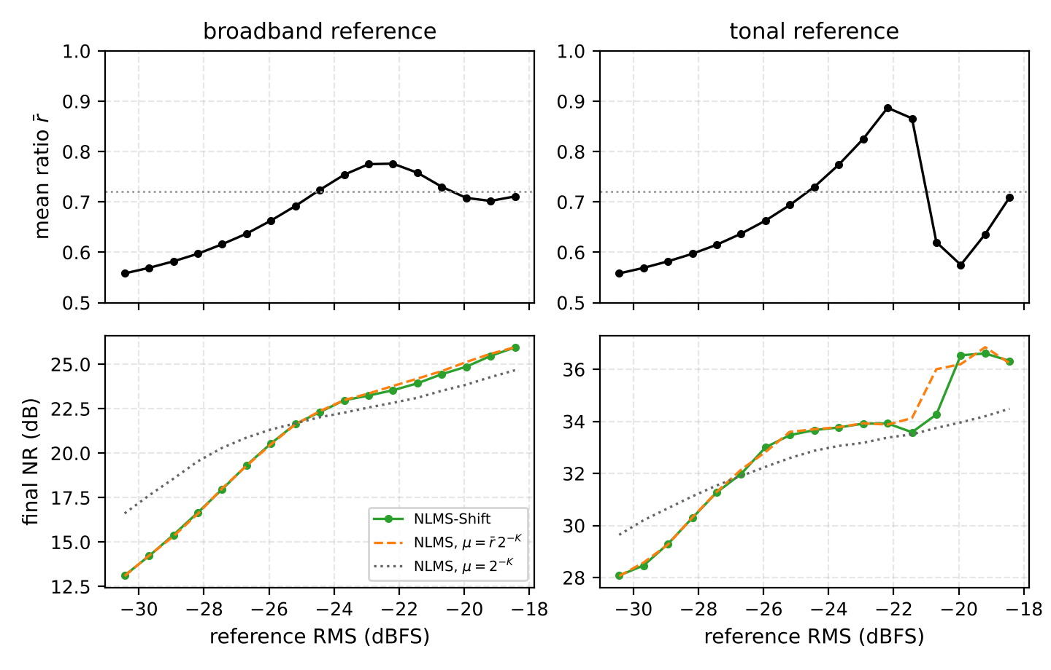
What the shift really changes: only the step size
μ[n] = r[n] · 2⁻ᴷ / (P + ε)
r[n] ∈ [0.5, 1) is where P + ε sits in its octave
Broadband
r̄ moves smoothly between 0.56 and 0.78. NLMS run with the constant step r̄·2⁻ᴷ matches NLMS-Shift within 0.27 dB at all 17 levels.
Tonal
P is nearly constant, so r̄ jumps from 0.87 to 0.62 within 0.75 dB of level at −21.1 dBFS: a step change plain NLMS does not have.
Design rule
Choose K and ε for the expected input level; that matters more than the shift itself.
Integer model, W = 12, L = 32, K = 3, ε = 2⁻². Left: broadband noise; right: two-tone reference.
Notes:
Writing the shift step exactly shows it is the NLMS step times a factor r between one half and one. Top panels: the mean factor versus input level. Bottom: NLMS-Shift (green) sits on top of NLMS with step r-bar times 2^-K (orange dashed), while NLMS with the nominal step (dotted) differs by up to 3.5 dB. On a tone the factor jumps when P+eps crosses a power of two.

Slide 9

NLMS-Shift costs NLMS's area but LMS's cycles
Complete board design, EP4CE115F29C7 | LMS | NLMS | NLMS-Shift
Logic elements | 1,792 | 2,626 | 2,610
Registers | 1,123 | 1,404 | 1,186
9-bit multipliers | 4 | 4 | 4
Fmax, slow 85 °C (MHz) | 70.08 | 59.75 | 58.66
Setup slack at 50 MHz (ns) | 5.731 | 3.263 | 2.953
Latency (cycles) | 35 | 37 | 37
Busy cycles per sample (board) | 73 | 130 | 72
RTL bit toggles per sample | 5,668 | 7,146 | 6,012
45%
fewer busy cycles than NLMS
15%
fewer registers than NLMS
31%
smaller: LMS vs either normalised variant
Power: in progress. Gate-level, activity-based energy per sample is being measured.
Quartus Prime Lite 25.1, commit da0b6f4. All three close timing at 50 MHz with no critical warnings.
Notes:
The divider's area is replaced by the leading-one detector, shifter and a wider update path, so logic elements are about equal. But the shift version needs 72 instead of 130 busy cycles per sample, has fewer registers, and toggles 16% fewer bits. Vectorless Quartus power is only an upper bound; gate-level energy per sample is still being run, so we make no energy claim yet.

Slide 10
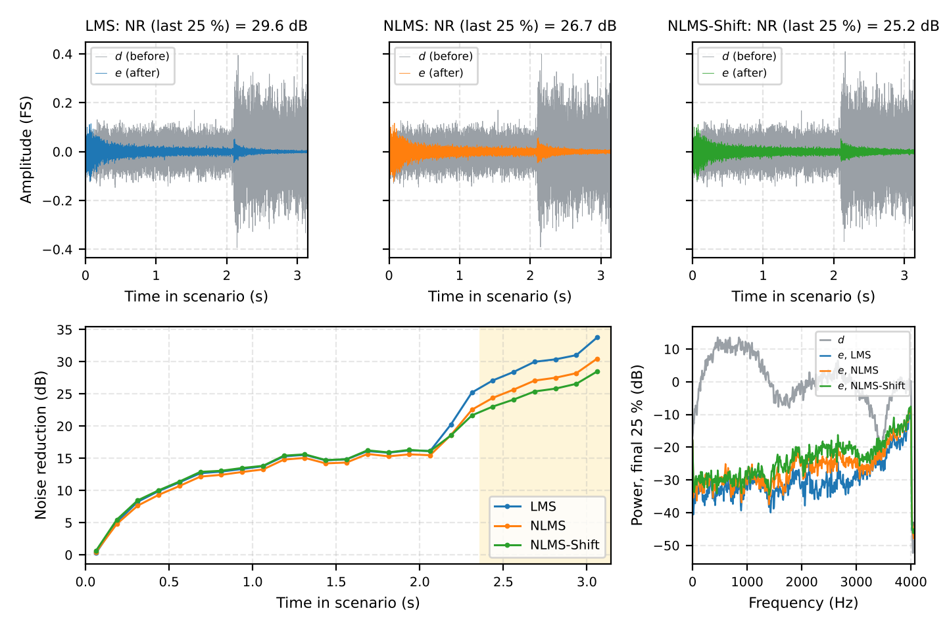
On the board, every output sample matches the model
25
Signal Tap captures, 3 algorithms, 2 sessions
724,459
output samples compared with the integer model
0
mismatches
GPIO timing (LMS / NLMS / Shift)
6,144 cycles per sample = 8,138.02 Hz
in → out: 36 / 38 / 38 cycles
busy: 73 / 130 / 72 cycles, as in RTL
Signal Tap captures of real codec data, amplitude-step noise: d and e (top), running NR and spectra (bottom).
Notes:
The FPGA records its own inputs and output with Signal Tap, triggered on the reset button. We feed the captured x and d to the integer model and compare every e sample: 25 captures, over 724 thousand samples, zero mismatches. So the silicon computes exactly what the simulation computes, even with analogue codec noise and offsets. Timing on the GPIO pins also matches the RTL.

Slide 11
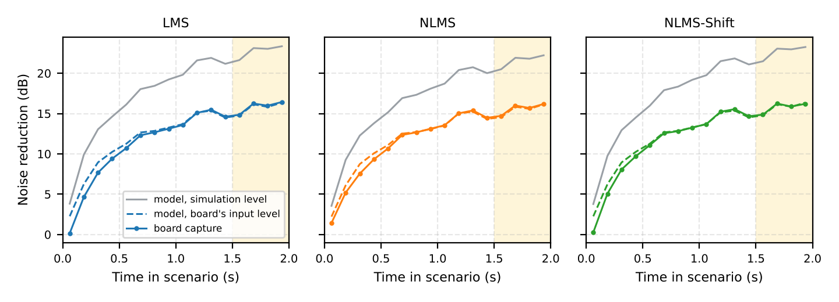
Board NR equals the model at the board's input level
Stationary, final NR (dB) | Board | Model, sim level | Model, board level
LMS | 15.88 | 22.77 | 15.76
NLMS | 15.65 | 21.60 | 15.53
NLMS-Shift | 15.80 | 22.68 | 15.78
Why lower than simulation? The codec delivered x and d at about −27 dBFS, 3 dB below the simulation level, so adaptation is slower. Level-matched, the model agrees within 0.2 dB (stationary, path switch).
Notes:
Session 2 played exactly the 2-second seed-1 simulation signals. Board NR was 2.9 to 10.6 dB below simulation for all three algorithms alike. Cause: input level, not hardware. Scaling the stimulus to the level the board received, the model matches within 0.2 dB on stationary and path-switch noise. For amplitude steps and recorded noise the quiet final quarter is limited by the analogue noise floor (about −70 dBFS), so the board is 1.7–8.1 dB below.

Slide 12



Freeze, DAC word and a 10-minute soak all pass
Freeze switch
PASS
DAC word, ANC mode
PASS
SW[1] flipped 1.44 s into the scenario. Output is bit-exact with adaptation stopped from that sample.
With SW[0] = 0, the word sent to the DAC equals {e, 0000}.
NR 15.4 → 15.2 dB frozen (15.9 dB if it had kept adapting)
1,792 / 1,792 samples match
DAC word, bypass
PASS
10-minute soak
PASS
With SW[0] = 1, the top 12 bits of the DAC word equal d.
Looped noise for 10 minutes; timing unchanged and no saturation, NACK or overrun flag.
1,792 / 1,792 samples match
6,144 cycles/sample · 38 latency · 72 busy
The analogue LINE OUT could not be recorded with the equipment available, so the proof stops at the DAC interface.
Notes:
Freeze holds the weights while filtering continues: the capture matches the model with adaptation stopped from the exact sample the switch was flipped. A third logic-analyser instance recorded the DAC word in ANC and bypass mode — all samples match. After 10 minutes the timing was unchanged and no error flag lit.

Slide 13
How ULLAP sits among related work
Work | Platform | Normaliser | Reported
Garrett et al. 2002 | ASIC, NLMS equaliser | Power-of-two (leading-zero count) | Origin of the shift idea
Zhao et al. 2018 | Virtex-7, beamformer | Quantised normaliser, CSD | ≥21% fewer LUTs vs divider
Huang et al. 2024 | DE2-115, 16-tap FIR | 4-bit LUT reciprocal | 10.52 vs 18.60 nJ/sample
Huang & Yao 2026 | DE2-115, 5th-order IIR | LOD + shift + 2-segment reciprocal | 5.07 vs 8.33 nJ/sample
Rodrigo & Buddhika 2024 (base) | MATLAB / Vivado sim | LMS only | No numeric results
ULLAP (this work) | DE2-115 + WM8731, 32-tap | LMS | divider | shift, one core | Equal tuning, 20-seed CI, bit-exact on board
Not a head-to-head benchmark. Platforms, word lengths and tasks differ. What ULLAP adds is three variants on one core under equal tuning, with a codec and a bit-exact chain to the board. No energy comparison until gate-level power is done.
Notes:
Removing the NLMS divider is an established idea. The Huang papers on the same DE2-115 board are the closest hardware relatives, but they are fully parallel and run at megasamples per second; ours is serial at 8 kHz. None of these compares LMS, a true divider and a shift on one core with equal tuning, and few test a complete audio system with a codec on a board.

Slide 14

Limitations, stated plainly
Not better than NLMS
Simulated acoustic paths
NLMS-Shift matches NLMS in cancellation; it is NLMS with a level-dependent step (×0.5 to ×1). The idea is prior art.
Paths are simulated even for real recordings. The base paper's closed-loop feedback (howling) is not covered.
No analogue output recording
Level-dependent board NR
Proof stops at the DAC word; LINE OUT was not recorded.
14–17 dB on the board vs 19–28 dB in simulation, because the input was 3 dB lower. Set codec gain or retune μ.
Power not final
Speech limits adaptation
Only vectorless estimates (upper bounds). Gate-level energy per sample is in progress.
Freezing during speech with a voice-activity detector is not evaluated.
Notes:
We want to be honest about scope. The shift variant is not a better canceller than NLMS; it's cheaper in cycles. The acoustic environment is simulated. The analogue output wasn't recorded. Board NR depends on input level. Power numbers are not final.

Slide 15
Conclusion
One serial 12-bit, 32-tap core runs LMS, NLMS and NLMS-Shift on a low-cost Cyclone IV board, with no processor.
Under equal tuning, NLMS-Shift matches NLMS within the 95% CI using 72 instead of 130 busy cycles per sample.
Real noise: 11.7–14.9 dB removed, 18.5–31.9 dB without speech, so speech is the limit.
On the board, 724,459 samples are bit-exact; board NR equals the model within 0.2 dB at the received level.
Future work
Gate-level energy per sample, then compare with Huang & Yao
Voice-activity detector driving the freeze input
Codec gain or step retune for the expected level
Multi-channel time-sharing (core is ~98% idle)
Public release with a DOI
Thank you · Questions?
Notes:
Summary of the four take-aways, then future work. Thank the audience and take questions.

