Slide 1
EAS2655 – Week 2
Agenda
Reading: section 1.1
Statistical distribution
Central Limit Theorem
Bootstrapping
Coding practices

Slide 2
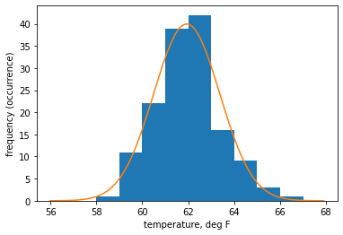
EAS2655 – Week 1 review
Atlanta’s Annual mean temperature ≃ Gaussian
Mean = 61.934°F
Median = 61.921°F
s.d. = 1.437 °F

Slide 3
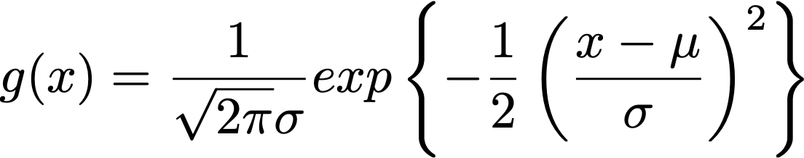
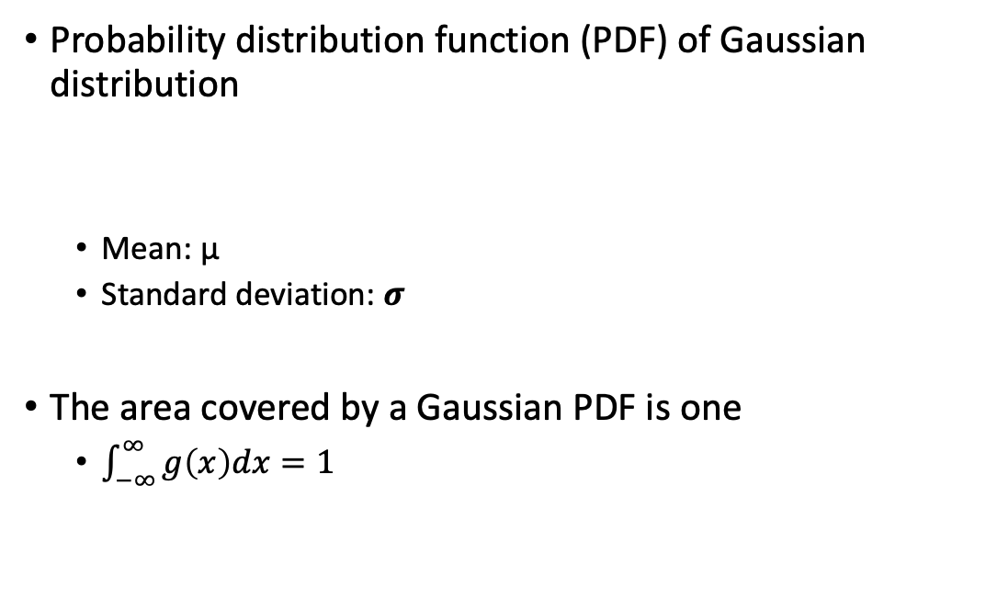
EAS2655 – Week 1 review
Probability distribution function (PDF) of Gaussian distribution
Mean: μ
Standard deviation: 𝝈
The area covered by a Gaussian PDF is one
$\int_{−∞}^{∞}{g\left(x\right)dx}=1$

Slide 4
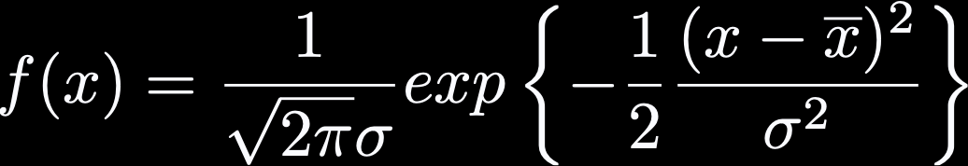
EAS2655 – Week 2
Atlanta’s annual mean temperature ≃ Gaussian
Properties of Gaussian (normal distribution)
Symmetric
Mean = Median = Mode
μ ± 1σ contains 68% of data
μ ± 2σ contains 95% of data

Slide 5
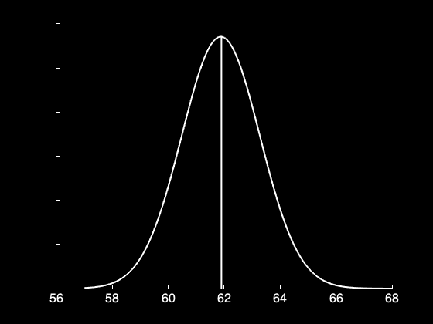
EAS2655 – Week 2
Atlanta’s annual mean temperature ≃ Gaussian
Properties of Gaussian (normal distribution)
Symmetric
Mean = Median
μ ±1σ contains 68% of data
μ ±2σ contains 95% of data
Median/mean

Slide 6
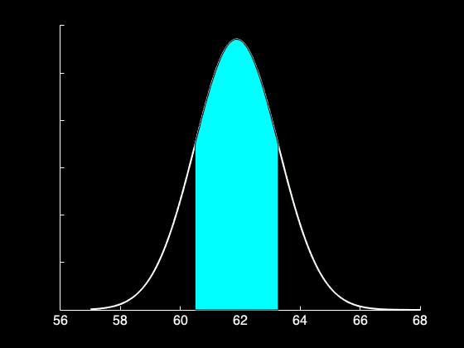
EAS2655 – Week 2
Atlanta’s annual mean temperature ≃ Gaussian
Properties of Gaussian (normal distribution)
Symmetric
Mean = Median = Mode
μ ±1σ contains 68% of data
μ ±2σ contains 95% of data
±1σ

Slide 7
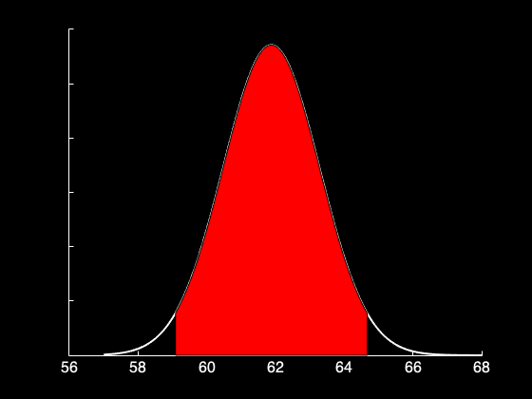
EAS2655 – Week 2
Atlanta’s annual mean temperature ≃ Gaussian
Properties of Gaussian (normal distribution)
Symmetric
Mean = Median = Mode
μ ±1σ contains 68% of data
μ ±2σ contains 95% of data
±2σ

Slide 8
EAS2655 – Week 2
Probability density function (PDF)
Gaussian as a PDF
The area covered by the PDF is the probability
μ ±1σ contains 68% of data, μ ±2σ contains 95% of data
0.68
0.95

Slide 9
EAS2655 – Week 2
Project 1: Atlanta Annual mean temperature
Sample mean = 61.934°F
Sample s.d. = 1.437 °F
144 years
Data within mean ± 1 s.d.: 104/144 = 72.2%
Data within mean ± 2 s.d.: 138/144 = 95.8%

Slide 10
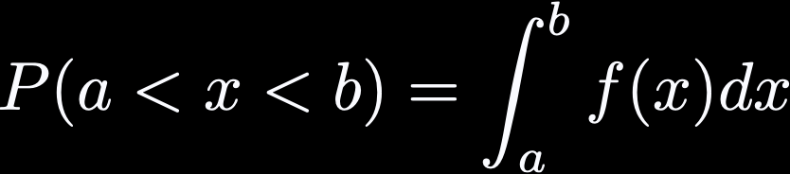
EAS2655 – Week 2
Probability density function (PDF)
Gaussian as a PDF
The area covered by the PDF is the probability
±1σ contains 68% of data, ±2σ contains 95% of data
More generally,

Slide 11
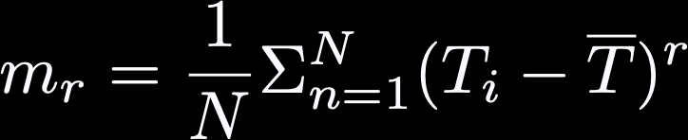
EAS2655 – Week 2
Higher order moments about the mean
r=2: Second order moment is variance.
r=3: Third order moment is skewness.

Slide 12
EAS2655 – Week 2
Project 2:
Example: rolling a dice
Let’s imagine rolling a dice N times and record the numbers as X = [X₁, X₂, X₃, …. X_{N}]
For a large N, what is the expected mean of X?
What is the expected standard deviation of X?

Slide 13
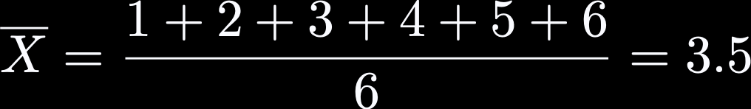
EAS2655 – Week 2
What is the expected mean of X?

Slide 14
EAS2655 – Week 2
What is the expected mean of X?
Let’s say P(x) is the probability of having the value, x. In this case, P(x) is constant, 1/6, for the range from 1 to 6. If N is very large, you will get roughly equal occurrence from 1 to 6, i.e. with the equal probability of 1/6. Then you expect to get the mean of 3.5 as the sum of xP(x)

Slide 15
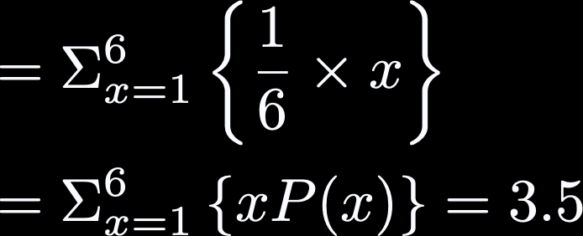
EAS2655 – Week 2
What is the expected mean of X?

Slide 16
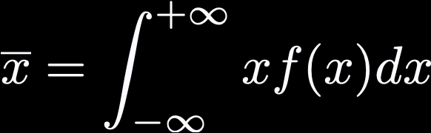
EAS2655 – Week 2
Given a PDF of a dataset, f(x), the mean can be calculated as follows.

Slide 17
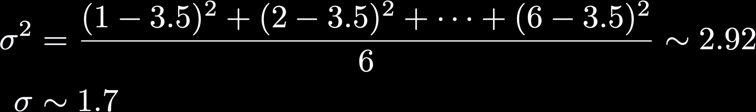
EAS2655 – Week 2
What is the expected standard deviation of X?

Slide 18

EAS2655 – Week 2
What is the expected standard deviation of X?

Slide 19
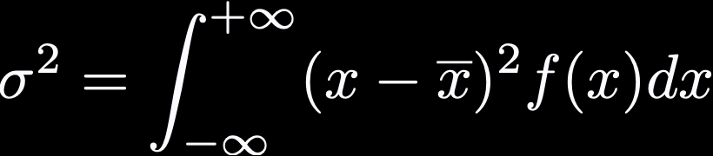
EAS2655 – Week 2
Given a PDF of a dataset, f(x), the variance can be calculated as the second moment around the mean.

Slide 20
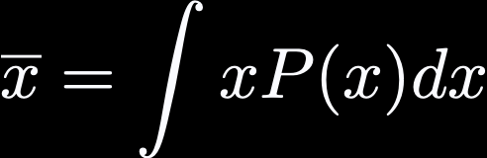
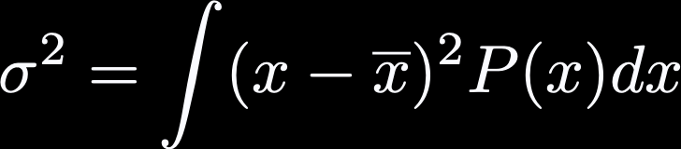
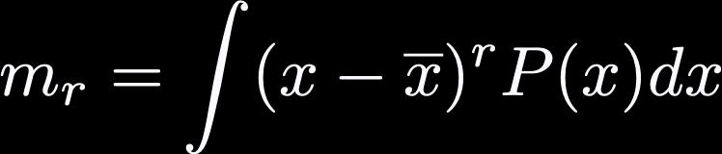
EAS2655 – Week 2
In continuous notation,
Mean
Variance
k-th moment

Slide 21
EAS2655 – Week 2
Central Limit Theorem
1. Mean of sample mean (M) is equal to the population mean (μ) for large enough samples.
What does this mean?

Slide 22
EAS2655 – Week 2
Central Limit Theorem
1. Mean of sample mean (M) is equal to the population mean (μ) for large enough samples.
Dice example: Let’s say you roll N=10 times, record average value as sample mean (M).
Repeat this (N=10 rolls) many times, you will have many sample means [M₁, M₂, …]. Then average of M will converge to 3.5.

Slide 23

EAS2655 – Week 2
Central Limit Theorem
2. Standard error measures the average distance between sample mean (M) and the true mean (μ).

Slide 24

EAS2655 – Week 2
Central Limit Theorem
2. Standard error measures the average distance between sample mean (M) and the true mean (μ).
Dice example: Sample mean, M, averages to 3.5 but each member of M is not exactly at 3.5.
Its typical error (difference from μ=3.5) is

Slide 25
EAS2655 – Week 2
Central Limit Theorem
3. Sample mean (M) follows the normal distribution (Gaussian) regardless of the parent population.

Slide 26
EAS2655 – Week 2
Central Limit Theorem
3. Sample mean (M) follows the normal distribution (Gaussian) regardless of the parent population.
Dice example: Make a histogram of M. We will see Gaussian distribution!

Slide 27
Computational example: rolling a dice
Develop a computer program to generate random number [1,6] for N times.
Then average the N numbers and record the result as M.
Repeat many times (let’s say 1,000 times).
What is the mean and standard deviation of M?
How does the histogram of M look like?

Slide 28
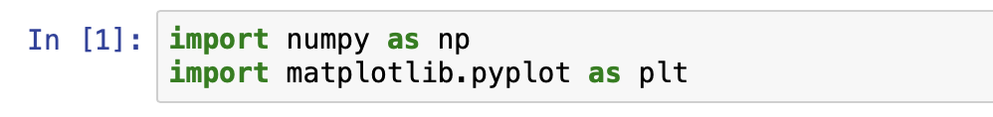
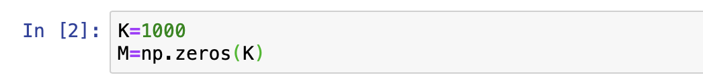
Python example
Import the libraries first
Define parameters (K=1000) and prepare an empty array for M

Slide 29
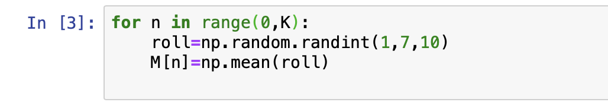

Python example
Use for loop. Use random number generator. Store average in M.
1. Mean of sample mean (M) is equal to the population mean (μ) for large enough samples.

Slide 30

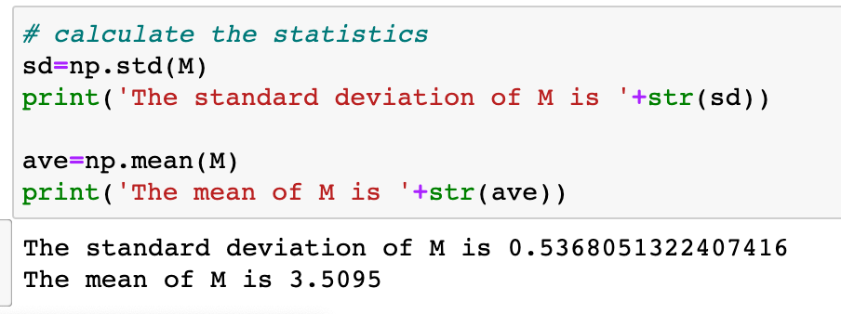
Python example
2. Standard error measures the average distance between sample mean (M) and the true mean (μ).

Slide 31
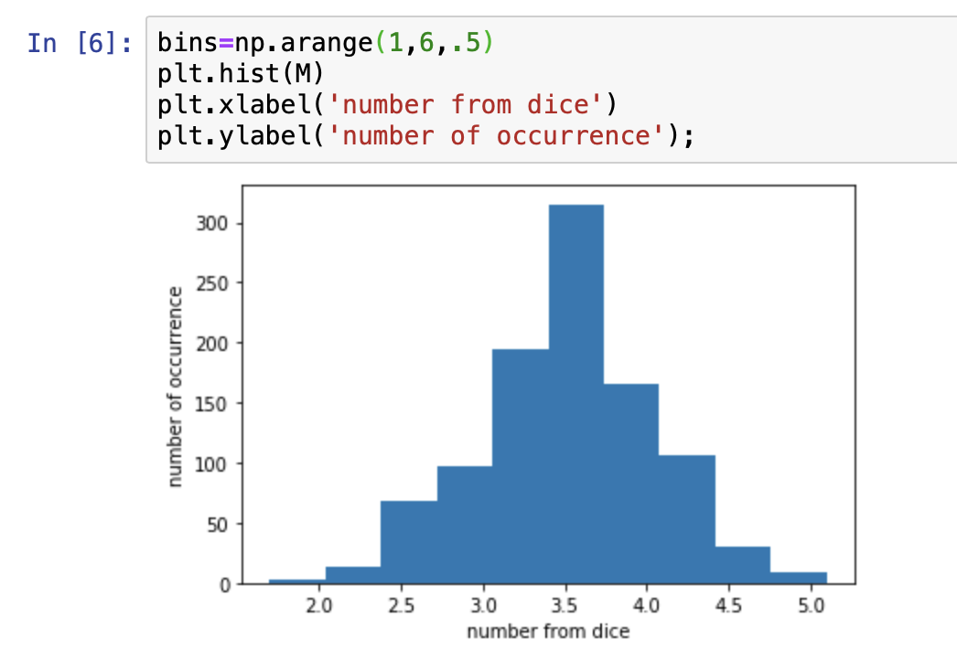
Python example
3. Sample mean (M) follows the normal distribution (Gaussian) regardless of the parent population.

Slide 32
Application to Atlanta’s temperature data
Randomly sample (non-overlapping) 10 years from the past 144 years (1879 to 2022). Take the average.
Repeat this many times. This will generate distribution of 10-year average temperature.
How does this compare to Gaussian with the expected mean and standard error?

Slide 33
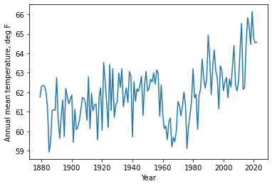
Application to Atlanta’s temperature data
Temperature of Atlanta appears to be warming up.
Is the last ~10 years significantly warmer than the long-term mean?

Slide 34
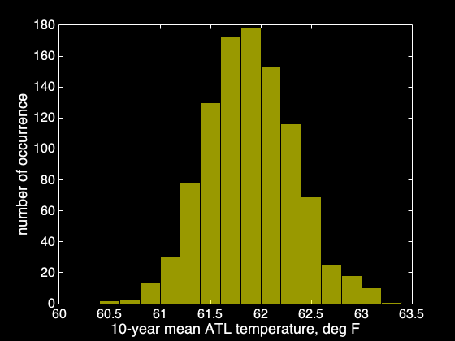
Application to Atlanta’s temperature data
N=10-year random sampling
Repeated K=1000 times
Mean of sample mean (M) = 61.89°F
True mean (μ) = 61.88°F
Standard deviation of M = 0.44°F
Standard error ( )= 0.44°F

Slide 35

Application to Atlanta’s temperature data
In the last 10 years (2010-2019) the average temperature was 64.23°F
95 percentile = 62.63°F

Slide 36

Application to Atlanta’s temperature data
In the last 10 years (2010-2019) the average temperature was 64.23°F
95 percentile = 62.63°F
99 percentile = 63.00°F

Slide 37
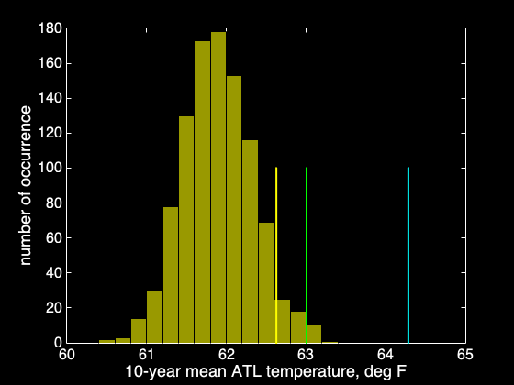
Application to Atlanta’s temperature data
In the last 10 years (2010-2019) the average temperature was 64.23°F
95 percentile = 62.63°F
99 percentile = 63.00°F
Last 10 years was significantly warmer relative to the long-term mean. How significant? It is much higher than 99 percentile.

Slide 38
Monte Carlo simulation / Bootstrap method
Random re-sampling of dataset
It can be applied to determine standard error and the statistical tests of hypothesis
This is called Monte Carlo Simulation. This approach allows to estimate percentile values from random resampling.
We will apply this approach to the historical climate data in the next lecture.

Slide 39
Additional material: Linear Algebra Review (1)

Slide 40
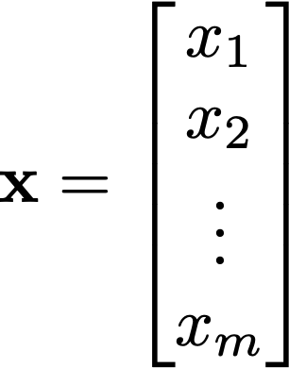
Vector
In physics, vector has a direction and magnitude, like velocity of a moving object.
In data science, a series of data can be expressed as a vector or an 1D array (let’s say there are m data points, then you have a m-dimensional vector)

Slide 41
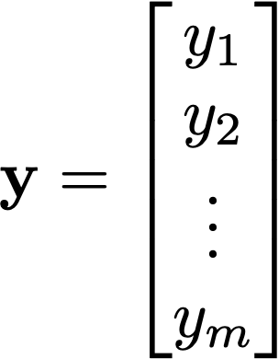
Vector
When there are more then two vectors, they can add together to form another vector
x + y
y
x

Slide 42
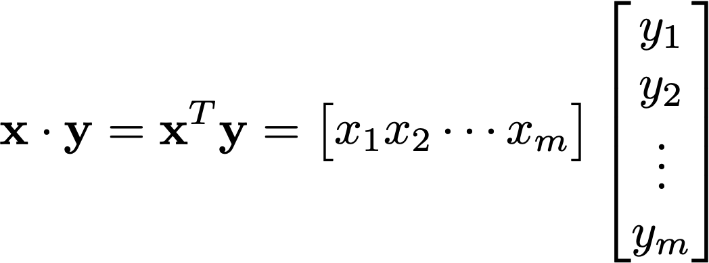

Vector
Vectors can multiply together: inner product produces a scalar
(remember “row times column”)
In a 2D example,
y
θ
x

Slide 43
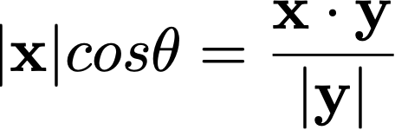
Vector
Vectors can multiply together: inner product produces a scalar
(remember “row times column”)
In a 2D example,
The projection of x onto y is:
y
θ
x

Slide 44
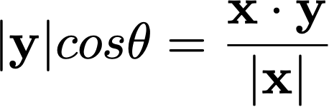
Vector
Vectors can multiply together: inner product produces a scalar
(remember “row times column”)
In a 2D example,
The projection of y onto x is:
y
θ
x

Slide 45
Inner product and (co)variance
In data analysis, vector can contain a collection of measurements (e.g. mean August temperature of Atlanta from last 140 years)

Slide 46
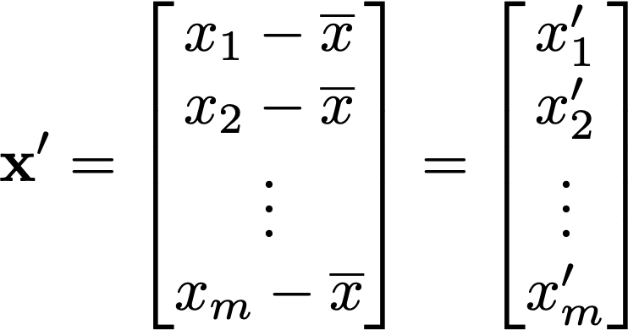
Inner product and (co)variance
Let’s subtract mean of x from all elements, so x becomes x’

Slide 47
Inner product and (co)variance
Inner product of x’ with itself the square of the ”length” of the x’ vector.
It is equal to the variance (σ² or σ_{xx}) of the data contained in vector x multiplied by N-1
The “length” |x’| is also called the L2 norm

Slide 48
Inner product and (co)variance
Inner product of x’ and y’ is:
the covariance of the data contained in vector x and y (multiplied by N-1)
(2) the projection of x onto y (multiplied by |y’|)
(3) Proportional to the correlation between x and y

Slide 49
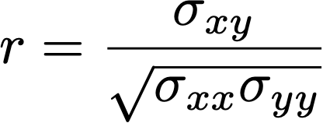
Inner product and (co)variance
Inner product of x’ and y’ is:
the covariance of the data contained in vector x and y (multiplied by N-1)
(2) the projection of x onto y (multiplied by |y’|)
(3) Proportional to the correlation between x and y

Slide 50
Continue to next week!

