Slide 1
EAS2655 - Week 7
Midterm this week (Thursday Feb 23rd, anytime of the day)
Covers material from Week 1 through 6
60min, online, open-book, OK to use of calculator, but No ChatGPT
This week
Term project
Review of sample questions

Slide 2
EAS2655 – Week 7
Term project requirement
Apply at least one quantitative method to earth science data
Regression / Correlation
Significance test / t-test
Multiple linear regression
Interpolation / smoothing / curve fitting
Fourier analysis / Singular value decomposition
Ordinary differential equations (ODE)
Choose your own topic / group or collaborative projects are welcome
Ask EAS faculty members for suggestion

Slide 3
EAS2655 – Week 7
Some of term project topics from past years:
Atlantic tropical cyclone statistics
Correlation analysis of temperature and precipitation in Key West
Martian Gale Crater Temperature and Pressure Data
ENSO impacts on North American Cities
Aerosol optical depth and temperature
Impact of air quality in LA and Dodgers performance at Home
Nitrogen loading into Gulf of Mexico
Campus air quality investigation
Bermuda Atlantic Time Series Analysis
The relationship between Atribacteria ASV abundance and geochemistry parameters

Slide 4
EAS2655 – Week 7
Term project timeline
March 17 – Topic due (submit via canvas)
Set the scope of your research
We will provide feedback
Schedule office hours if you need input
April 18, 20, and 25 – Presentations (aim for 7 min presentation + 2 min Q&A; collaborative projects can go up to 10 min presentation + 3min Q&A)
Presentation slides (aim for 7-10 slides including title, background, results, and conclusions)
Visualize the data analysis
Grading rubric

Slide 5
EAS2655 – Week 7
Term project grading rubric
Structure
Introduction/Method/Results/Conclusion
Scientific contents
Stated objective/Data analysis/Interpretation
Graphics / Figures
Data presentation/axes labeled correctly?/units/easy to read and understand?
Delivery of presentation
Clarity of slides/clear voice and good pace/response to questions

Slide 6
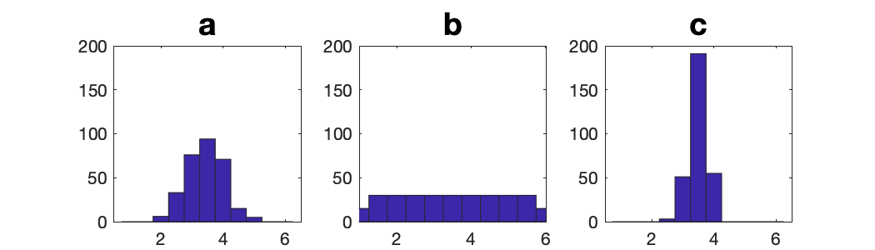
Quiz 1
You are teaching a statistics class with 300 students. You let each student roll dice 9 times, average the numbers and report the result. You then generate a histogram. Which graph do you expect to see?

Slide 7
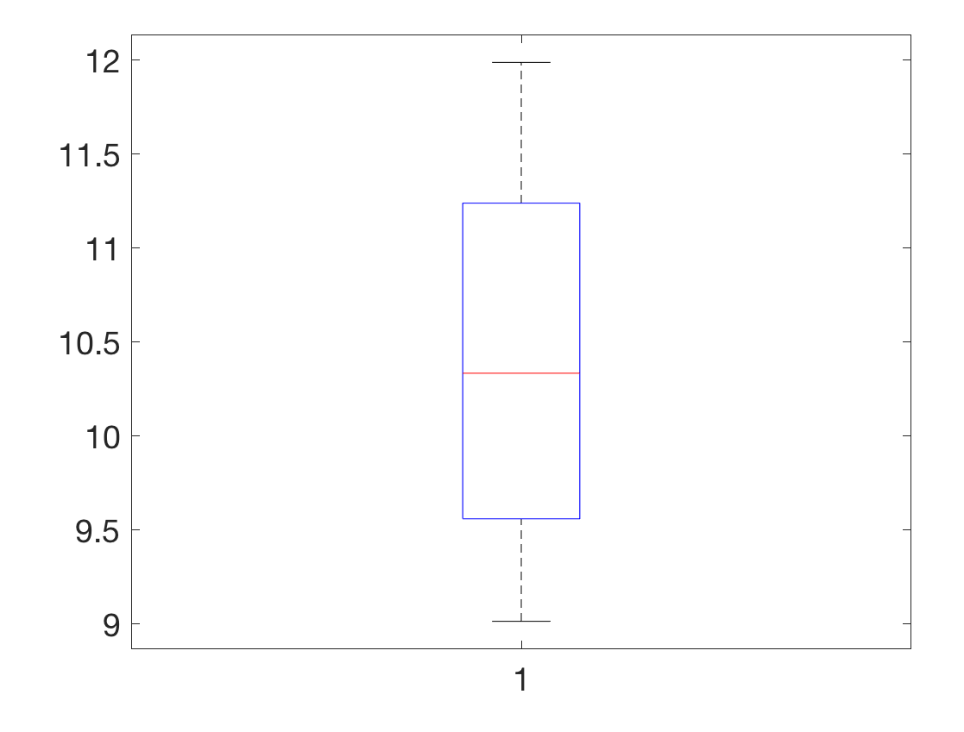
Quiz 2
You generated a box plot from the measurements you made in the lab. Approximately, what is the median and IQR?
1 and 1.5
9.5 and 3
10.3 and 1.5
10.3 and 3

Slide 8
Quiz 3
You assembled the dataset from your recent field study. The initial processing of the data indicates that the standard deviation is much greater than the IQR from the same dataset, more than a factor of 10. Which statement is most relevant to this situation?
The sample contains outliers. They must be identified before further analysis.
It is normal to have different magnitudes between standard deviation and IQR.
The samples of the dataset form a Gaussian distribution.
95% confidence interval depends on the standard deviation.

Slide 9
Quiz 4
The Central Limit Theorem states that the average of random samples will produce a Gaussian distribution. The mean of samples derived from 100 measurements is found to be 10 with a sample standard deviation of 1.0. What is the 95% confidence interval of the true population mean?
9.7 < μ < 10.3
9.8 < μ < 10.2
9.98 < μ < 10.02
8 < μ < 12
Notes:
D; t = signal/SE

Slide 10
Quiz 5
The t-value from the previous question could not reject the null hypothesis with 95% confidence level. Assuming that the mean productivity response remains the same, how many more additional deposition events will be required to increase the t-value to 1.9?
6
10
16
20

Slide 11
Quiz 6
An online survey shows that the economy-class air ticket from Atlanta to Boston randomly fluctuated following the Gaussian distribution with the mean of $400 and the standard deviation of $50. Approximately what’s the probability for finding a deal below $300??
32%
16%
2.5%
5%

Slide 12
Quiz 7
You are investigating the relationship between humidity and pollen count and found a moderate, negative correlation. Which statement is NOT true?
On average, less pollen is observed on high humidity days.
On some high humidity days, more pollen is found.
Correlation does not mean causal relationship.
Pollen level is always high on low humidity days.

Slide 13
Quiz 8
You performed a linear regression analysis and your data showed R² value of 0.6. Which statement is true?
There is a positive relationship between the two variables.
36% of variance is explained by the linear relationship.
60% of variance is explained by the linear relationship.
Correlation does not mean causal relationship.

Slide 14
Quiz 9
True or False: Due to the difficulty of obtaining a large sample, I decided to perform hypothesis testing at a lower, 90% confidence level. This makes my conclusion relatively prone to making Type I errors.
True
False

Slide 15
Quiz 10
True or False: An error occurs when you reject the null hypothesis wrongly when random sampling falsely causes an apparently strong signal. If I am using 90% confidence level, on average, this can happen once in every 100 cases.
True
False

Slide 16
Quiz 11
True or False: I want to narrow the uncertainty in my laboratory measurement by taking larger number of samples. I need to make two times more measurements in order to reduce the standard error by half.
True
False

Slide 17
Quiz 12
We want to compare mean January temperature of Atlanta between 1950s and 2000s. The January temperature from 1950 to 1959 has the mean value of 45.4°F with the standard deviation of 4°F. For 2000 to 2009, the mean value is 47.4°F with the standard deviation of 4°F. What would be the null hypothesis?
January temperatures of 1950s and 2000s are different
January temperature of 1950s is warmer than 2000s
January temperature of 1950s is cooler than 2000s
January temperatures of 1950s and 2000s are the same

Slide 18
Quiz 13
You are analyzing marine primary productivity data following 10 aerosol dust deposition events. Comparing one week before and after the deposition, on average, the ocean productivity increased by 6 gC/m2/day. Standard deviation of productivity is 12 gC/m2/day. What is the t-value?
t = 0.6
t = 0.9
t = 1.2
t = 1.5

Slide 19
Quiz 14
Following the previous question, you are performing t-test to determine the significance of the increase in marine primary productivity induced by dust events with one-tailed test. The degree of freedom is 9 and you choose to use 95% confidence level. Fill in the box below to calculate the critical t-value.
>>tcrit = tinv( ,9)

Slide 20
Quiz 15
The above t-test was not significant at the stated confidence interval. Assuming that the mean increase of 6 gC/m2/day remains the same, how many additional dust events will be required to increase the magnitude of |t| to 1.8?
4
7
16
30

Slide 21
Quiz 16
You performed the t-test and concluded that the A and B are not significantly correlated. How did you arrive this conclusion?
The average values of A and B are similar.
The average values of A and B are significantly different.
The effective sample size is large.
The t value of the correlation did not exceed the critical value at the chosen confidence level.

Slide 22
Quiz 17
You calculated the correlation coefficient between El-Nino Southern Oscillation and the December sea surface temperature over the Subtropical North Pacific Ocean for the last 66 years. The correlation coefficient was -0.6. What is the 95% confidence interval of the true correlation?
-0.9 < r < -0.3
-0.8 < r < -0.4
-0.7 < r < -0.5
-0.65 < r <-0.55

Slide 23
Quiz 18
Consider the dataset X = [12, 5, 64, 0, 47, 88, 19, 37, 22, 63, 72]. What is the median?
37
22
42
47

Slide 24
Quiz 19
You have collected a dataset and want to visualize its statistical distribution. What would be the appropriate plot to make?
Histogram
Scatter diagram
Least square fit
Bar chart

Slide 25
Quiz 20
If the sample size N is sufficiently large, we may assume that the sample mean is normally distributed, i.e. we may approximate its distribution with a Gaussian. What is the minimal sample size that can be considered as sufficiently large?
N=10
N=15
N=30
N=100

