Slide 1
EAS2655 – Week 1
Instructor: Pengfei Liu
Email: pengfei.liu@eas.gatech.edu
Teaching Assistant: Abhinav Pratap Singh
Email: abhinavps@gatech.edu
Tue, Thu: 14:00-15:15 L1116
Office hour:
Thu 15:30-16:30 pm (Liu)
Wed 10:00-11:00 am (Singh)

Slide 2
EAS2655 – Week 1
Agenda
Introduction
Syllabus
Course overview
Schedule for the spring term
Evaluation: grading scheme
MATLAB or Python?
Review of fundamental statistics

Slide 3
EAS2655 – Week 1
The default class delivery mode is in person.
However, we will broadcast/record lectures
We will accept delayed homework submission with reasonable explanations. Please let us know BEFORE the deadline so we can work out some arrangements
There will be NO paper handouts
All homework will be submitted online
All exams will be online

Slide 4
EAS2655 – Week 1
Objective: practical application of basic statistics and differential equations as a set of tools to investigate Earth Science problems
Textbook:
Ito, Quantitative Techniques for Earth and Atmospheric Sciences
downloadable from canvas
MATLAB only
Github: https://github.com/pengfeiliu371/EAS2655_S2023
Equipment: You will need a computer that can run MATLAB and/or Python

Slide 5
EAS2655 – Week 1
[50%] homework (8 best scores from 9 assignments)
[30%] 2 midterms and a final. We use the best two of the three exams (15% x 2 = 30%)
[20%] term project (oral presentation)

Slide 6
EAS2655 – Week 1
Tentative schedule
Week 1: Reviews of basic statistics
Week 2: Normal distribution and Central Limit Theorem
Week 3: Hypothesis testing
Week 4: Regression and correlation
Week 5: Confidence interval and significance test
Week 6: Multiple linear regression
Week 7: Review and Midterm #1

Slide 7
EAS2655 – Week 1
Week 8: Data visualization
Week 9: Correlation maps
Week 10: Fourier Analysis
Week 11: Ordinary differential equation (box model)
Week 12: Matrix exponential (multiple box model)
Week 13: Review and Midterm #2
Week 14: Student presentations

Slide 8
A review of basic statistics

Slide 9
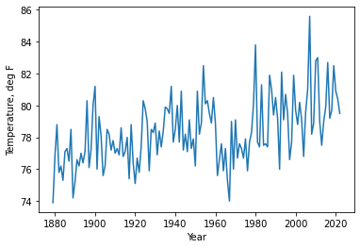
A quick look at the monthly (August) temperature of Atlanta
National weather service, w2.weather.gov

Slide 10
What is the representative value?

Slide 11
What is the representative value?
Mean
Median (50 percentile)

Slide 12
How much does the data vary?

Slide 13
How much does the data vary?
Standard deviation
IQR (Inter-Quartile Range) = (75 percentile) – (25 percentile)

Slide 14
Mean vs median
Mean and Median: which one should you choose?

Slide 15
Mean vs median
Mean and Median: which one should you choose?
Atlanta annual mean temperature
Mean = 61.934°F
Median = 61.921°F
The annual mean temperature generally follows a normal distribution (un-skewed)

Slide 16
Mean vs median
Mean and Median: which one should you choose?
9 people makes $50K and 1 person make $1M
Mean = $145K
Median = $50K
The answer depends on the statistical distribution of the data. Mean and variance are impacted by outliers.

Slide 17
Mean vs median
Mean and Median: which one should you choose?
9 people makes $50K and 1 person make $1M
Remove outlier ($1M) and re-calculate the mean and median
Mean (w/o outlier): $50K
Median: $50K

Slide 18
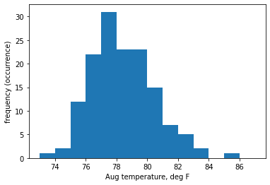

Statistical distribution
Statistical distribution of data: Histogram
Data is binned.
Data count is displayed as a bar chart.
The area is equal to the
(sample size) x (bin size)

Slide 19
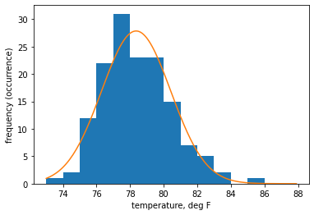
Statistical distribution
Statistical distribution of data: Histogram
Data is binned.
Data count is displayed as a bar chart.
The area is equal to the
(sample size) x (bin size)

Slide 20
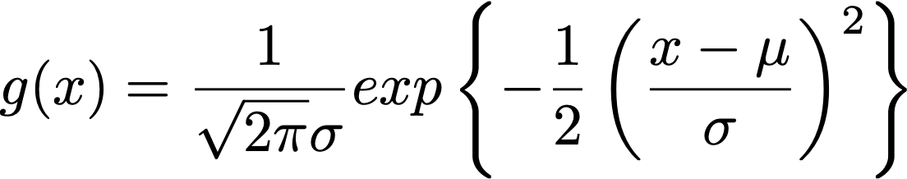
Gaussian: normal distribution
The bell curve
Symmetric
The total area covered by a Gaussian is unity (1).
So, the orange plot is NΔx g(x).

Slide 21
Visualizing distribution
To generate a plot like this we need to:
Download data
Read data into MATLAB or Python (data I/O)
Manipulate data as needed
Plot them

Slide 22
Reading data using MATLAB
GUI approach “Import Data” from the menu bar
There are many commands in MATLAB to read in data. Use ’>> help xxx’ to learn how to use them (replace xxx with the name of the command). Here are a couple of examples: load, fopen, fread, fclose, readtable, importdata, textscan, textread, csvread, csvwrite, xlsread, etc…

Slide 23
Reading data using python
“Pandas” is the core library for processing spreadsheet-like data tables in python. In combination with ”numpy” and “matplotlib” libraries, it performs similar to MATLAB
import numpy as np
import pandas as pd
https://pandas.pydata.org/docs/getting_started/index.html

Slide 24
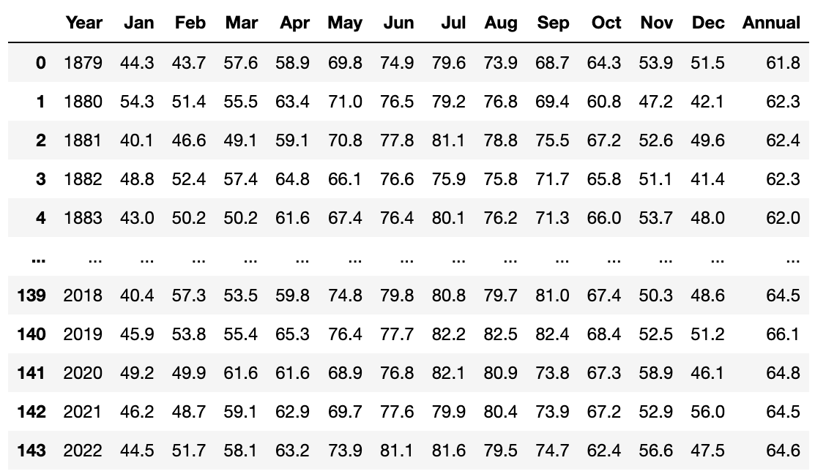
Example: monthly temperature of Atlanta since 1879 to present
Data source: w2.weather.gov
Available from Github repo and Canvas

Slide 25
Example: monthly temperature of Atlanta since 1879 to present

Slide 26
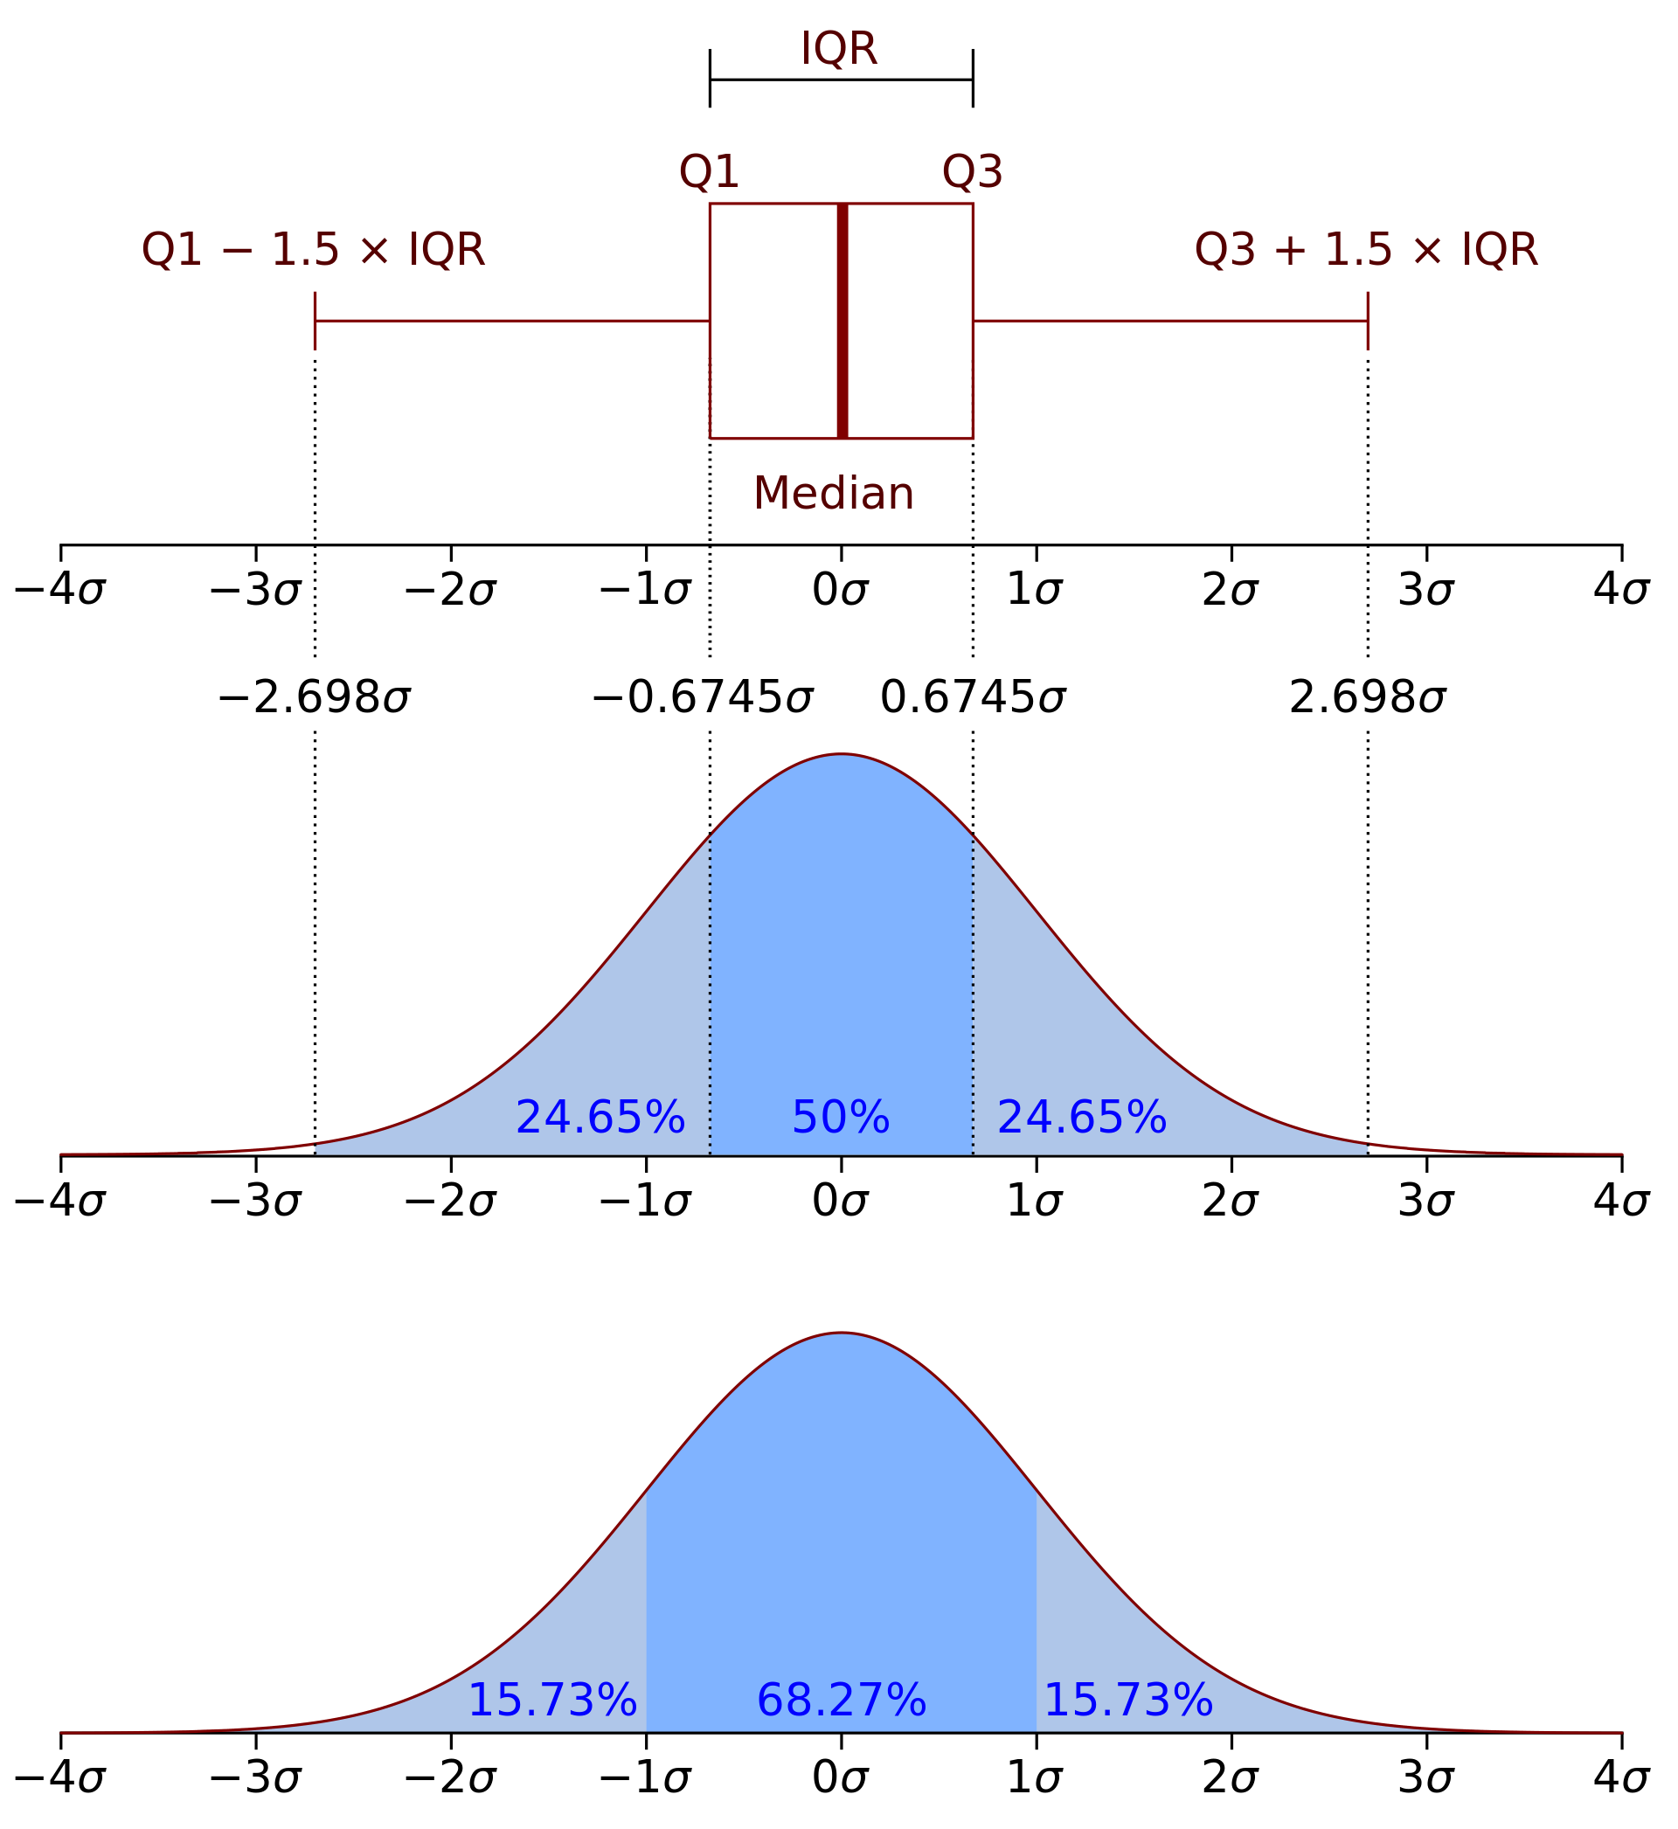
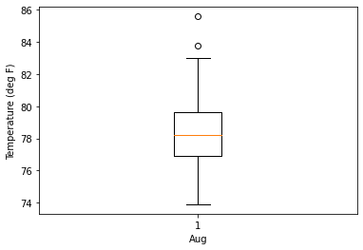
Example: monthly temperature of Atlanta since 1879 to present
Box plot for a normal distribution

Slide 27
Example: monthly temperature of Atlanta since 1879 to present
”outliers”
”maximum” and “minimum”
Data source: w2.weather.gov
Available from: https://github.com/pengfeiliu371/EAS2655_S2023/blob/master/python/ATL_MonMeanTemp_1879_2022.xlsx

Slide 28
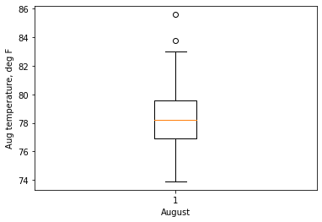
Example: monthly temperature of Atlanta since 1879 to present
”75 percentile” and “25 percentile”
”median or 50 percentile”
Data source: w2.weather.gov
Available from: https://github.com/pengfeiliu371/EAS2655_S2023/blob/master/python/ATL_MonMeanTemp_1879_2022.xlsx

Slide 29
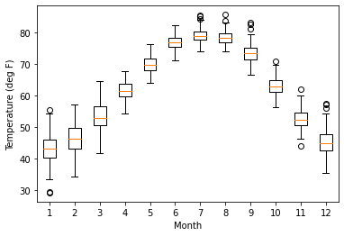
Example: monthly temperature of Atlanta since 1879 to present
Data source: w2.weather.gov
Available from: https://github.com/pengfeiliu371/EAS2655_S2023/blob/master/python/ATL_MonMeanTemp_1879_2022.xlsx

Slide 30
References
MATLAB: Check out mathworks.com website:
Data I/O
GUI data import tool https://www.mathworks.com/help/matlab/ref/importtool.html
“readtable” https://www.mathworks.com/help/matlab/ref/readtable.html
(old but still works) “xlsread” https://www.mathworks.com/help/matlab/ref/xlsread.html
Plotting:
Mathworks tutorial https://www.youtube.com/watch?v=rLeMOEWkoa8
Python
Data I/O
“pandas” https://pandas.pydata.org/docs/getting_started/index.html
“pandas.read_excel” https://pandas.pydata.org/docs/reference/api/pandas.read_excel.html
Plotting:
matplotlib https://matplotlib.org/
Cartopy https://scitools.org.uk/cartopy/docs/latest/

Slide 31
Let’s reproduce these figures using Python and MATLAB!

Slide 32
Before Thursday
Reading: Ito book section 1.1
Install python/MATLAB on your computer
For python users, I will be using Anaconda and Jupyter notebook. We will be using libraries such as numpy, pandas, xarray, matplotlib, cartopy this semester. There libraries should be already pre-installed in Anaconda. If not, you could install these packages manually when they are needed (see conda cheat sheet on Canvas)
Bring a laptop in the class on Thursday, if possible

Slide 33
Agenda (Thursday)
Demo in MATLAB (Atlanta temperature)
Basic MALAB/Python Tutorial (by Abhinav)
How to download data from weather.gov
Homework 1
Active learning: Run the code by your own

