Slide 1
EAS2655 – Week 5
Agenda
Some reviews
Statistical significance of correlation and regression
Reading section 1.4

Slide 2
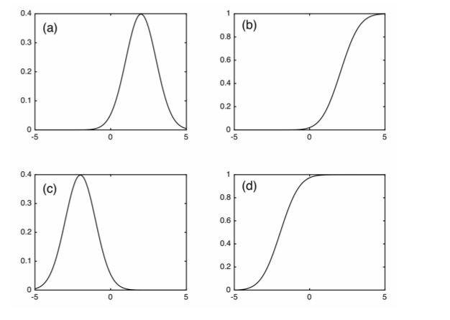
Review Quiz
Which of the graphs below shows the Cumulative Distribution Function (CDF) of a Gaussian with the mean of +2 and the standard deviation of 1?

Slide 3
Review Quiz
Your dataset included 50 measurements with the mean of 20 and the standard deviation of 7. What is the standard error of the sample mean?
1
3
5
7

Slide 4
Review Quiz
For the previous question, what is the 95% confidence interval on the true mean?
6 < μ< 34
13 < μ< 27
18 < μ< 22
19 < μ< 21

Slide 5
Review Quiz
True or False: The signal I detect in my data collection is not significant at the 95% confidence level. It is acceptable to lower the confidence level so that I can make the signal significant.

Slide 6
Review Quiz
The sales volume at the Dancing Sheep Coffee Shop averaged $1,000 per day. In the last 10 days, however, the average sales have increased to $1,200 per day with a standard deviation of $150. What is the standard error of 10-day average sales?
$50
$100
$150
$200

Slide 7
Review Quiz
For the previous question, I want to test whether or not there was a significant increase in the sales for the last 10 days. What is the t-value of the average sales from the last 10 days?
t=1.0
t=2.0
t=3.0
t=4.0

Slide 8
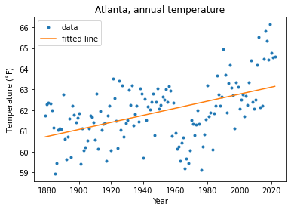

EAS2655 – Week 5
Statistical significance of regression coefficient (slope)
$$\tilde{y}=0.017x+28.7$$
$$R^{2}=0.245$$

Slide 9
EAS2655 – Week 5
Statistical significance of regression coefficient (slope)
Procedure
1. Select confidence level
2. State null hypothesis and alternative hypothesis
3. State statistics used
4. Determine critical region
5. Evaluate whether data rejects the null hypothesis

Slide 10
EAS2655 – Week 5
Statistical significance of regression coefficient (slope)
Procedure
1. Select confidence level ➔ 99%
2. State null hypothesis and alternative hypothesis
3. State statistics used
4. Determine critical region
5. Evaluate whether data rejects the null hypothesis

Slide 11
EAS2655 – Week 5
Statistical significance of regression coefficient (slope)
Procedure
1. Select confidence level ➔ 99%
2. State null hypothesis and alternative hypothesis
H0: The regression coefficient is NOT significantly larger than 0.
H1: The regression coefficient is significantly larger than 0.
3. State statistics used
4. Determine critical region
5. Evaluate whether data rejects the null hypothesis
Notes:
As we already know the slope is positive

Slide 12
EAS2655 – Week 5
Statistical significance of regression coefficient (slope)
Procedure
1. Select confidence level ➔ 99%
2. State null hypothesis and alternative hypothesis
H0: The regression coefficient is NOT significantly larger than 0.
H1: The regression coefficient is significantly larger than 0.
3. State statistics used
Student’s t-distribution will be used with one-tailed test.
4. Determine critical region
5. Evaluate whether data rejects the null hypothesis
Notes:
Q:Why do we use one-tailed?

Slide 13
EAS2655 – Week 5
Statistical significance of regression coefficient (slope)
Procedure
1. Select confidence level ➔ 99%
2. State null hypothesis and alternative hypothesis
H0: The regression coefficient is NOT significantly larger than 0.
H1: The regression coefficient is significantly larger than 0.
3. State statistics used
Student’s t-distribution will be used with one-tail test.
4. Determine critical region
5. Evaluate whether data rejects the null hypothesis

Slide 14
EAS2655 – Week 5
4. Determine critical region
Degree of freedom = N-2
a = 1-CL
One-tailed test: tcrit=tinv(1-a,df)
5. Evaluate whether data rejects the null hypothesis

Slide 15
EAS2655 – Week 5
4. Determine critical region
Degree of freedom = N-2 = 142
a = 1-CL = 0.01
One tail test: tcrit=tinv(1-a,df) = 2.35
5. Evaluate whether data rejects the null hypothesis

Slide 16

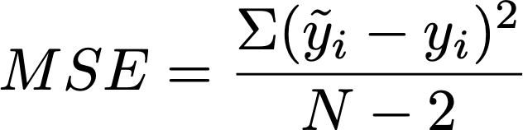
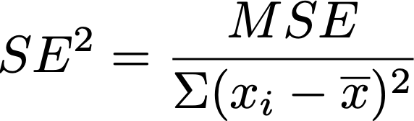
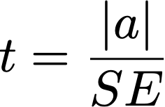
EAS2655 – Week 5
4. Determine critical region
Degree of freedom = N-2 = 142
a = 1-CL = 0.01
One tail test: tcrit=tinv(1-a,df) = 2.35
5. Evaluate whether data rejects the null hypothesis
Calculate the MSE
SE² of the regression coefficient is MSE/|x-x_{ave}|²
t-value is |a|/SE where

Slide 17
EAS2655 – Week 5
4. Determine critical region
Degree of freedom = N-2 = 142
a = 1-CL = 0.01
One-tailed test: tcrit=tinv(1-a,df) = 2.35
5. Evaluate whether data rejects the null hypothesis
Calculate the MSE
SE² of the regression coefficient is MSE/|x-x_{ave}|²
t-value is |a|/SE where
a=0.017 degF/yr, SE = 0.0025 degF/yr, t-value = 6.78
|t-value| > tcrit. Null hypothesis is rejected. Atlanta’s annual mean temperature has a significant linear trend with 99% confidence level.

Slide 18
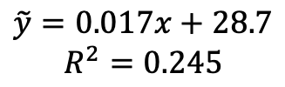
EAS2655 – Week 5
Statistical significance of regression coefficient (slope)
$$\tilde{y}=0.017x+28.7$$
$$R^{2}=0.245$$
It turned out that the linear trend is statistically significant with 99% confidence level.
It is good to report this with R2 value of 0.245. Linear trend explains 24.5% of the total variance.

Slide 19
EAS2655 – Week 5
4. Determine critical region
Degree of freedom = N-2 = 142
a = 1-CL = 0.01
One-tailed test: tcrit=tinv(1-a,df) = 2.35
5. Evaluate whether data rejects the null hypothesis
Calculate the MSE
SE² of the regression coefficient is MSE/|x-x_{ave}|²
t-value is |a|/SE where
a=0.017 degF/yr, SE = 0.0025 degF/yr, t-value = 6.78
|t-value| > tcrit. Null hypothesis is rejected. Atlanta’s annual mean temperature has a significant linear trend with 99% confidence level.

Slide 20
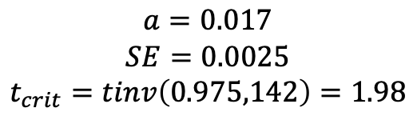

EAS2655 – Week 5
What is the uncertainty of the linear trend?
Confidence interval of the regression coefficient
Choose confidence level (95%, 99% etc)
Calculate the critical t value for two-tail test
The confidence interval is a ± tcrit*SE
For example, 95% confidence interval of the linear trend is:
$$a=0.017$$
$$SE=0.0025$$
$$t_{crit}=tinv\left(0.975,142\right)=1.98$$
$$a=0.017±0.005\deg{F}$$

Slide 21
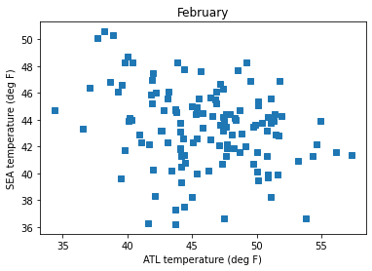
Statistical significance of Correlation
Statistical significance of correlation:
R=-0.4
Is this statistically significant?

Slide 22
EAS2655 – Week 5
Statistical significance of correlation coefficient (r value)
Procedure
1. Select confidence level
2. State null hypothesis and alternative hypothesis
3. State statistics used
4. Determine critical region
5. Evaluate whether data rejects the null hypothesis

Slide 23
EAS2655 – Week 5
Statistical significance of correlation coefficient (r value)
Procedure
1. Select confidence level ➔ 95%
2. State null hypothesis and alternative hypothesis
3. State statistics used
4. Determine critical region
5. Evaluate whether data rejects the null hypothesis

Slide 24
EAS2655 – Week 5
Statistical significance of correlation coefficient (r value)
Procedure
1. Select confidence level ➔ 95%
2. State null hypothesis and alternative hypothesis
H0: There is NO significant correlation between ATL and SEA
H1: There is a significant correlation
3. State statistics used
4. Determine critical region
5. Evaluate whether data rejects the null hypothesis

Slide 25
EAS2655 – Week 5
Statistical significance of correlation coefficient (r value)
Procedure
1. Select confidence level ➔ 95%
2. State null hypothesis and alternative hypothesis
H0: There is NO significant negative correlation between ATL and SEA Feb temperature
H1: There is a significant negative correlation
3. State statistics used
Student’s t-distribution with one-tailed test
4. Determine critical region
5. Evaluate whether data rejects the null hypothesis

Slide 26
EAS2655 – Week 5
4. Determine critical region
Degree of freedom = df=N-2 = 126 (1894-2022 minus missing data)
alpha=1-CL
tcrit=tinv(1-alpha,df) = 1.66
(For 99% confidence level
tcrit=tinv(1-0.01,df) = 2.36)
5. Evaluate whether data rejects the null hypothesis

Slide 27
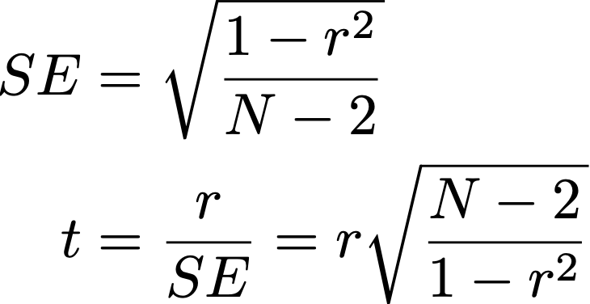
EAS2655 – Week 5
4. Determine critical region
Degree of freedom = df=N-2 = 117 (1901-2020 minus missing data)
alpha=1-CL
tcrit=tinv(1-alpha,df) = 2.36
5. Evaluate whether data rejects the null hypothesis
SE = 0.0857
r = -0.273
t = |-0.273|/0.0857 = 3.19
t > tcrit. H0 is rejected.
There is a significant negative correlation

Slide 28
EAS2655 – Week 5
Statistical significance of correlation: R=-0.273
Is this statistically significant?
YES. This correlation is statistically significant at 95% confidence level.
Correlation is moderate: this relationship explains about 7.5% of variance in the data.

Slide 29
EAS2655 – Week 5
Some more thoughts on regression & correlation
Regression: Do I get the same linear relationship if I regress y onto x or x onto y?

Slide 30
EAS2655 – Week 5
Correlation: Do I get the same r value if I correlate (x and y) or (y and x) ?

Slide 31
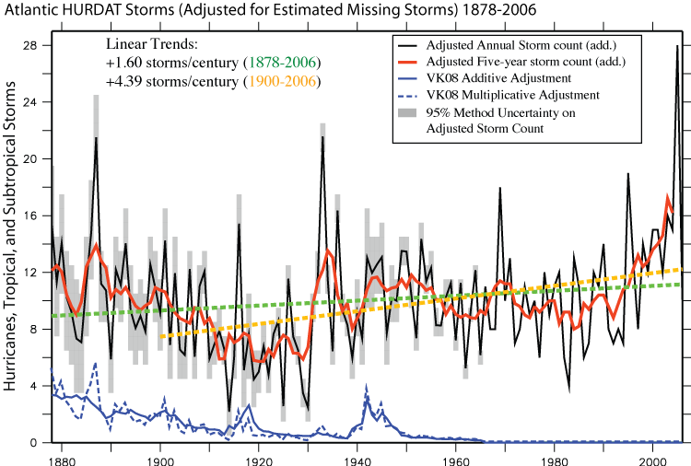
EAS2655 – Week 5
Vecchi and Knutson (2008), J. Clim

Slide 32
EAS2655 – Week 5
Endpoint effect
As you have seen in HW4, the regression coefficient can vary depending on the period of analysis.
In particular, if there are extreme data points near the beginning or end of the domain, they strongly influence the regression coefficient. This is called the “endpoint effect”.

Slide 33
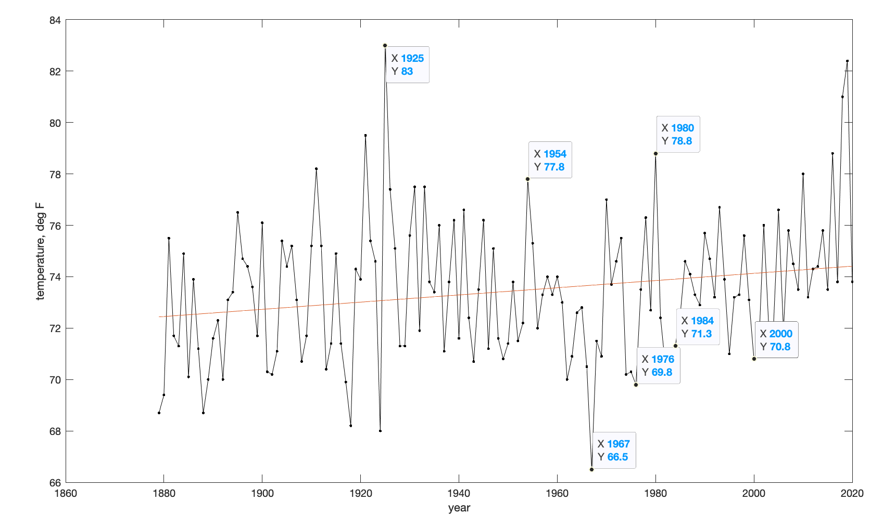
EAS2655 – Week 5

Slide 34
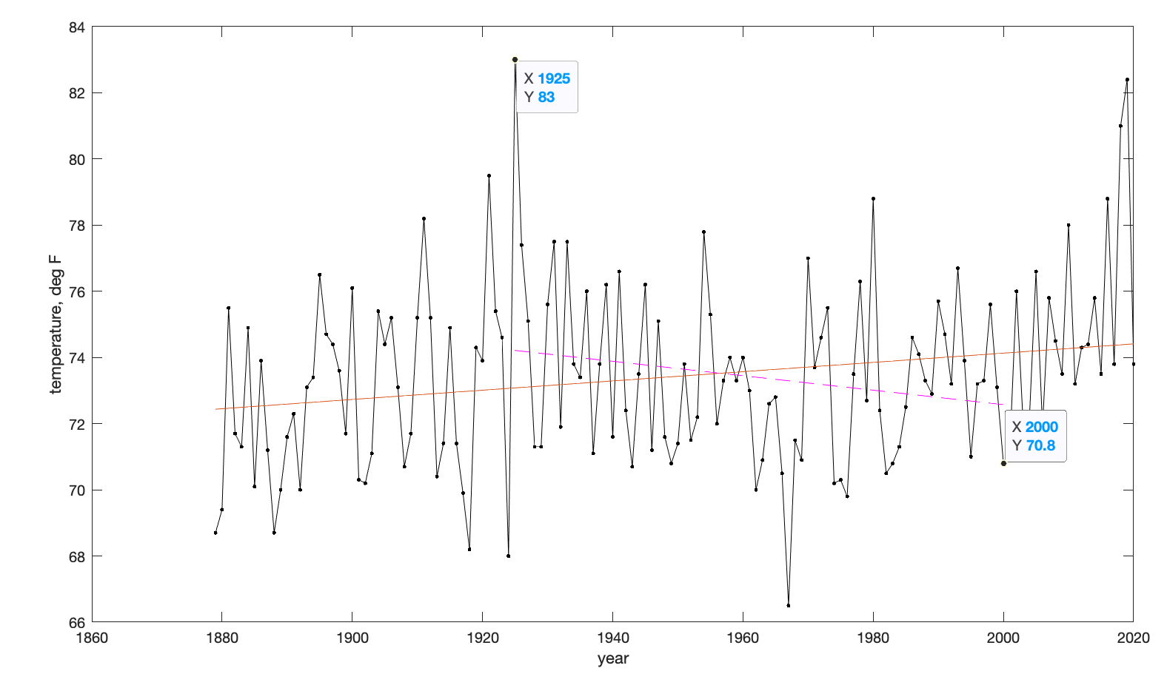
EAS2655 – Week 5

Slide 35
EAS2655 – Week 5
How can we mitigate the endpoint effect and avoid misleading conclusions?

