Slide 1
EAS2655 – Week 4
Agenda
Some review questions/applications
Reading section 1.3
Regression and Correlation
Least square method – minimization of Mean Square Error (MSE)
Correlation coefficient : R
Coefficient of determination : R²

Slide 2
Review question 1
The following is data from a random sample: [6, 150, 3, 16, 0, 11, 7, 17, 14, 8]. What are the median and inter-quartile range (IQR)?
8 and 10
9.5 and 10
8 and 12
9.5 and 12

Slide 3
Review question 2
You generated a histogram with the sample size N and the bin size of 0.5. What is the area covered by histogram?
0.5N
N
2N
1

Slide 4
Review question 3
You are randomly sampling from a Gaussian distribution with mean=13 and standard deviation=3. What is the probability that you get 10 < x < 13?
68%
95%
17%
34%

Slide 5
Review question 4
You collected a dataset and found that your data contains a few data points that are extremely large. What would be the most appropriate approach to calculate its spread in data?
mean
median
Standard deviation
IQR

Slide 6
Review question 5
The number from rolling a dice has a mean value of 3.5 and the standard deviation of 1.7. Imagine you roll a dice 50 times, and record the average as X. This is repeated many times. What is the expected range of X with 95% probability?
3.3<X<3.7
3.0<X<4.0
2.5<X<4.5
2.0<X<5.0

Slide 7
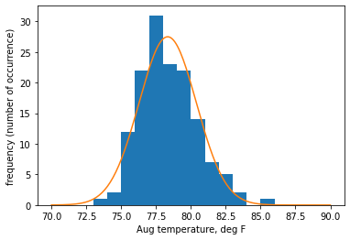
Statistical distribution and confidence interval
Uncertainty of single measurement:
IF the data is normally distributed, there is 95% probability that a single measurement (x) lies within the range of 2 standard deviation (σ) from the population mean (μ).
x = μ ± 2σ

Slide 8
Confidence interval
We can also write μ = x ± 2σ
True mean lies within 2σ of the single measurement
“95% confidence interval”

Slide 9
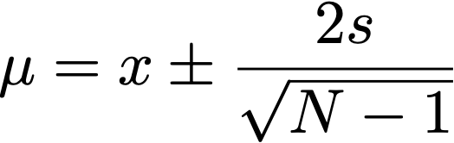
Confidence interval
N sample means (s) with sample standard deviation of s
For N>30, true mean lies within 2 SE of sample mean
“95% confidence interval”

Slide 10
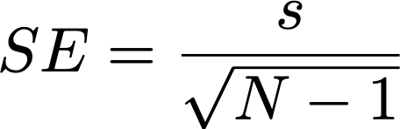

Uncertainty from multiple (N) measurements
Consider taking N samples randomly from a population
What is the 95% confidence interval on the true mean?
Sample mean (M) is the average of N samples
Uncertainty scales with SE.
If N < 30, use Student’s t-distribution instead of Gaussian.
The 95% confidence interval is

Slide 11

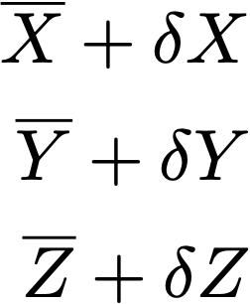


Propagation of uncertainty
Additive problem
D = X + 2Y – 3Z
Given the best estimates and uncertainties in (X, Y, Z), estimate the range of D

Slide 12
Propagation of uncertainty
Additive problem
D = X + 2Y – 3Z
Given the best estimates and uncertainties in (X, Y, Z), estimate the range of D
The most conservative uncertainty estimate:

Slide 13
Propagation of uncertainty
Additive problem
D = X + 2Y – 3Z
Given the best estimates and uncertainties in (X, Y, Z), estimate the range of D
If the uncertainty is independent and random:

Slide 14
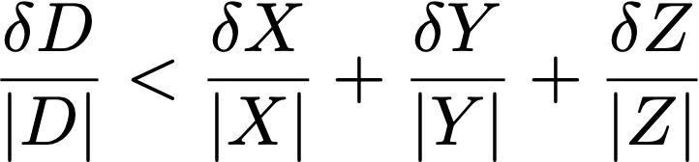
Propagation of uncertainty
Multiplicative problem
D = X * Y / Z
Given the best estimates and uncertainties in (X, Y, Z), estimate the range of D
The most conservative uncertainty estimate:

Slide 15
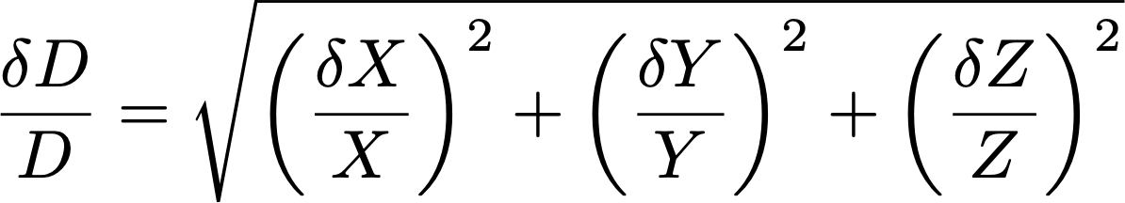
Propagation of uncertainty
Multiplicative problem
D = X * Y / Z
Given the best estimates and uncertainties in (X, Y, Z), estimate the range of D
If the uncertainty is independent and random:

Slide 16
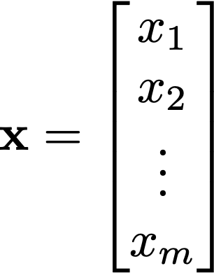
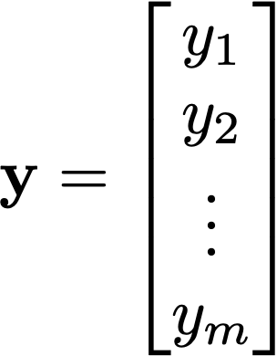
Linear algebra review (2) : vector
When there are more then two vectors, they can add together to form another vector
x + y
y
x

Slide 17
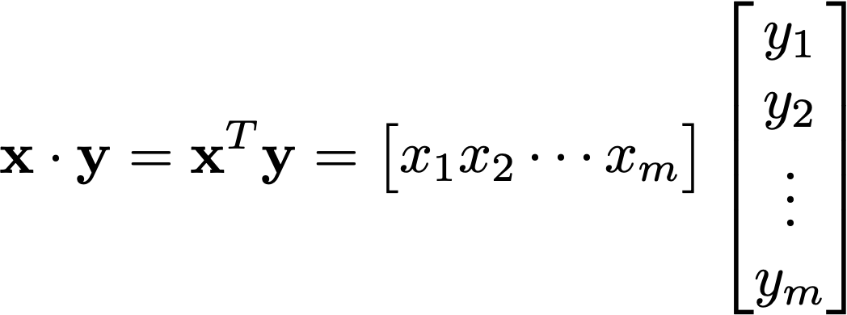

Vector
Vectors can multiply together: inner product produces a scalar
(remember “row times column”)
In a 2D example,
y
θ
x

Slide 18

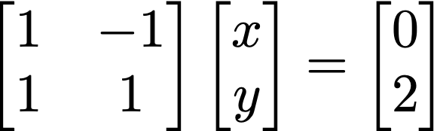
Matrix-vector product and
A (2 x 2) example
A
x
=
b

Slide 19


Matrix-vector product and
A (2 x 2) example
Matrix-vector product is essentially a collection of inner products, i.e. (rows) x (column)
A
x
=
b
The “row” point of view:
Inner products

Slide 20
Matrix-vector product and
A (2 x 2) example
y=x
A
x
=
b
The “row” point of view:
Intersection of two lines
y=-x+2
The problem Ax = b is solvable only if the two lines intersect at a point

Slide 21
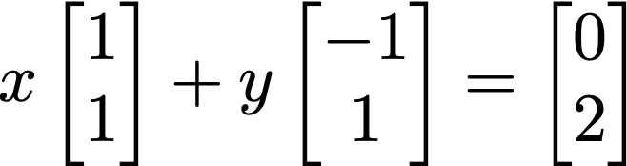
Matrix-vector product and
A (2 x 2) example
A
x
=
b
The “column” point of view:

Slide 22
Matrix-vector product and
A (2 x 2) example
A
x
=
b
The “column” point of view:

Slide 23
Matrix-vector product and
A (2 x 2) example
A
x
=
b
The “column” point of view:

Slide 24
Matrix-vector product and
A (2 x 2) example
A
x
=
b
The problem Ax = b is solvable only if b is in the “column space” of A.

Slide 25

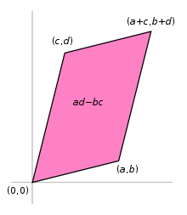
Matrix-vector product and
Inverse matrix A⁻¹
If inverse matrix of A exists, we have
Inverse of A exists IF the determinant of the matrix A (detA or |A|) is not zero
For a 2x2 matrix, it is (ad-bc)

Slide 26
Matrix-vector product and
What are the examples of detA=0
One of the rows of A is all zero
Two rows of A are equal
One row of A is a multiple of another row
When determinant is zero, the matrix is singular (two lines are parallel to each other)

Slide 27
Matrix-vector product and
What are the examples of detA=0
One of the rows of A is all zero
Two rows of A are equal
One row of A is a multiple of another row
When determinant is zero, the matrix is singular (two lines are parallel to each other)

Slide 28
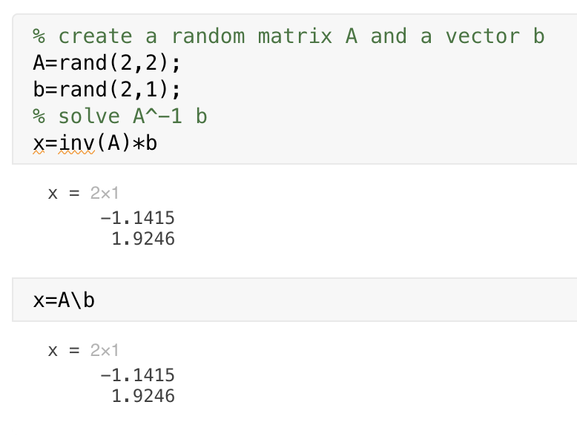
Matrix-vector product and
Inverse matrix A⁻¹
If inverse matrix of A exists, we have
In MATLAB it is inv function. Also the backslash operation “A\b” does it for you…
In Python, np.linalg.inv (or scipy.linalg.inv)

Slide 29
Matrix-vector product and
What if A is not a square matrix?

Slide 30
Matrix-vector product and
What if A is not a square matrix?
Let’s say there are too many (m) equations than (n) unknowns.
In this case, there is no unique solution x that can satisfy all equations in Ax = b in the exact sense

Slide 31
Matrix-vector product and
Consider A is (m x 2) matrix, x is (2 x 1) and b is (m x 1) and m is much larger than 2.
In this case, A x is unlikely equal to b in the exact sense.
However, we could look for the approximate solution x that minimizes the magnitude of the misfit |Ax - b| (aka least square method).

Slide 32
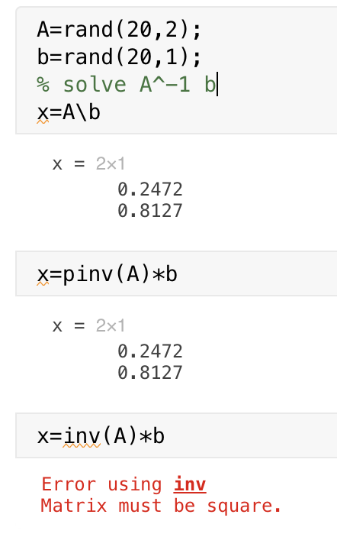
Matrix-vector product and
In MATLAB, ”backslash”(\) takes care of this problem.
It is also called pseudoinverse problem, and ”pinv” is the MATLAB function.
In python, it is available as numpy.linalg.pinv or scipy.linalg.pinv

Slide 33


Pseudoinverse of non-square matrix A
⬅ Solution to this equation does no exist because of non-square A
However, pseudoinverse provides a solution that minimizes the discrepancies between Ax and b
This is the pseudoinverse of A
The solution, x, is the best-fit solution to Ax = b in the “Least Square” sense!

Slide 34
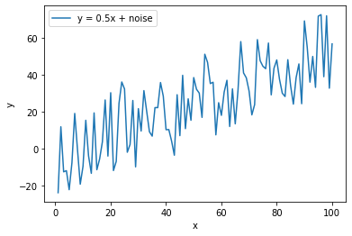
Linear regression
You have N paired dataset x_{i} and y_{i}
Find the linear relationship y = ax + b that best matches your dataset

Slide 35
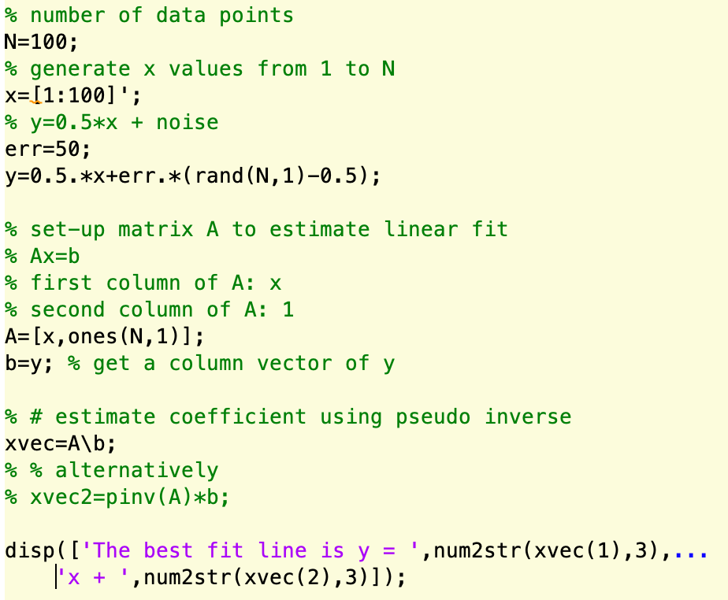
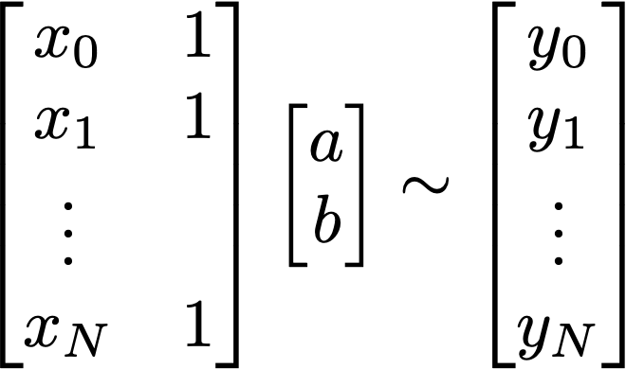
Linear regression in Ax = b form
A x ~ b
The best fit line is y = 0.492x + 1.7

Slide 36
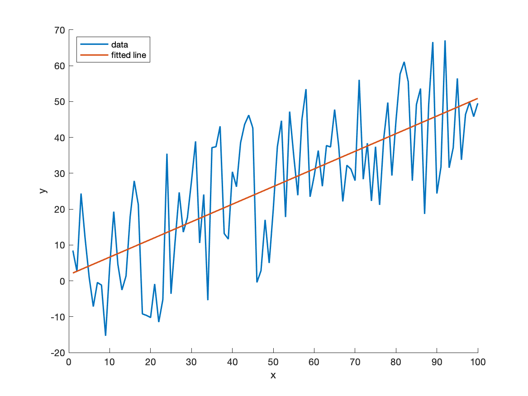
Linear regression in Ax = b form
The best fit line is y = 0.492x + 1.7

Slide 37
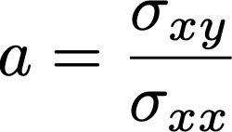


Regression coefficient a in y = ax + b
The linear coefficient (a) is called regression coefficient.
It is also said that ”y is regressed onto x”, and the regression coefficient measures the changes in y due to a unit increase in x.
It can also be shown that:
Covariance
=
Variance in x

Slide 38
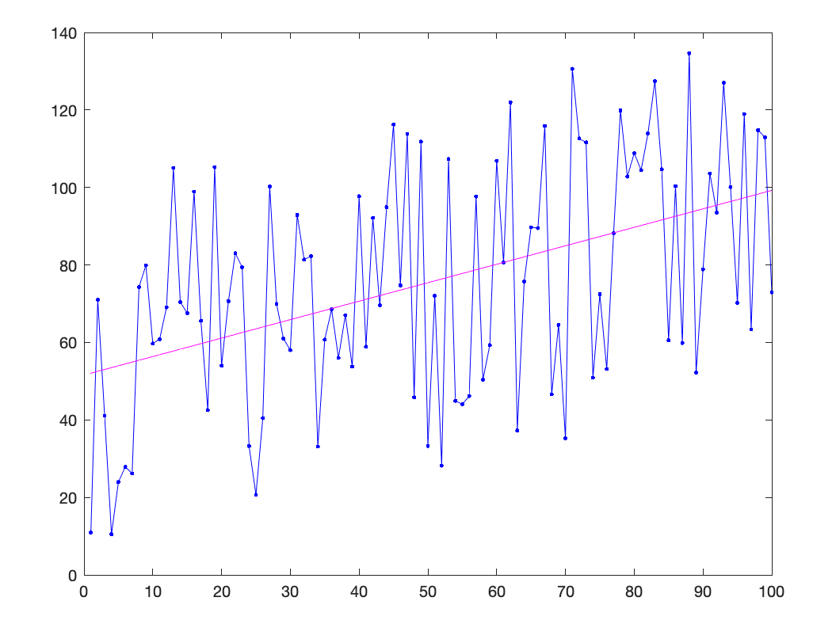
Regression coefficient a in y = ax + b
Covariance
=
Variance in x
x : explanatory variable
y: explained variable
How much variance in y can be explained by the regression?

Slide 39
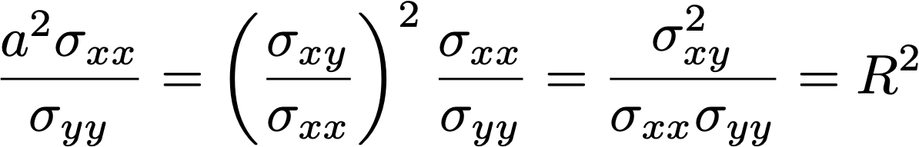
Regression coefficient a in y = ax + b
Covariance
=
Variance in x
x : explanatory variable
y: explained variable
How much variance in y can be explained by the regression?

Slide 40
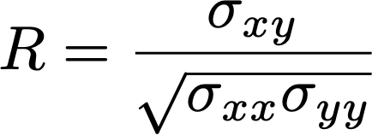
R² : coefficient of determination
R² measures the fraction of variance explained by the regression.
(correlation coefficient) =
R is called Pearson’s correlation, or simply, r-value. This quantifies a measure of the relationship between the two variable. It varies from -1 to +1. You can think of it as a unitless, normalized covariance.

Slide 41
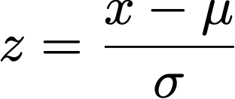
Standardization (z-transform)
Transforms the data so it has zero mean and 1 standard deviation.
Covariance between the two standardized variables are equal to their correlation.

Slide 42
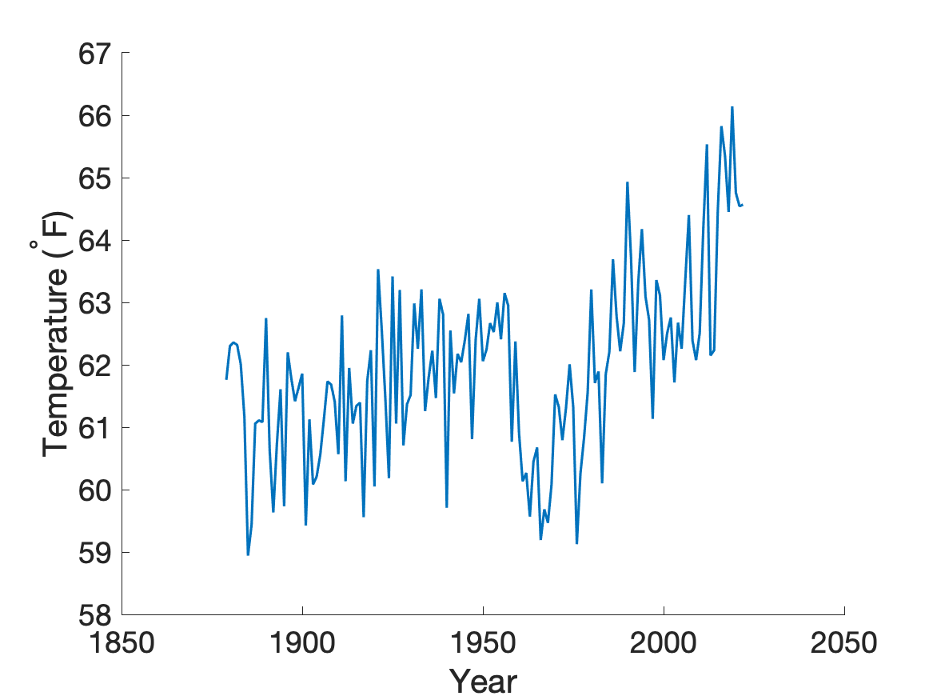
Application to Atlanta’s temperature data
Temperature of Atlanta appears to be warming up.
Let’s estimate the linear trend, which is a regression of temperature (y) onto time (x).

Slide 43
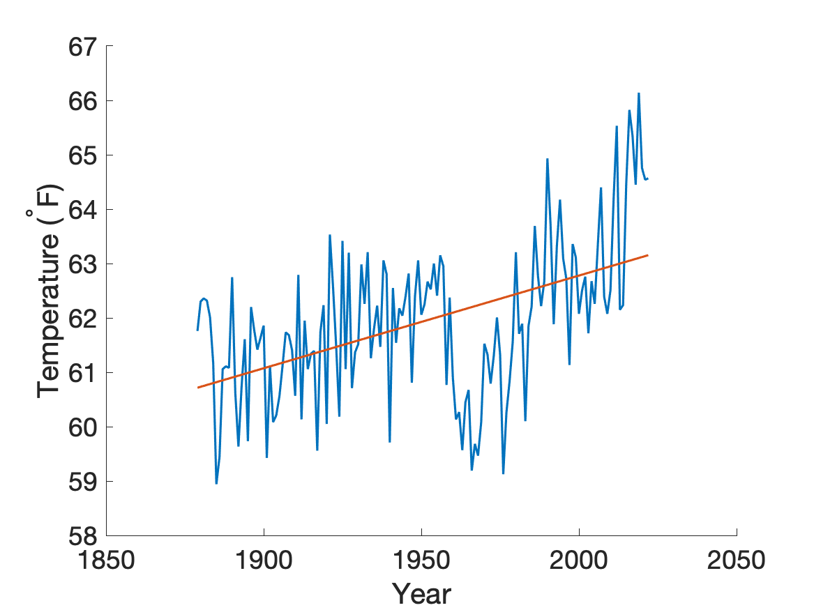
Application to Atlanta’s temperature data
Temperature of Atlanta appears to be warming up.
Let’s estimate the linear trend
y = ax + b
a = 0.017 °F/year
R² = 0.245

Slide 44
Application to Atlanta’s temperature data
Temperature of Atlanta appears to be warming up.
Let’s estimate the linear trend
y = ax + b
a = 0.017 °F/year
R² = 0.245
Linear trend explains 24.5% of the total variance in the data.

Slide 45
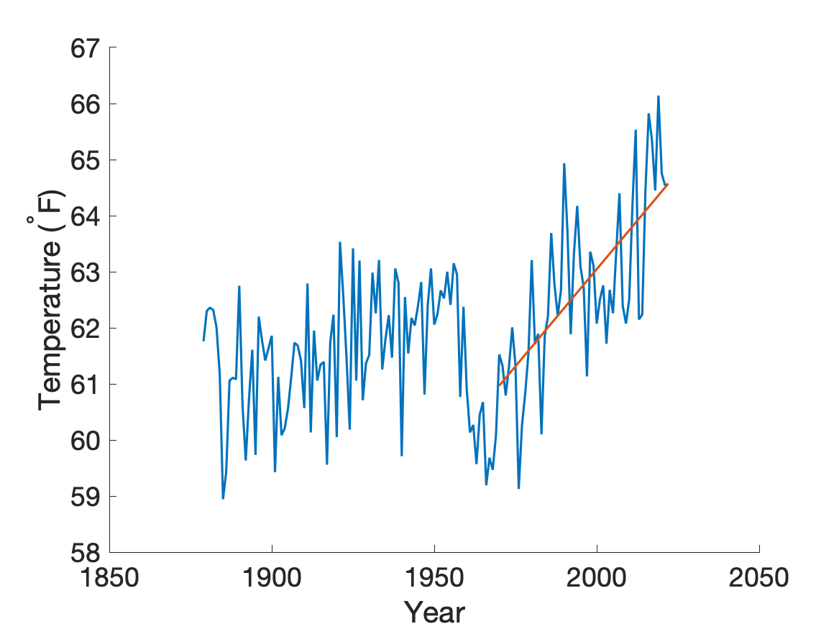
Application to Atlanta’s temperature data
Temperature of Atlanta appears to be warming up.
The warming trend seems to be higher after 1970s.
Let’s estimate the linear trend
y = ax + b
a = 0.069 °F/year
R² = 0.496
Linear trend explains 49.6% of the total variance in the data.

Slide 46
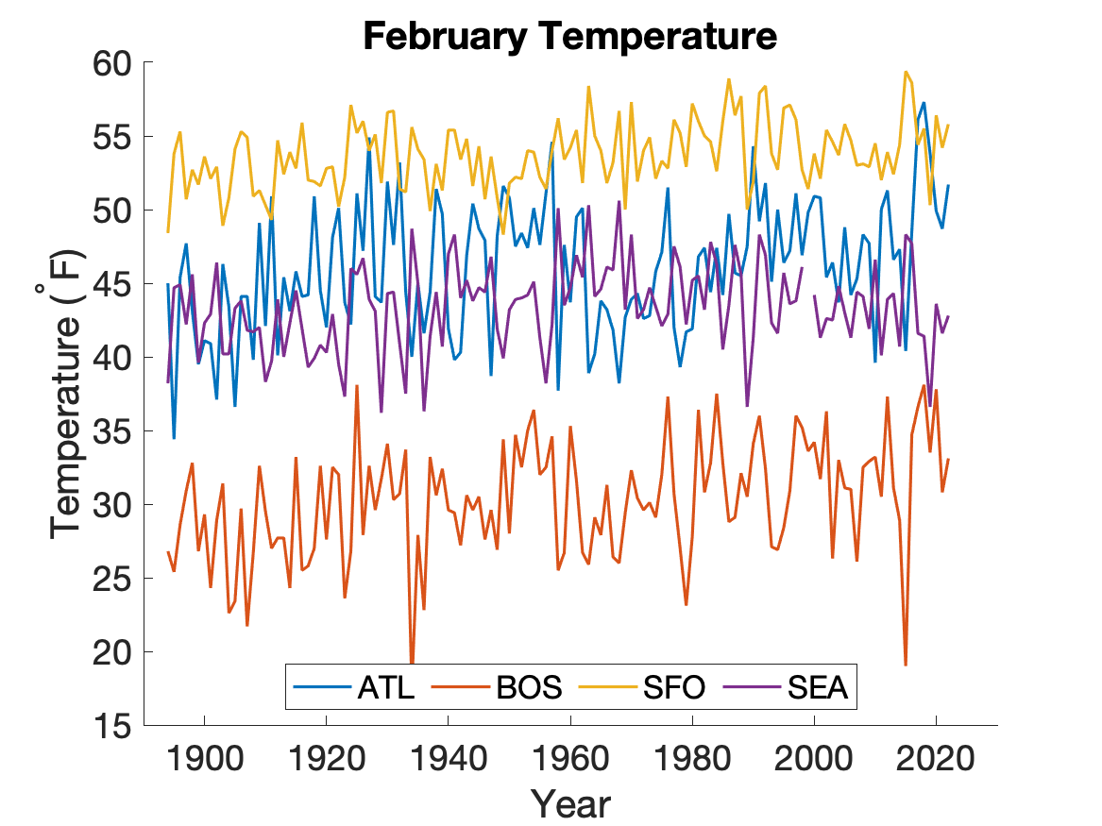
Comparing difference cities

Slide 47
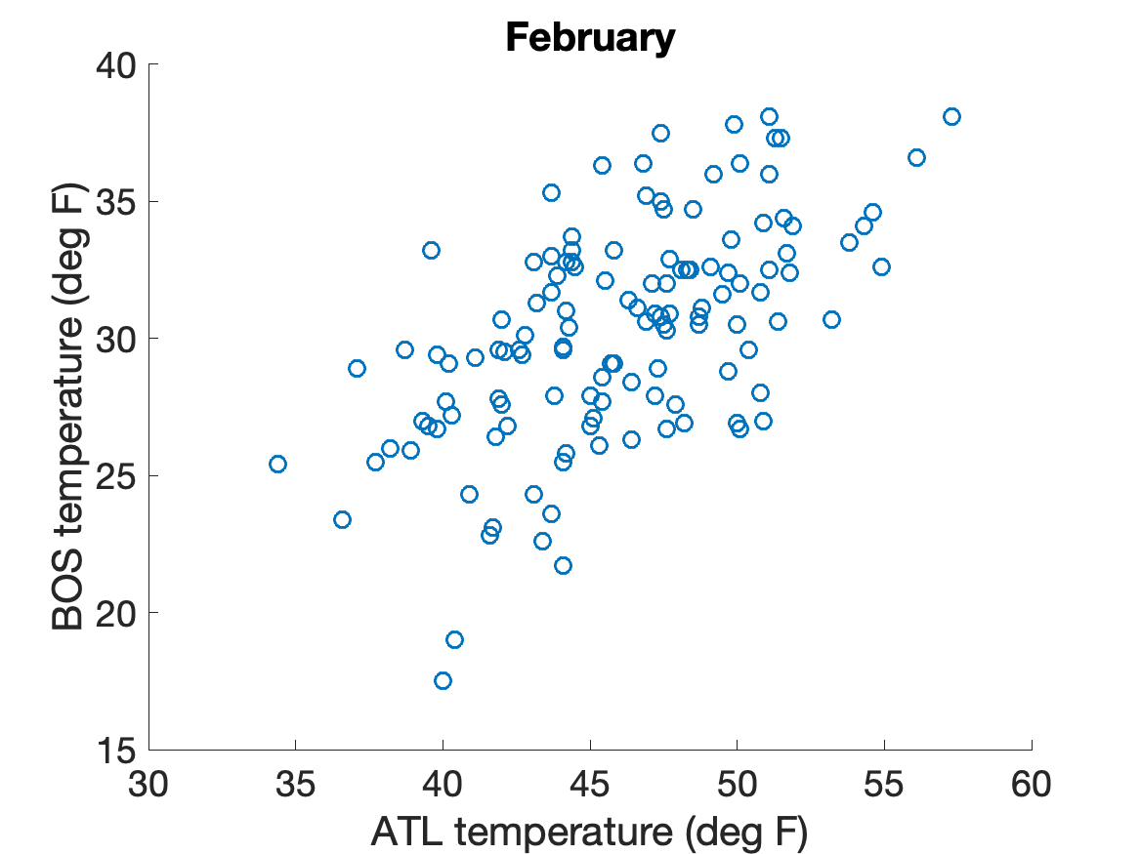
Comparing two cities
R=0.57

Slide 48
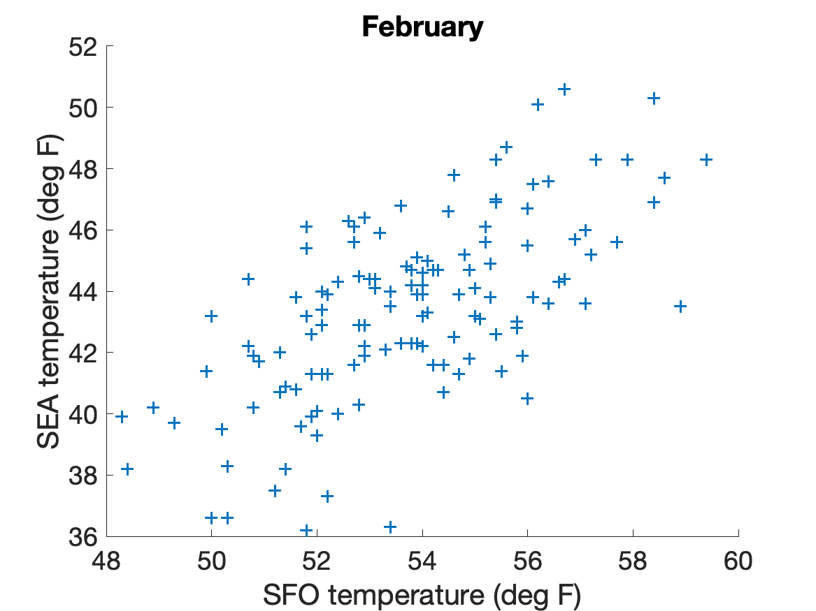
Comparing two cities
R=0.64

Slide 49
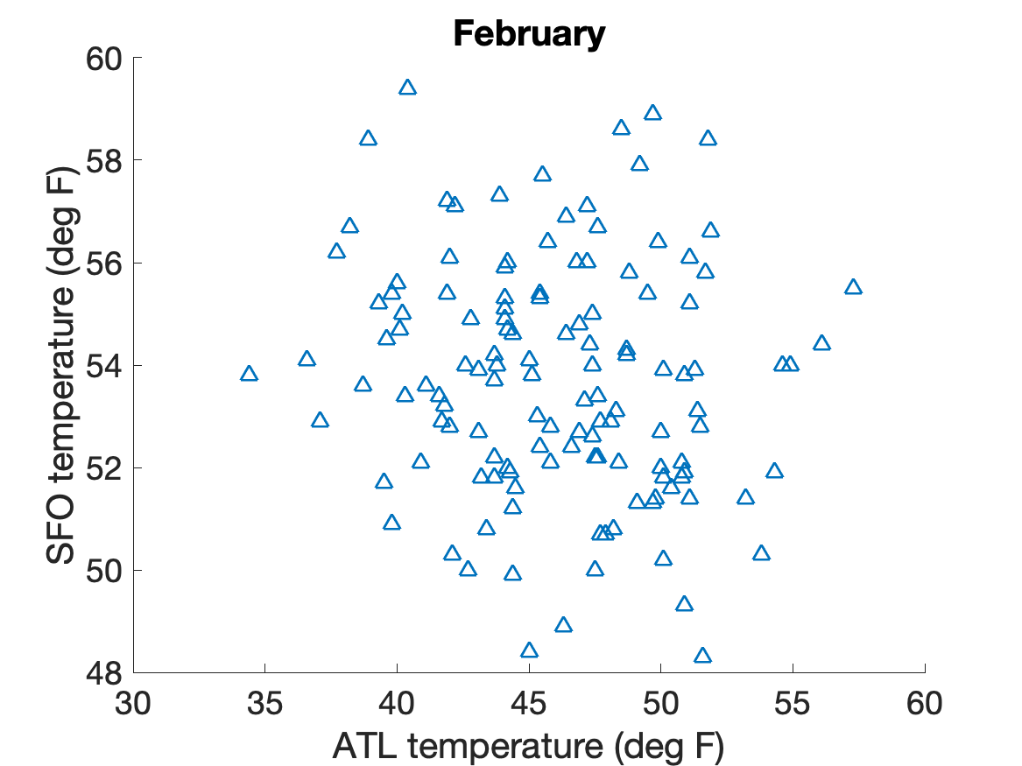
Comparing two cities
R=-0.13

Slide 50
Covariance matrix
Data matrix: D
Temperature records from (M) cities are stored as row vector (M x N) matrix
We subtract mean value from each rows.
C = 1/N-1 * DD^{T}
can be calculated as np.cov(D) in python, cov(D) in MATLAB

Slide 51
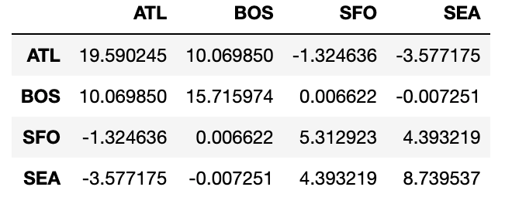
Covariance matrix
Covariance matrix: C for February temperature

Slide 52
Correlation matrix
Correlation matrix: R
Similar to covariance matrix but each element is divided by the product of standard deviation (z-transform)
This can be calculated as np.corrcoef(D) in python and corrcoef(D) in MATLAB

Slide 53
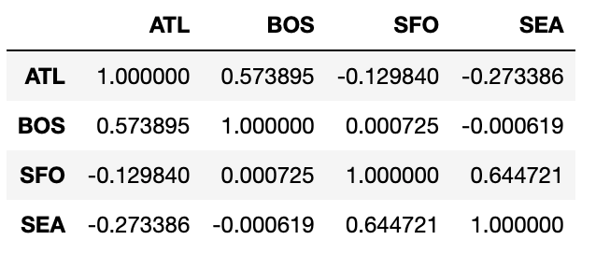
Correlation matrix
Correlation matrix: R for February temperature

Slide 54
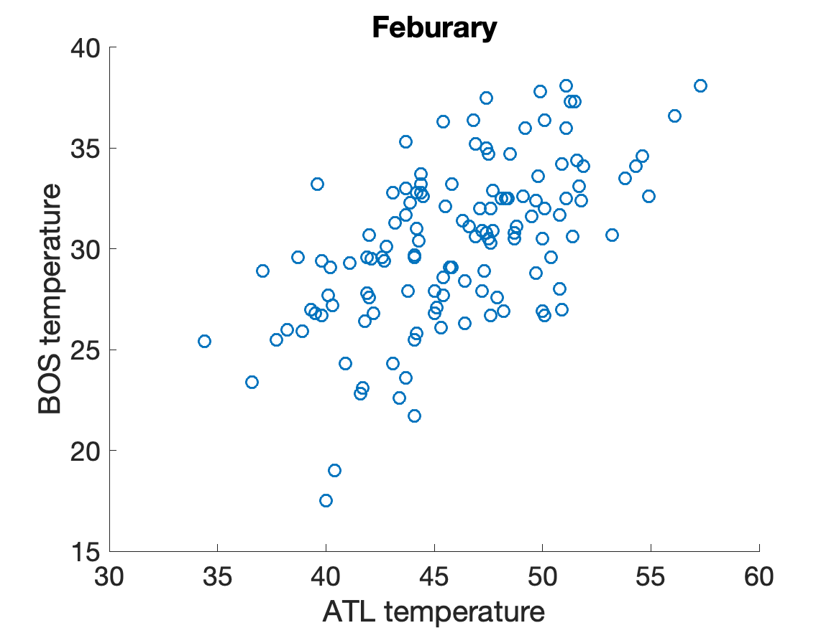
Significance of correlation
You have a pair of N observations, x and y, with a correlation coefficient of r.
Temperature of Atlanta and Boston
r=0.57
Is this statistically significant?

Slide 55
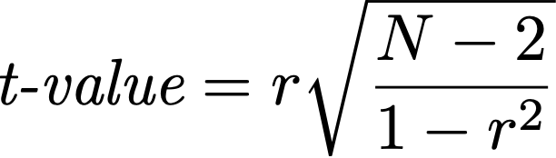
Significance of correlation
You have a pair of N observations, x and y, with a correlation coefficient of r.
N=128, r=0.57
t=7.9 >> 2
Atlanta and Boston are significantly correlated at 95% confidence interval

