Slide 1
EAS2655 – Week 10 Fourier analysis
Agenda
Basic concepts and terminology
Intro to Fourier Series
Discrete Fourier Transform/Fast Fourier Transform
Applications of Fourier Transform
Low-pass filtering
Data compression
Reading p.61-77

Slide 2
EAS2655 – Week 10
Terminology
Continuous function: g(x)
Discrete data (discretized function)
g = [g₁ g₂ g₃ ･ ･ ･ g_{N}]
x = [x₁ x₂ x₃ ･ ･ ･ x_{N}]

Slide 3
EAS2655 – Week 10
Terminology
Independent variable: is the cause. Its value is independent of other variables in your study.
Dependent variable: is the effect. Its value depends on changes in the independent variable.

Slide 4
EAS2655 – Week 10
Terminology
Independent variable : coordinates, time, frequency, x, y, z, longitude, latitude, altitude
Dependent variable : temperature, pressure, humidity, magnetic field, …

Slide 5
EAS2655 – Week 10
Terminology
Independent variable : ex. time
t = [t₁ t₂ t₃ ･ ･ ･ t_{N}]
= [1 2 3 4 ･ ･ ･ N] x Δt
Dependent variable : ex. Temperature of Atlanta
T = T(t)
= [T₁ T₂ T₃ ･ ･ ･ T_{N}]

Slide 6
EAS2655 – Week 10
Terminology
Column vector
Row vector
Inner product (dot product)

Slide 7
EAS2655 – Week 10
Terminology
Perpendicular (orthogonal)
Perpendicular and unit length (orthonormal)

Slide 8
EAS2655 – Week 10
Terminology
Inner product of continuous functions

Slide 9

EAS2655 – Week 10
Terminology
Two views of linear regression
(1) Method of least squares
(2) Projection of observation (y) onto (x) and (1) vector space

Slide 10
EAS2655 – Week 10
Fourier Series
Inner product of continuous functions
Cosine and sine functions form orthogonal basis
Use linear combination of cosine and sine functions to express any periodic function

Slide 11
EAS2655 – Week 10
Fourier Series for 2π periodic continuous function
2π periodic : f(x) = f(x+2π)
Imagine this as a regression (i.e. projection) problem.
$f\left(x\right)=a_{0}+a_{1}cos⁡(x)$+ $b_{1}sin⁡(x)$+ $a_{2}cos⁡(2x)$+ $b_{2}sin⁡(2x)$+…

Slide 12

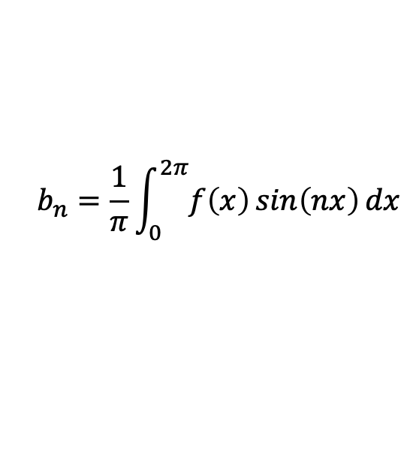
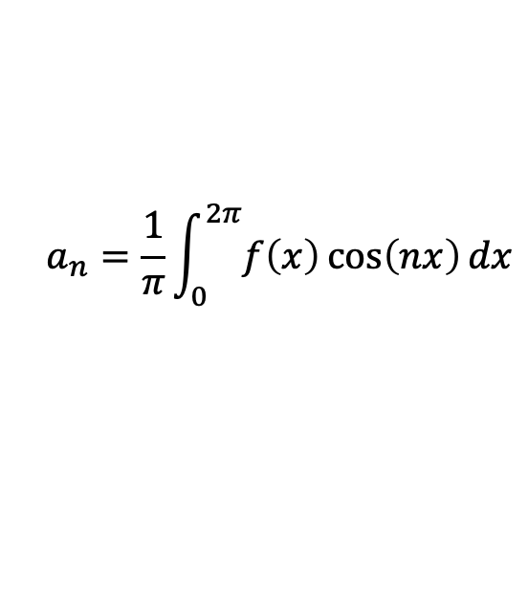
EAS2655 – Week 10
Fourier Series for 2π periodic continuous function
Formula:
$$a_{n}=\frac{1}{π}\int_{0}^{2π}{f\left(x\right)\cos\left(nx\right)dx}$$
$$a_{0}=\overline{f(x)}$$
$$b_{n}=\frac{1}{π}\int_{0}^{2π}{f\left(x\right)\sin\left(nx\right)dx}$$

Slide 13
EAS2655 – Week 10
Fourier Series for T periodic function
T periodic : f(x) = f(x+T).
Practically, your data does not have to be periodic as long as the signal of your interest is within T period.
$f\left(x\right)=a_{0}+a_{1}cos⁡\frac{2πx}{T}$+ $b_{1}sin⁡$ $\frac{2πx}{T}$+ $a_{2}cos⁡$ $\frac{4πx}{T}$+ $b_{2}sin\frac{4πx}{T}$+…

Slide 14

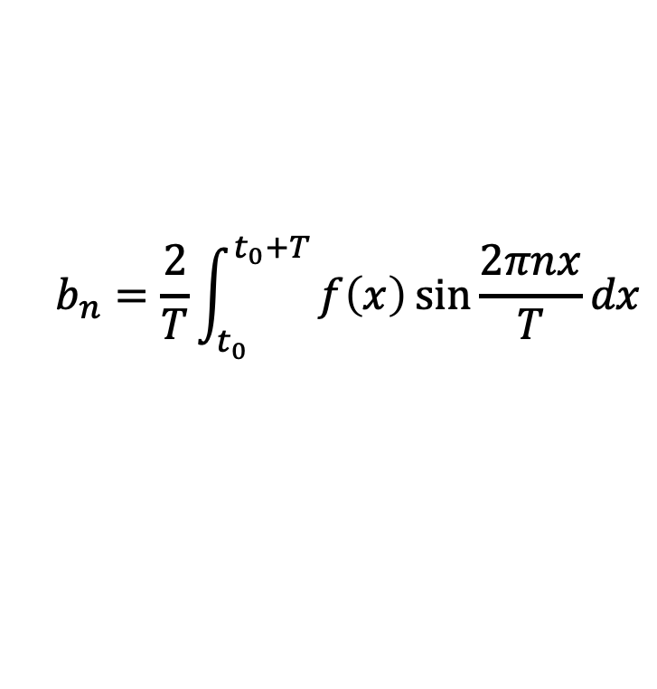
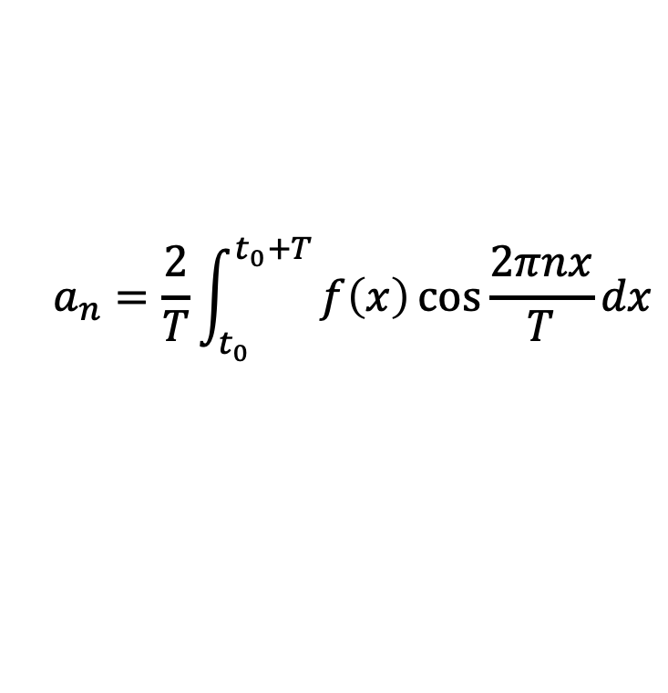
EAS2655 – Week 10
Fourier Series for T periodic function
Formula:
$$a_{n}=\frac{2}{T}\int_{t_{0}}^{t_{0}+T}{f\left(x\right)\cos{\frac{2πnx}{T}}dx}$$
$$a_{0}=\overline{f(x)}$$
$$b_{n}=\frac{2}{T}\int_{t_{0}}^{t_{0}+T}{f\left(x\right)\sin{\frac{2πnx}{T}}dx}$$

Slide 15
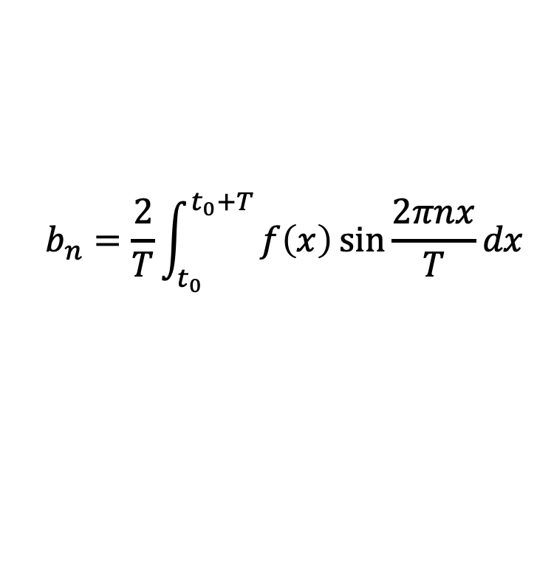
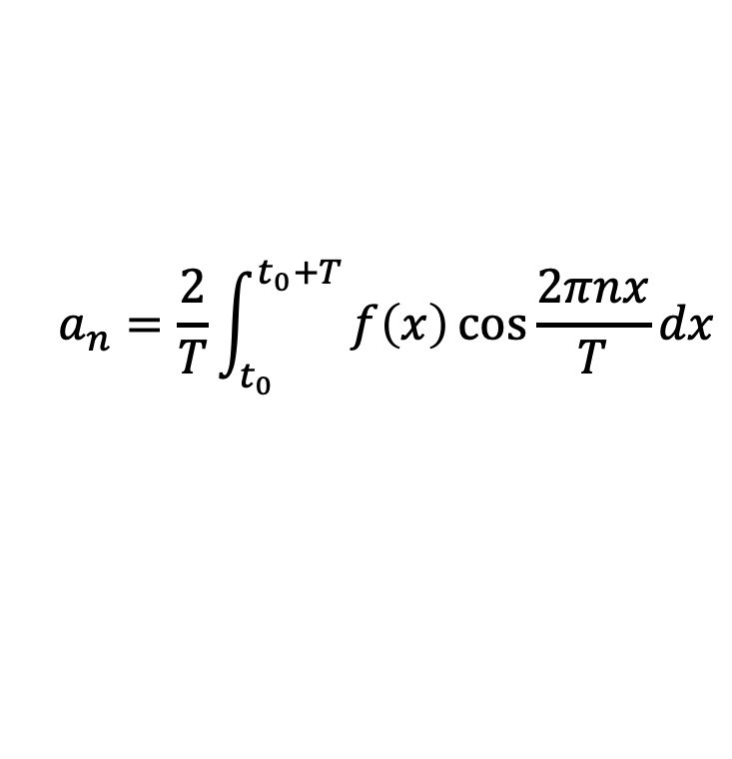
EAS2655 – Week 10
Fourier Series for T periodic function
Formula:
$$a_{n}=\frac{2}{T}\int_{t_{0}}^{t_{0}+T}{f\left(x\right)\cos{\frac{2πnx}{T}}dx}$$
$$a_{0}=\overline{f(x)}$$
$$b_{n}=\frac{2}{T}\int_{t_{0}}^{t_{0}+T}{f\left(x\right)\sin{\frac{2πnx}{T}}dx}$$
If you know f(x) and can calculate the integral, the Fourier coefficients, a_{n}, b_{n}, can be determined. But what about the case where f(x) comes from measurements?

Slide 16
EAS2655 – Week 10
Fourier Series for discrete data with a length T
You have discrete dataset: T = T(t)
= [T₁ T₂ T₃ ･ ･ ･ T_{N}]
Can we express T (vector) as a linear combination of cosine and sine (vectors)?
How do we calculate Fourier coefficients?
(projections/inner product)

Slide 17
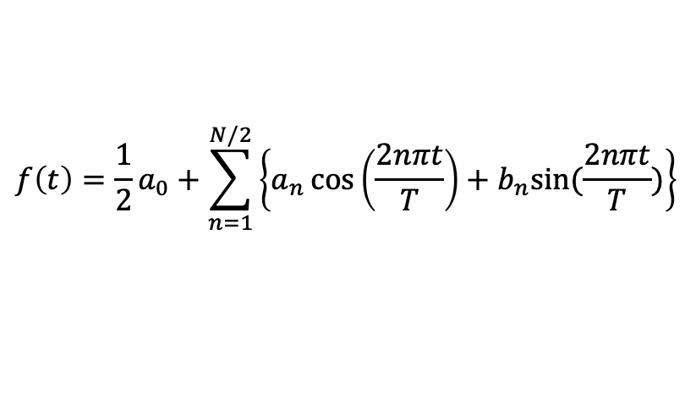
EAS2655 – Week 10
Fourier Series for discrete data with a length T
f= [f₁ f₂ f₃ ･ ･ ･ f_{N}]
$$f\left(t\right)=\frac{1}{2}a_{0}+\sum_{n=1}^{N/2}{\left\{a_{n}\cos\left(\frac{2nπt}{T}\right)+b_{n}sin⁡(\frac{2nπt}{T})\right\}}$$
For discrete data, the Fourier series is truncated at n=N/2, because we need at least two data points to determine one oscillation.

Slide 18
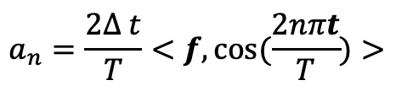
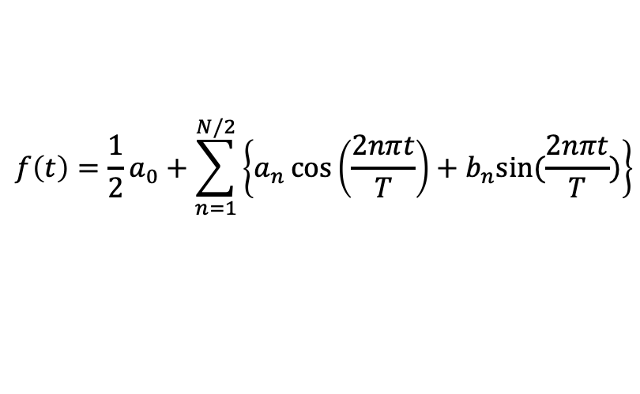
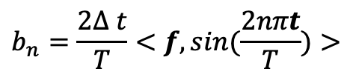
EAS2655 – Week 10
Fourier Series for discrete data with a length T
$$f\left(t\right)=\frac{1}{2}a_{0}+\sum_{n=1}^{N/2}{\left\{a_{n}\cos\left(\frac{2nπt}{T}\right)+b_{n}sin⁡(\frac{2nπt}{T})\right\}}$$
Derived the coefficients by calculating the inner products
$$a_{n}=\frac{2∆ t}{T}<f,cos⁡(\frac{2nπt}{T})>$$
$$b_{n}=\frac{2∆ t}{T}<f,sin⁡(\frac{2nπt}{T})>$$

Slide 19
EAS2655 – Week 10
Fourier series: Nyquist frequency
For discrete data, the Fourier series is truncated at n=N/2, because we need at least two data points to determine one oscillation.
Nyquist frequency:
Named after Harry Nyquist
The highest frequency that a discrete data can resolve
f=1/(2𝚫t)=0.5f_{s} (f_{s} is the sampling rate)
Example 1: March temperature of Atlanta
Sampling rate 1 per year
Nyquist frequency is 1/(2*1 year)=0.5 cycle/year
Example 2: monthly CO2 data from Mauna Loa
Sampling rate 12 per year (1 per month)
Nyquist frequency is 1/(2*1/12 year)= 6 cycles/year

Slide 20
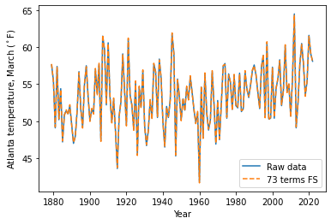
EAS2655 – Week 10
Example: Atlanta temperature
Raw data:
x= [1879, 1880, …, 2022]
y is the Atlanta March temperature for 144 years
N=142
Transform:
Fourier coefficients: a_{n}, b_{n}
n= 1, 2,…, N/2
FT converts functions from space or time domain into the frequency domain

Slide 21
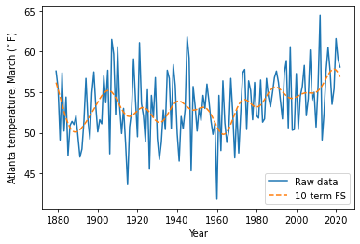
EAS2655 – Week 10
FT Applications: Low-pass/high-pass filtering
Reconstruct Atlanta July temperature using truncated Fourier series for n = 1, 2, …, 10
The highest frequency resolved has a period of
T/10 = 144/10 = 14.4 years
Higher frequency variations are filtered (low-pass filter).

Slide 22
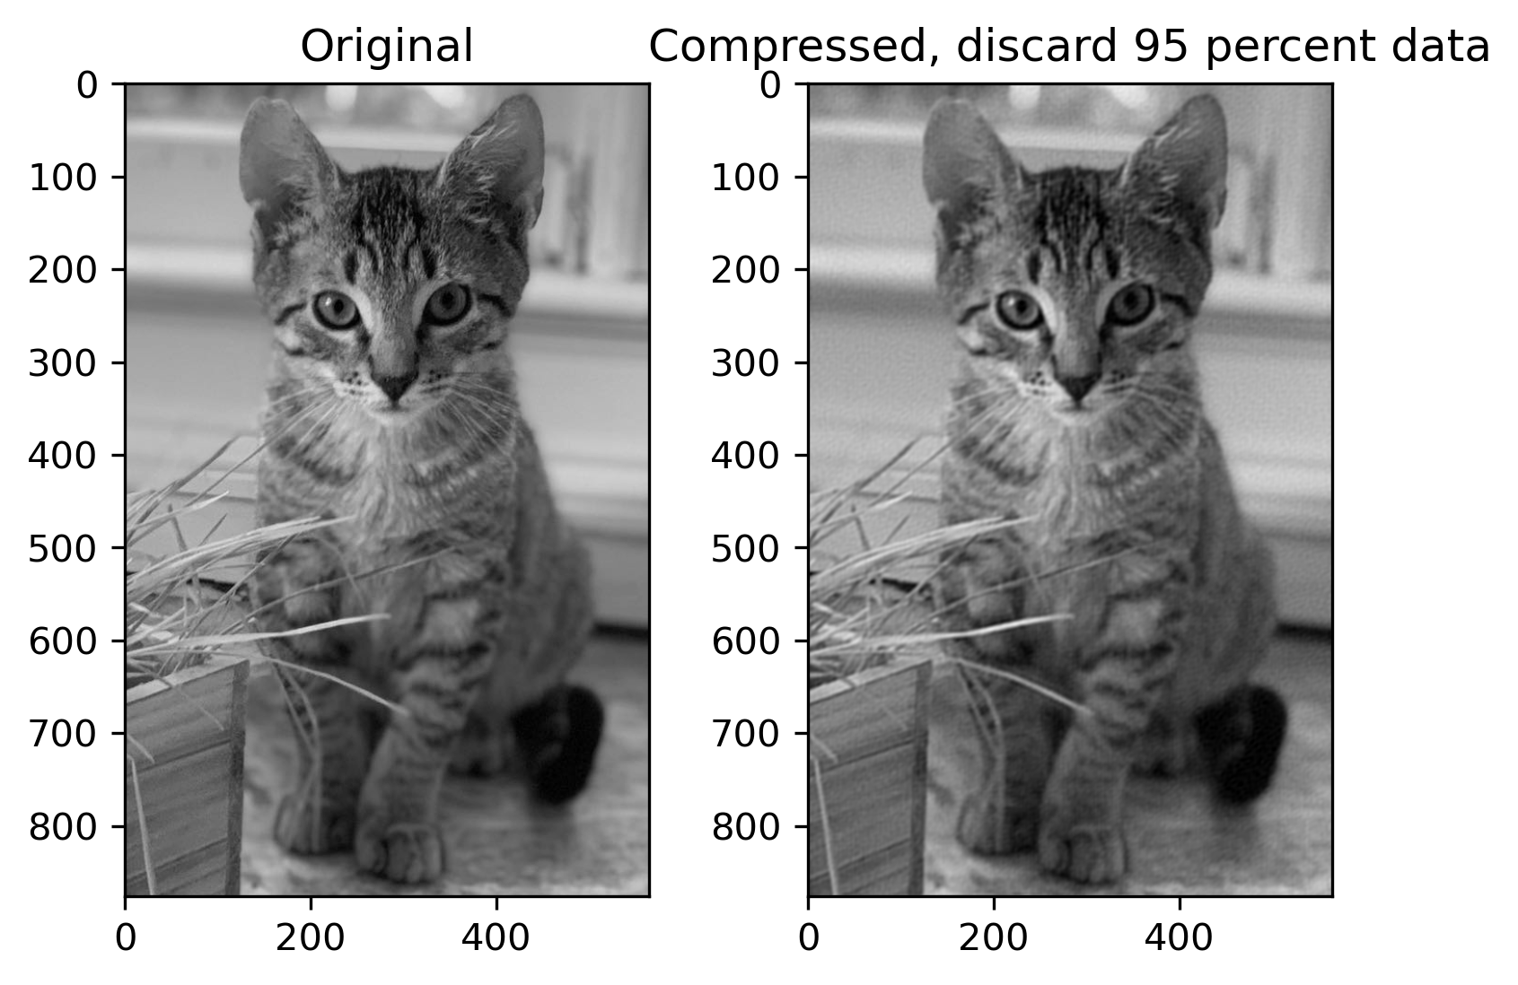
EAS2655 – Week 10
FT Applications: data compression
JPEG files use cosine functions for image compression, similar to the idea of Fourier series.

Slide 23
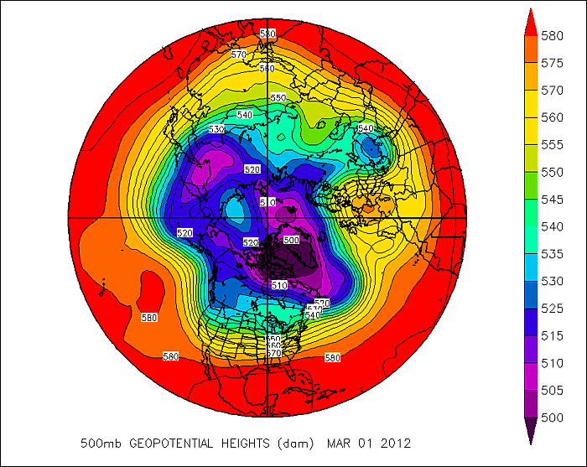
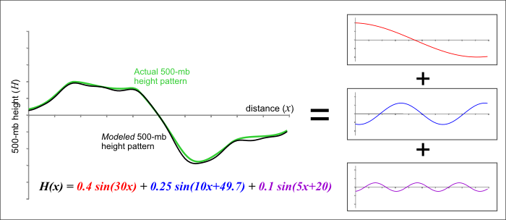
EAS2655 – Week 10
FT Applications: spectral model
A spectral model attempts to replicate wavelike patterns in key atmospheric variables
Computationally efficient
Doesn’t work well for finite domains (regional model)
Notes:
https://www.e-education.psu.edu/worldofweather/node/2112

Slide 24
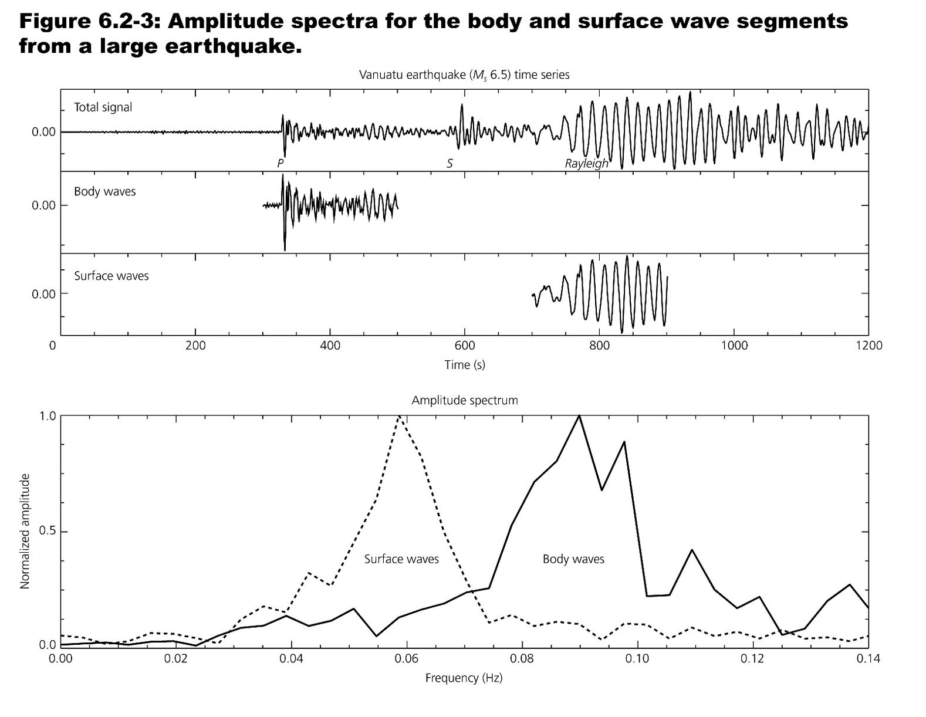
EAS2655 – Week 10
FT Applications: seismology

Slide 25
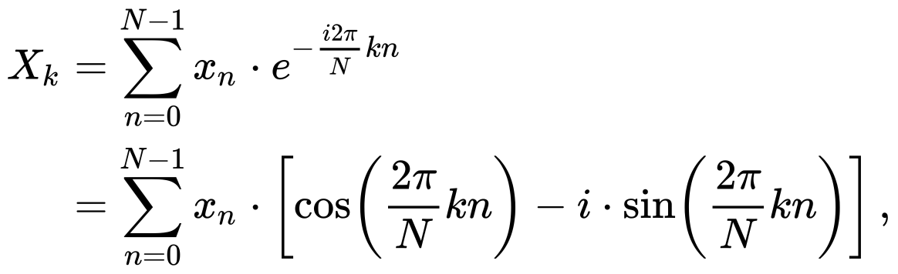
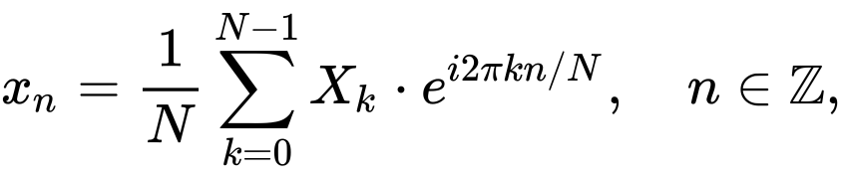
EAS2655 – Week 10
Discrete Fourier Transform (DFT)
Inverse transform:

Slide 26
EAS2655 – Week 10
Fast Fourier Transform (FFT)
A FFT is an algorithm that computes the discrete Fourier transform.
It factorizing the the DFT matrix into a product of sparse matrices, and manages to reduce the complexity of DFT from O(N²) to O(NlogN).
FFT: X=fft(Y)
Inverse FFT: Y=ifft(X)

Slide 27
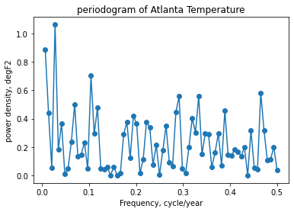
EAS2655 – Week 10
Power spectrum
Power density ~ X_{k}²
Total of the power spectral density (PSD) over all frequencies equals to the variance of x_{n}
PSD measures the density of variance contained in the frequency band

