Slide 1
HW 2 outcomes

Slide 2
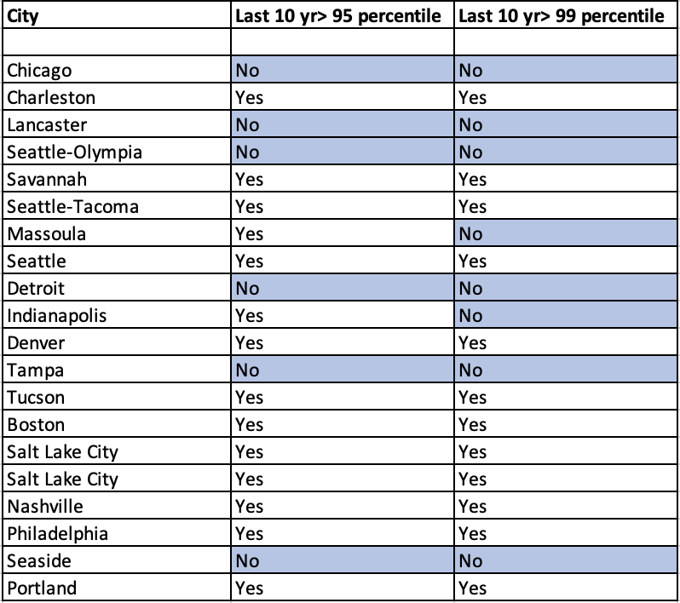
Summary
For most cities, the last ten years were warmer than even the 99 percentile.
For a few cities, the last ten year average was more than the total mean but less than 95 percentile.

