Slide 1
EAS2655 – Week 6
Agenda
Midterm online (Feb 23) covers materials up to the end of this week and HW5 (due this Friday)
Midterm: Thursday, Feb 23 on Canvas
Open book; calculator allowed; 25 questions; time limit: 60 min (anytime of the day)
Sample midterm questions (and sample answers) will be available this Thursday
Mid-term Review session on next Tuesday
No new HW this week
Let us know if you have questions on HW
Reading section 1.5
Multiple linear regression
Fitting a polynomial to input data
Interpolation & Smoothing

Slide 2
Multiple Linear Regression (MLR)
Linear regression : y = ax + b
Sometimes we may want to have more than one explanatory variable (x₁, x₂, …).
It can be the same explanatory variable but in polynomial form (x, x², x³, …). Or it can also be different functions (sin, cos, etc).
Matrix approach
MATLAB/Python built-in functions
Interpolation and smoothing

Slide 3
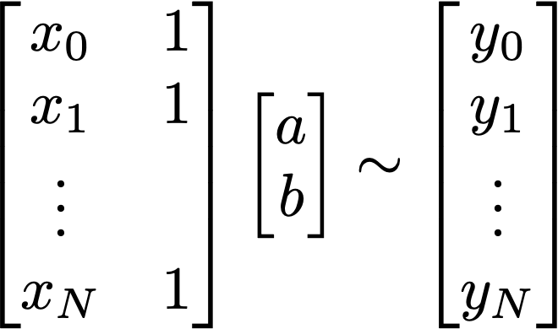
Linear regression in Ax = b form
In this form of Ax = b problem, it represents estimating y as a linear function of x as y_{est}=ax+b
To add more explanatory variable than x, you can add more column vector to the A matrix.
A x ~ b

Slide 4
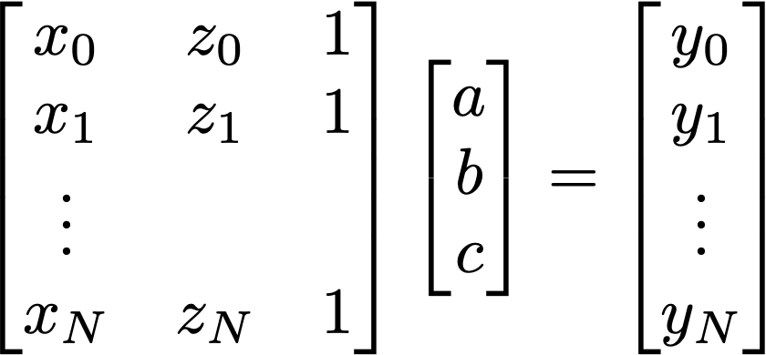
Linear regression in Ax = b form
In this form of Ax = b problem, it represents estimating y as a linear function of x as y_{est}=ax+b
To add more explanatory variable than x, you can add more column vector to the A matrix.
In this case, we just added another variable z. So it approximates y_{est}=ax+bz+c
This will work as long as z is not zeros or multiple of other columns (x and 1).
A x ~ b

Slide 5

Linear regression in Ax = b form
Pseudoinverse to obtain x (regression coefficients)
MATLAB
x = A\b
x = pinv(A)*b
A x ~ b
Python
x = np.linalg.pinv(A)@b

Slide 6
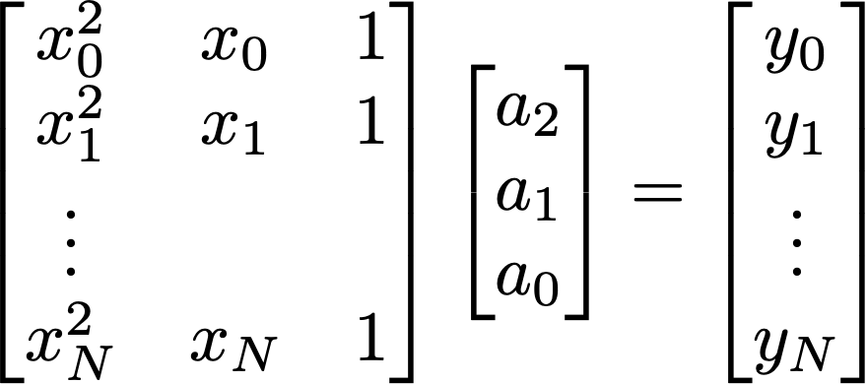
Linear regression in Ax = b form
This can be applied to fit a polynomial y=a₀+a₁x+a₂x²+…
Coefficients of N-th order polynomial can be optimized to best fit the data (y) using (N+1) column matrix A.
Fortunately, we don’t have to code these outselves every time we need to fit a polynomial. USE polyfit (MATLAB) or numpy.polyfit (python)
A x ~ b

Slide 7
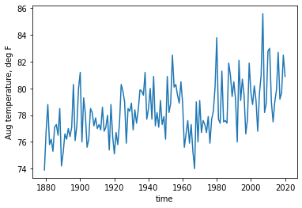
Least square
Looking at the August temperature (T) of Atlanta, I expect an increasing trend with time (t). The expected relationship is:
where a₀ and a₁ are constants.
T(t)

Slide 8
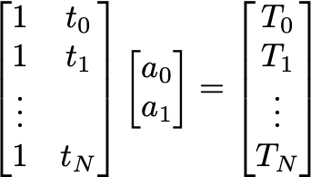
Least square and pseudoinverse
Looking at the August temperature (T) of Atlanta, I expect an increasing trend with time (t). The expected relationship is:
where a₀ and a₁ are constants.
T(t)
A x ~ b

Slide 9
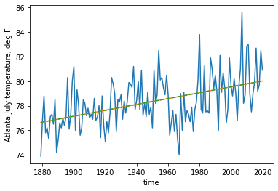

An example
y_{est} = Ax = a₀ + a₁ t
A x = b

Slide 10
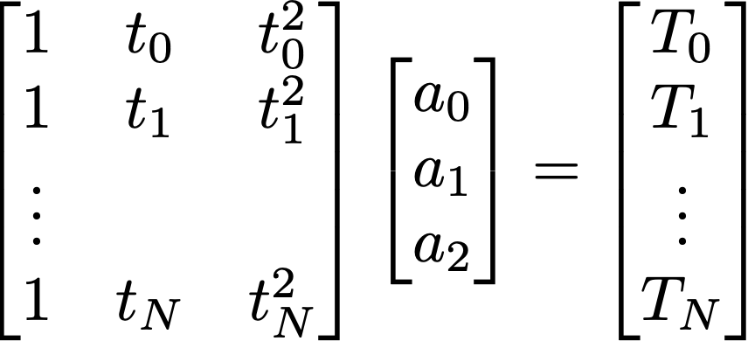

An example
A x = b

Slide 11
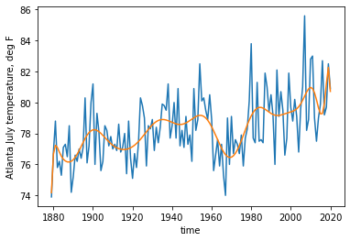
An example
A x = b

Slide 12
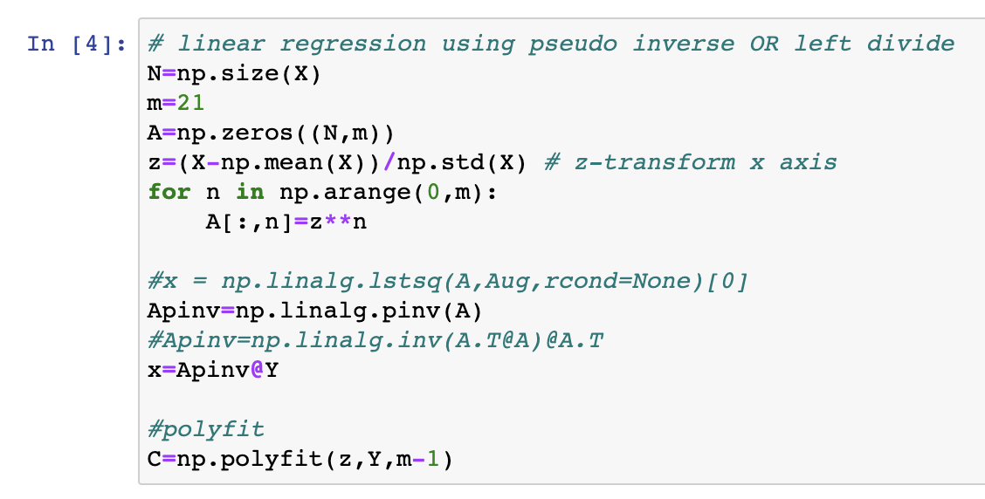
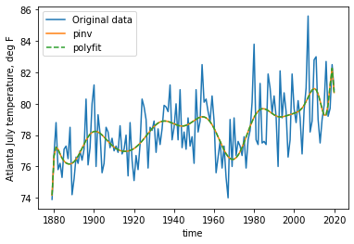
A python example
np.polyfit

Slide 13
A python example
Normalization is often necessary to make this algorithm work for higher order polynomial
np.polyfit

Slide 14
Smoothing
Real data often contains noises.
For example, atmospheric data contains high-frequency weather events on top of slowly varying climate signals. Ocean data can contain the effects of tides, waves, eddies, seasonal cycles etc…
Sometimes, we want to remove the high-frequency “noises” so that we can focus on the slowly varying climate signals.
Smoothing (filtering) is almost necessary step in data analysis. Fitting a low-order polynomial (or even a line) can be a method to remove the unwanted noises (or high frequency signal).

Slide 15
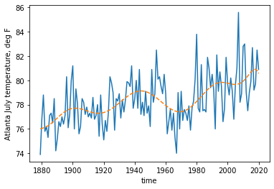
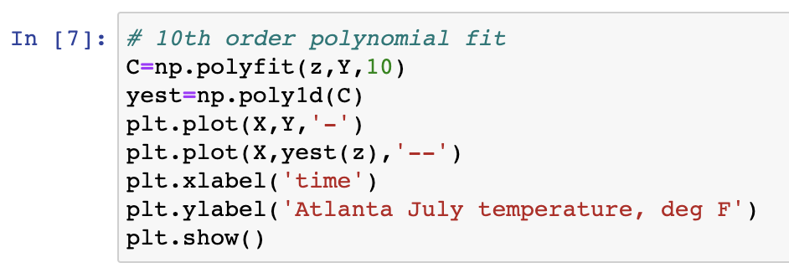
np.polyfit (python) and polyfit (MATLAB)
In python, C = np.polyfit (x,y,n) will calculate the coefficients (C) for n-th order polynomial fit to the data y(x).
Then yest = np.poly1d(C) will create a polynomial function

Slide 16
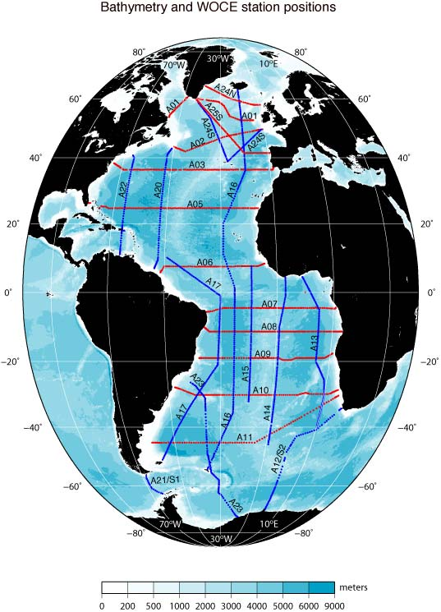
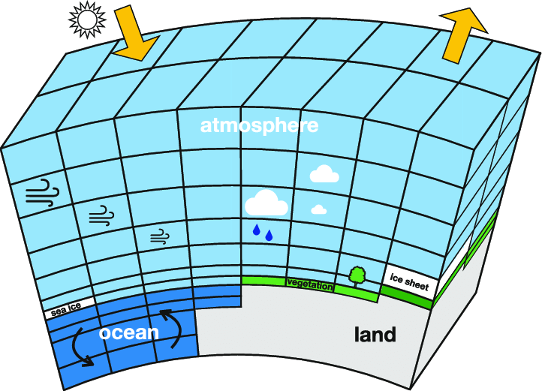
Interpolation

Slide 17
We may need to interpolate data when…
Comparing datasets that are defined in different grid system in space and/or in time
Data points are sparse/irregular/noisy, and it needs to be placed on regular grid before data analysis/interpretation
There is a data gap (missing data) that needs to be filled
Preparing inputs (e.g. boundary conditions) for a model that are continuous, smooth and without gaps

Slide 18
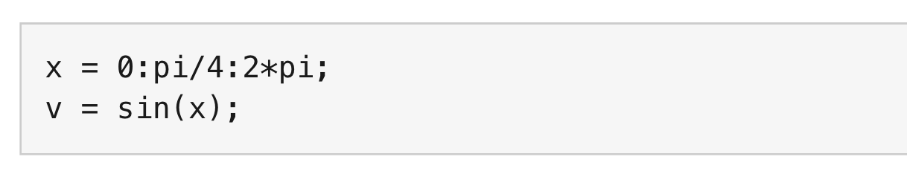
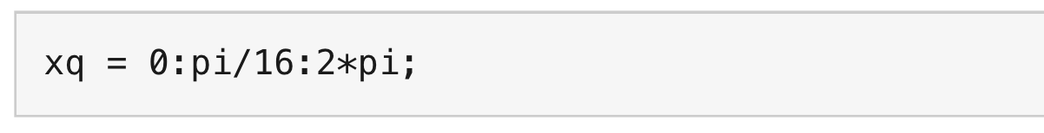
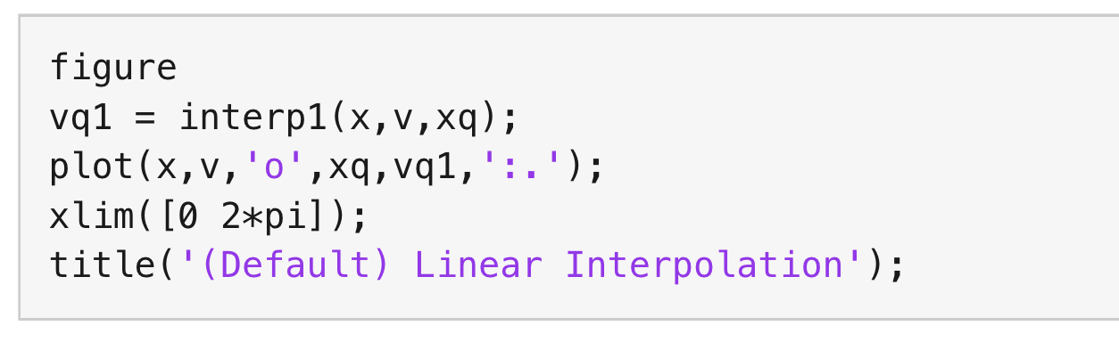
1. piecewise linear (MATLAB)
The input is a sine function subsampled at every π/4
The interpolation output is desired at every π/16
The MATLAB function, interp1, by default give you the piecewise linear interpolation

Slide 19
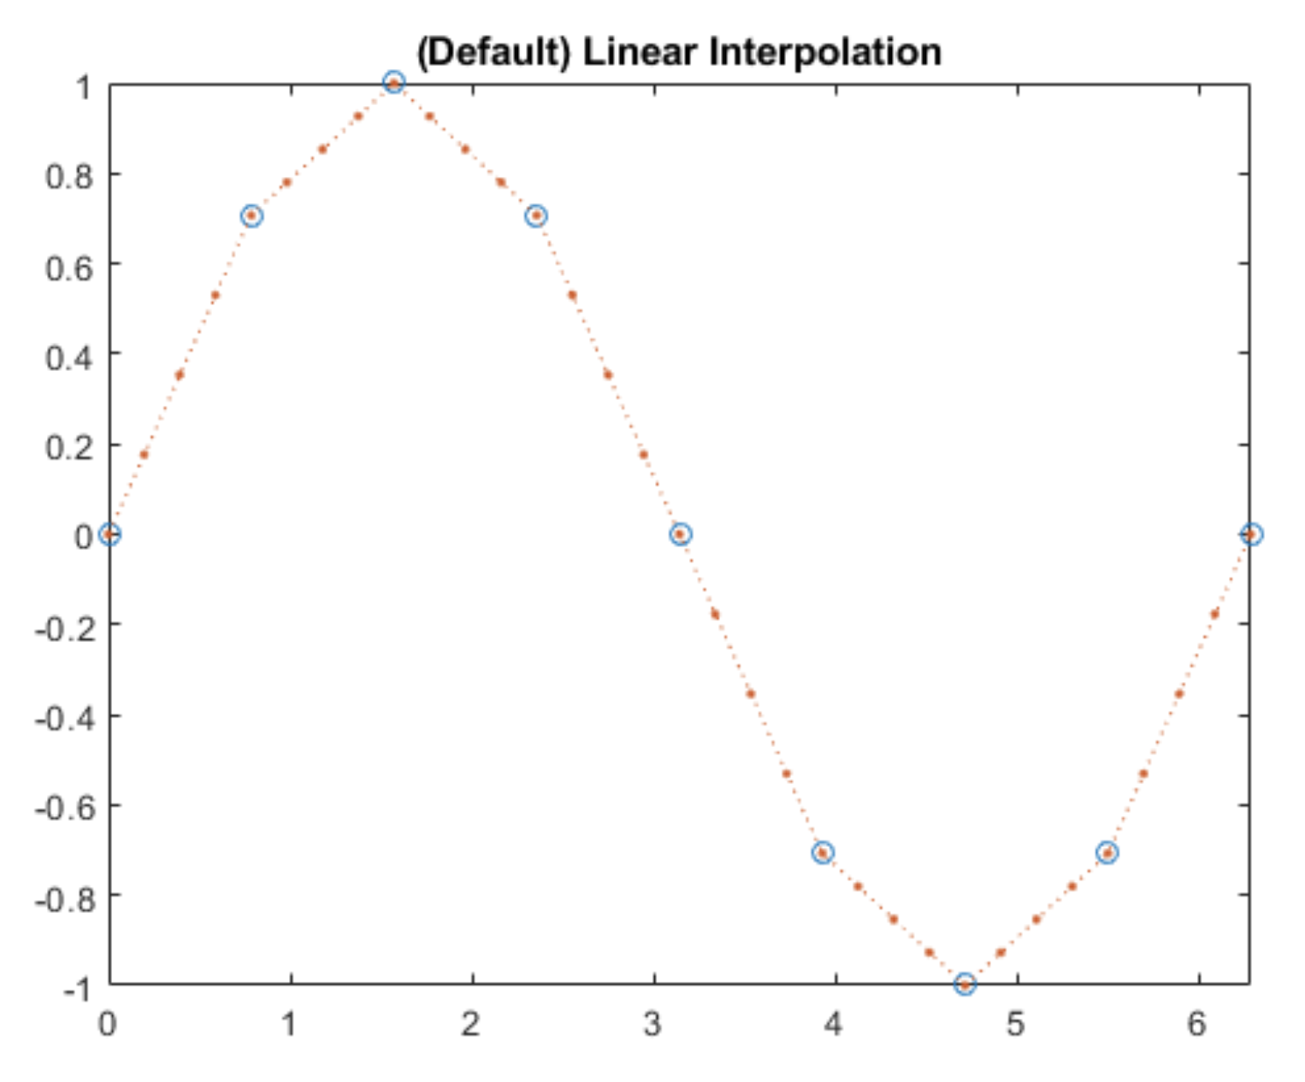
1. piecewise linear (MATLAB)
The input is a sine function subsampled at every π/4
The interpolation output is desired at every π/16
The MATLAB function, interp1, by default give you the piecewise linear interpolation

Slide 20
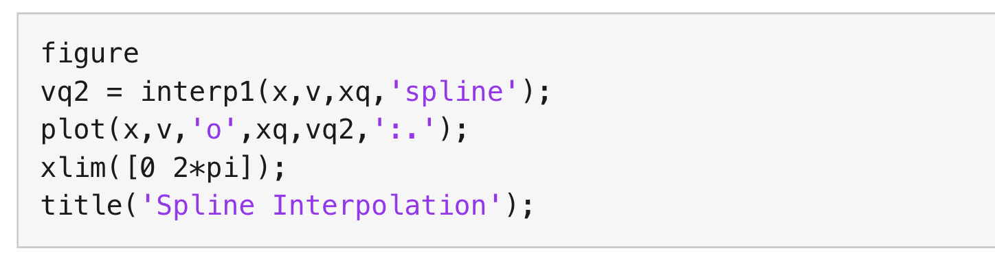
2. spline (MATLAB)
The input is a sine function subsampled at every π/4
The interpolation output is desired at every π/16
See the option ‘spline’ for the input of interp1 function

Slide 21
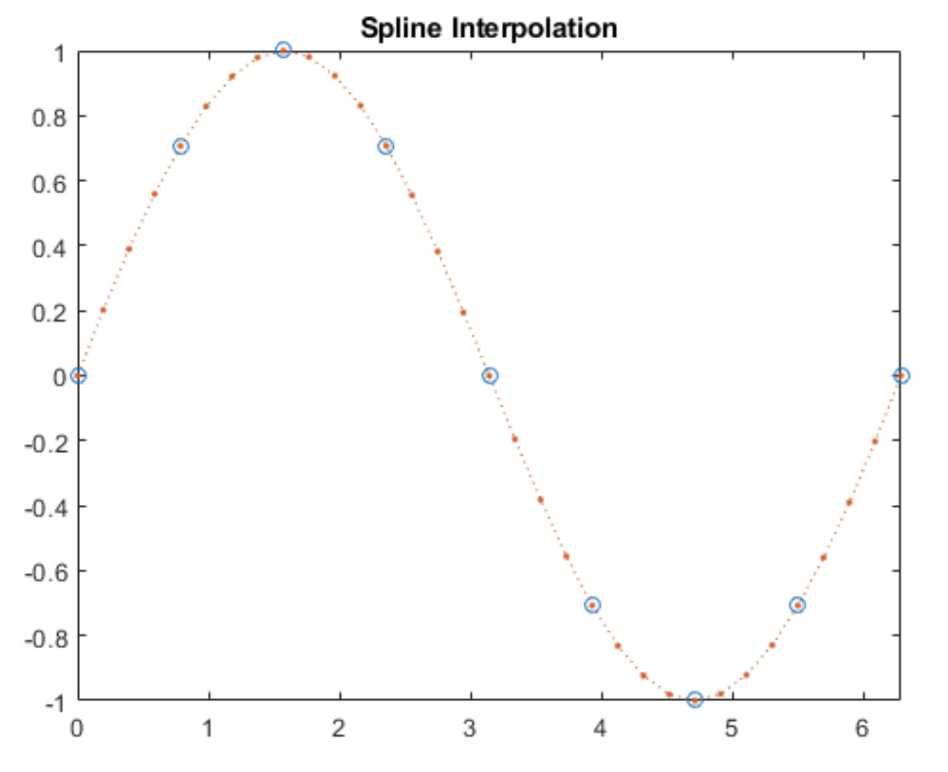
2. spline (MATLAB)
The input is a sine function subsampled at every π/4
The interpolation output is desired at every π/16
See the option ‘spline’ for the input of interp1 function

Slide 22
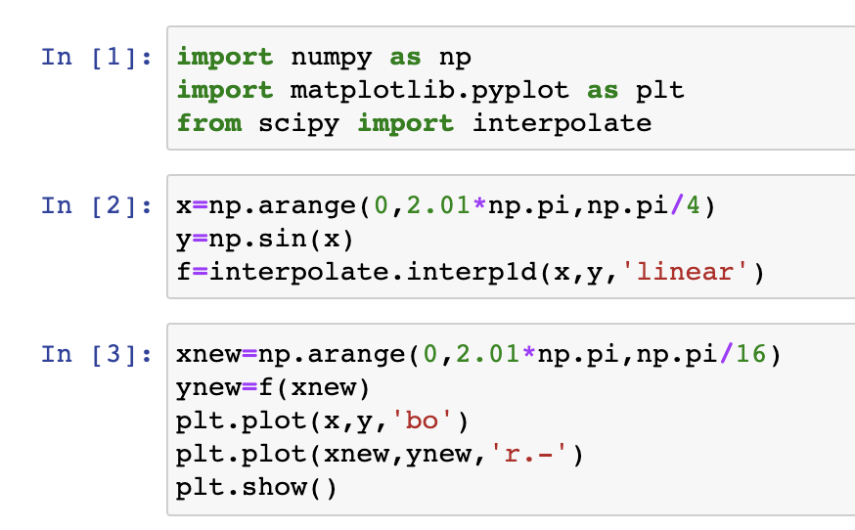
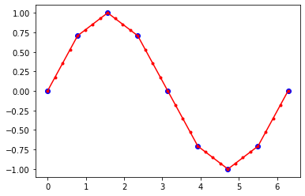
Python: scipy.interpolate.interp1d (linear)

Slide 23
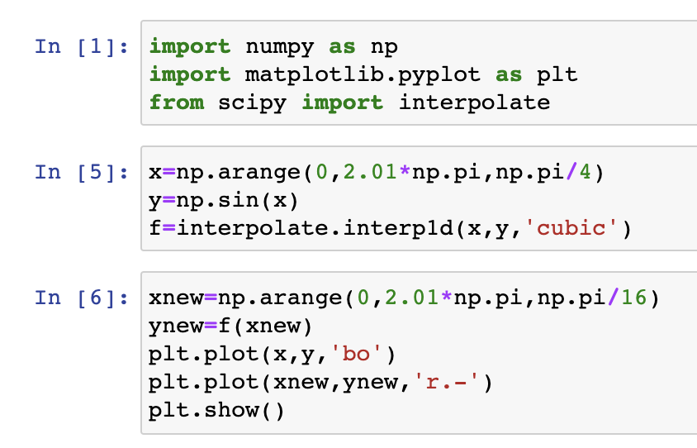
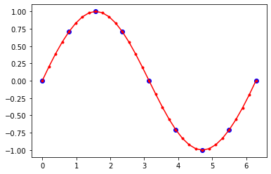
Python: scipy.interpolate.interp1d (spline)

Slide 24
Python: scipy.interpolate.interp1d (spline)

Slide 25
Two dimensional interpolation
Input/output are in 2 dimensions: f(x,y)
Example: Input is a temperature on 2° x 2° longitude-latitude grid and the desired output is on 1° x 1° grid.
Bilinear interpolation → this is what I use for the first try. Under the hood, the algorithm first interpolate in one direction, and then linearly interpolate again in the other direction
Other options would be nearest neighbor and cubic spline

Slide 26
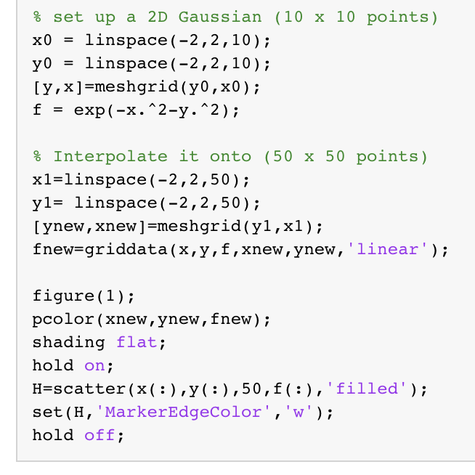
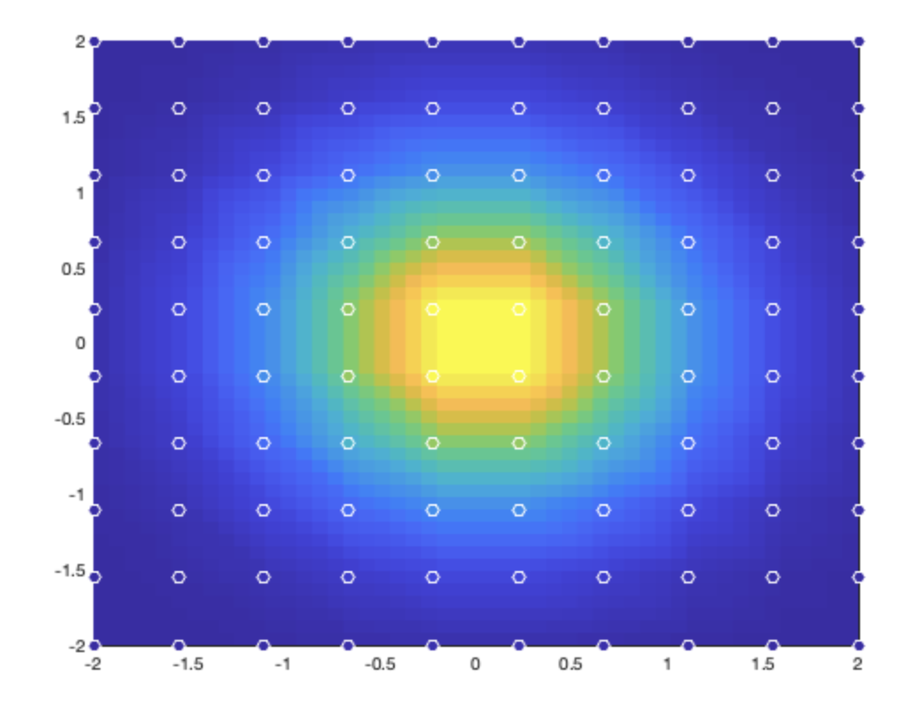
MATLAB: fnew = griddata(x,y,f,xnew,ynew)
Bilinear interpolation

Slide 27
MATLAB: fnew = griddata(x,y,f,xnew,ynew)
Bilinear interpolation

Slide 28
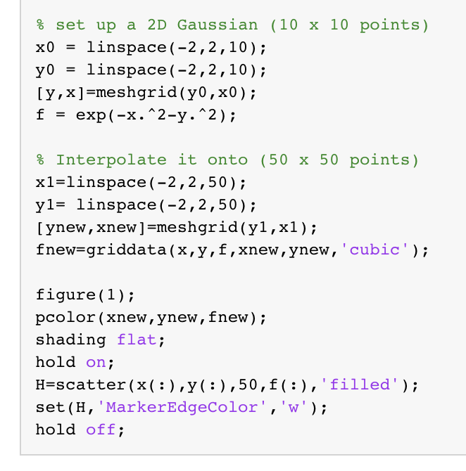
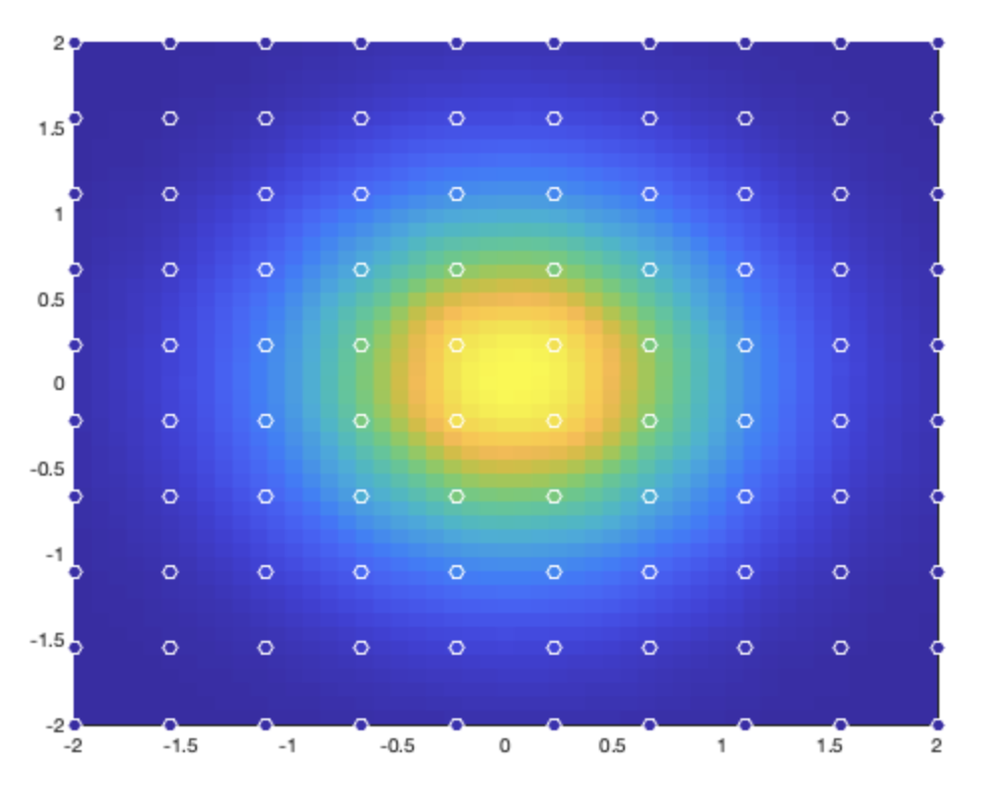
MATLAB: fnew = griddata(x,y,f,xnew,ynew)
Cubic interpolation

Slide 29
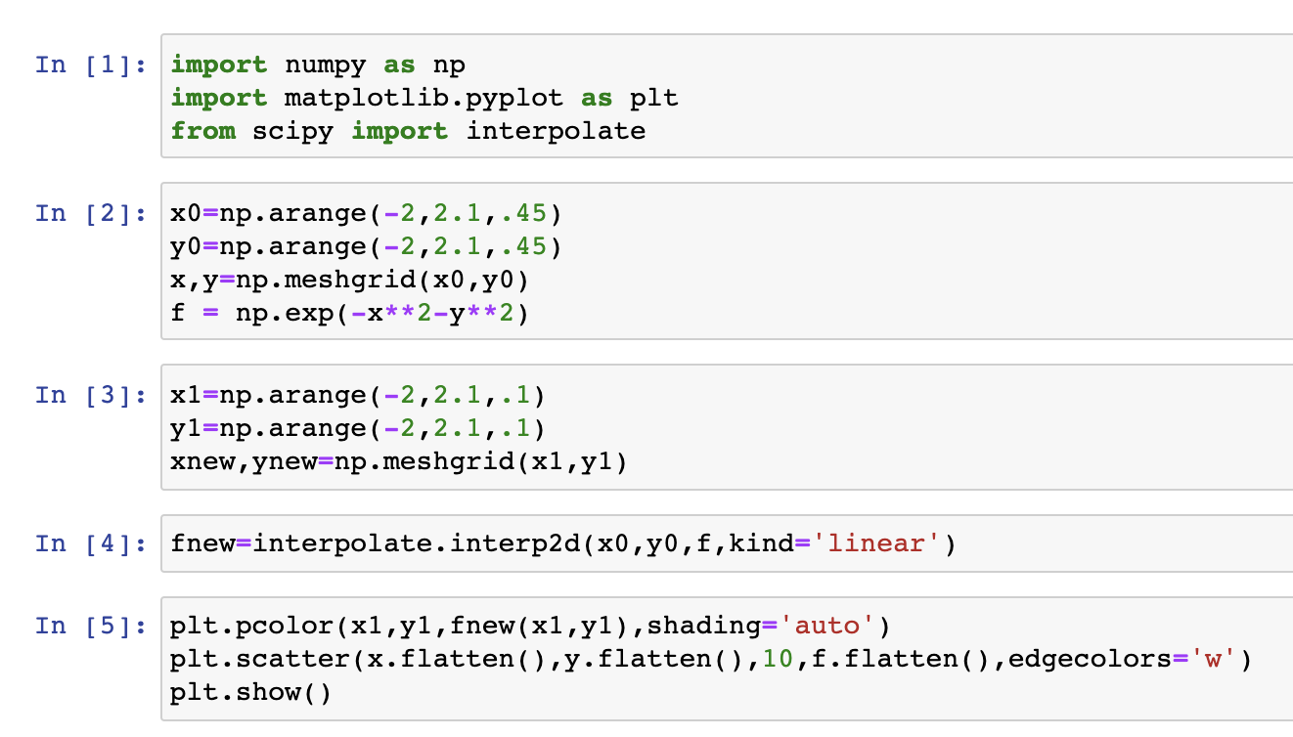
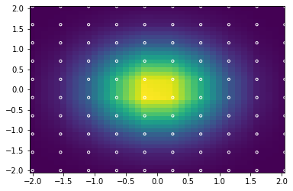
Python: interpolate.interp2d

Slide 30
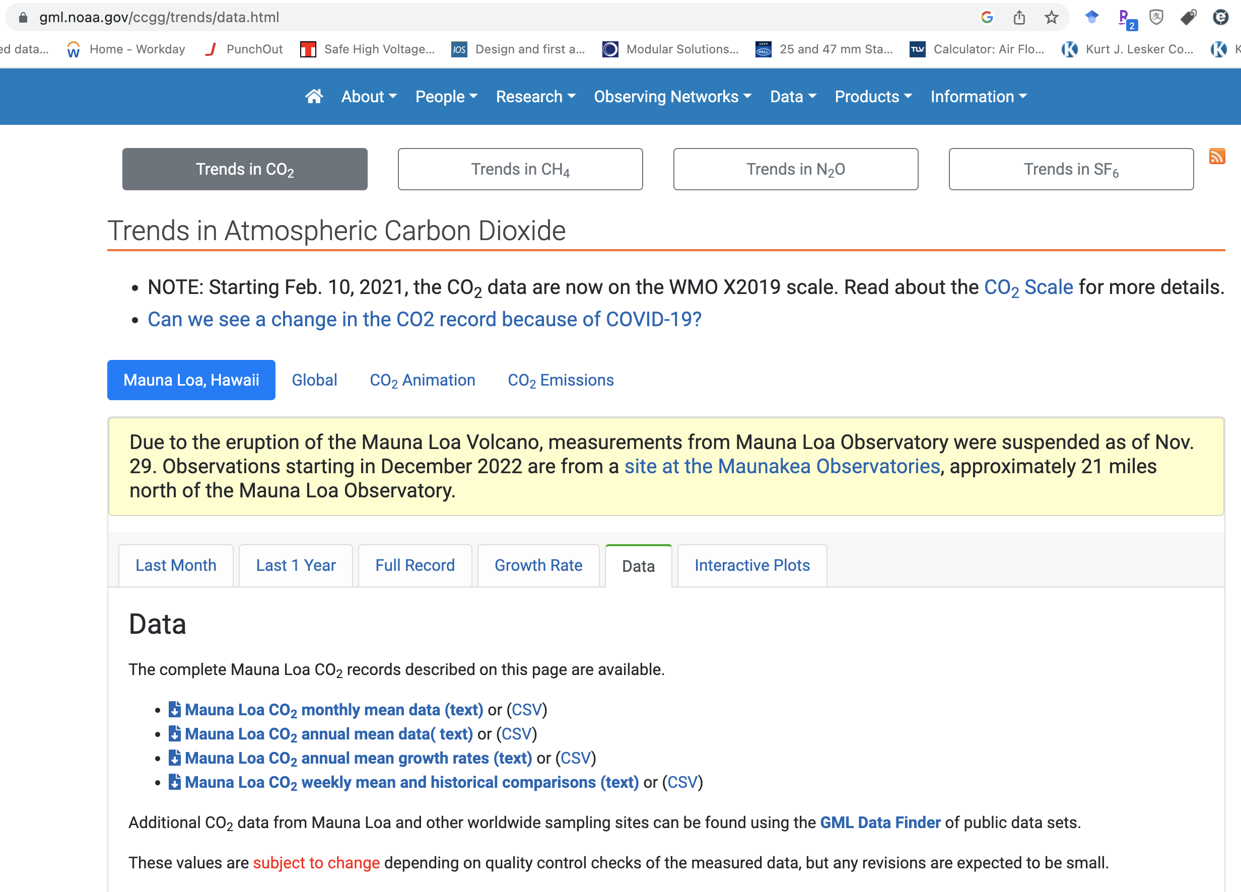

Slide 31
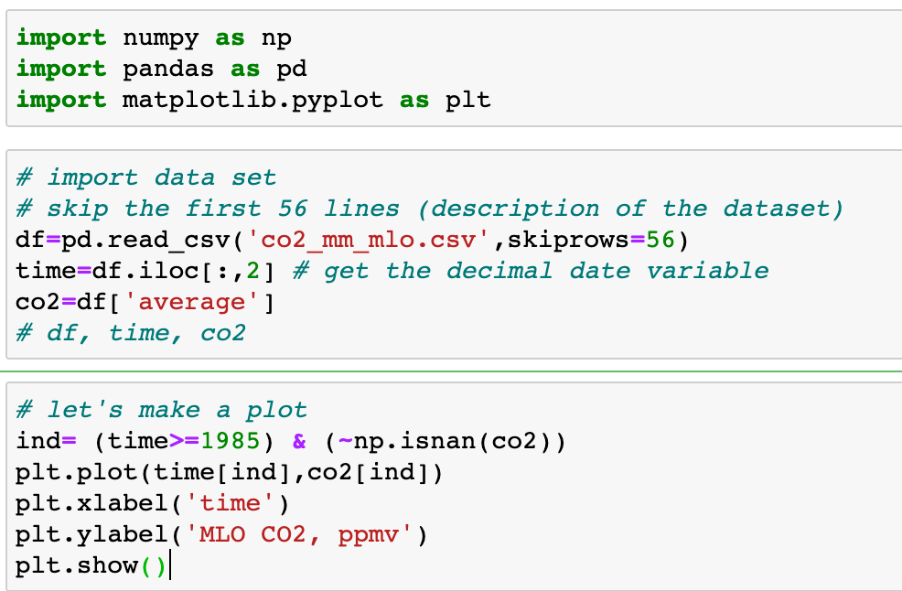
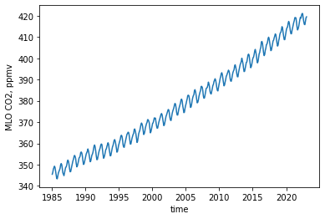
example: Atmospheric CO2 data

Slide 32
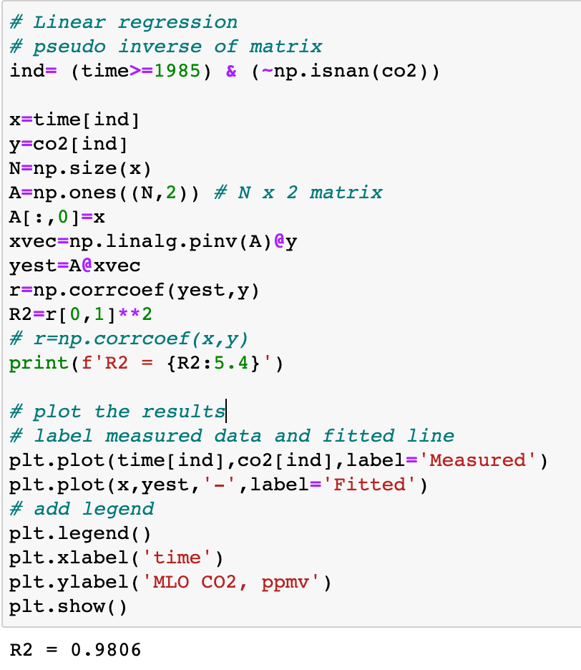
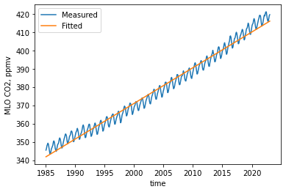
Linear regression

Slide 33
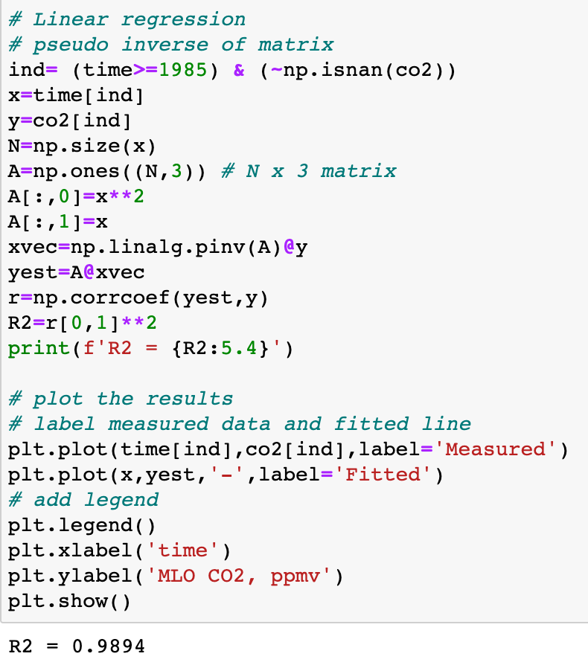
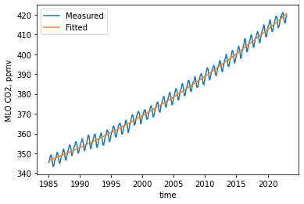
Quadratic = 2nd order polynomial fit

Slide 34
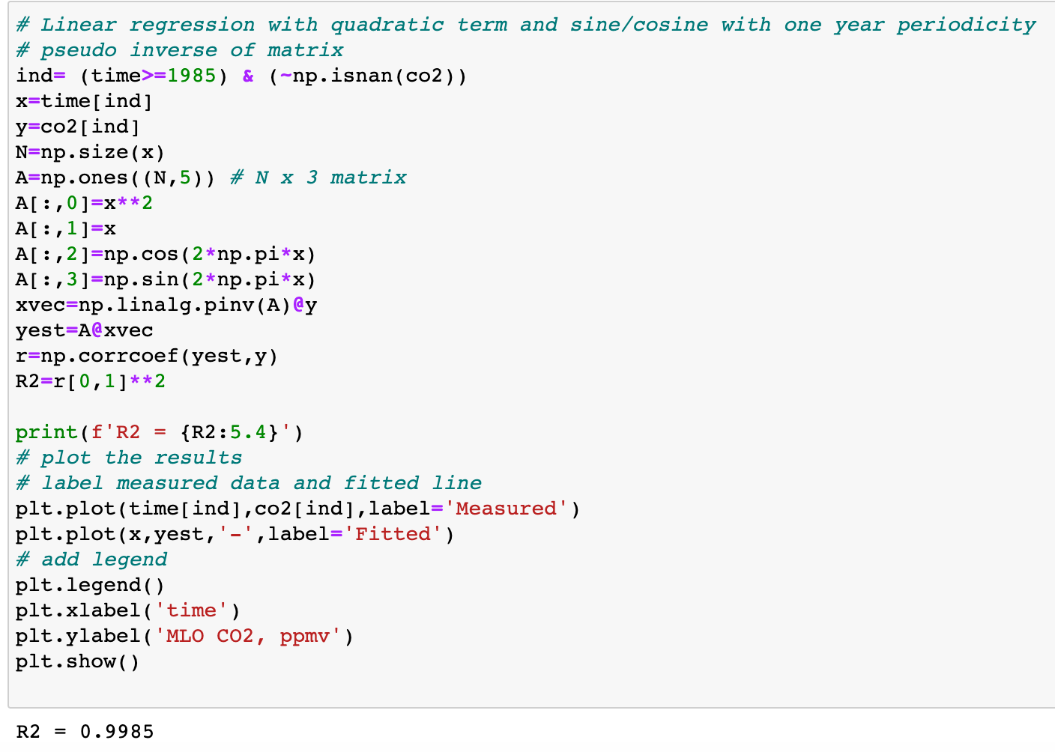
Include sine/cosine terms

Slide 35
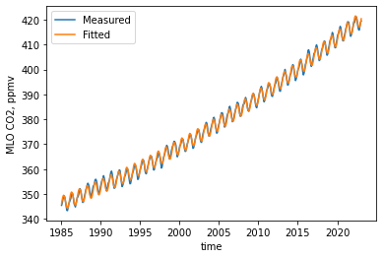
Include sine/cosine terms

