Slide 1
Review
Linear regression & correlation (Week 4)
Regression coefficient, r, R²
Statistical significance (Week 5)
t-test for slope and r
One-tailed and two-tailed tests
Data visualization & NETCDF data (Week 8)
Calculate climatological mean, annual mean, etc
Making global maps using different projections

Slide 2
EAS2655 – Week 9
Agenda
Review
Trends of global air temperature
Significance test considering autocorrelation
Develop function to calculate slope, correlation coefficient, and confidence interval
Correlation map for NINO3.4

Slide 3
Exercise 1: Global map of air temperature trends
Scientific question:
How does the surface air temperature (T_{air}) change in the last ~70 years?
Dataset: NCEP monthly air temperature, 1948-2022
Methods: linear regression
Calculate the annual mean temperature from monthly data
Calculate the slopes of annual temperature trends
Visualize the results in a global map
We will add statistical tests in Exercise 2

Slide 4
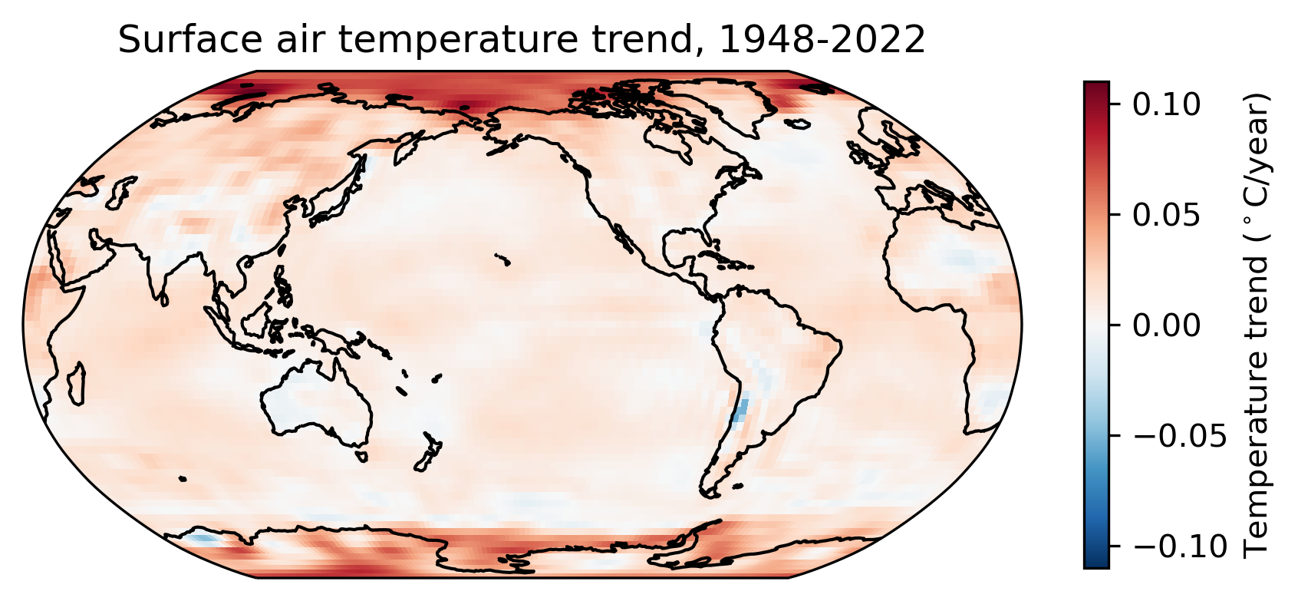
Exercise 1: Results
Interpretation:
During the last 70 years, the annual temperature in most areas shows an increasing trend;
Large increasing trends are observed in polar regions.

Slide 5
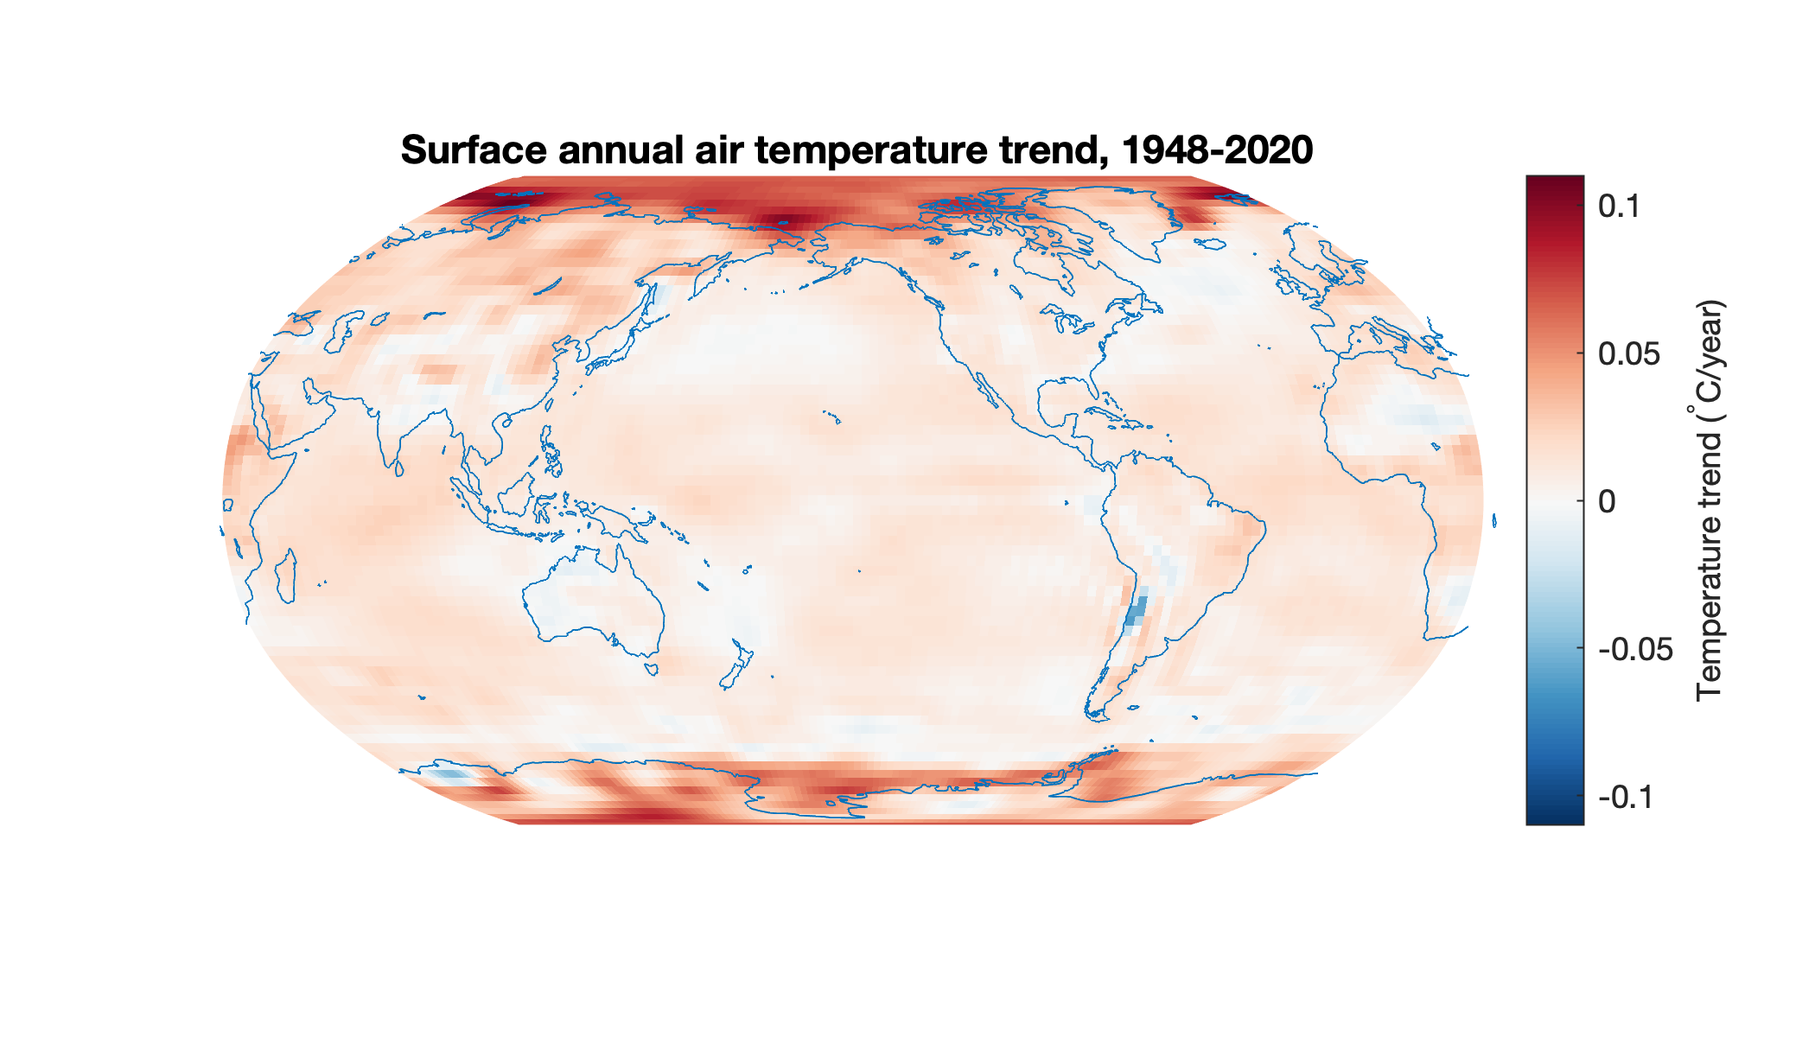
Are these trends statistically significant?

Slide 6
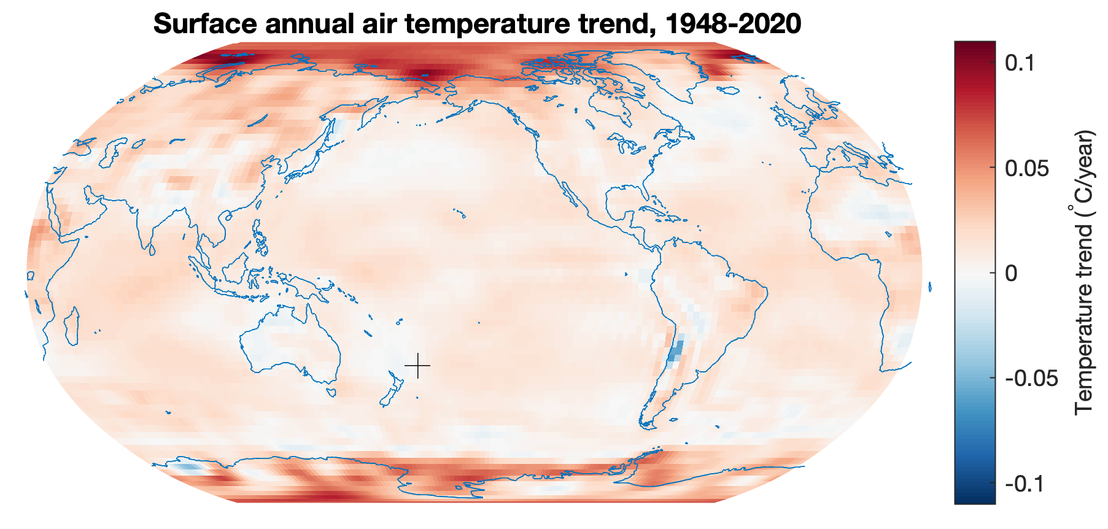
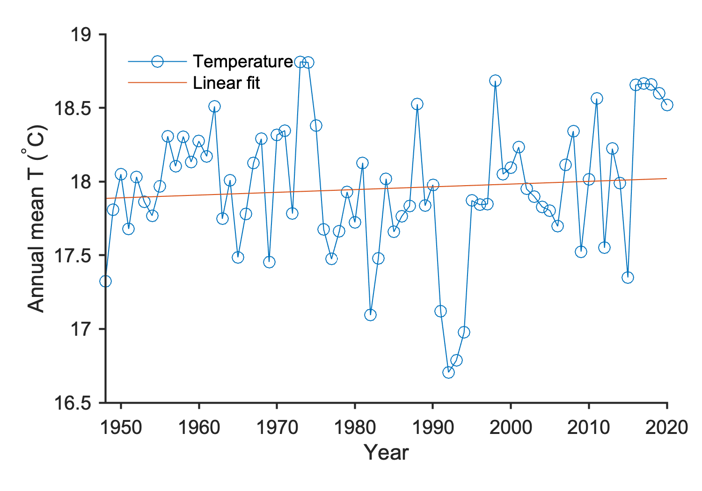
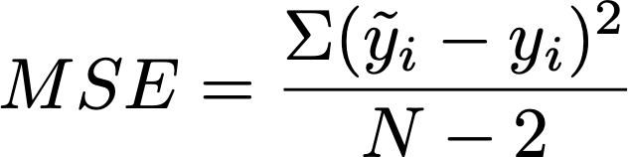
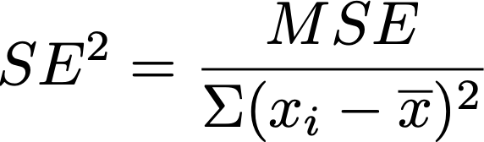
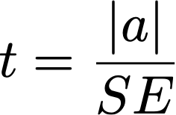




$$N=73$$
$$\tilde{y}=0.0019x+14.25$$
$$R^{2}=0.0076$$
Statistical significance of regression coefficient (slope)
Procedure
1. Select confidence level: CL=95%
2. State null hypothesis and alternative hypothesis
H0: The regression coefficient is NOT significantly different from 0
H1: The regression coefficient is significantly different from 0
3. State statistics used: t-test, two-tailed
4. Determine critical region: 0.0019+-2*0.0025
5. Evaluate whether data rejects the null hypothesis
We cannot reject the null hypothesis
= 0.2069
= 6.38e-6
= 0.0019/0.0025 = 0.74
$t_{crit}$=tinv(0.975,71)=2.0
t < t_{crit}

Slide 7
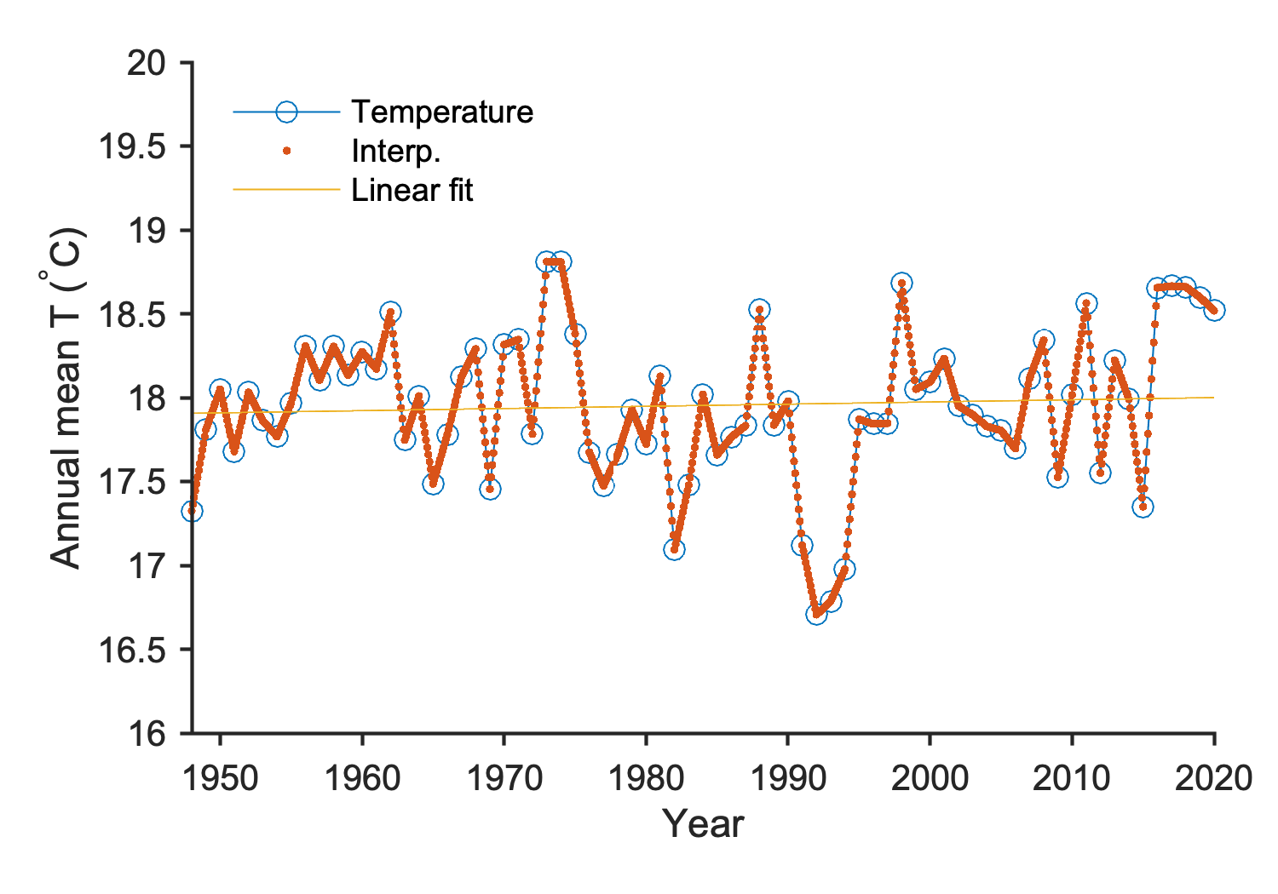




Does interpolation help to increase sample size?
Answer: No!
= 0.1621
= 4.33e-7
= 0.0013/6.6e-4 = 1.97
$t_{crit}$=2.0
Interpolation appears to increase the sample size and thus reduce SE
However, the interpolated data points are not independent
Interpolation does not increase the effective sample size
$$N=865$$
$$\tilde{y}=0.0013x+15.38$$
$$R^{2}=0.0045$$

Slide 8
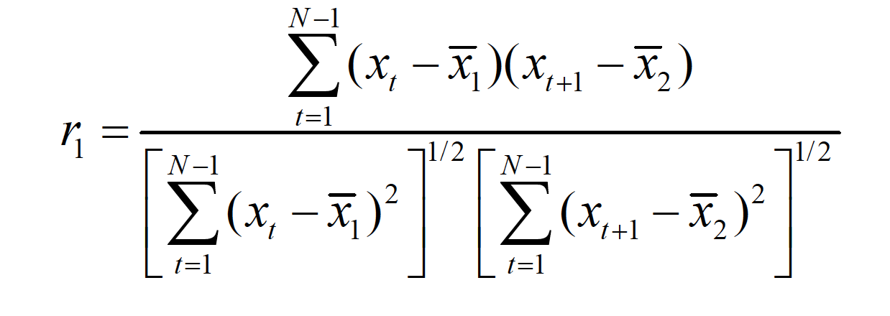
Autocorrelation of time series data (lag 1)
Autocorrelation: the correlation is computed between one time series and the same series lagged by one or more time units.
x₁
r₁ is the the autocorrelation coefficient.
1
2
3
t
t+1
N
1
2
3
t
t+1
N
x₂

Slide 9
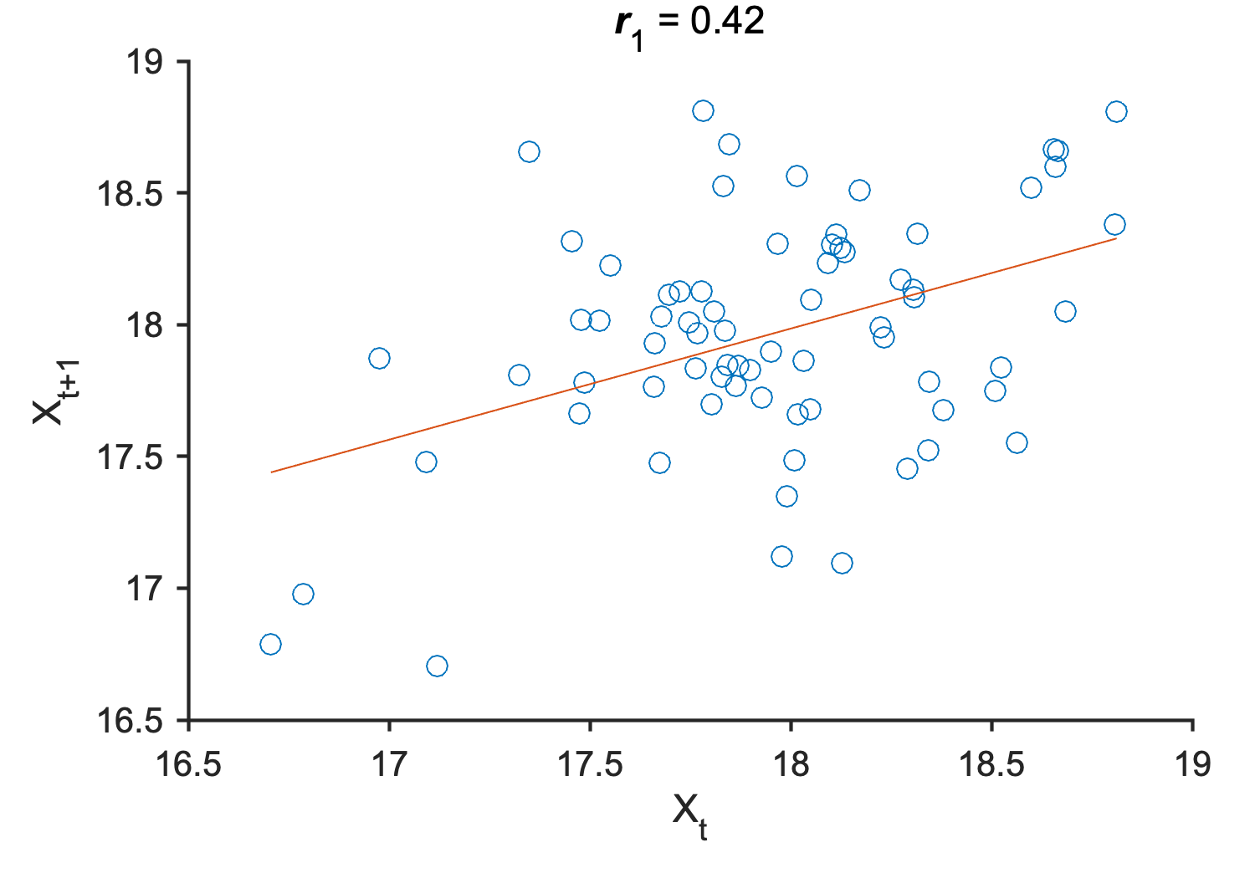
Autocorrelation of time series data
Time series (N=73)
Scatter plot for lag1 (N=72)
Time series of annual mean temperature is autocorrelated (i.e., the temperature of a given year can depend on the temperature of the previous year).

Slide 10
Effective sample size
If a time series of length N is autocorrelated, the number of independent observations is fewer than N;
An autocorrelated time series indicate data points are not random in time, and the information in each observations is not totally separated from other observations;
The reduction in number of independent observations has implications for hypothesis testing;
Standard statistical tests typically depend on the assumption of random samples;
The sample size needs to be adjusted to apply these tests for autocorrelated time series.

Slide 11
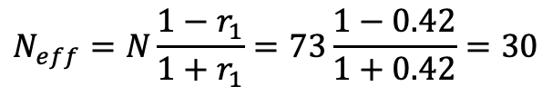
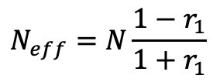
Effective sample size
The equation is derived based on the assumption that the autocorrelation in the time series represents first-order autocorrelation (dependence on lag-1 only).
In other words, the governing process is Markov.
Computation of the effective sample size only requires sample size (N) and the first-order sample autocorrelation coefficient (r₁)
In the previous example, N=73, r₁=0.42, the effective sample size after adjustment for autocorrelation is:
$$N_{eff}=N\frac{1−r_{1}}{1+r_{1}}$$
$$N_{eff}=N\frac{1−r_{1}}{1+r_{1}}=73\frac{1−0.42}{1+0.42}=30$$

Slide 12


Effective sample size
Significance test for regression coefficient (slope): t-test, confidence level=95%, two-tailed
Before adjustment (N=73):
After adjustment (N_{eff}=30):
= 0.2069
= 0.5317
= 6.38e-6
= 1.64e-5
= 0.0019/0.0025 = 0.74
= 0.0019/0.0041 = 0.46
$t_{crit}$=tinv(0.975,71)=2.0
$t_{crit}$=tinv(0.975,28)=2.05

Slide 13
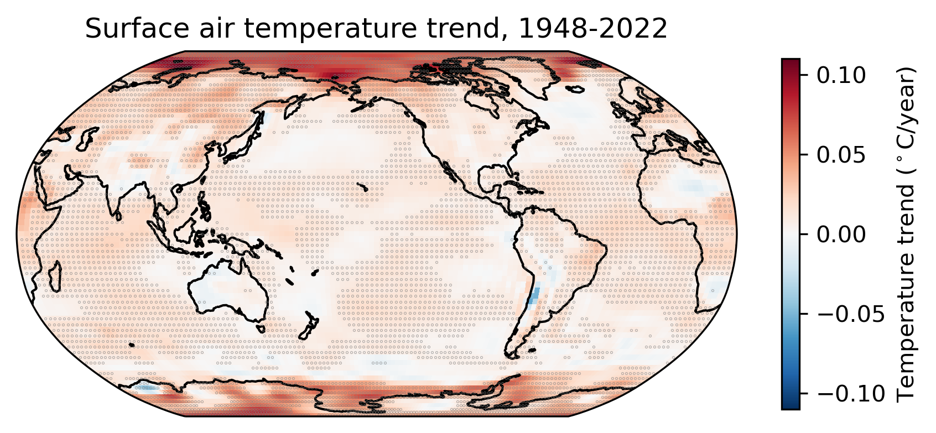
Exercise 2: Are these trends statistically significant?
Figure. Trends of annual mean surface air temperature derived from linear regression. Grey dots indicate the trends are significantly different from zero at 95% confidence level.

Slide 14
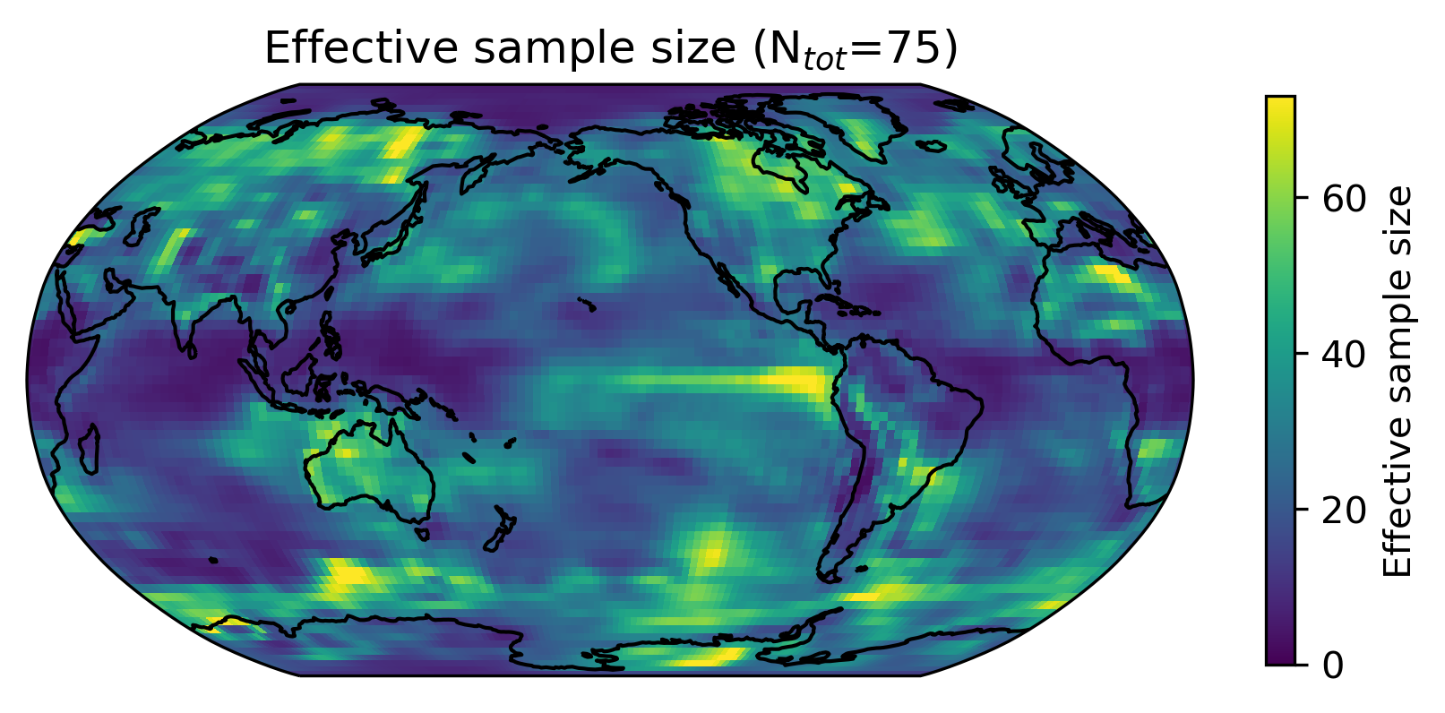
Effective sample size

Slide 15
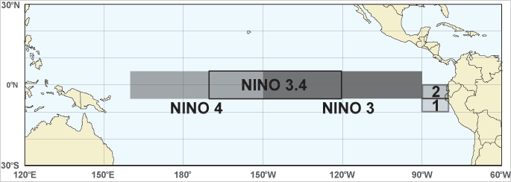
Exercise 3: Correlation map between air temperature and climate index
ENSO: The El Niño-Southern Oscillation (ENSO) is a recurring climate pattern involving changes in the temperature of waters in the central and eastern tropical Pacific Ocean.
Niño 3.4 (SST anomaly over 5N-5S, 170W-120W): El Niño or La Niña events are defined when the Niño 3.4 SSTs exceed +/- 0.4C for a period of six months or more.

Slide 16
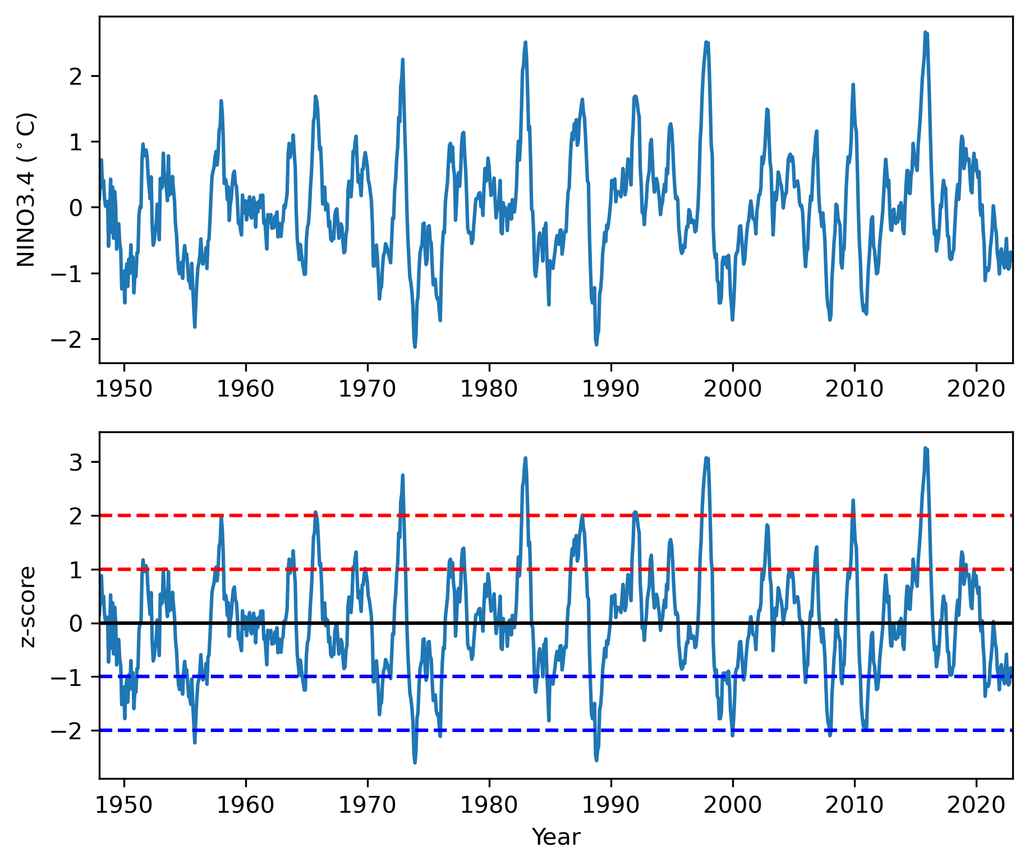
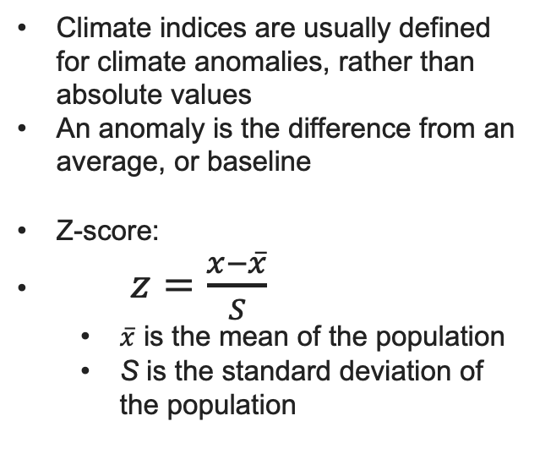
Climate indices: Nino 3.4 index and its z-score
Climate indices are usually defined for climate anomalies, rather than absolute values
An anomaly is the difference from an average, or baseline
Z-score:
$z=\frac{x−\overline{x}}{S}$
$\overline{x}$ is the mean of the population
S is the standard deviation of the population

Slide 17
Climate indices
Climate indices:
ENSO indices: Niño 1+2, Niño 3, Niño 3.4, Ocean Niño index (ONI), Niño 4
https://climatedataguide.ucar.edu/climate-data/nino-sst-indices-nino-12-3-34-4-oni-and-tni
North Pacific Gyre Oscillation (NPGO; Di Lorenzo et al.)
http://www.o3d.org/npgo/
Pacific North American Index (PNA)
https://www.ncdc.noaa.gov/teleconnections/pna/
More climate indices
https://psl.noaa.gov/data/climateindices/list/

Slide 18
Exercise 3: correlation map
Scientific question:
How does ENSO influence surface air temperature anomalies?
Datasets
Niño 3.4 monthly sea surface temperature (SST)
https://climatedataguide.ucar.edu/climate-data/nino-sst-indices-nino-12-3-34-4-oni-and-tni
Monthly mean surface air temperature from NCEP
air.mon.mean.nc
Methods
Calculate monthly anomalies for both surface air temperature and Niño 3.4 SST
Calculate the correlation between monthly air temperature anomalies and Niño 3.4
Show correlation coefficient (r) values in a map
Test whether these correlations are statistically significant (two-tailed t-test)

Slide 19
Home work: Statistical significance for correlation coefficient (r value; considering autocorrelation)
Procedure
1. Select confidence level → 95%
2. State null hypothesis and alternative hypothesis
H0: There is NO significant correlation between NINO3.4 index and temperature
H1: There is a significant correlation
3. State statistics used
Student t-test, two-tailed
4. Determine critical region
5. Evaluate whether data rejects the null hypothesis

Slide 20
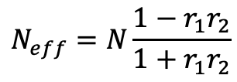
Statistical significance for correlation coefficient (r value; considering autocorrelation)
4. Determine critical region
Effective sample size depends on the lag-1 autocorrelation for both X (surface air temperature) and Y (NINO3.4)
Where r₁ and r₂ are the lag-1 autocorrelation for X and Y, respectively
Degree of freedom, df=Neff-2
alpha=1-CL
tcrit=tinv(1-alpha/2,df)
5. Evaluate whether data rejects the null hypothesis
$$N_{eff}=N\frac{1−r_{1}r_{2}}{1+r_{1}r_{2}}$$

Slide 21

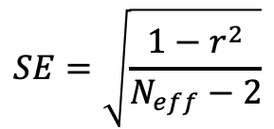
Statistical significance for correlation coefficient (r value; considering autocorrelation)
4. Determine critical region
5. Evaluate whether data rejects the null hypothesis
If |r| > CI. H0 is rejected.
$$SE=\sqrt{\frac{1−r^{2}}{N_{eff}−2}}$$
$$CI=tcrit∗SE$$

Slide 22
Homework (due 03/17/2023)
Download the NINO3.4 index (nino34.long.txt) and NCEP surface air temperature (air.mon.mean.nc) from Canvas website.
Pick a month and extract the time series (1948-2022) for NINO3.4 and surface air temperature for the month of you choice.
Modify the function “regrcorr2” to additionally include the confidence interval of correlation coefficient r. The calculation should consider the autocorrelation for both NINO3.4 and surface air temperature. The output of the modified function should include the correlation coefficient and its confidence interval (using two-tailed t-test).
Apply your function to calculate the correlation coefficient (and its confidence interval at 95% confidence level) for the correlation between surface air temperature and NINO3.4 for the month your choose in step 2.
Generate a global map of the correlation coefficient. Use a diverging color map (e.g., Blue-Red) to indicate the sign and magnitude of the correlation.
Over the correlation map, plot a dot for the statistically significant correlation (95% confidence level, two-tailed test).
Generate a report in .PDF format and submit via Canvas.

