Slide 1
EAS2655 – Week 12
Agenda
3-box ocean phosphorus model
Basic concepts and terminology
Matrix exponential (analytic solution of linear ODE)
Eigen values and eigen vectors
Numerical solution: Euler forward & backward methods
ODE stability
Reading p. 85-97

Slide 2
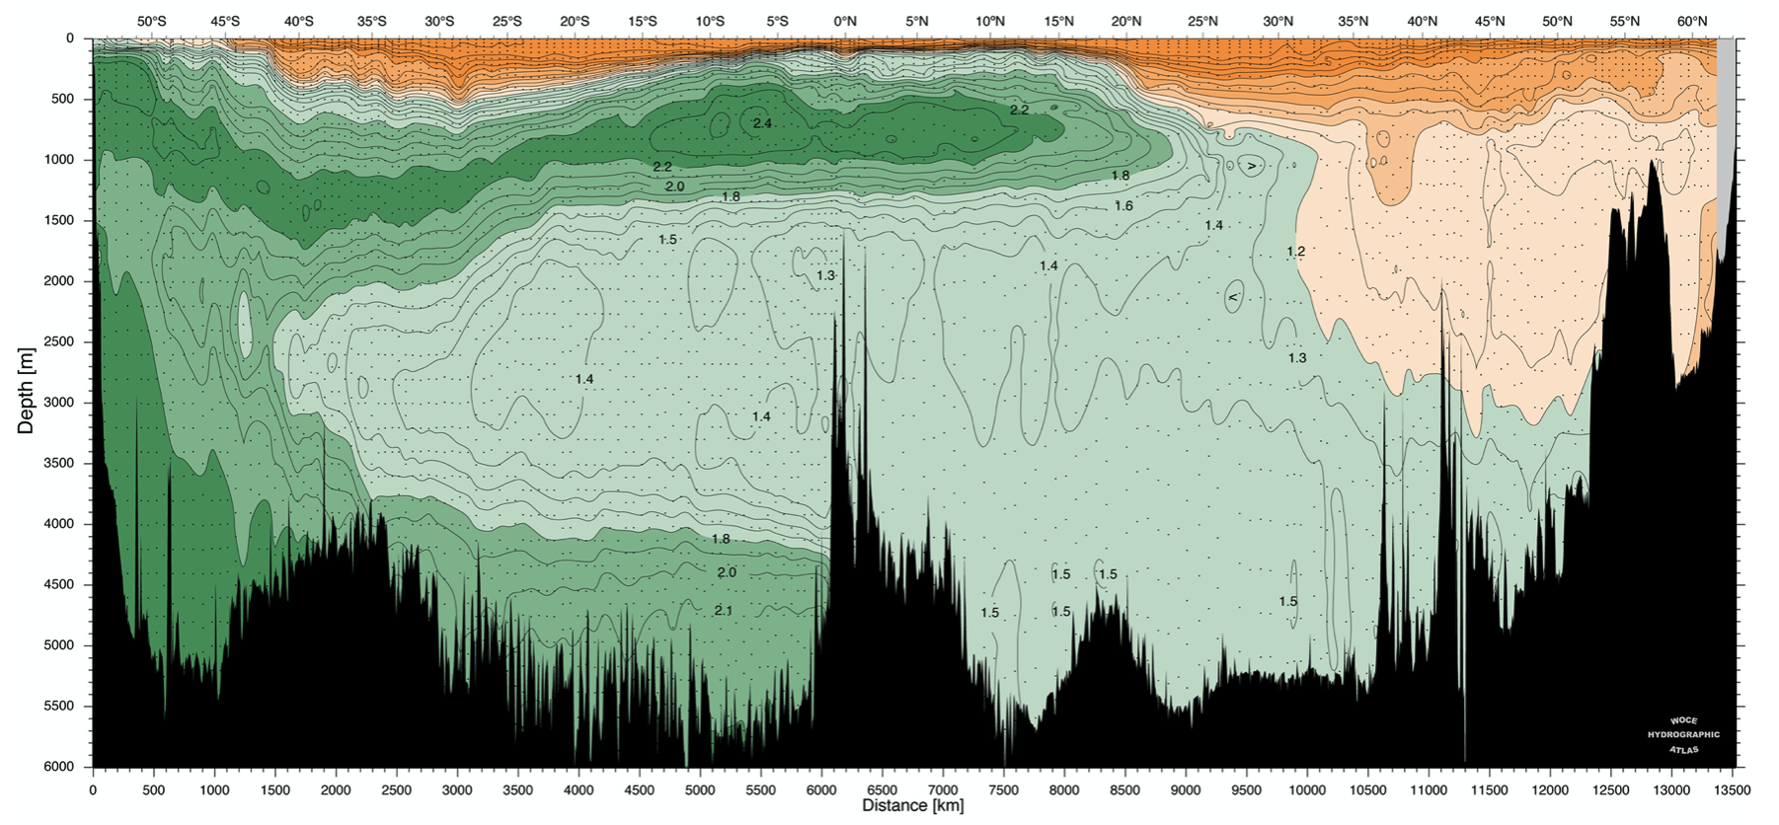
Week 12: Multi-box model
Read the text section 2.2
Phosphorus (P) is an essential nutrient in the ocean
Higher P conc.
Lower P conc.
Lower latitude
Higher latitude

Slide 3
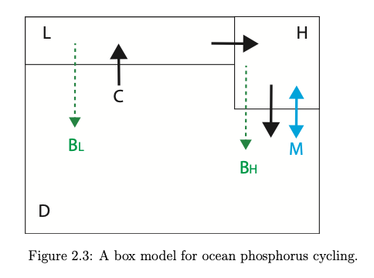
Week 12: Box model
3 Box system (low / high latitude, deep ocean)

Slide 4
Week 12: Box model
3 Box system (low / high latitude, deep ocean)
C: circulation rate (thermohaline circulation)
M: mixing rate (deep convection)
B: biological carbon export

Slide 5
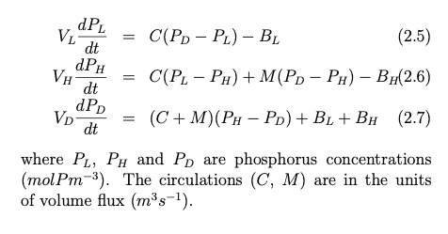
Week 12: Box model
3 Box system (low / high latitude, deep ocean)

Slide 6


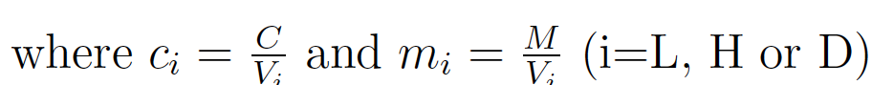



Week 12: Box model
Matrix formulation
“State” vector: P
Model matrix: T
The model

Slide 7


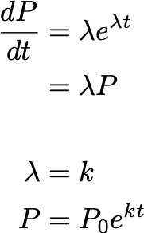
A system of linear ODE
Remember if you have, an ODE
Expect an exponential solution
Plug in, and find that

Slide 8



A system of linear ODE
Now you have a system of ODE
Expect an exponential solution
Plug in, and find that

Slide 9

A system of linear ODE
Now you have a system of ODE
Expect an exponential solution
Plug in, and find that
Thus, λ and P₀ forms eigenvalue-eigenvector pair of the matrix T

Slide 10


A system of linear ODE
Given a system of ODE
λ_{i} and q_{i} are the eigenvalue-eigenvector pair
Then the solution is a linear combination of
For the 3 box model
what values should we pick for c₁, c₂ and c₃?

Slide 11


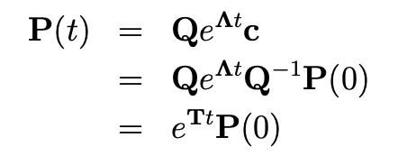

A system of linear ODE
Initial condition at t=0,
So,
The whole solution for P(t) is
“Matrix exponential”

Slide 12
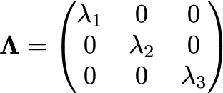
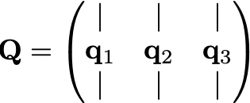
Matrix exponential
“Matrix exponential”
Λ contains eigenvalues (as main diagonal)
Q contains eigenvectors (as column vectors)
Since T is 3x3 matrix, Λ and Q are also 3x3 matrices.

Slide 13


Analytic solution to the initial value problem
Given a system of ODE
Analytic solution for the initial value problem is

Slide 14
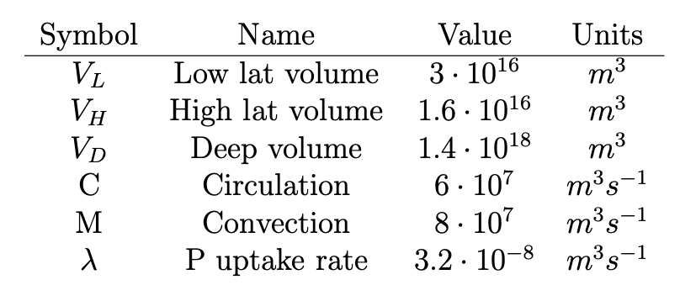
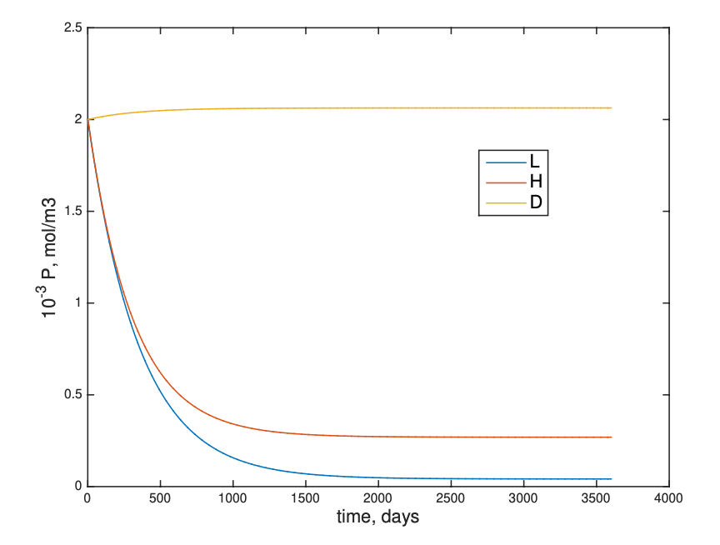

Slide 15
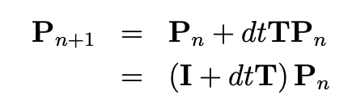
Numerical solution
Euler forward scheme
As before, it is PROBLEMATIC if a large timestep is used.

Slide 16
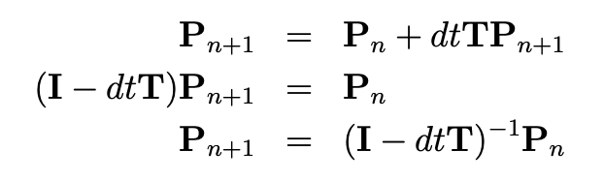
Numerical solution
Euler backward scheme
While Euler backward is the same accuracy (1st order) as the forward scheme, it is STABLE even with a large time step

Slide 17
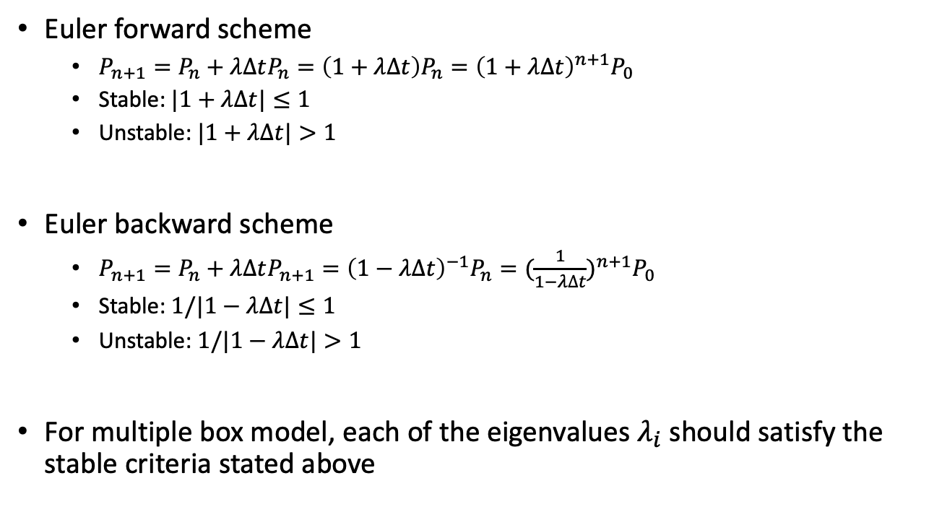
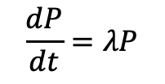
Stability of numerical solution
$$\frac{dP}{dt}=λP$$
Simplified one box model
Euler forward scheme
$P_{n+1}=P_{n}+λ∆tP_{n}=\left(1+λ∆t\right)P_{n}={\left(1+λ∆t\right)}^{n+1}P_{0}$
Stable: $|1+λ∆t|≤1$
Unstable: $|1+λ∆t|>1$
Euler backward scheme
$P_{n+1}=P_{n}+λ∆tP_{n+1}={\left(1−λ∆t\right)}^{−1}P_{n}={(\frac{1}{1−λ∆t})}^{n+1}P_{0}$
Stable: $1/|1−λ∆t|≤1$
Unstable: $1/|1−λ∆t|>1$
For multiple box model, each of the eigenvalues $λ_{i}$ should satisfy the stable criteria stated above

Slide 18
Steady state solution

Slide 19

Steady state solution
Another look: 3 eigenvalues
Two negative λ₂, λ₃ : decaying solution
These do not contribute to the steady state
λ₁ = 0 : this does not evolve with time
This one is the basis for steady state solution
Find the value of c₁ from initial condition

Slide 20

Steady state solution
d/dt → 0
IF T is invertible, P=0
It is not solvable because the inverse of T does not exist. (Mathematically the matrix T is not full rank. In another words, T is degenerate. The original differential equations are not linearly independent).

Slide 21
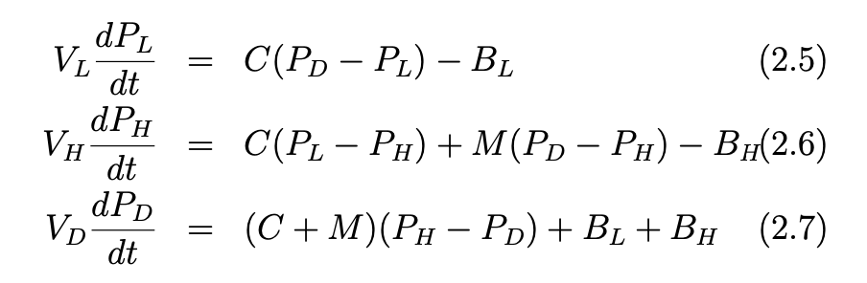
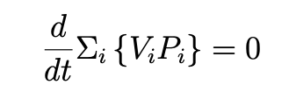

Steady state solution
Another look:
If the three equations are summed together, the RHS vanishes.
Conservation of P in the system

Slide 22

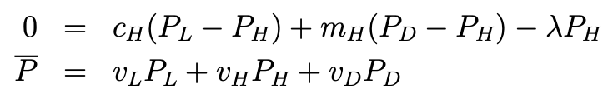
Steady state solution
Replace one of the steady state equations (here, deep ocean) with the statement of conservation

Slide 23
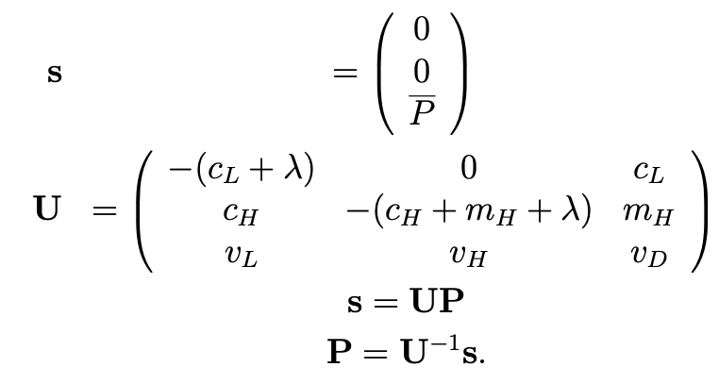
Steady state solution
In the vector-matrix form,

Slide 24
Review and Midterm 2 next week
Midterm 2 review (Tuesday, April 11)
Midterm 2 ( Thursday, April 13, 60 min, 22-25 questions, open book, on Canvas)
Three exams in total are worth 30% of your final grade
2 midterm exams, 1 final exam;
Take best 2 out of 3 for 15% each

