Slide 1

AMAZON PRODUCT REVIEW ANALYSIS
Team members
Shahnawaz
Deeksha

Slide 2
Objective
Analyze the reviews of customers on products of different brands.
Forecast or predict the reviews of different brands.

Slide 3
Process
Identify the top brand products of highest ratings.
Identify the bottom brand products of lowest ratings.
Which year & month has highest number of reviews .
Highest number of customers in which year.
Rating wise sales.
Average price of the products.
Top product in every sentiment category.
Highest reviews of which sentiment
Highest reviews of customers is verified or not.

Slide 4



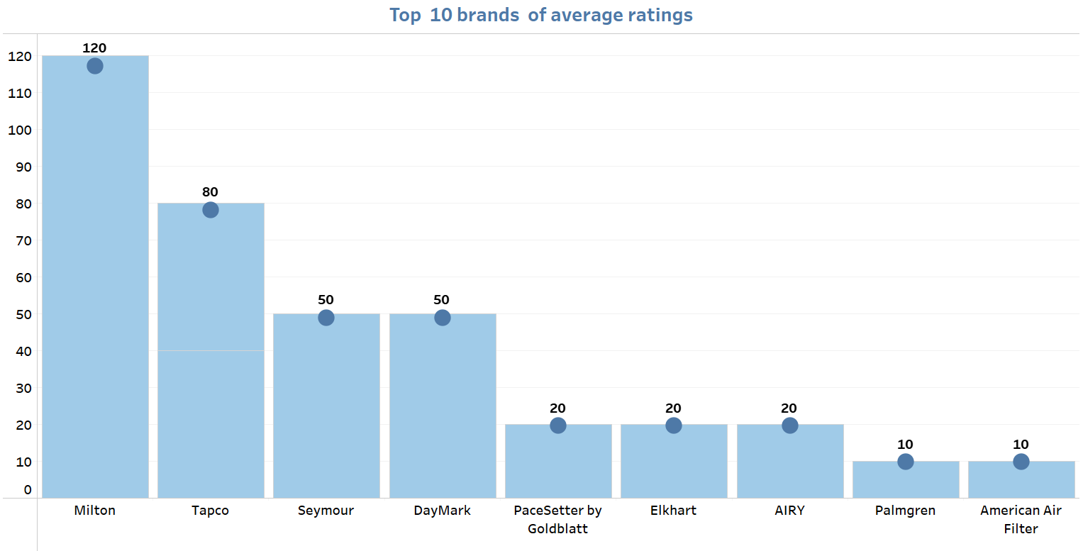
TOOLS & HOMES
Observation
Highest rating of product – Milton brand
Lowest rating of product – American air filter & Palmgren
Solution
We can remove Palmgren & American Air Filter products for their poor average ratings.

Slide 5
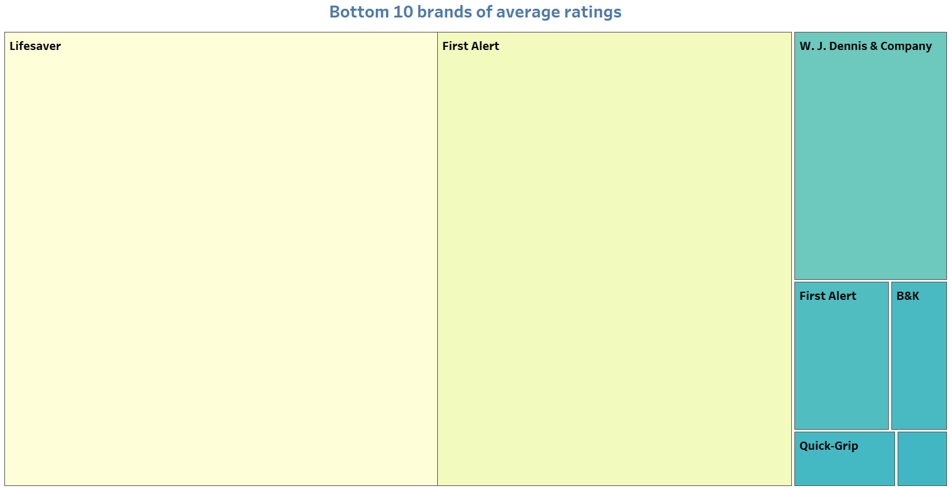
Observation
Highest rating of bottom brands – Lifesaver
Lowest rating of bottom brands – Frame Master
Solution
We cannot take these brands products these are the lowest brands and average ratings is also poor for First Alert, B&K, Quick-Grip and Frame Master

Slide 6
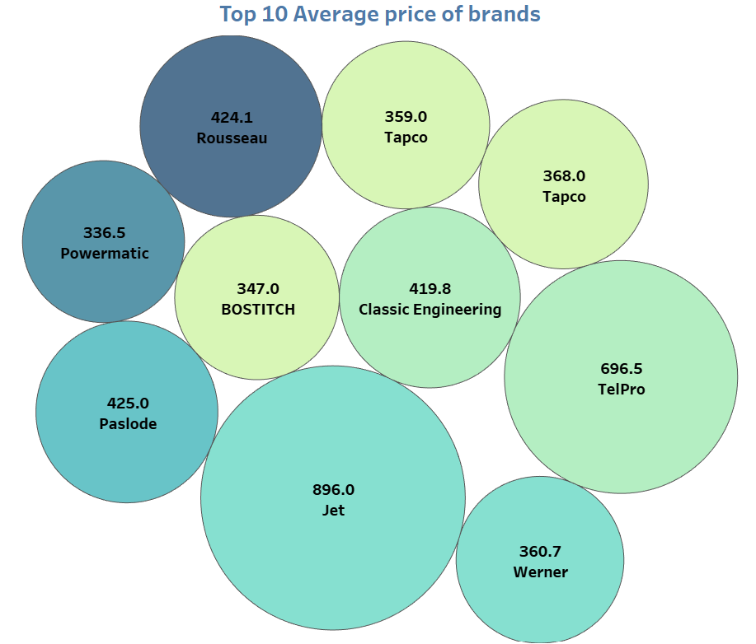
Observation
Highest average price – Jet
Lowest average price – Powermatic
Solution
Customers like more products of jet brand its sales is higher.
Provide Jet brand extra benefits for doing more sales.

Slide 7
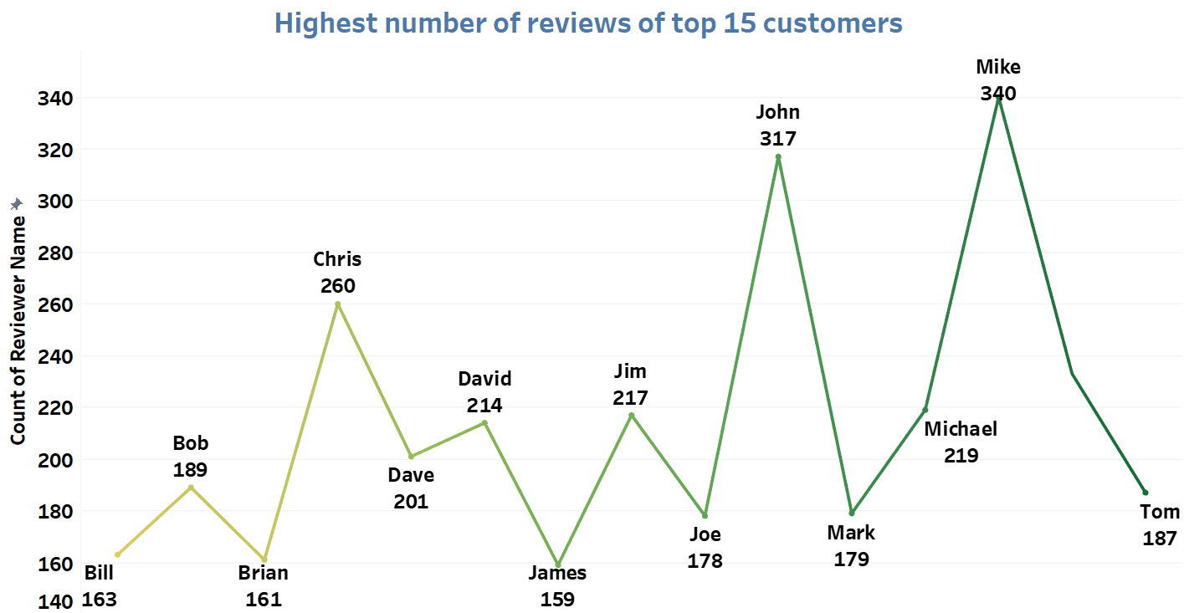
Observation
Highest number of reviews – Mike & John
Solution
Gift cards for shopping on Amazon to Mike and John

Slide 8
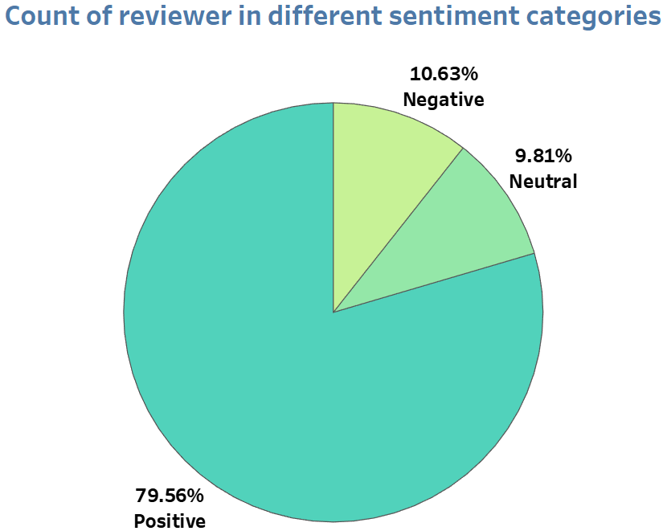
Observation
Highest reviews of customer – 79.56% Positive reviews
Solution
To reduce negative reviews we can remove bottom brands products and also those have low ratings like Frame Master, Quick Grip , B&K industries

Slide 9
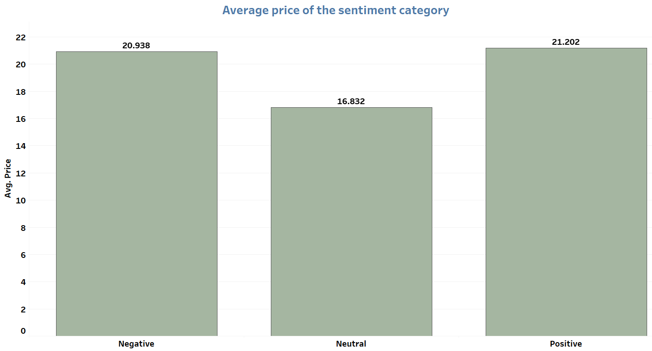
Observation
Highest average price of sentiment – Positive sentiment
Lowest average price of sentiment – Neutral sentiment
Solution
Neutral reviews of products is not like much or dislike by the customers. Those brands need to advertise more , launch more products with better quality.

Slide 10

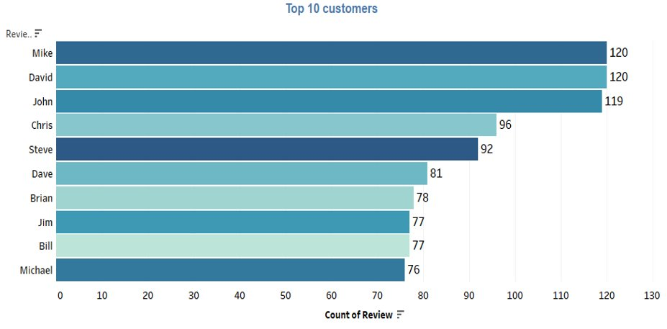
LAWN & GARDEN
Observation
Mike, David and John give maximum reviews on product
Solution
We could provide them 10% off coupon who gives us a reviews.

Slide 11
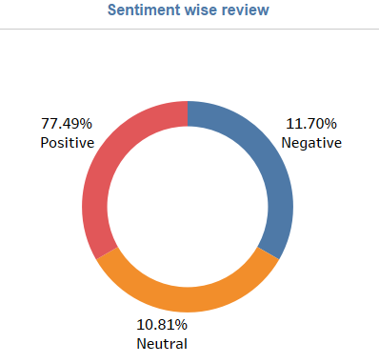
Observation
Maximum reviews of customers are positive
Solution
We can share positive reviews on social site.
Respond to negative reviews professionally.

Slide 12
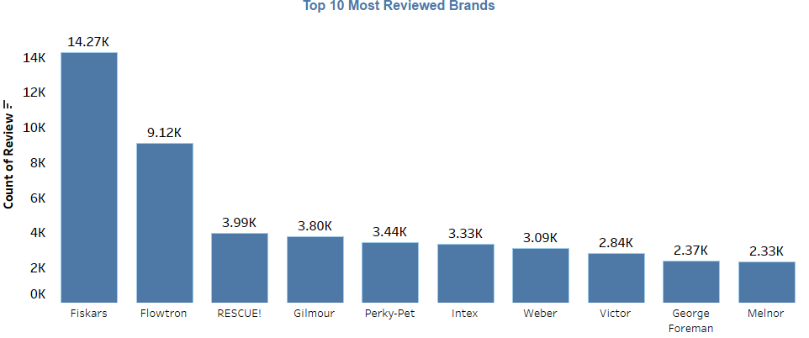
Observation
Highest count of reviews – Fiskars
Second highest count of reviews – Flowtron
Solution
we can increased customer satisfaction to understand customers expectation.

Slide 13
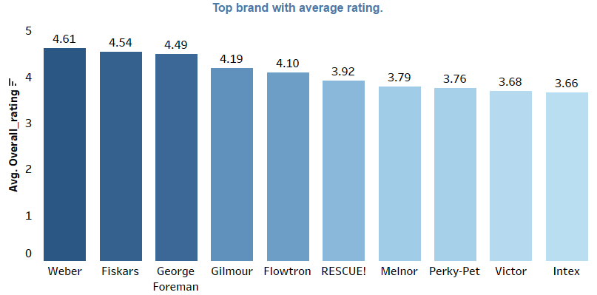
Observation
Highest average rating - Weber
Solution
Can provide insights into the factors driving customer satisfaction and
can help businesses identify areas for improvement.

Slide 14
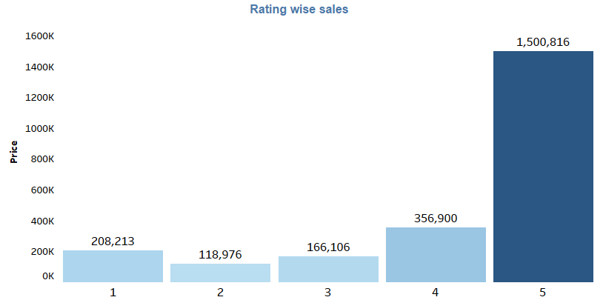
Observation
Highest sales 65% – 5 rating
Solution
To increase our ratings
we can increase our product quality and shipping on time.

Slide 15
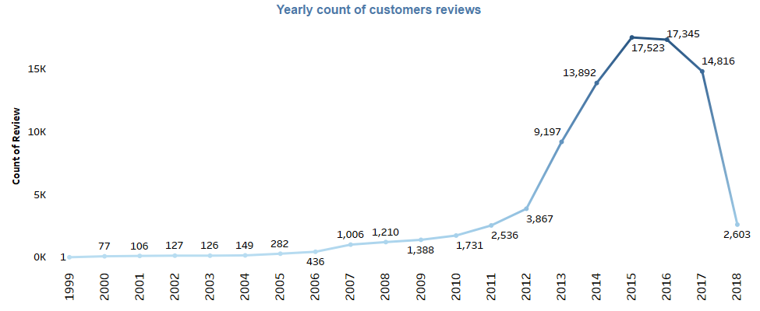
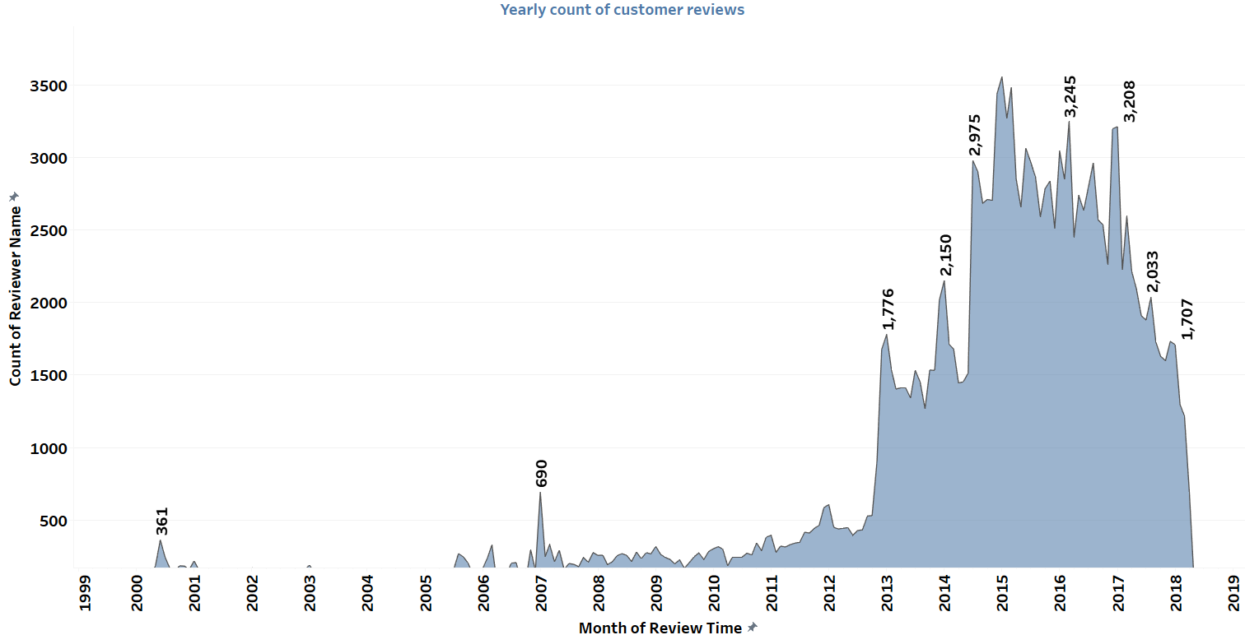
Comparision of both data of number of customer reviews yearly
Lawn & Garden
Tools & Homes
LAWN & GARDEN - Number of reviews is increasing yearly till 2015 and decreasing after that.
TOOLS & HOMES - Number of reviews is increasing yearly till 2015 and decreasing after that

Slide 16
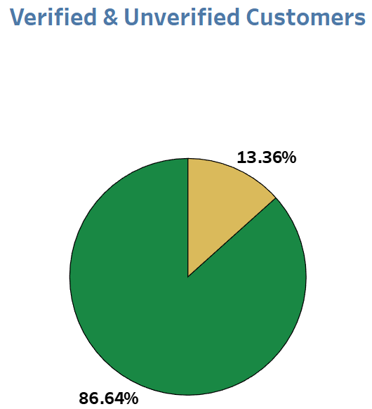
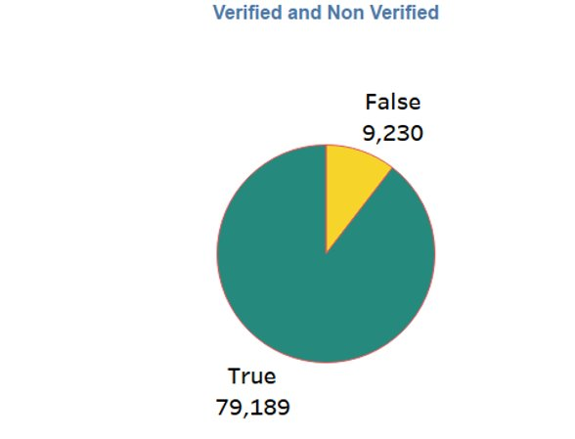
Comparision of both data of Verified & Unverified Customers
Tools & Homes
Lawn & Garden
Verified customers – 86.64%
Unverified customers – 13.36%
Verified customers – 89.51%
Unverified customers – 10.49%

Slide 17
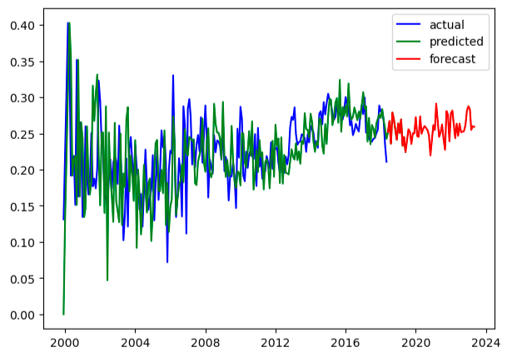
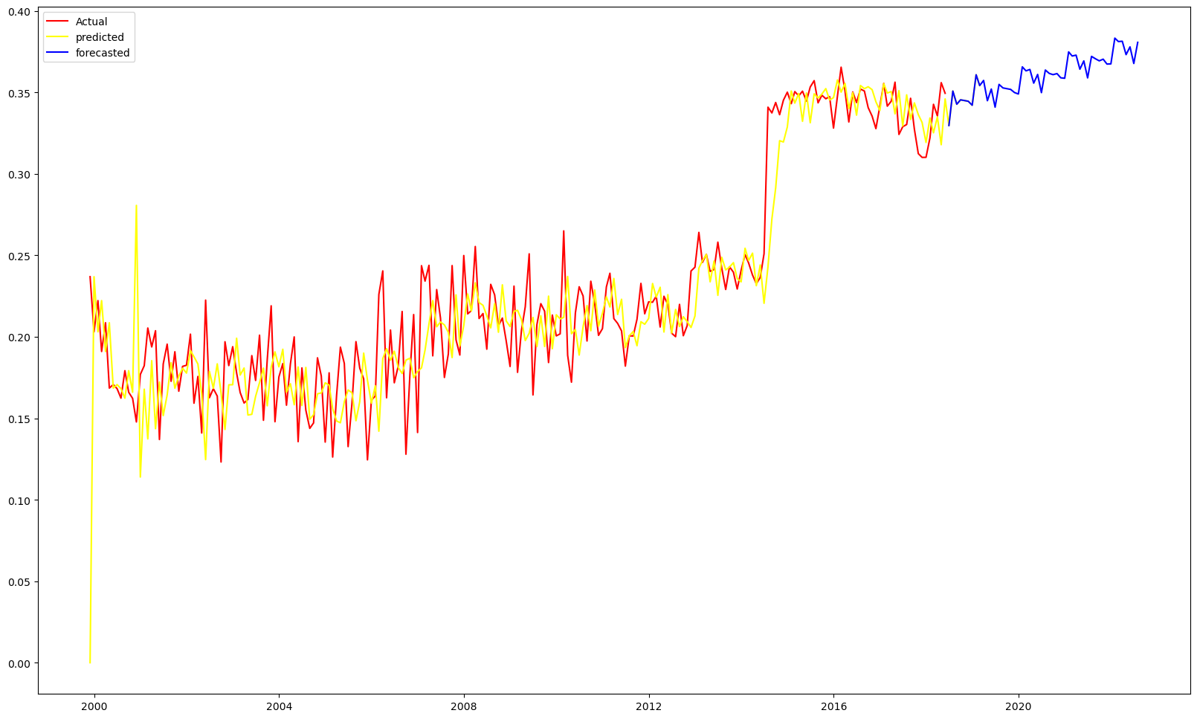
Comparision of both data of forecasting
Lawn & Garden
Tools & Homes
Sales will little bit low till 2024
Sales will go above so we need to increase our stocks

Slide 18
Technical Analysis of both data
Tools & Homes
Algorithm used – SARIMA
P value is 0.059
Root mean square value is 0.032
Sentiment Analysis – Text Blob
Model performance – Good
Lawn & Garden
Algorithm used – SARIMA
P value is 0.81
Root mean square value is 0.057
Sentiment Analysis – Text Blob
Model performance - Good

Slide 19
Solution
Tools & Homes
79.56% are positive reviews, 9.81% are neutral reviews and 10.63% are negative reviews. To reduce the product negative reviews we can remove the products of bottom brands who have low ratings like Frame Master, Quick-grip, B&K industries .
Increase the stock of top brands products who have higher ratings those brands are Milton, Tapco.
John and Mike have maximum number of reviews on products – give them gift cards for shopping on Amazon.
Number of reviews is increasing from 1999 to 2015 after that reviews dropped till 2018 to improve the number of reviews analyze the sentiments of customers - reply them , analyze their problems and exchange their products if manufacturer send another product or a default product to a customer.
Lawn & Garden
77.49% are positive reviews, 10.81% are neutral reviews and 11.70% are negative reviews. To reduce the product negative reviews we can improve the products of bottom brands who have low ratings like Wells Lamont, Carruth, Oregon Scientific, Universal Forest.
Increase the stock of top brands products who have higher ratings those brands are Weber, Fiskars, George Foreman, Flowtron.
Number of reviews is increasing from 1999 to 2015 after that 39.31% reviews dropped till 2018 to improve the number of reviews analyze the sentiments of customers and reply them.
Mike, David and John have maximum number of reviews on products so, give them 30% off coupon.

Slide 20
THANK YOU

