Slide 1









RAPID GUARD
DISCRETE MATHEMATICS AND GRAPH THEORY

Slide 2

IDEATION

Slide 3
IDEATION
The objective of the Rapid Guard project is to develop a real-time incident reporting system that leverages graph theory algorithms to efficiently identify and notify nearby members for swift assistance during emergencies. Timely responses are crucial in critical situations, as they can significantly impact outcomes and enhance community safety by enabling immediate action when incidents occur.

Slide 4

ALGORITHM

Slide 5
ALGORITHM
The algorithm sorts members assigned to the same center as the incident location and allocates them to respond to the incident. It ensures that no member is assigned more than one incident at a time by modeling the assignment as a bipartite graph. This approach allows for efficient and conflict-free matching between available members and active incidents.

Slide 6
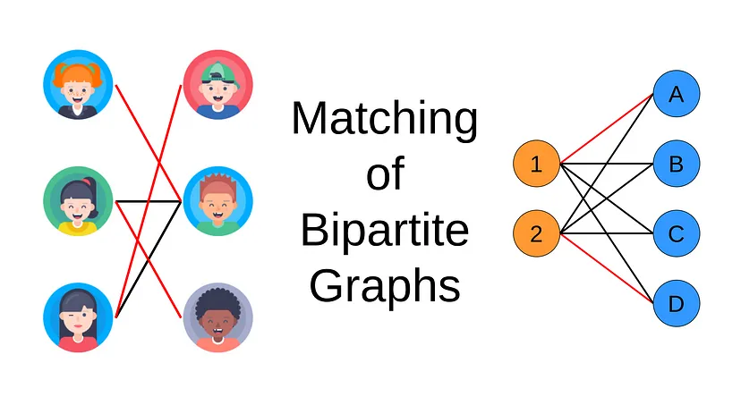
BIPARTITE GRAPH
A bipartite graph is commonly used in various algorithms, particularly in applications like matching problems, recommendation systems, and network flow. In matching algorithms, bipartite graphs enable the identification of optimal pairings between two distinct sets.

Slide 7

SOLUTION

Slide 8
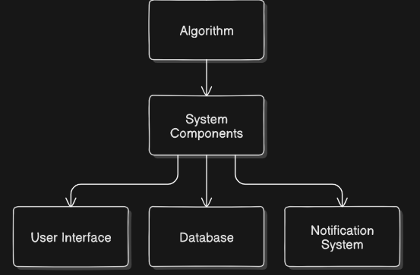
SOLUTION
How the System Works:
Members report incidents through a Google site.
The system captures the incident location.
It analyzes the proximity of other members to the incident site.

Slide 9

USER-INTERFACE
Incident Reporting:-
A member witnesses or experiences an incident and reports it through the Google site.
The site captures the details, including the incident type and location.
The data is then sent to the system’s database for processing

Slide 10

DATABASE
Analysis Phase:
The system identifies the incident's location and retrieves the list of members.
Using a graph theory algorithm, it calculates the shortest paths from the incident site to nearby members.
The system determines which members are closest based on their stored locations and proximity to the incident.

Slide 11

NOTIFICATION SYSTEM
Notification:-
Once nearby members are identified, the system sends a command or notification to those members.
Notifications can be sent via SMS, email, or app alerts, instructing them to respond to the incident immediately.
The system also informs the incident head, providing updates and member statuses in real-time.

Slide 12
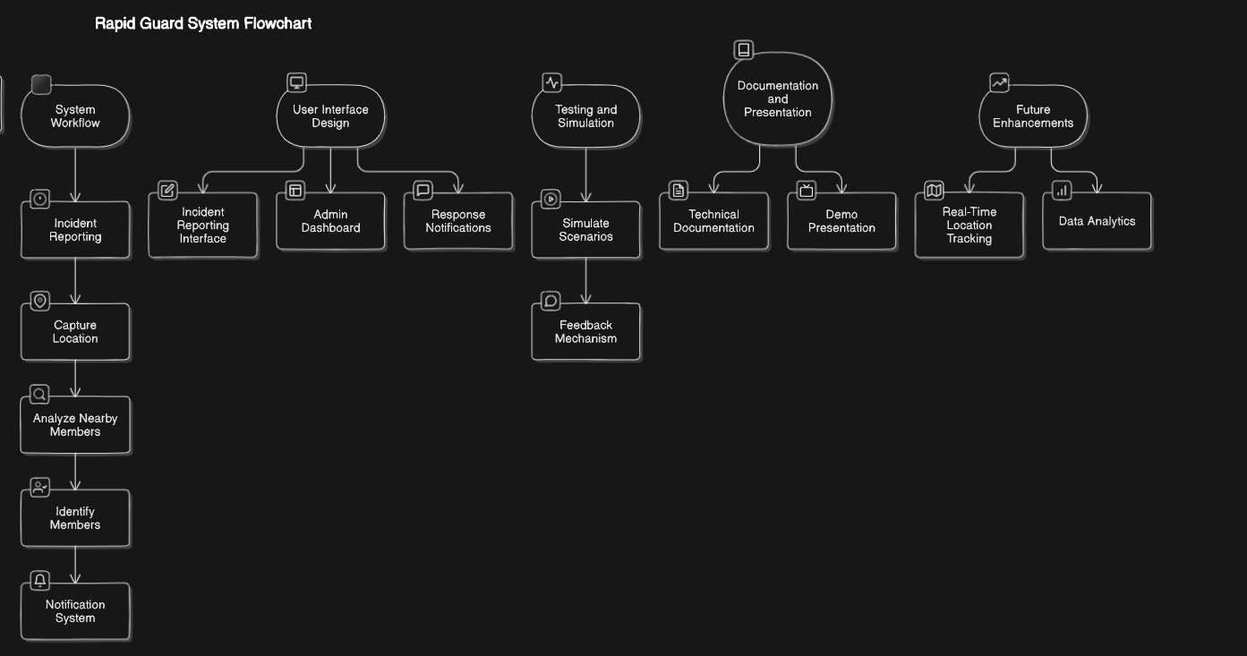
Incident Reporting:
A member reports an incident using the Incident Reporting Interface.
The system receives and processes the report.
Capture Location:
The system captures the exact location of the incident through the report.
The location data is stored and used for further analysis.
Analyze Nearby Members:
The system analyzes all registered members and calculates which ones are closest to the incident location.
Identify Members:
The system identifies the nearest available members based on their proximity and availability.
This ensures the correct members are dispatched.
Notification System:-
The system also informs the admin or incident head about the situation

Slide 13

REAL-WORLD
APPLICATION

Slide 14
APPLICATION
REAL-WORLD
Use Cases:
Emergency services (fire, medical assistance).
Community safety initiatives.
Potential Impact:
Enhanced community safety.
Faster response times during emergencies.

