Slide 1
User Authentication

Slide 2
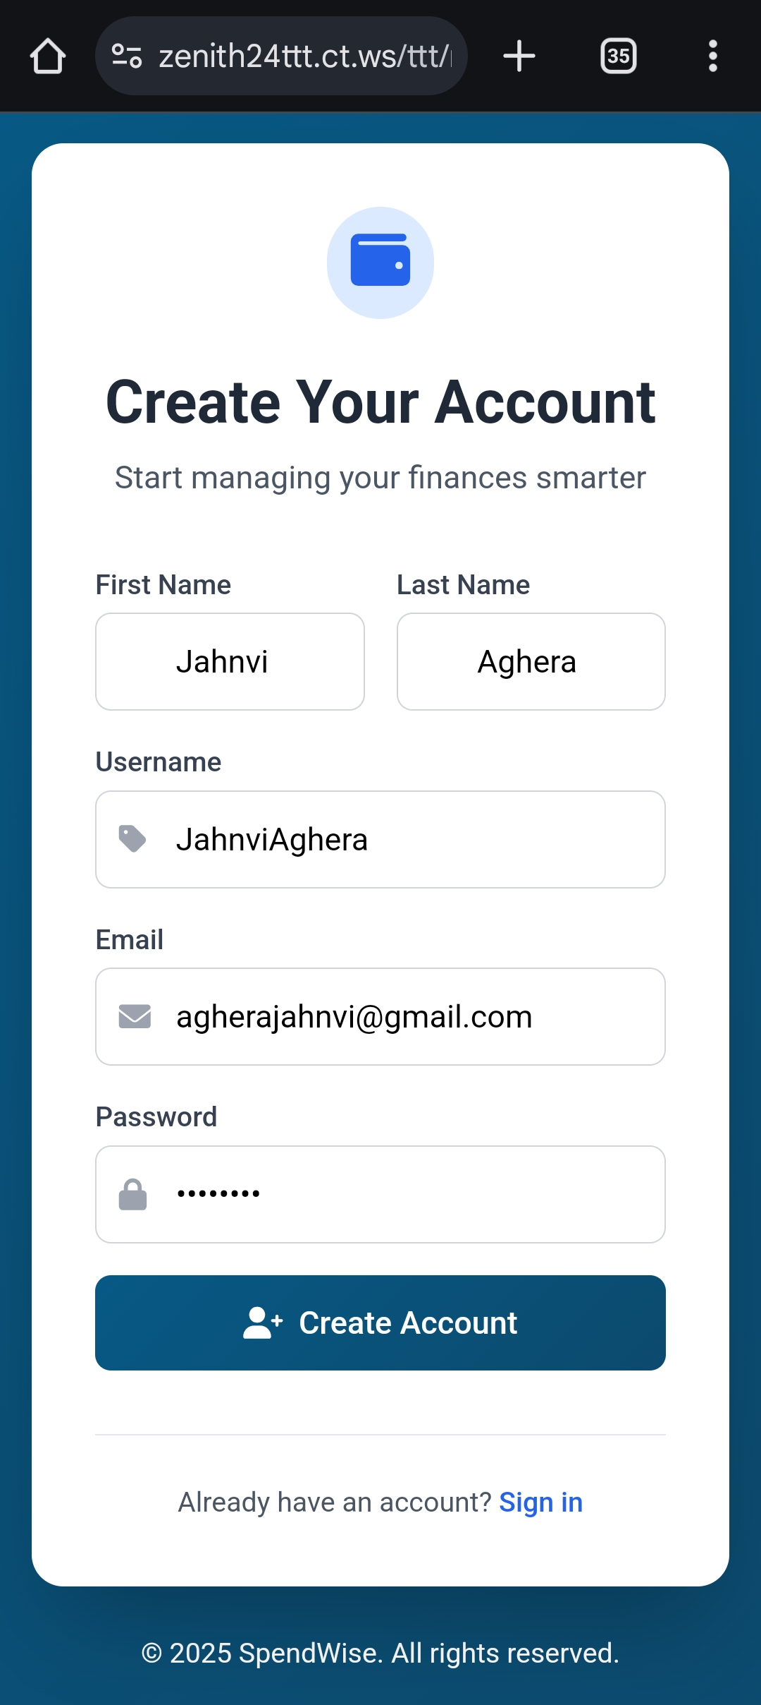

Slide 3
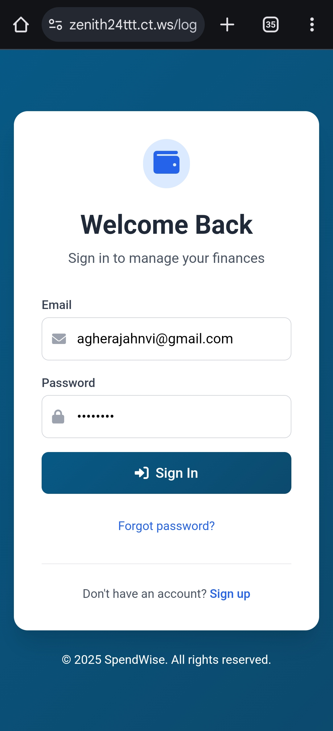

Slide 4
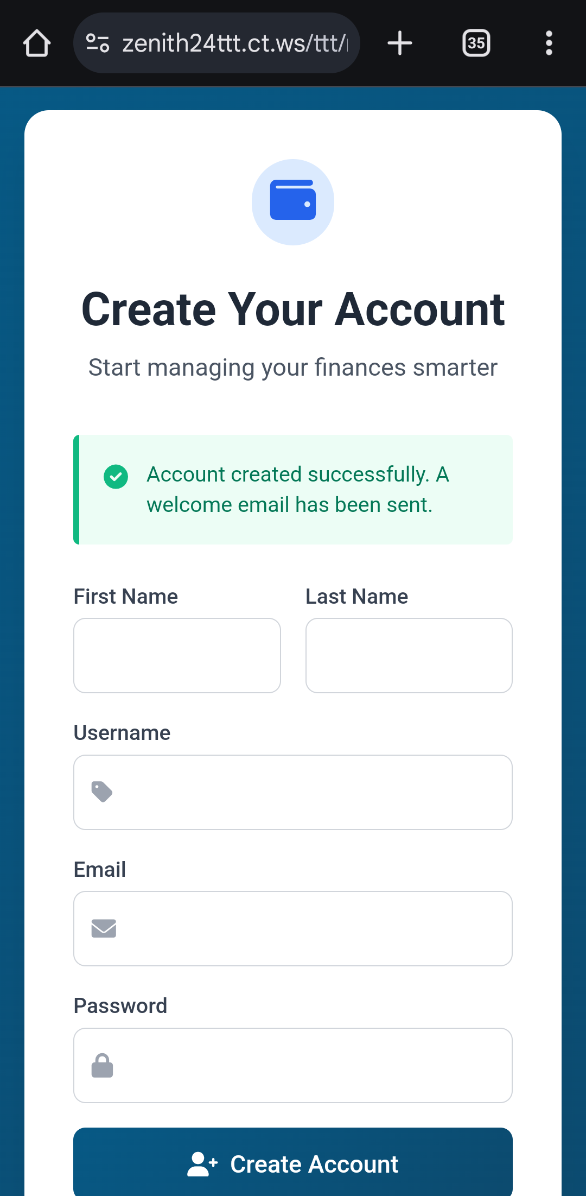

Slide 5
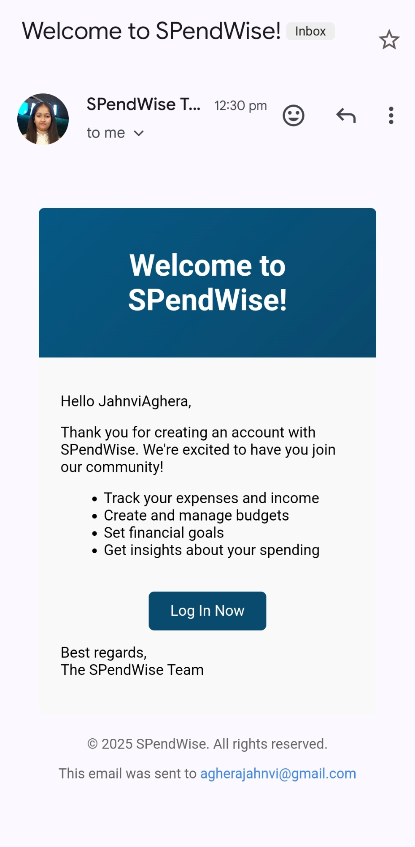

Slide 6
Dashboard

Slide 7


Slide 11
Add Budget

Slide 12
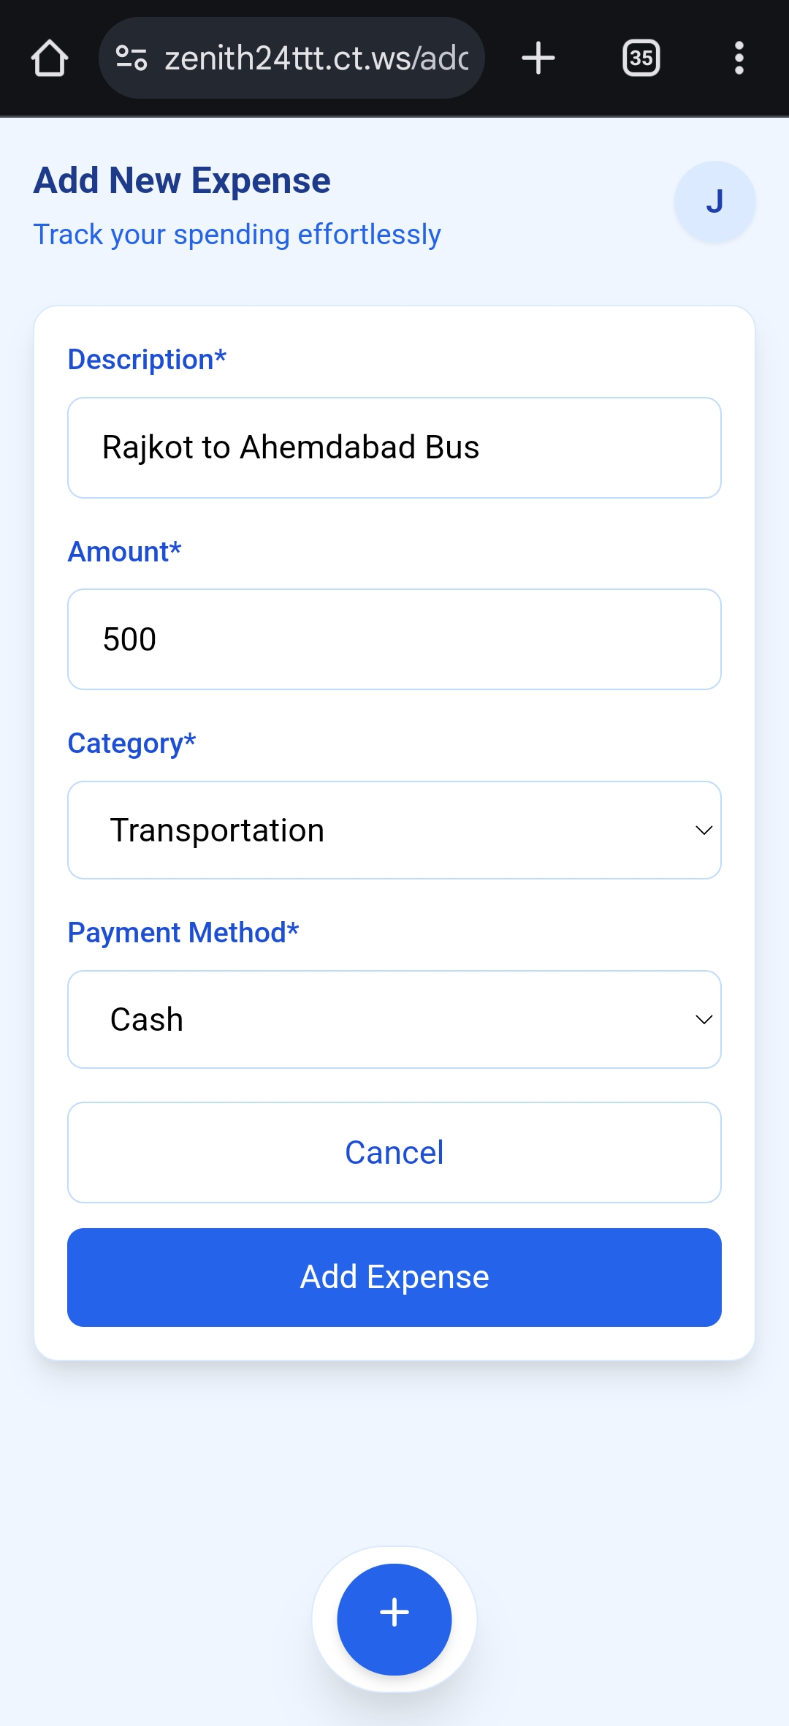

Slide 15
Record Expense

Slide 16
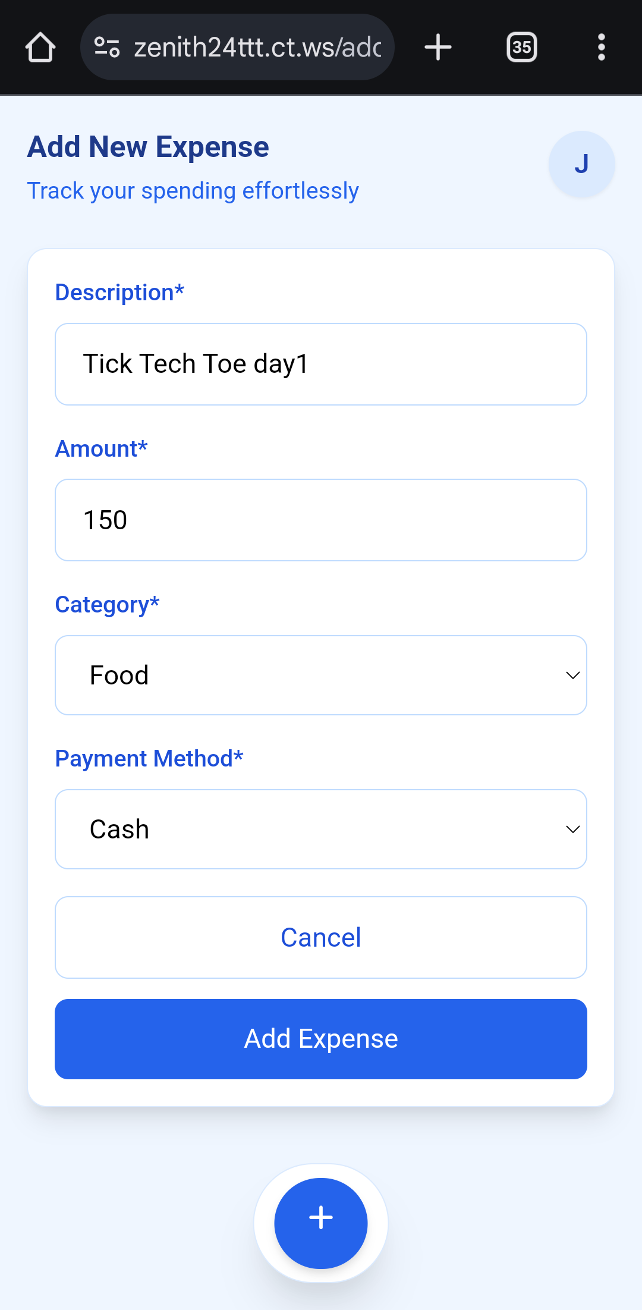

Slide 19


Slide 22
Manage Transactions

Slide 23
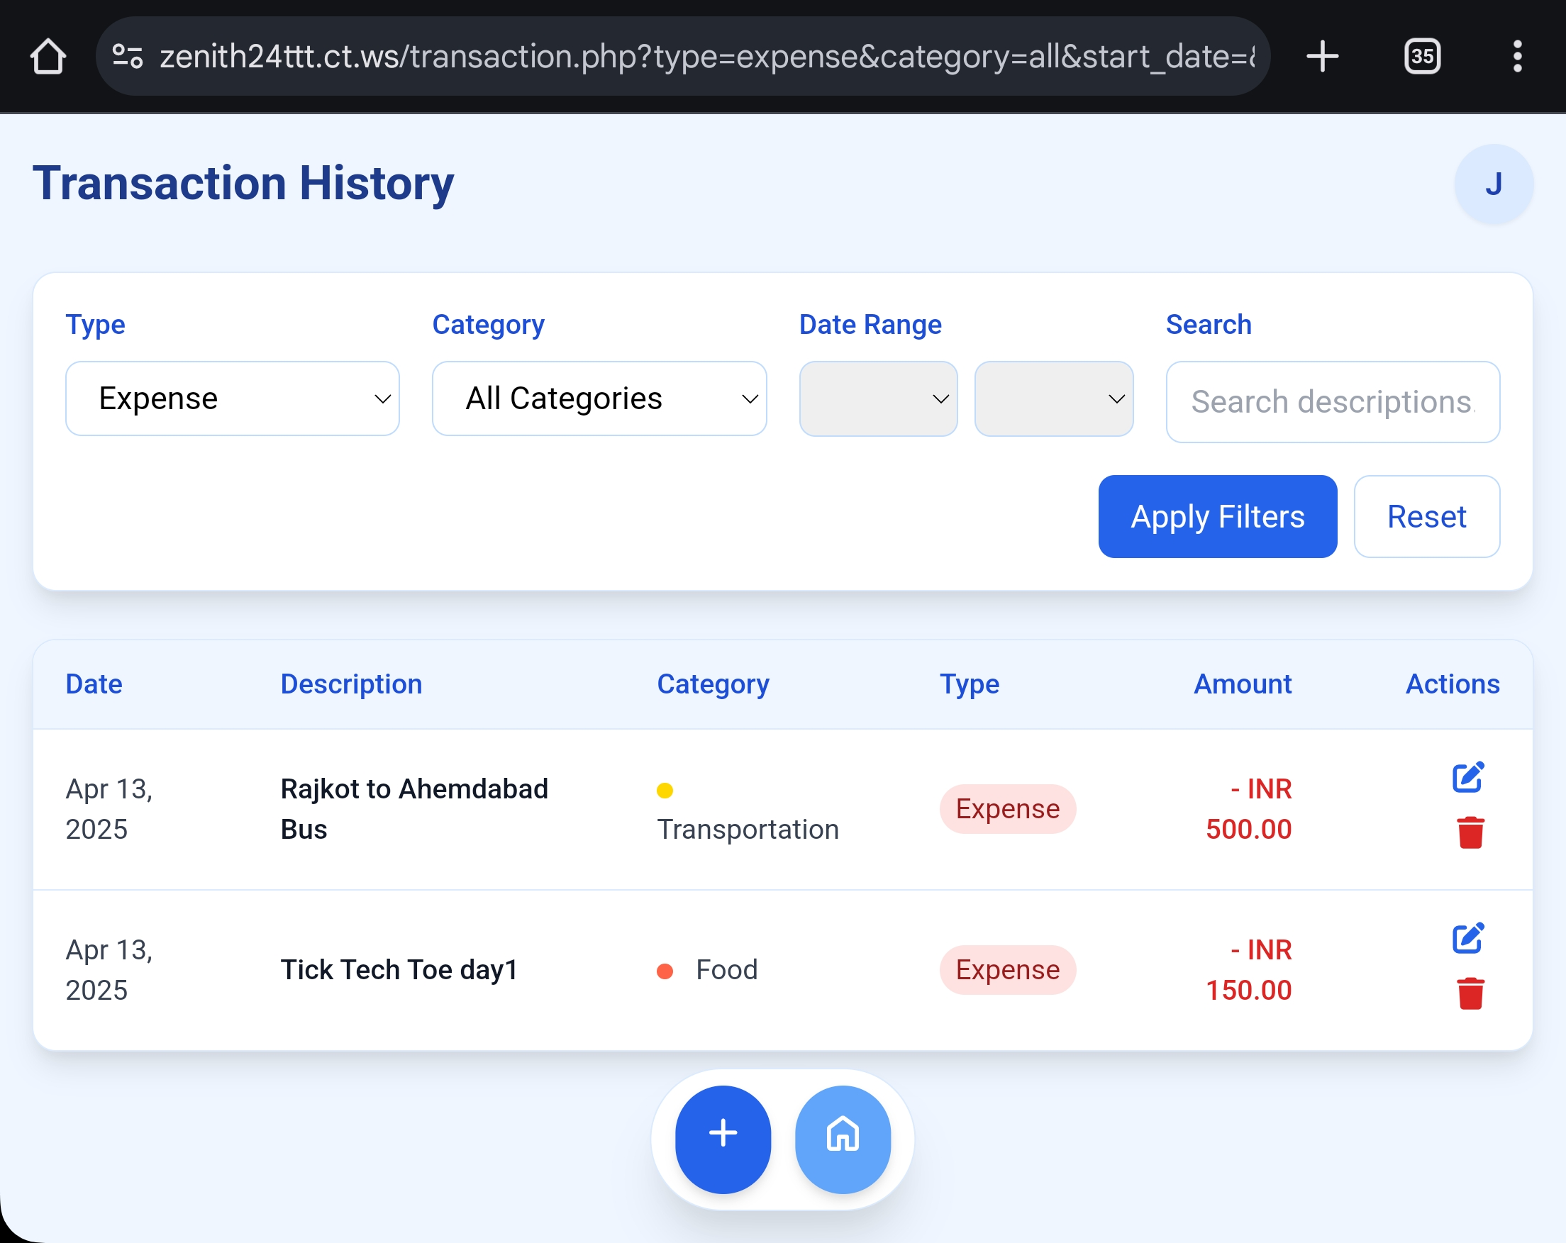

Slide 25
Export Transactions

Slide 26


Slide 30
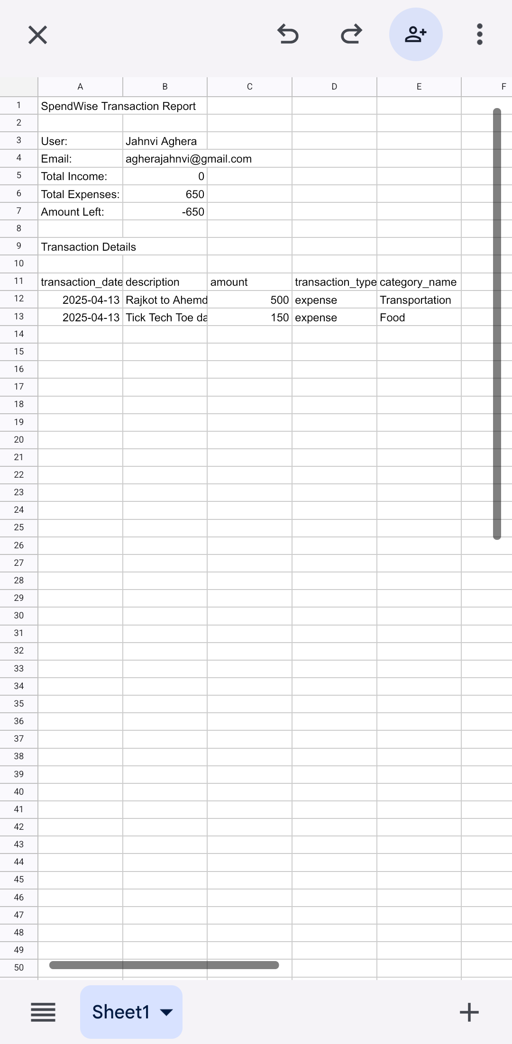

Slide 31
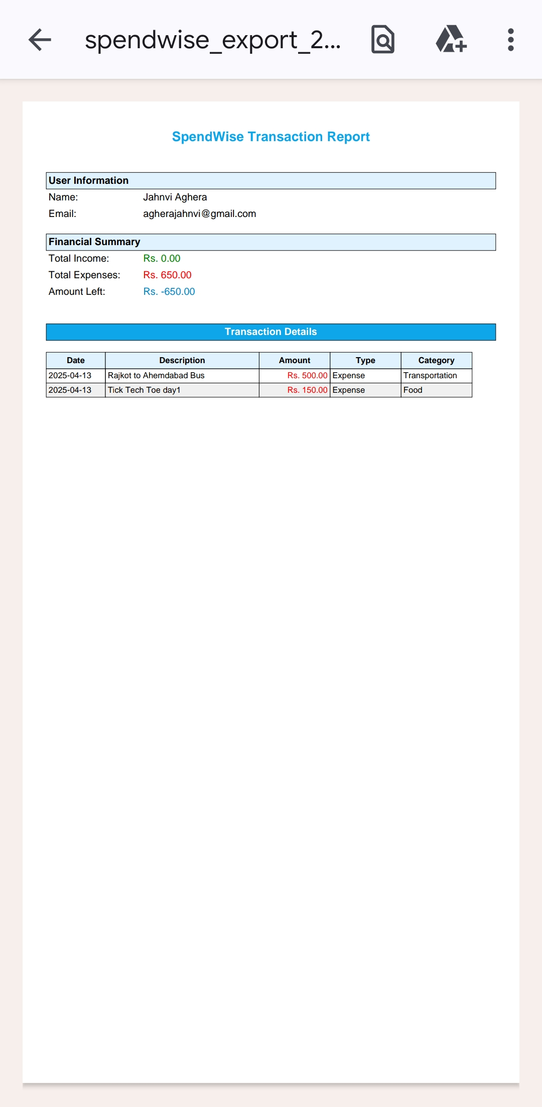

Slide 33
User Profile Management

Slide 34


Slide 36
AI Assistance

Slide 37
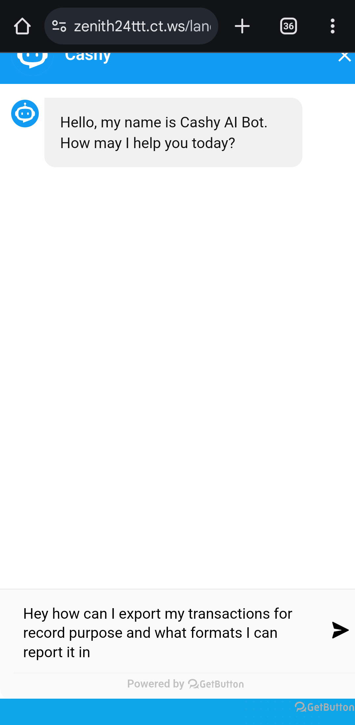

Slide 39
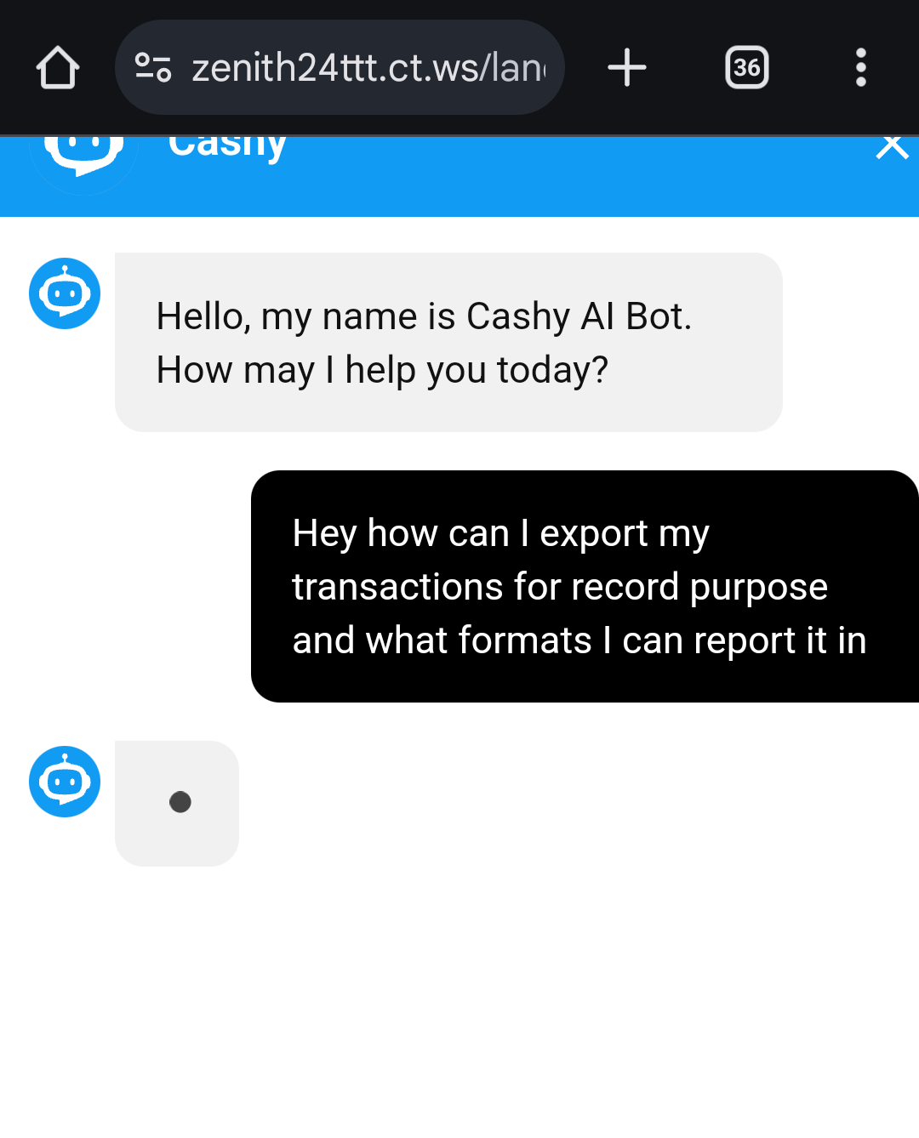

Slide 41
