Slide 1
FINAL TEAM PRESENTATION
FlowCore Warehouse Project
Inbound warehouse commissioning simulation
Panagiotis Pontikeas Eftychiadis & Arsenios Diamantakos

Slide 2
Chosen Scope
FlowCore simulates a small inbound warehouse process
Incoming goods arrive at the inbound dock and represented as pallets
They are later assigned and stored to one valid warehouse location
Event records are created to capture each pallet through the inbound flow
Validation checks are performed to check that everything worked as expected
FlowCore Warehouse Project

Slide 3
Business Scenario
Receive
Assign
Store
4
Record
Validate
->
->
->
->
DOCK-01
Location
Pallet
Evidence
Proof
Receipt RCV-1001 arrives at DOCK-01.
Three pallets are assigned to valid warehouse locations.
The expected final state is STORED for all pallets.
The baseline result is 3 pallets, 9 status events and 0 capacity violations.
FlowCore Warehouse Project

Slide 4
Implementation Architecture
Config files define receipts, locations and assignment rules.
Bash scripts build the runtime snapshots and validation logs.
Oracle tables store the receipt, pallets, locations, status events, and calculates available storage capacity
Verifies the priority placement rule for high-quantity pallets.
2
3
4
5
Config CSV
Bash runtime
SQL & PL/SQL
C++
FlowCore Warehouse Project

Slide 5
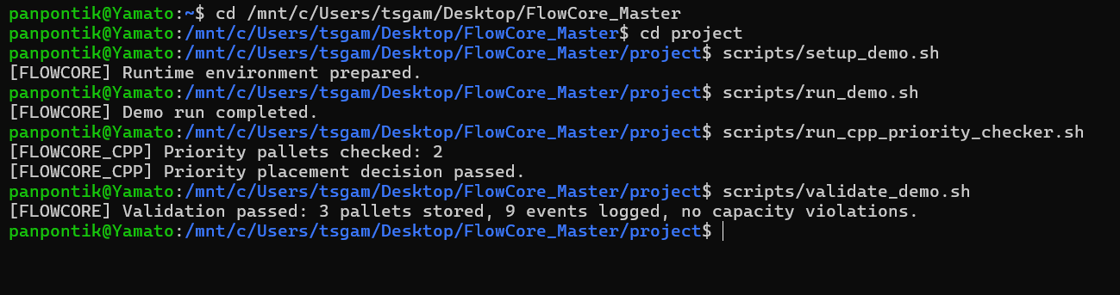
Bash Runtime
setup_demo.sh prepares the environment and runtime folders
run_demo.sh executes the selected inbound scenario
The C++ script also runs from the same terminal
validate_demo.sh checks whether the final state matches the expected result
FlowCore Warehouse Project

Slide 6
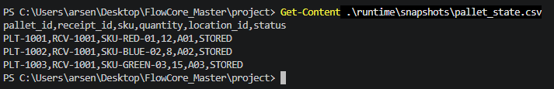
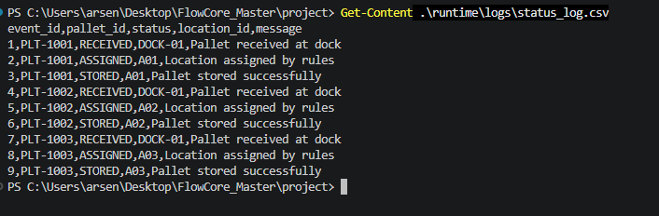
Generated CSV evidence
Pallet state
Status log
FlowCore Warehouse Project

Slide 7
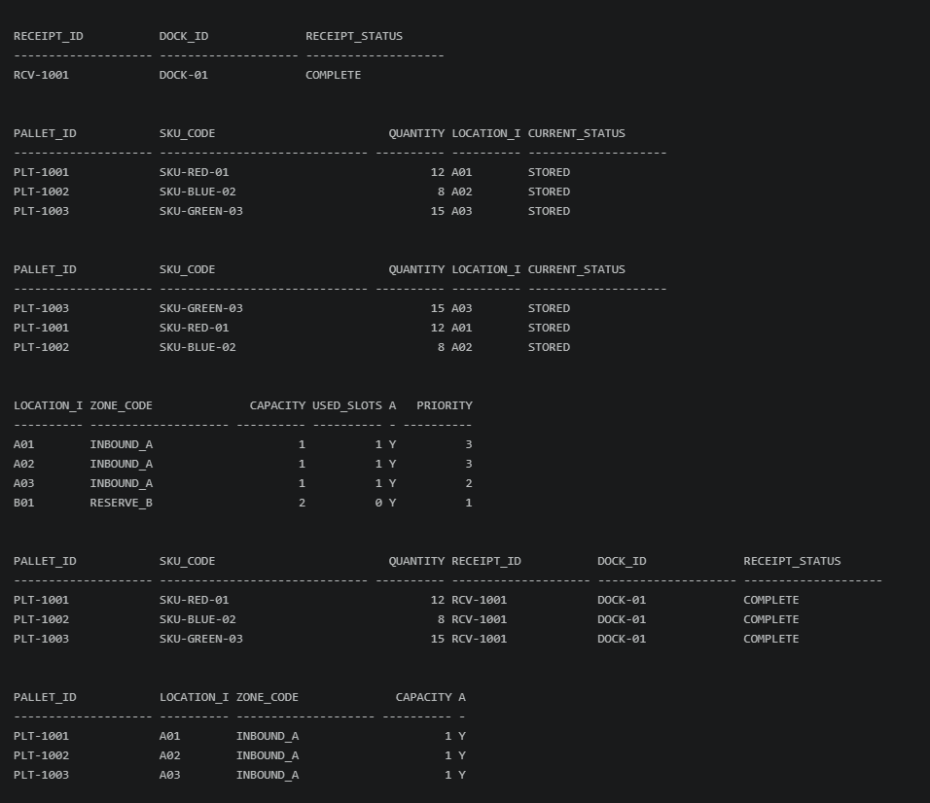
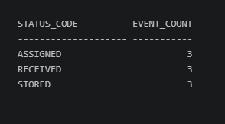
Oracle SQL
FlowCore Warehouse Project
Oracle stores the same warehouse scenario in relational tables so the final state can
be queried and validated.
MySchema.sql creates RECEIPT, LOCATION, PALLET, and STATUS_EVENT.
Sample_Data.sql loads the baseline scenario: 1 receipt, 5 locations, 3 pallets, and
9 lifecycle events.
SQL_Operations.sql demonstrates retrieval, filtering, joins, aggregation, validation checks,
and a safe UPDATE/ROLLBACK example.
Status Proof
FlowCore Warehouse Project

Slide 8
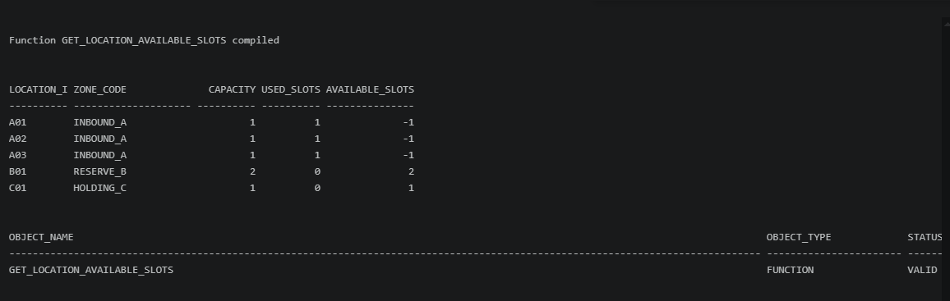

PL/SQL Capacity Function
06
Function: GET_LOCATION_AVAILABLE_SLOTS(location_id)
It calculates remaining slots for each warehouse location.
Formula: available slots = capacity - used_slots - assigned pallets.
Expected baseline: A01=0, A02=0, A03=0, B01=2, C01=1.
This supports placement decisions by showing which locations still have available capacity
FlowCore Warehouse Project

Slide 9
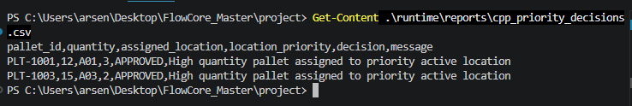
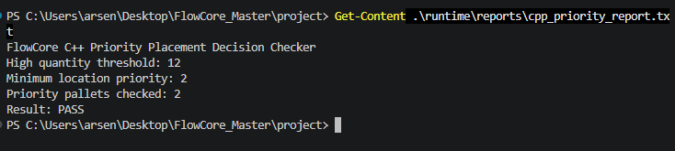
C++ Priority Placement Decision Checker
07
Input: pallet_state.csv and location_usage.csv from the Bash runtime.
Rule: high-quantity pallets must be assigned to active priority locations.
High quantity threshold: quantity >= 12.
Minimum location priority: 2.
Expected result: 2 priority pallets checked and priority placement decision passed
FlowCore Warehouse Project

Slide 10
Final Outcome and Reflection
Validated Outcome
The inbound scenario runs end to end.
3 pallets reach STORED status.
9 lifecycle events are recorded.
No capacity violations are detected.
SQL, PL/SQL, Bash, and C++ all confirm the same baseline result.
What we would improve
Standardize naming, file structure, and document style from the beginning.
Add a single automated run script for the full demo sequence.
Add stronger error handling for invalid locations, missing files, and failed database loads.
Keep screenshots and evidence files organized during development, not only at the end.
FlowCore Warehouse Project

