Slide 1
UCD Sprint
Amir Dirin

Slide 2
In week 2 we need to make a group and add it in oma
Group size Max 3.
UCD | 35 %
harjoitukset | 30 %
projekti | 70 %
Koodi | 45 %
harjoitukset | 20 %
projekti | 80 %
Scale: 15 credits
One period
Prerequisites: Basic Concepts of Web Technology
Course is constructed around a project
There is an obligation to be present!
Trello (or similar) is used as the platform for executing the project and display project process
Git will be used for version control
You have to deliver tasks in time
Math has exam
Suggestions for Optional Functionalities (to get higher grade)
commenting/liking media
client statistics
applying/extracting metadata (EXIF)
third party APIs
etc.
UX
specific user group*
user feedback (incl. testing)*
applying UI guidelines*

Slide 3
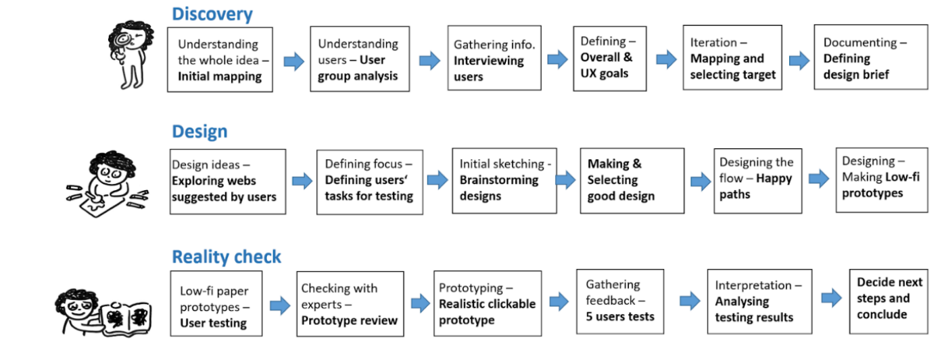
Design Processes
An overview of the 3 phases and the 18 steps in the UCD Sprint (images ©Might Could Studios)

Slide 4
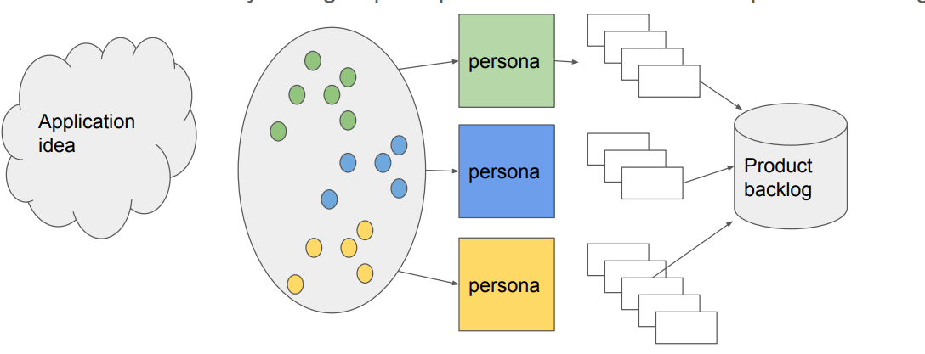
Software Engineering projects

Slide 5
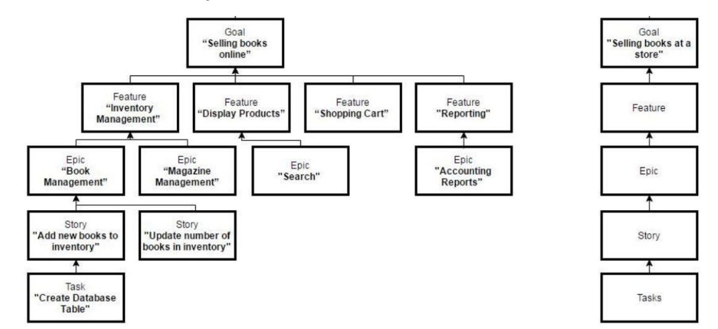
User Stories, epics and features
Further Reading
https://www.gla.ac.uk/media/Media_730149_smxx.pdf

