Slide 1
Usability Testing
Amir Dirin

Slide 2
Testing Methods
Same as Formative
Surveys/questionnaires
Interviews
Observation
Documentation
Automatic data recording/tracking
Artificial/controlled studies
Heuristic Evaluation
Cognitive Walkthrough
Usability Study
KSLM (Keystroke-level model)
…

Slide 3
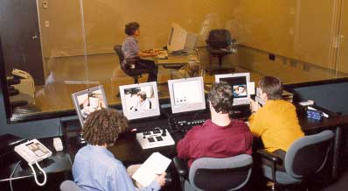
Sun Microsystem Usability Lab

Slide 4
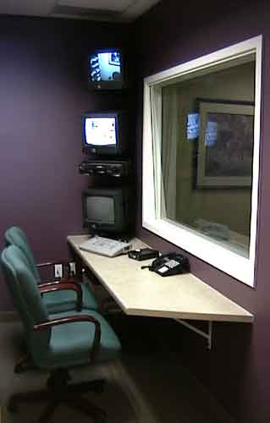
Usability Lab -
Observation Room
State-of-the-art observation room equipped with three monitors to view participant, participant's monitor, and composite picture in picture.
One-way mirror plus angled glass captures light and isolates sound between rooms.
Comfortable and spacious for three people, but room enough for six seated observers.
Digital mixer for unlimited mixing of input images and recording to VHS, SVHS, or MiniDV recorders.

Slide 5
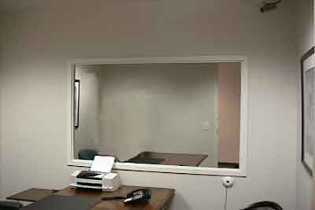
Usability Lab - Participant Room
Sound proof room similar to a standard office.
Pan-tilt-zoom high
resolution digital
camera (visible in
upper right corner).
Microphone
Door not visible
to other participants

Slide 6
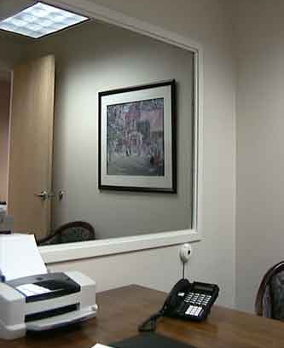
Usability Lab - Participant Room
Note the half-silvered mirror

Slide 7
Other Capture - Software
Modify software to log user actions
Can give time-stamped keypress or mouse event
  Sync with video
Commercial software available
Two problems:
  Too low-level, want higher level events
  Massive amount of data, need analysis tools

Slide 8
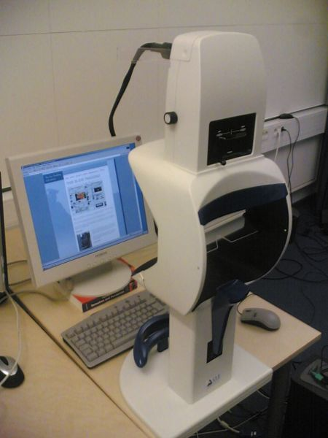

Eye-tracking

Slide 9
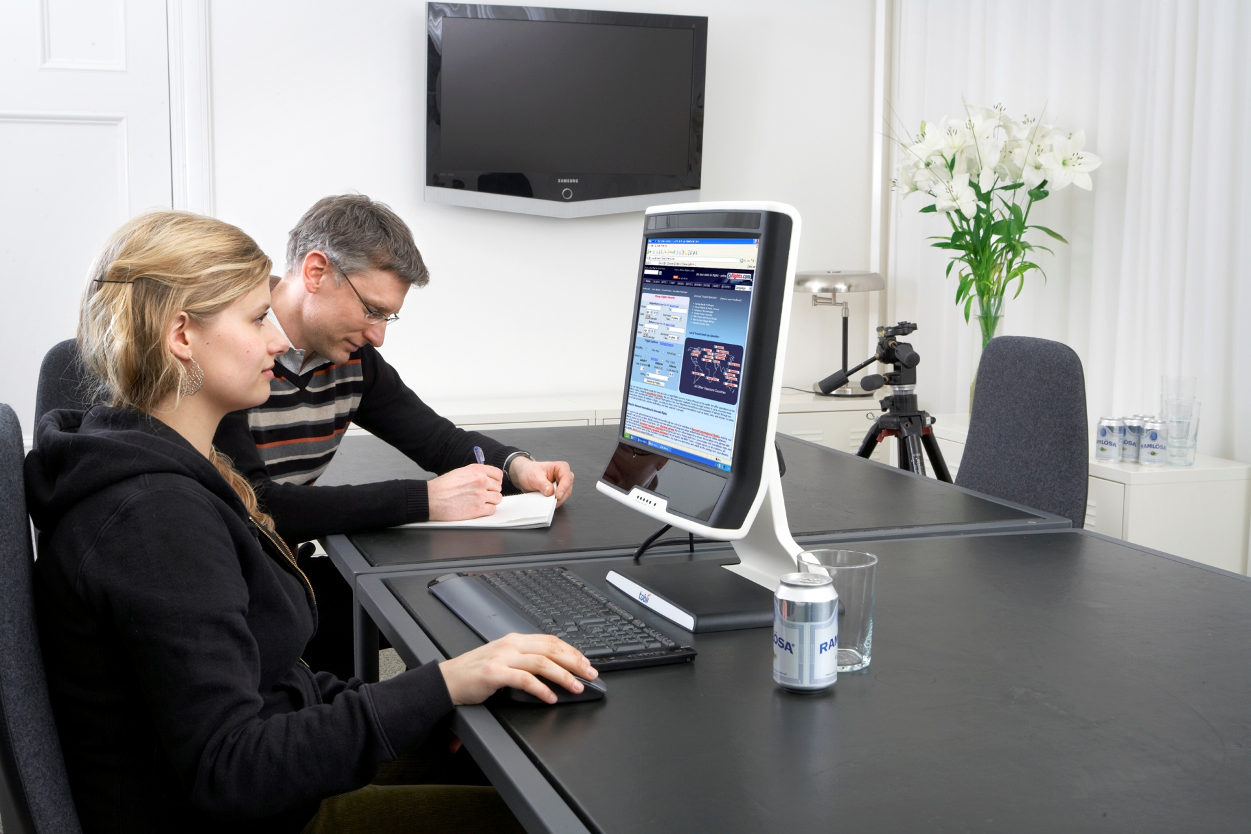
Eye tracking now

Slide 10
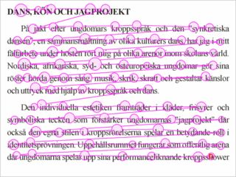
Example
Notes:
https://www.youtube.com/watch?v=zL-HmsHwvN8

Slide 11
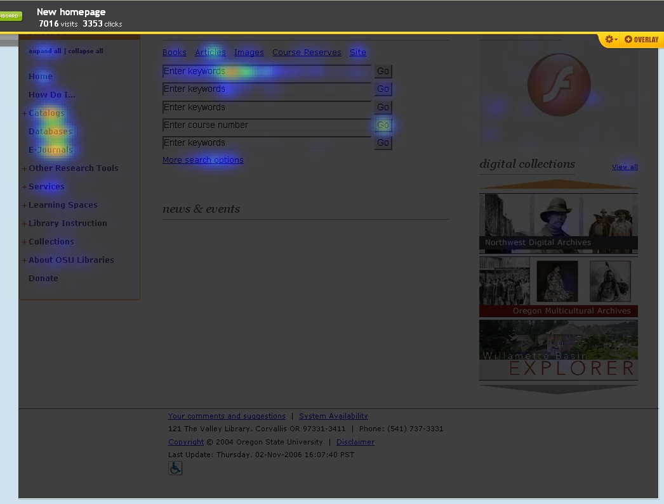
Example: Crazyegg (2)

Slide 12
Complimentary methods
Talkaloud protocols
Pre-post surveys
Participant screening/normalization
Compare results to existing benchmarks
  Standard tests have standard results, know what the “normal” should be, more power.

Slide 13
Study considerations
Number of subjects
Experimental design
  Between vs within subject comparisons
Biases

Slide 14
Within-subject or Between-subject Design
Repeated measures vs. single sample (or low number of samples
Are we testing whether two groups are different (between subjects), or whether a treatment had an effect (within subject)?
  Between subjects we typically look at population averages
  Within subjects we typically look at the average change in subjects (analysis of variance)

Slide 15
Within-subject or Between-subject Design (2)
Within-subject design
  Cheap, fewer subjects, more data
  Removes individual differences
  Introduces learning and carryover effects
  Can’t use the same stats as on between subjects because the observations are no longer independent

Slide 16
Pitfalls (general biases)
Biased testing
  Tests that cannot disprove your hypothesis
Biased selection
  Exclude subjects which may not fit your model
Biased subjects
  Want to help
  You may tell them what you want
  Hawthorn effect
Biased interpretation
  “Read” your expectations into data

Slide 17
Resources
“Design and Analysis: A Researcher’s Handbook” by Geoffrey Keppel
HyperStat Online (http://davidmlane.com/hyperstat/)
The Little Handbook of Statistical Practice (http://www.tufts.edu/~gdallal/LHSP.HTM)

