Slide 1
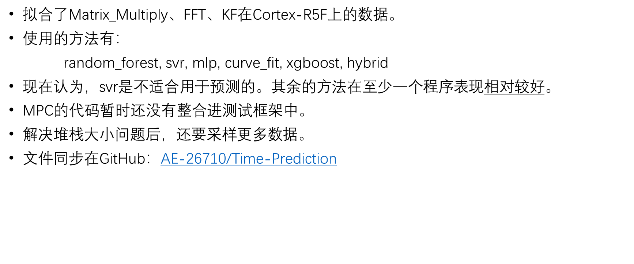
10/9
拟合了Matrix_Multiply、FFT、KF在Cortex-R5F上的数据。
使用的方法有：
random_forest, svr, mlp, curve_fit, xgboost, hybrid
现在认为，svr是不适合用于预测的。其余的方法在至少一个程序表现$相对$较好。
MPC的代码暂时还没有整合进测试框架中。
解决堆栈大小问题后，还要采样更多数据。
文件同步在GitHub：AE-26710/Time-Prediction

Slide 2
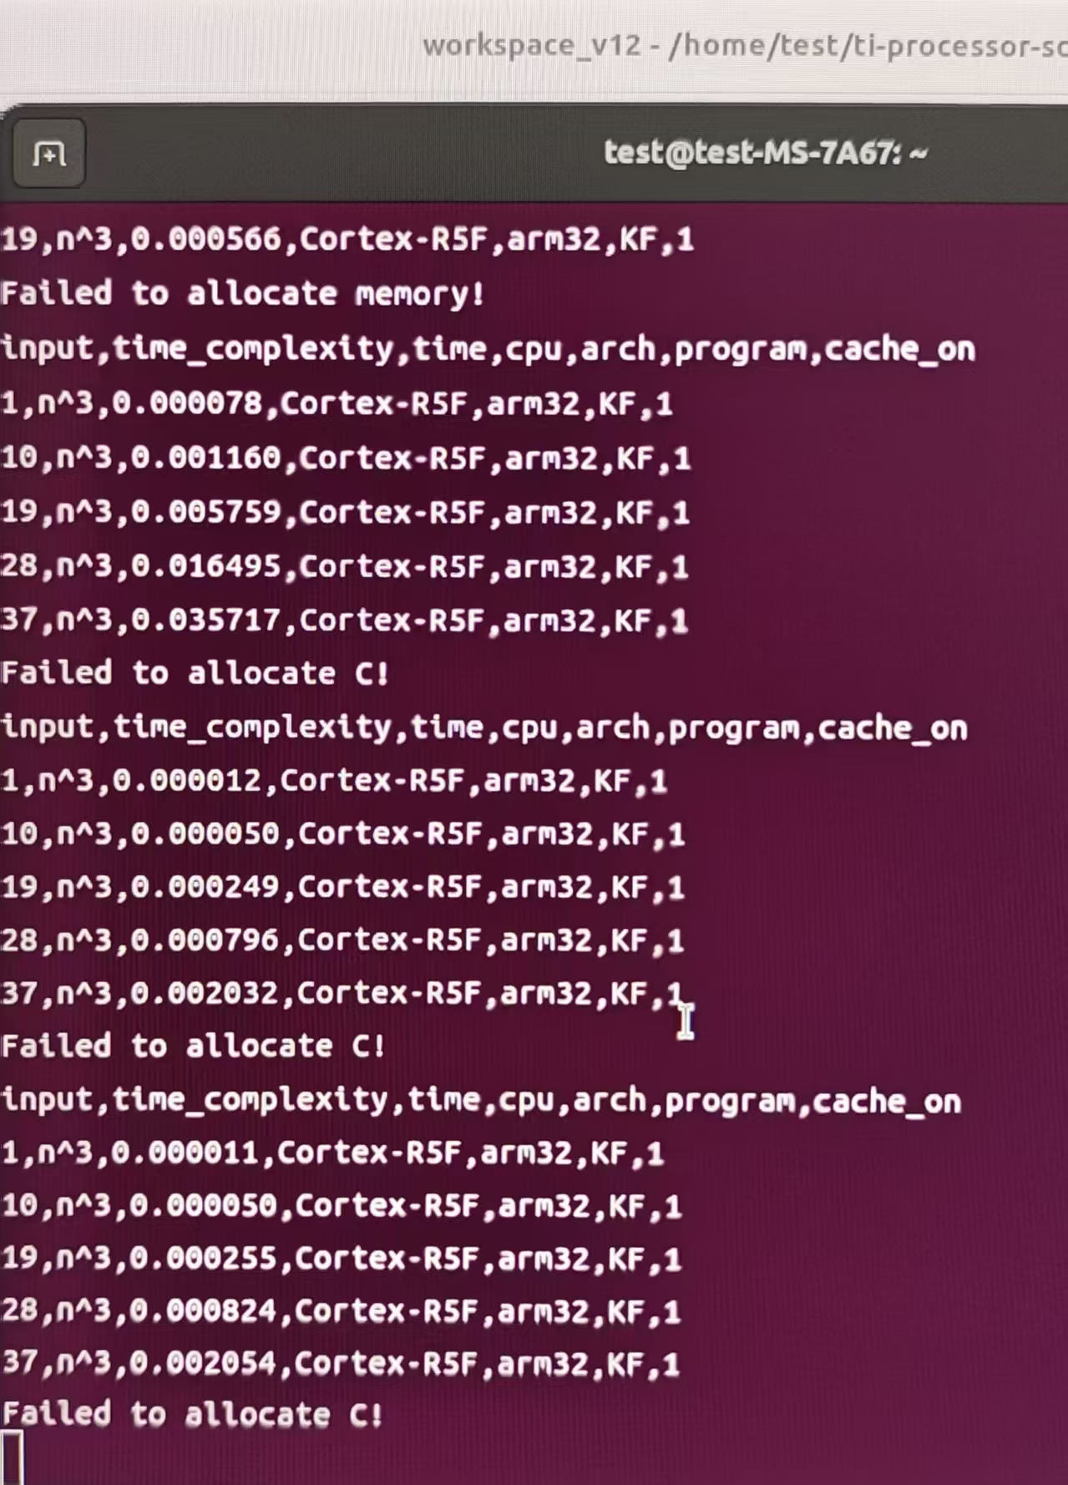
有时某一次的测试数据与其他的测试数据差一个数量级，目前不知道原因。应该采用这部分数据吗？

Slide 3
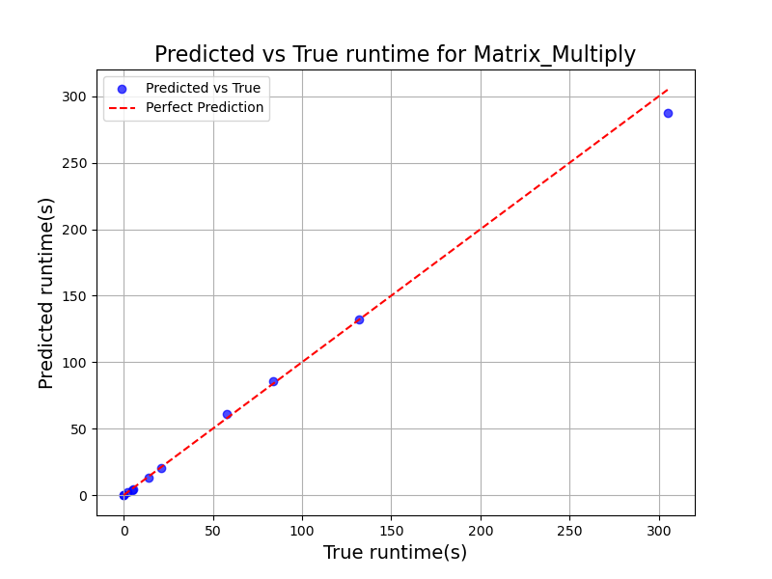

随机森林回归
表现较好
model = RandomForestRegressor(
n_estimators=100,
random_state=2
)
MAPE: 0.2768
R²: 0.9963
RMSE: 5.3571
model = RandomForestRegressor(
n_estimators=1000,
random_state=2
)
MAPE: 0.3288
R²: 0.9956
RMSE: 5.8434

Slide 4
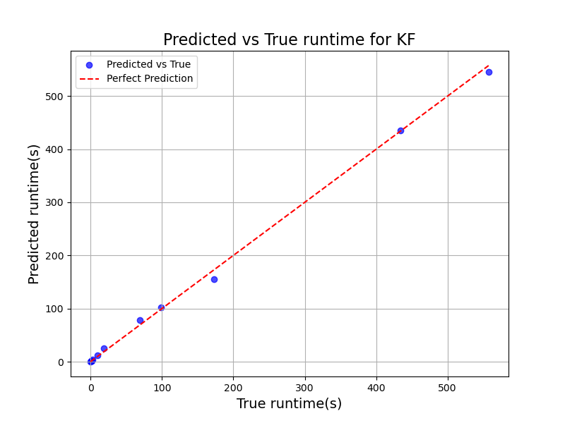

随机森林回归
表现较好
model = RandomForestRegressor(
n_estimators=200,
random_state=2
)
MAPE: 2.0482
R²: 0.9985
RMSE: 7.1898
model = RandomForestRegressor(
n_estimators=2,
random_state=2
)
MAPE: 1.8589
R²: 0.9987
RMSE: 6.6951

Slide 5
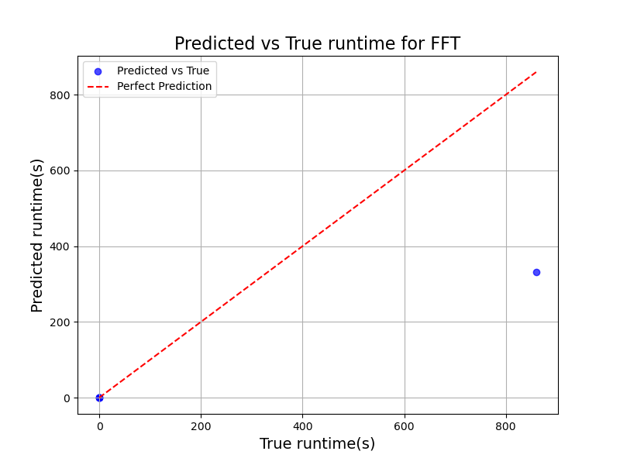
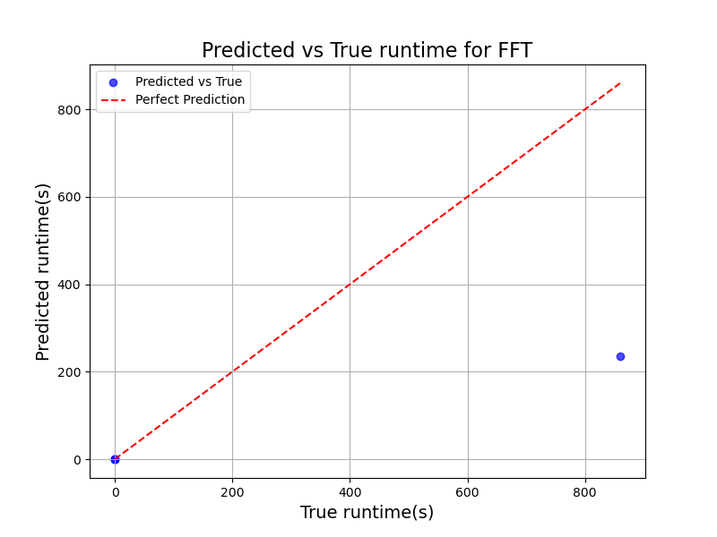
随机森林回归
model = RandomForestRegressor(
n_estimators=100,
random_state=2
)
MAPE: 0.1769
R²: 0.5288
RMSE: 236.0175
Best params (random_forest_tuned, FFT): {'bootstrap': False, 'max_depth': 13, 'max_features': 'log2', 'min_samples_leaf': 3, 'min_samples_split': 7, 'n_estimators': 284}
MAPE: 0.5116
R²: 0.3419
RMSE: 278.9316

Slide 6


支持向量回归
model = SVR(
kernel='rbf',
C=1000,
epsilon=0.5
)
MAPE: 3784.3033
R²: 0.9996
RMSE: 1.8431
手动调参
Best params (svr_tuned): {'C': 6878.031163887243, 'degree': 4, 'epsilon': 0.38179294084056103, 'gamma': 5.46030627903238, 'kernel': 'rbf’}
MAPE: 2892.1275
R²: 0.9996
RMSE: 1.7198
引入RandomizedSearchCV自动搜索参数

Slide 7
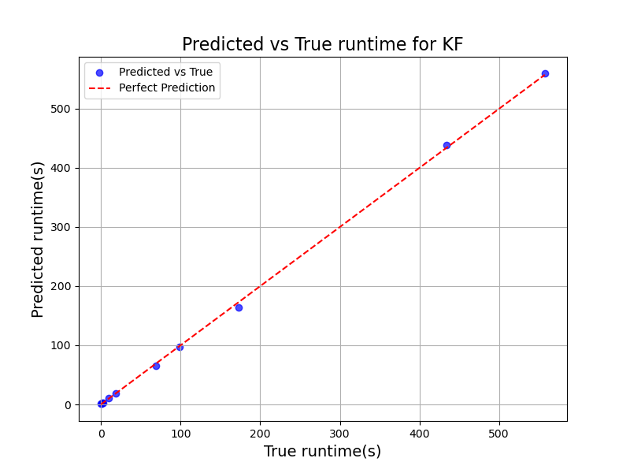

支持向量回归
model = SVR(
kernel='rbf',
C=1000,
epsilon=0.5
)
MAPE: 1357.1281
R²: 0.9997
RMSE: 3.3460
手动调参
Best params (svr_tuned): {'C': 6878.031163887243, 'degree': 4, 'epsilon': 0.38179294084056103, 'gamma': 5.46030627903238, 'kernel': 'rbf’}
MAPE: 1335.9732
R²: 0.9994
RMSE: 4.5853
引入RandomizedSearchCV自动搜索参数

Slide 8
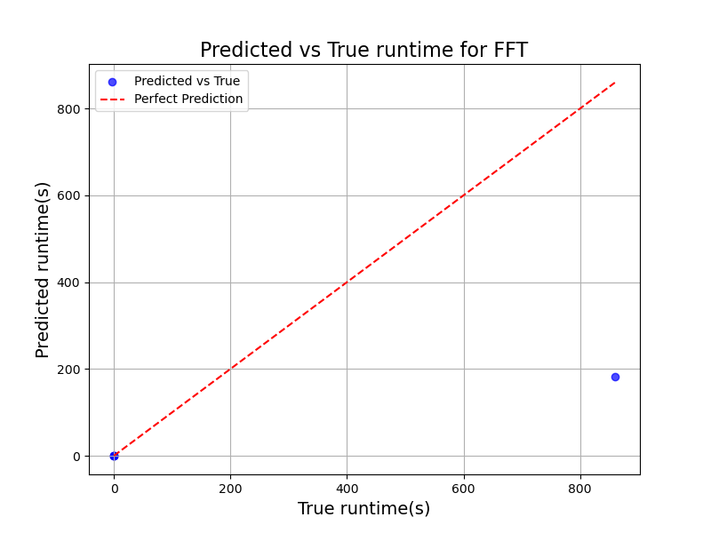
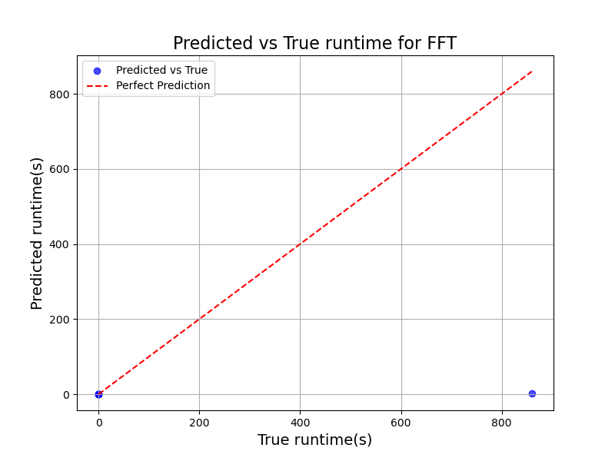
支持向量回归
model = SVR(
kernel='rbf',
C=1000,
epsilon=0.5
)
MAPE: 6909.5662
R²: 0.2224
RMSE: 303.2106
手动调参
Best params (svr_tuned): {'C': 577.8627854332454, 'degree': 3, 'epsilon': 0.11958479832931303, 'gamma': 1.0963607629633412e-05, 'kernel': 'rbf’}
MAPE: 1662.4767
R²: -0.2448
RMSE: 383.6208
引入RandomizedSearchCV自动搜索参数

Slide 9


神经网络回归
mlp = MLPRegressor(
hidden_layer_sizes=(100, 50),
activation='relu',
solver='adam',
max_iter=10000,
random_state=2
)
MAPE: 544.7565
R²: 0.9996
RMSE: 1.7809
手动调参
Best params (mlp_tuned): {'regressor__activation': 'relu', 'regressor__alpha': 0.006680351314068706, 'regressor__hidden_layer_sizes': (200, 100), 'regressor__learning_rate_init': 0.07602233354654259, 'regressor__solver': 'lbfgs’}
MAPE: 335.4517
R²: 0.9994
RMSE: 2.1308
引入RandomizedSearchCV自动搜索参数

Slide 10
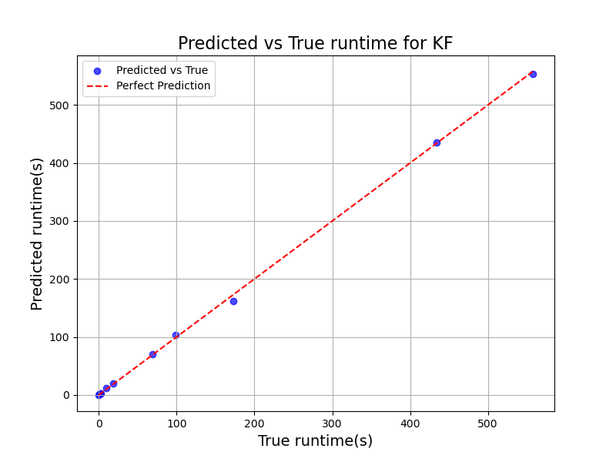
神经网络回归
表现较好
Best params (mlp_tuned): {'regressor__activation': 'relu', 'regressor__alpha': 0.006680351314068706, 'regressor__hidden_layer_sizes': (200, 100), 'regressor__learning_rate_init': 0.07602233354654259, 'regressor__solver': 'lbfgs’}
MAPE: 46.8010
R²: 0.9995
RMSE: 3.9219

Slide 11
神经网络回归
Best params (mlp_tuned): {'regressor__activation': 'logistic', 'regressor__alpha': 0.027638772178671115, 'regressor__hidden_layer_sizes': (200, 100), 'regressor__learning_rate_init': 0.0251637321277227, 'regressor__solver': 'adam’}
MAPE: 4376.2991
R²: -0.2491
RMSE: 384.2825

Slide 12

拟合多项式
poly = PolynomialFeatures(
degree=3,
include_bias=True
)
MAPE: 2011.0220
R²: 0.9993
RMSE: 2.3611
T(N) = 5.038849091828685e-07 * N^3 + -0.00013313793040276603 * N^2 + 0.008000656253323172 * N + 0.257575

Slide 13

拟合多项式
MAPE: 645.0855
R²: 0.9998
RMSE: 2.5920
T(N) = 1.0143942756480705e-06 * N^3 + -0.00027262610626153634 * N^2 + 0.016611600964441024 * N + 0.669018

Slide 14
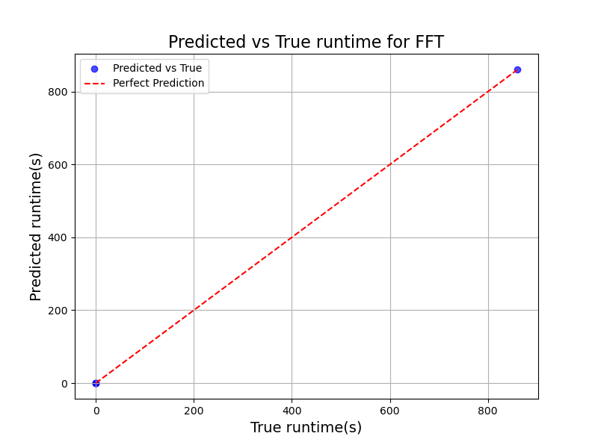
拟合多项式
表现较好
MAPE: 50.0670
R²: 1.0000
RMSE: 0.5282
T(N) = 4.933307294951645e-07 * N log2(N) + 0.003611

Slide 15

XGBoost回归
表现较好
model = XGBRegressor(
n_estimators=500,
max_depth=15,
learning_rate=0.05,
random_state=2,
n_jobs=-1,
verbosity=0
)
MAPE: 4.7861
R²: 0.9865
RMSE: 10.2801
手动调参
Best params (xgboost_tuned): {'colsample_bytree': 0.9447600319730725, 'gamma': 1.1871972283905326e-05, 'learning_rate': 0.0339394647270345, 'max_depth': 13, 'n_estimators': 858, 'reg_alpha': 6.751542867668973e-06, 'reg_lambda': 0.00016239865993185278, 'subsample': 0.63708662969523}
MAPE: 4.8126
R²: 0.9865
RMSE: 10.2800
引入RandomizedSearchCV自动搜索参数

Slide 16

XGBoost回归
表现较好
model = XGBRegressor(
n_estimators=500,
max_depth=15,
learning_rate=0.05,
random_state=2,
n_jobs=-1,
verbosity=0
)
MAPE: 1.4526
R²: 0.9964
RMSE: 11.0045
手动调参
Best params (xgboost_tuned): {'colsample_bytree': 0.5875581919673329, 'gamma': 0.0004302614800676075, 'learning_rate': 0.23717426076930576, 'max_depth': 14, 'n_estimators': 245, 'reg_alpha': 0.00017320857784693374, 'reg_lambda': 2.9143439864895515e-06, 'subsample': 0.5131920745577545}
MAPE: 7.7352
R²: 0.9964
RMSE: 11.0036
引入RandomizedSearchCV自动搜索参数

Slide 17

XGBoost回归
model = XGBRegressor(
n_estimators=500,
max_depth=15,
learning_rate=0.05,
random_state=2,
n_jobs=-1,
verbosity=0
)
MAPE: 3.2217
R²: 0.6639
RMSE: 199.3429
手动调参
Best params (xgboost_tuned): {'colsample_bytree': 0.9902425394993892, 'gamma': 1.6454409475075095e-06, 'learning_rate': 0.13578266219061227, 'max_depth': 5, 'n_estimators': 440, 'reg_alpha': 2.5418943562330136e-07, 'reg_lambda': 1.973004444308398e-06, 'subsample': 0.8628150378383002}
MAPE: 2.3804
R²: 0.6639
RMSE: 199.3426
引入RandomizedSearchCV自动搜索参数

Slide 18
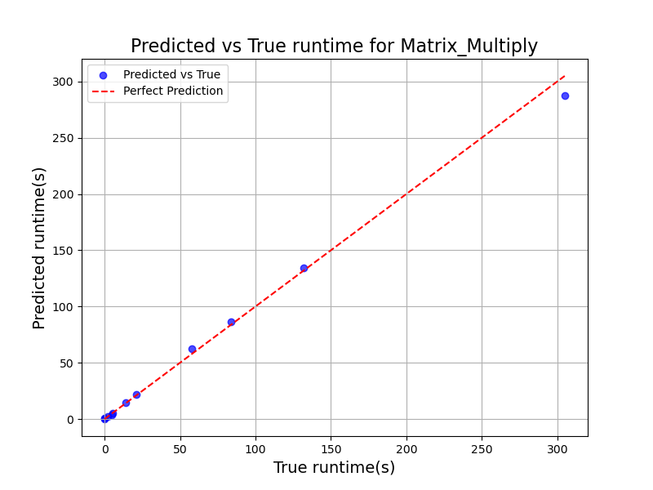
Hybrid
MAPE: 3.2217
R²: 0.6639
RMSE: 199.3429

Slide 19

Hybrid
MAPE: 625.5941
R²: 0.9993
RMSE: 4.9308

Slide 20

Hybrid
表现较好
MAPE: 0.9842
R²: 1.0000
RMSE: 0.5302

