Slide 1
同平台runtime预测（静态特征）：通过输入规模n预测运行时间T
预测对象：卡尔曼滤波KF，快速傅里叶变换FFT，模型预测控制MPC，
安全算法AES/MD5/SHA256
平台：J721的A72，J721的R5，OK8MP的M7
预测方法
  随机森林回归 RF：对非线性、异常值鲁棒，外推弱
  支持向量回归 SVR：对单变量平滑非线性拟合好；对尺度敏感需标准化；外推弱
  多层感知机回归 MLP：表达力强，可拟合复杂曲线；需要较多数据与正则/早停来防过拟合；对尺度敏感；外推一般
  解析模型的非线性最小二乘CURVE：可解释、外推性好（当先验正确时）
  梯度提升树XGB：对非线性、异常值鲁棒，外推弱
  解析先验 + 残差学习HYBRID：兼顾可解释性与灵活性，常比单一模型更稳健
  每个方法会在7个不同的种子下测试

Slide 2
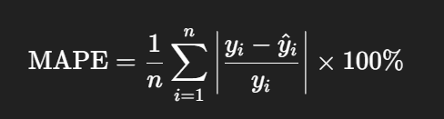
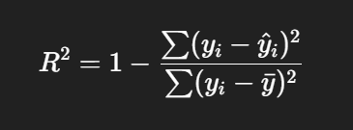
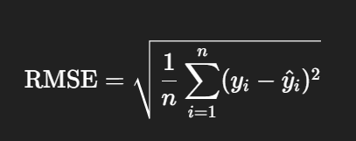
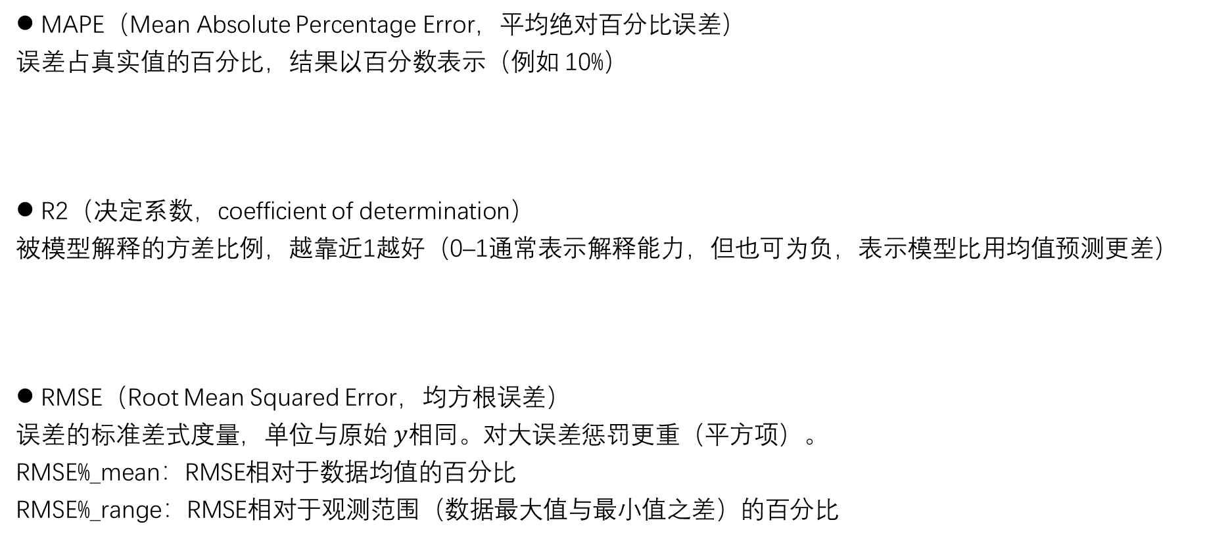
评价指标
MAPE（Mean Absolute Percentage Error，平均绝对百分比误差）
误差占真实值的百分比，结果以百分数表示（例如 10%）
R2（决定系数，coefficient of determination）
被模型解释的方差比例，越靠近1越好（0–1通常表示解释能力，但也可为负，表示模型比用均值预测更差）
RMSE（Root Mean Squared Error，均方根误差）
误差的标准差式度量，单位与原始 $y$相同。对大误差惩罚更重（平方项）。
RMSE%_mean：RMSE相对于数据均值的百分比
RMSE%_range：RMSE相对于观测范围（数据最大值与最小值之差）的百分比

Slide 3
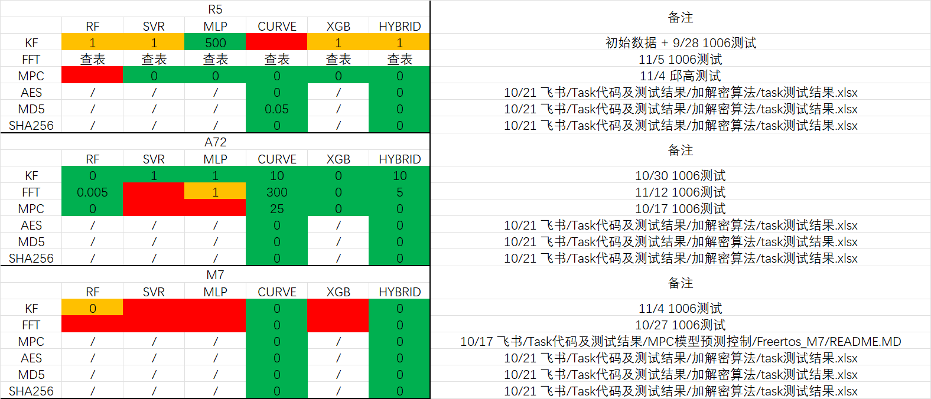
实验结果一览表
3个评价指标：
MAPE / RMSE%_range(%) / RMSE%_mean(%)
都满足：
  < 10% 优秀
  10–20% 中等
  >20% 差
实验结果表明
CURVE和HYBRID两种有先验的拟合方式效果普遍较好，原因在于算子的复杂度已知。
说明：
表格中的数字代表忽略了运行时间小于该数字(ms)的样本数据，“/”表示方法不必要，因为这些算子具有明显的线性特征
目前模型使用的都是相同参数
在预测程序的配置区修改predicted_app、host_cpu、PREDICT_METHOD、LOWER_BOUND就可以复现实现结果

Slide 4
后面PPT是各种预测方法的实验记录及其分析

Slide 5
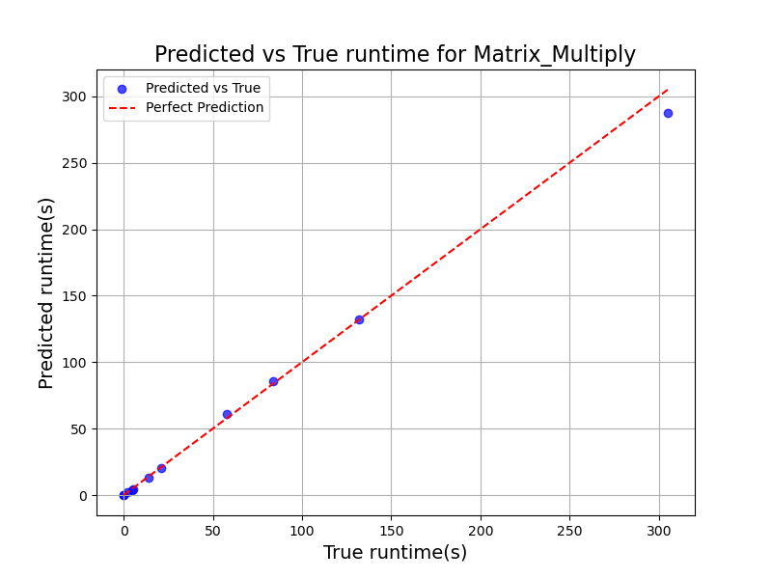

随机森林回归
model = RandomForestRegressor(
n_estimators=100,
random_state=2
)
MAPE: 0.2768
R²: 0.9963
RMSE: 5.3571
model = RandomForestRegressor(
n_estimators=1000,
random_state=2
)
MAPE: 0.3288
R²: 0.9956
RMSE: 5.8434
对矩阵乘，RF预测效果不好，原因？

Slide 6
改进1：现在用多个随机种（数据划分、模型）进行多轮测试
随机森林回归
Predicting runtime for Matrix_Multiply on Cortex-R5F
Test size: 0.1, Lower bound: -1.0
Method: random_forest
Seed 1: MAPE=0.0699 (优秀), R2=0.9971, RMSE=5.7602 (s), RMSE%_mean=4.98% (优秀), RMSE%_range=1.67% (优秀), N=11
Seed 2: MAPE=0.2367 (差), R2=0.9937, RMSE=5.3302 (s), RMSE%_mean=15.19% (中等), RMSE%_range=2.19% (优秀), N=11
Seed 6: MAPE=0.3420 (差), R2=0.9957, RMSE=5.8029 (s), RMSE%_mean=10.19% (中等), RMSE%_range=1.90% (优秀), N=11
Seed 42: MAPE=0.1349 (中等), R2=0.9984, RMSE=4.2699 (s), RMSE%_mean=3.89% (优秀), RMSE%_range=1.28% (优秀), N=11
Seed 123: MAPE=0.0747 (优秀), R2=0.9994, RMSE=2.4110 (s), RMSE%_mean=2.78% (优秀), RMSE%_range=0.93% (优秀), N=11
Seed 2025: MAPE=0.1119 (中等), R2=0.9972, RMSE=1.4969 (s), RMSE%_mean=6.24% (优秀), RMSE%_range=1.80% (优秀), N=11
Seed 33550336: MAPE=0.1358 (中等), R2=0.9924, RMSE=7.2779 (s), RMSE%_mean=9.64% (优秀), RMSE%_range=2.53% (优秀), N=11
MAPE: 0.1580 ± 0.0982 (中等)
R2: 0.9963 ± 0.0025
RMSE: 4.6213 ± 2.0422 (s)
RMSE%_mean: 7.56% ± 4.36% (优秀)
RMSE%_range: 1.76% ± 0.54% (优秀)
（评价指标的数值是7个seed的平均水平）
有助于减少随机性

Slide 7
随机森林回归：Seed影响
Seed 2: MAPE=0.2367 (差), R2=0.9937, RMSE=5.3302 (s), RMSE%_mean=15.19% (中等), RMSE%_range=2.19% (优秀), N=11
Seed 6: MAPE=0.3420 (差), R2=0.9957, RMSE=5.8029 (s), RMSE%_mean=10.19% (中等), RMSE%_range=1.90% (优秀), N=11
RF效果不好，应该是与随机种参数有关。随机种参数影响数据划分（不同划分可能噪声不同）和模型表现。
就这两个表现不好的样例来看：即Seed 2和Seed 6
  RMSE%_range 很低（≈2%），说明把均方根误差相对于范围看就是一个很小的比例。
  RMSE%_mean 给出的 10–15% 说明均方根误差相对于均值仍然是中等 ，可反推均值：
    mean ≈ 100 * RMSE / RMSE%_mean
      Seed2 mean ≈ 100*5.3302/15.19 ≈ 35.1 s
      Seed6 mean ≈ 100*5.8029/10.19 ≈ 56.9 s
然而 MAPE（平均绝对百分比误差）很高（23.7% / 34.2%），说明按“每个样本的相对百分比误差”去平均时出现了很多非常大的百分比项。我认为在这里可能的原因有：
  存在不少非常小的真实值 y（例如接近 0），使得 |error|/y 非常大，从而把平均 MAPE 拉高。
  在小 y 上模型相对表现差。
  这也印证了数据小时查表的合理性。

Slide 8
改进2：尝试修改训练集和测试集的划分，各项指标略有改善
随机森林回归
Predicting runtime for Matrix_Multiply on Cortex-R5F
Test size: 0.3, Lower bound: 0
Method: random_forest
Seed 1: MAPE=0.0703 (优秀), R2=0.9955, RMSE=7.3870 (s), RMSE%_mean=6.49% (优秀), RMSE%_range=2.14% (优秀), N=33
Seed 2: MAPE=0.1688 (中等), R2=0.9972, RMSE=5.9634 (s), RMSE%_mean=7.81% (优秀), RMSE%_range=1.67% (优秀), N=33
Seed 6: MAPE=0.1663 (中等), R2=0.9964, RMSE=5.6810 (s), RMSE%_mean=7.50% (优秀), RMSE%_range=1.74% (优秀), N=33
Seed 42: MAPE=0.1120 (中等), R2=0.9977, RMSE=4.6514 (s), RMSE%_mean=5.25% (优秀), RMSE%_range=1.39% (优秀), N=33
Seed 123: MAPE=0.1848 (中等), R2=0.9968, RMSE=6.0358 (s), RMSE%_mean=7.15% (优秀), RMSE%_range=1.61% (优秀), N=33
Seed 2025: MAPE=0.0901 (优秀), R2=0.9955, RMSE=6.0807 (s), RMSE%_mean=8.27% (优秀), RMSE%_range=1.62% (优秀), N=33
Seed 33550336: MAPE=0.0986 (优秀), R2=0.9975, RMSE=5.0404 (s), RMSE%_mean=5.91% (优秀), RMSE%_range=1.46% (优秀), N=33
MAPE: 0.1273 ± 0.0452 (中等)
R2: 0.9967 ± 0.0009
RMSE: 5.8342 ± 0.8739 (s)
RMSE%_mean: 6.91% ± 1.08% (优秀)
RMSE%_range: 1.66% ± 0.24% (优秀)
从训练集/测试集按90%/10%划分改为70%/30%划分。
70/30 提供更稳定、更低方差的测试误差估计，更容易发现模型的泛化问题（比如过拟合）。
90/10 给训练更多数据，可能让模型在训练上表现更好，但测试集太小会导致评估结果高度不稳定（噪声大），容易被“幸运的划分”误导。
数据量很大（几千）时可以用90%/10%，因为此时测试集依然很大。
此外还可以准备额外的独立测试集，或者使用交叉验证。

Slide 9
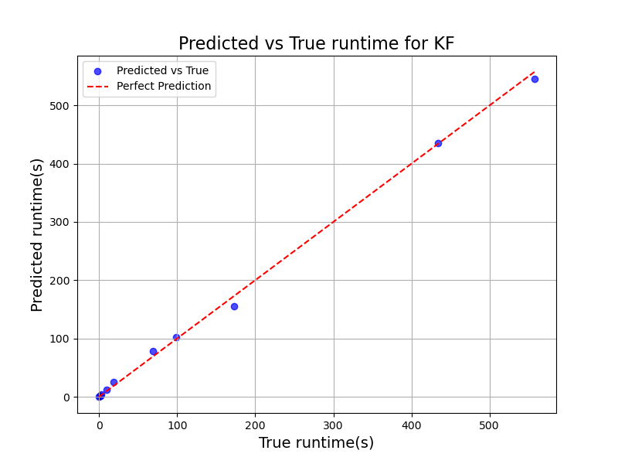

随机森林回归
相对较好
model = RandomForestRegressor(
n_estimators=200,
random_state=2
)
MAPE: 2.0482
R²: 0.9985
RMSE: 7.1898
model = RandomForestRegressor(
n_estimators=2,
random_state=2
)
MAPE: 1.8589
R²: 0.9987
RMSE: 6.6951

Slide 10
综合1、2点，测试运行时间大于1s的数据
随机森林回归
Predicting runtime for KF on Cortex-R5F
Test size: 0.3, Lower bound: 1
Method: random_forest
Seed 1: MAPE=0.0746 (优秀), R2=0.9932, RMSE=18.5183 (s), RMSE%_mean=8.24% (优秀), RMSE%_range=2.47% (优秀), N=28
Seed 2: MAPE=0.1277 (中等), R2=0.9954, RMSE=14.4128 (s), RMSE%_mean=8.03% (优秀), RMSE%_range=1.92% (优秀), N=28
Seed 6: MAPE=0.1071 (中等), R2=0.9961, RMSE=13.2809 (s), RMSE%_mean=6.88% (优秀), RMSE%_range=1.92% (优秀), N=28
Seed 42: MAPE=0.0850 (优秀), R2=0.9976, RMSE=9.2902 (s), RMSE%_mean=5.51% (优秀), RMSE%_range=1.35% (优秀), N=28
Seed 123: MAPE=0.0783 (优秀), R2=0.9944, RMSE=15.2321 (s), RMSE%_mean=6.56% (优秀), RMSE%_range=2.28% (优秀), N=28
Seed 2025: MAPE=0.1729 (中等), R2=0.9957, RMSE=14.9215 (s), RMSE%_mean=6.74% (优秀), RMSE%_range=1.99% (优秀), N=28
Seed 33550336: MAPE=0.1214 (中等), R2=0.9913, RMSE=22.4851 (s), RMSE%_mean=10.61% (中等), RMSE%_range=3.00% (优秀), N=28
MAPE: 0.1096 ± 0.0348 (中等)
R2: 0.9948 ± 0.0021
RMSE: 15.4487 ± 4.1424 (s)
RMSE%_mean: 7.51% ± 1.65% (优秀)
RMSE%_range: 2.14% ± 0.52% (优秀)

Slide 11
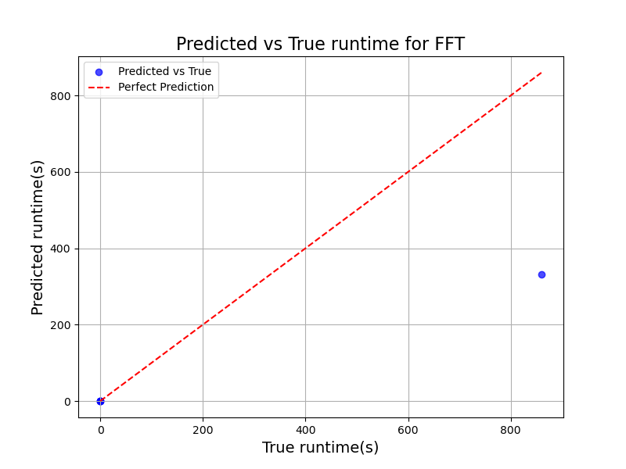
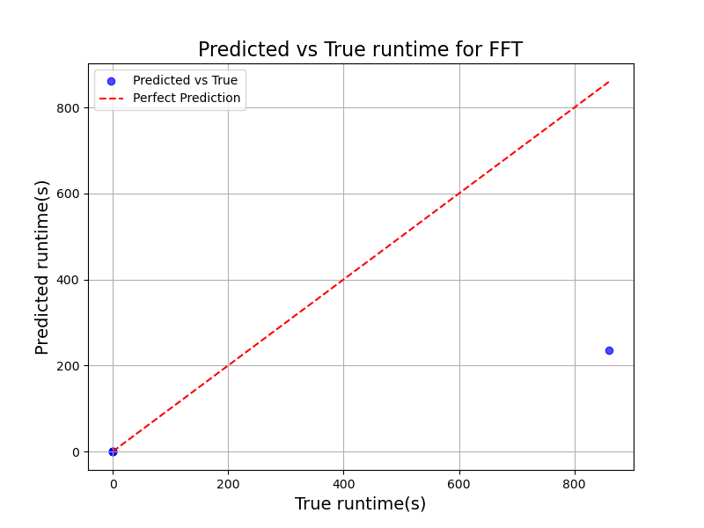
随机森林回归
FFT表现依然很差
model = RandomForestRegressor(
n_estimators=100,
random_state=2
)
MAPE: 0.1769
R²: 0.5288
RMSE: 236.0175
Best params (random_forest_tuned, FFT): {'bootstrap': False, 'max_depth': 13, 'max_features': 'log2', 'min_samples_leaf': 3, 'min_samples_split': 7, 'n_estimators': 284}
MAPE: 0.5116
R²: 0.3419
RMSE: 278.9316
手动调参
引入RandomizedSearchCV自动搜索参数
Predicting runtime for FFT on Cortex-R5F
Test size: 0.3, Lower bound: -1.0
Method: random_forest
Seed 1: MAPE=0.3518 (差), R2=0.0194, RMSE=234.8103 (s), RMSE%_mean=216.62% (差), RMSE%_range=27.32% (差), N=14
Seed 2: MAPE=0.4503 (差), R2=0.5912, RMSE=141.3403 (s), RMSE%_mean=225.68% (差), RMSE%_range=16.44% (中等), N=14
Seed 6: MAPE=0.2569 (差), R2=0.5849, RMSE=142.2317 (s), RMSE%_mean=219.72% (差), RMSE%_range=16.55% (中等), N=14
Seed 42: MAPE=0.2629 (差), R2=0.5649, RMSE=7.7358 (s), RMSE%_mean=236.38% (差), RMSE%_range=16.98% (中等), N=14
Seed 123: MAPE=0.3722 (差), R2=0.5932, RMSE=3.5653 (s), RMSE%_mean=219.74% (差), RMSE%_range=16.38% (中等), N=14
Seed 2025: MAPE=0.2233 (差), R2=0.5940, RMSE=0.3835 (s), RMSE%_mean=227.97% (差), RMSE%_range=16.40% (中等), N=14
Seed 33550336: MAPE=0.3418 (差), R2=0.5648, RMSE=145.7026 (s), RMSE%_mean=213.62% (差), RMSE%_range=16.95% (中等), N=14
MAPE: 0.3227 ± 0.0793 (差)
R2: 0.5018 ± 0.2131
RMSE: 96.5385 ± 92.5626 (s)
RMSE%_mean: 222.82% ± 7.75% (差)
RMSE%_range: 18.14% ± 4.05% (中等)

Slide 12


支持向量回归 Matrix_Multiply
model = SVR(
kernel='rbf',
C=1000,
epsilon=0.5
)
MAPE: 3784.3033
R²: 0.9996
RMSE: 1.8431
Best params (svr_tuned): {'C': 6878.031163887243, 'degree': 4, 'epsilon': 0.38179294084056103, 'gamma': 5.46030627903238, 'kernel': 'rbf’}
MAPE: 2892.1275
R²: 0.9996
RMSE: 1.7198
手动调参
引入RandomizedSearchCV自动搜索参数
效果很差，如上。
剔除运行时间不大于1秒的样本数据后，表现良好
Predicting runtime for Matrix_Multiply on Cortex-R5F
Test size: 0.3, Lower bound: 1.0
Method: svr
Seed 1: MAPE=0.0453 (优秀), R2=0.9981, RMSE=4.2580 (s), RMSE%_mean=3.98% (优秀), RMSE%_range=1.14% (优秀), N=27
Seed 2: MAPE=0.1300 (中等), R2=0.9974, RMSE=6.0052 (s), RMSE%_mean=6.21% (优秀), RMSE%_range=1.61% (优秀), N=27
Seed 6: MAPE=0.0947 (优秀), R2=0.9994, RMSE=2.1946 (s), RMSE%_mean=2.62% (优秀), RMSE%_range=0.62% (优秀), N=27
Seed 42: MAPE=0.0868 (优秀), R2=0.9968, RMSE=5.6407 (s), RMSE%_mean=6.22% (优秀), RMSE%_range=1.69% (优秀), N=27
Seed 123: MAPE=0.0359 (优秀), R2=0.9994, RMSE=2.7768 (s), RMSE%_mean=2.26% (优秀), RMSE%_range=0.81% (优秀), N=27
Seed 2025: MAPE=0.0959 (优秀), R2=0.9997, RMSE=1.9306 (s), RMSE%_mean=1.79% (优秀), RMSE%_range=0.58% (优秀), N=27
Seed 33550336: MAPE=0.1213 (中等), R2=0.9988, RMSE=3.5958 (s), RMSE%_mean=3.90% (优秀), RMSE%_range=0.96% (优秀), N=27
MAPE: 0.0871 ± 0.0354 (优秀)
R2: 0.9985 ± 0.0011
RMSE: 3.7717 ± 1.6133 (s)
RMSE%_mean: 3.85% ± 1.80% (优秀)
RMSE%_range: 1.06% ± 0.45% (优秀)

Slide 13
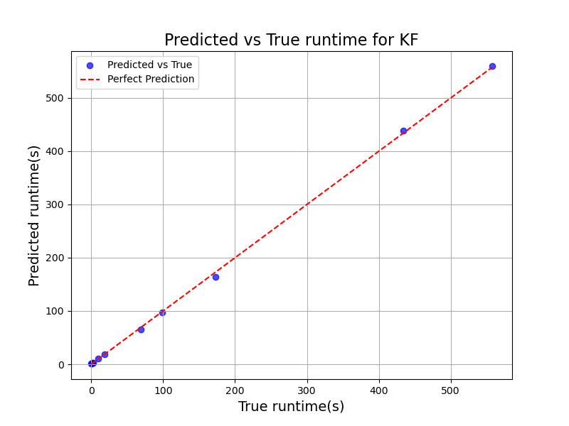

支持向量回归 KF
model = SVR(
kernel='rbf',
C=1000,
epsilon=0.5
)
MAPE: 1357.1281
R²: 0.9997
RMSE: 3.3460
Best params (svr_tuned): {'C': 6878.031163887243, 'degree': 4, 'epsilon': 0.38179294084056103, 'gamma': 5.46030627903238, 'kernel': 'rbf’}
MAPE: 1335.9732
R²: 0.9994
RMSE: 4.5853
手动调参
引入RandomizedSearchCV自动搜索参数
效果不好，如上。
剔除运行时间不大于1秒的样本数据后，表现良好
Predicting runtime for KF on Cortex-R5F
Test size: 0.3, Lower bound: 1.0
Method: svr
Seed 1: MAPE=0.0345 (优秀), R2=0.9981, RMSE=9.7083 (s), RMSE%_mean=4.32% (优秀), RMSE%_range=1.30% (优秀), N=28
Seed 2: MAPE=0.1405 (中等), R2=0.9964, RMSE=12.7481 (s), RMSE%_mean=7.11% (优秀), RMSE%_range=1.70% (优秀), N=28
Seed 6: MAPE=0.1054 (中等), R2=0.9988, RMSE=7.2954 (s), RMSE%_mean=3.78% (优秀), RMSE%_range=1.06% (优秀), N=28
Seed 42: MAPE=0.0754 (优秀), R2=0.9998, RMSE=2.6088 (s), RMSE%_mean=1.55% (优秀), RMSE%_range=0.38% (优秀), N=28
Seed 123: MAPE=0.0448 (优秀), R2=0.9971, RMSE=11.0453 (s), RMSE%_mean=4.76% (优秀), RMSE%_range=1.66% (优秀), N=28
Seed 2025: MAPE=0.3072 (差), R2=0.9991, RMSE=6.6797 (s), RMSE%_mean=3.02% (优秀), RMSE%_range=0.89% (优秀), N=28
Seed 33550336: MAPE=0.0918 (优秀), R2=0.9977, RMSE=11.6779 (s), RMSE%_mean=5.51% (优秀), RMSE%_range=1.56% (优秀), N=28
MAPE: 0.1142 ± 0.0924 (中等)
R2: 0.9982 ± 0.0012
RMSE: 8.8234 ± 3.5314 (s)
RMSE%_mean: 4.29% ± 1.78% (优秀)
RMSE%_range: 1.22% ± 0.48% (优秀)

Slide 14
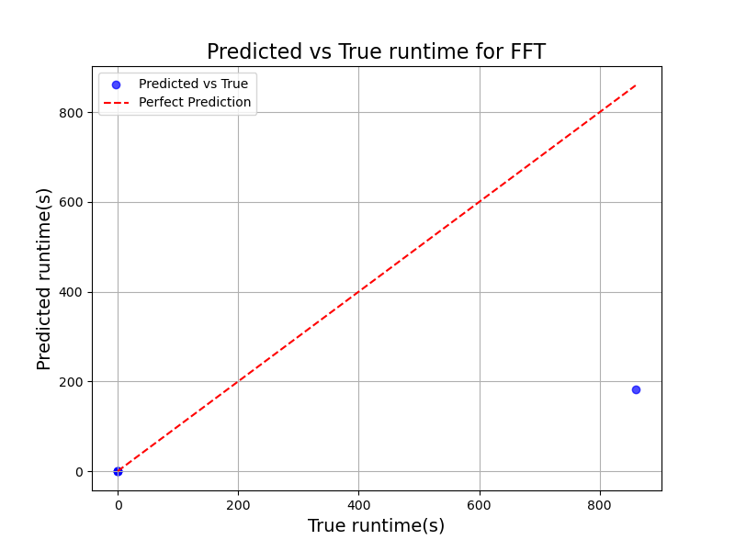
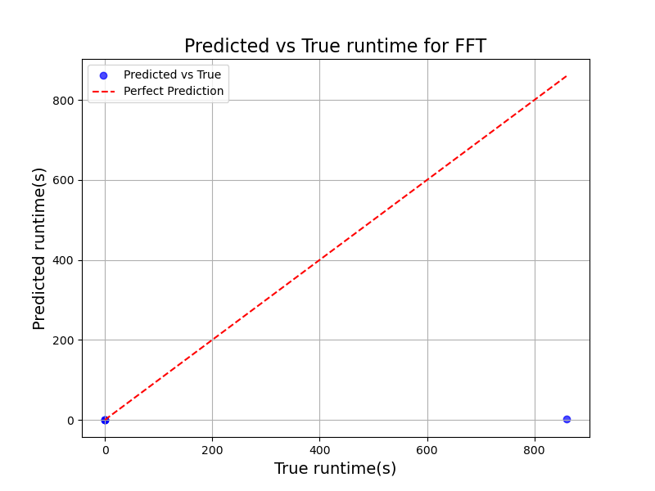
支持向量回归 FFT
model = SVR(
kernel='rbf',
C=1000,
epsilon=0.5
)
MAPE: 6909.5662
R²: 0.2224
RMSE: 303.2106
Best params (svr_tuned): {'C': 577.8627854332454, 'degree': 3, 'epsilon': 0.11958479832931303, 'gamma': 1.0963607629633412e-05, 'kernel': 'rbf’}
MAPE: 1662.4767
R²: -0.2448
RMSE: 383.6208
手动调参
引入RandomizedSearchCV自动搜索参数
效果不好，如上。
剔除运行时间不大于1秒的样本数据后，对FFT表现依然很差
Predicting runtime for FFT on Cortex-R5F
Test size: 0.3, Lower bound: 1.0
Method: svr
Seed 1: MAPE=0.2804 (差), R2=-0.0012, RMSE=383.6057 (s), RMSE%_mean=119.90% (差), RMSE%_range=44.88% (差), N=3
Seed 2: MAPE=0.2030 (差), R2=0.9789, RMSE=2.5650 (s), RMSE%_mean=11.05% (中等), RMSE%_range=5.94% (优秀), N=3
Seed 6: MAPE=0.3003 (差), R2=0.9934, RMSE=13.6899 (s), RMSE%_mean=6.68% (优秀), RMSE%_range=3.33% (优秀), N=3
Seed 42: MAPE=0.2229 (差), R2=0.9757, RMSE=28.7611 (s), RMSE%_mean=18.69% (中等), RMSE%_range=6.99% (优秀), N=3
Seed 123: MAPE=0.7506 (差), R2=0.9780, RMSE=13.1562 (s), RMSE%_mean=17.82% (中等), RMSE%_range=6.66% (优秀), N=3
Seed 2025: MAPE=0.6243 (差), R2=0.9212, RMSE=10.6553 (s), RMSE%_mean=22.33% (差), RMSE%_range=11.47% (中等), N=3
Seed 33550336: MAPE=0.5243 (差), R2=-0.1055, RMSE=385.9964 (s), RMSE%_mean=109.32% (差), RMSE%_range=44.96% (差), N=3
MAPE: 0.4151 ± 0.2166 (差)
R2: 0.6772 ± 0.5005
RMSE: 119.7757 ± 181.2139 (s)
RMSE%_mean: 43.68% ± 48.82% (差)
RMSE%_range: 17.75% ± 18.72% (中等)

Slide 15


神经网络回归 Matrix_Multiply
mlp = MLPRegressor(
hidden_layer_sizes=(100, 50),
activation='relu',
solver='adam',
max_iter=10000,
random_state=2
)
MAPE: 544.7565
R²: 0.9996
RMSE: 1.7809
Best params (mlp_tuned): {'regressor__activation': 'relu', 'regressor__alpha': 0.006680351314068706, 'regressor__hidden_layer_sizes': (200, 100), 'regressor__learning_rate_init': 0.07602233354654259, 'regressor__solver': 'lbfgs’}
MAPE: 335.4517
R²: 0.9994
RMSE: 2.1308
手动调参
引入RandomizedSearchCV自动搜索参数
效果不好，如上。
剔除运行时间不大于0.5秒的样本数据后，表现良好
Predicting runtime for Matrix_Multiply on Cortex-R5F
Test size: 0.3, Lower bound: 0.5
Method: mlp
Seed 1: MAPE=0.0652 (优秀), R2=0.9982, RMSE=4.7590 (s), RMSE%_mean=4.24% (优秀), RMSE%_range=1.27% (优秀), N=28
Seed 2: MAPE=0.1091 (中等), R2=0.9966, RMSE=6.2106 (s), RMSE%_mean=6.93% (优秀), RMSE%_range=1.66% (优秀), N=28
Seed 6: MAPE=0.0907 (优秀), R2=0.9986, RMSE=4.0178 (s), RMSE%_mean=4.17% (优秀), RMSE%_range=1.17% (优秀), N=28
Seed 42: MAPE=0.0760 (优秀), R2=0.9996, RMSE=1.9081 (s), RMSE%_mean=2.27% (优秀), RMSE%_range=0.55% (优秀), N=28
Seed 123: MAPE=0.0646 (优秀), R2=0.9969, RMSE=5.6927 (s), RMSE%_mean=4.91% (优秀), RMSE%_range=1.71% (优秀), N=28
Seed 2025: MAPE=0.0717 (优秀), R2=0.9988, RMSE=4.0340 (s), RMSE%_mean=3.65% (优秀), RMSE%_range=1.08% (优秀), N=28
Seed 33550336: MAPE=0.1117 (中等), R2=0.9986, RMSE=4.4941 (s), RMSE%_mean=4.25% (优秀), RMSE%_range=1.20% (优秀), N=28
MAPE: 0.0841 ± 0.0199 (优秀)
R2: 0.9982 ± 0.0011
RMSE: 4.4452 ± 1.3882 (s)
RMSE%_mean: 4.35% ± 1.41% (优秀)
RMSE%_range: 1.23% ± 0.39% (优秀)

Slide 16
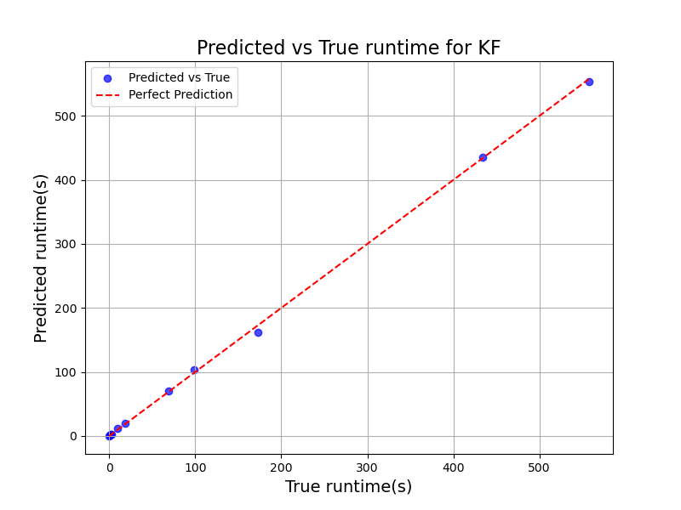
神经网络回归 KF
Best params (mlp_tuned): {'regressor__activation': 'relu', 'regressor__alpha': 0.006680351314068706, 'regressor__hidden_layer_sizes': (200, 100), 'regressor__learning_rate_init': 0.07602233354654259, 'regressor__solver': 'lbfgs’}
MAPE: 46.8010
R²: 0.9995
RMSE: 3.9219
引入RandomizedSearchCV自动搜索参数
效果不好，如上。
剔除运行时间不大于0.5秒的样本数据后，表现良好
Predicting runtime for KF on Cortex-R5F
Test size: 0.3, Lower bound: 0.5
Method: mlp
Seed 1: MAPE=0.0671 (优秀), R2=0.9980, RMSE=9.9251 (s), RMSE%_mean=4.36% (优秀), RMSE%_range=1.32% (优秀), N=29
Seed 2: MAPE=0.1114 (中等), R2=0.9969, RMSE=12.1973 (s), RMSE%_mean=6.57% (优秀), RMSE%_range=1.63% (优秀), N=29
Seed 6: MAPE=0.0675 (优秀), R2=0.9993, RMSE=5.6438 (s), RMSE%_mean=3.23% (优秀), RMSE%_range=0.84% (优秀), N=29
Seed 42: MAPE=0.1070 (中等), R2=0.9969, RMSE=11.4985 (s), RMSE%_mean=6.46% (优秀), RMSE%_range=1.61% (优秀), N=29
Seed 123: MAPE=0.0752 (优秀), R2=0.9971, RMSE=10.9083 (s), RMSE%_mean=5.79% (优秀), RMSE%_range=1.72% (优秀), N=29
Seed 2025: MAPE=0.0995 (优秀), R2=0.9989, RMSE=6.8675 (s), RMSE%_mean=3.56% (优秀), RMSE%_range=1.05% (优秀), N=29
Seed 33550336: MAPE=0.1035 (中等), R2=0.9968, RMSE=12.5540 (s), RMSE%_mean=6.28% (优秀), RMSE%_range=1.68% (优秀), N=29
MAPE: 0.0902 ± 0.0194 (优秀)
R2: 0.9977 ± 0.0010
RMSE: 9.9421 ± 2.6830 (s)
RMSE%_mean: 5.18% ± 1.43% (优秀)
RMSE%_range: 1.41% ± 0.34% (优秀)

Slide 17
神经网络回归 FFT
Best params (mlp_tuned): {'regressor__activation': 'logistic', 'regressor__alpha': 0.027638772178671115, 'regressor__hidden_layer_sizes': (200, 100), 'regressor__learning_rate_init': 0.0251637321277227, 'regressor__solver': 'adam’}
MAPE: 4376.2991
R²: -0.2491
RMSE: 384.2825
引入RandomizedSearchCV自动搜索参数
效果不好，如上。
剔除运行时间不大于1秒的样本数据后，表现良好
Predicting runtime for FFT on Cortex-R5F
Test size: 0.3, Lower bound: 1.0
Method: mlp
Seed 1: MAPE=0.0177 (优秀), R2=0.9994, RMSE=9.6531 (s), RMSE%_mean=3.02% (优秀), RMSE%_range=1.13% (优秀), N=3
Seed 2: MAPE=0.0630 (优秀), R2=0.9977, RMSE=0.8556 (s), RMSE%_mean=3.68% (优秀), RMSE%_range=1.98% (优秀), N=3
Seed 6: MAPE=0.0785 (优秀), R2=0.9963, RMSE=10.1727 (s), RMSE%_mean=4.96% (优秀), RMSE%_range=2.47% (优秀), N=3
Seed 42: MAPE=0.0226 (优秀), R2=1.0000, RMSE=1.0693 (s), RMSE%_mean=0.69% (优秀), RMSE%_range=0.26% (优秀), N=3
Seed 123: MAPE=0.2150 (差), R2=1.0000, RMSE=0.4303 (s), RMSE%_mean=0.58% (优秀), RMSE%_range=0.22% (优秀), N=3
Seed 2025: MAPE=0.0339 (优秀), R2=0.9949, RMSE=2.7062 (s), RMSE%_mean=5.67% (优秀), RMSE%_range=2.91% (优秀), N=3
Seed 33550336: MAPE=0.1885 (中等), R2=0.9994, RMSE=8.9620 (s), RMSE%_mean=2.54% (优秀), RMSE%_range=1.04% (优秀), N=3
MAPE: 0.0885 ± 0.0807 (优秀)
R2: 0.9982 ± 0.0020
RMSE: 4.8356 ± 4.5219 (s)
RMSE%_mean: 3.02% ± 1.95% (优秀)
RMSE%_range: 1.43% ± 1.05% (优秀)

Slide 18
在运行时间大于1秒的数据上表现良好
拟合多项式 Matrix_Multiply
Predicting runtime for Matrix_Multiply on Cortex-R5F
Test size: 0.3, Lower bound: 1.0
Method: curve_fit
拟合公式 (cubic): T(N) = 4.3226277054994453e-07 * N^3 + -2.0862520794859675e-06 * N^2 + -0.06689848074436114 * N + 12.859605
Seed 1: MAPE=0.0680 (优秀), R2=0.9985, RMSE=3.8106 (s), RMSE%_mean=3.57% (优秀), RMSE%_range=1.02% (优秀), N=27
拟合公式 (cubic): T(N) = 4.2738982693857415e-07 * N^3 + 1.237759618249166e-05 * N^2 + -0.07628695039796836 * N + 14.741285
Seed 2: MAPE=0.1919 (中等), R2=0.9978, RMSE=5.5002 (s), RMSE%_mean=5.69% (优秀), RMSE%_range=1.47% (优秀), N=27
拟合公式 (cubic): T(N) = 4.678375274448998e-07 * N^3 + -6.839138376553646e-05 * N^2 + -0.02779512715072722 * N + 6.288652
Seed 6: MAPE=0.0904 (优秀), R2=0.9993, RMSE=2.4101 (s), RMSE%_mean=2.87% (优秀), RMSE%_range=0.68% (优秀), N=27
拟合公式 (cubic): T(N) = 4.7207120847748915e-07 * N^3 + -6.279998485335789e-05 * N^2 + -0.03744647693828777 * N + 8.664294
Seed 42: MAPE=0.0993 (优秀), R2=0.9968, RMSE=5.6359 (s), RMSE%_mean=6.22% (优秀), RMSE%_range=1.69% (优秀), N=27
拟合公式 (cubic): T(N) = 4.878052105604081e-07 * N^3 + -9.49400378413378e-05 * N^2 + -0.019700190913805163 * N + 5.738953
Seed 123: MAPE=0.0416 (优秀), R2=0.9994, RMSE=2.6905 (s), RMSE%_mean=2.19% (优秀), RMSE%_range=0.78% (优秀), N=27
拟合公式 (cubic): T(N) = 4.483972283468473e-07 * N^3 + -3.3395435645058386e-05 * N^2 + -0.04756806156590248 * N + 9.756775
Seed 2025: MAPE=0.1086 (中等), R2=0.9995, RMSE=2.2678 (s), RMSE%_mean=2.10% (优秀), RMSE%_range=0.68% (优秀), N=27
拟合公式 (cubic): T(N) = 4.208773825942904e-07 * N^3 + 2.107791962287693e-05 * N^2 + -0.08085361522447715 * N + 15.338666
Seed 33550336: MAPE=0.1885 (中等), R2=0.9990, RMSE=3.2330 (s), RMSE%_mean=3.50% (优秀), RMSE%_range=0.87% (优秀), N=27
MAPE: 0.1126 ± 0.0574 (中等)
R2: 0.9986 ± 0.0010
RMSE: 3.6497 ± 1.4104 (s)
RMSE%_mean: 3.73% ± 1.63% (优秀)
RMSE%_range: 1.03% ± 0.40% (优秀)

Slide 19

拟合多项式 KF
MAPE: 645.0855
R²: 0.9998
RMSE: 2.5920
T(N) = 1.0143942756480705e-06 * N^3 + -0.00027262610626153634 * N^2 + 0.016611600964441024 * N + 0.669018

Slide 20
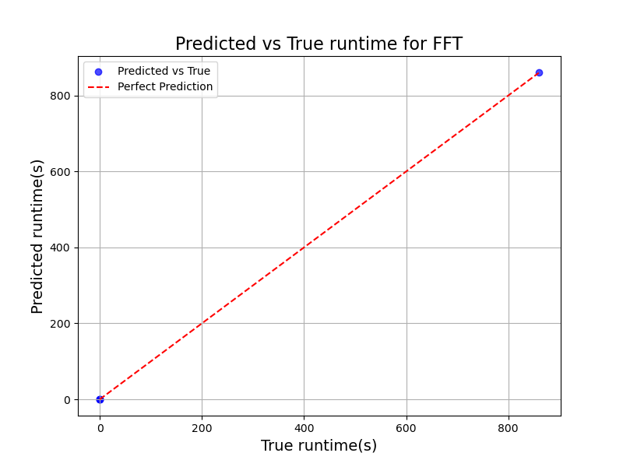
拟合多项式 FFT
MAPE: 50.0670
R²: 1.0000
RMSE: 0.5282
T(N) = 4.933307294951645e-07 * N log2(N) + 0.003611
手动调参
表现不佳，但在剔除运行时间不大于0.1秒的样本后，表现改善
Predicting runtime for FFT on Cortex-R5F
Test size: 0.3, Lower bound: 0.1
Method: curve_fit
拟合公式 (fft): T(N) = 4.927300161370875e-07 * N log2(N) + 0.089903
Seed 1: MAPE=0.0685 (优秀), R2=1.0000, RMSE=0.0793 (s), RMSE%_mean=0.16% (优秀), RMSE%_range=0.04% (优秀), N=4
拟合公式 (fft): T(N) = 4.927320933295469e-07 * N log2(N) + 0.087347
Seed 2: MAPE=0.2005 (差), R2=1.0000, RMSE=0.0739 (s), RMSE%_mean=0.14% (优秀), RMSE%_range=0.04% (优秀), N=4
拟合公式 (fft): T(N) = 4.926476771558109e-07 * N log2(N) + 0.060783
Seed 6: MAPE=0.0296 (优秀), R2=1.0000, RMSE=0.2700 (s), RMSE%_mean=0.23% (优秀), RMSE%_range=0.07% (优秀), N=4
拟合公式 (fft): T(N) = 4.926533533078908e-07 * N log2(N) + 0.040025
Seed 42: MAPE=0.0866 (优秀), R2=1.0000, RMSE=0.2892 (s), RMSE%_mean=0.21% (优秀), RMSE%_range=0.07% (优秀), N=4
拟合公式 (fft): T(N) = 4.927370737719805e-07 * N log2(N) + 0.080887
Seed 123: MAPE=0.1827 (中等), R2=1.0000, RMSE=0.0652 (s), RMSE%_mean=0.12% (优秀), RMSE%_range=0.03% (优秀), N=4
拟合公式 (fft): T(N) = 4.927444768636933e-07 * N log2(N) + 0.074904
Seed 2025: MAPE=0.0814 (优秀), R2=1.0000, RMSE=0.0732 (s), RMSE%_mean=0.24% (优秀), RMSE%_range=0.08% (优秀), N=4
拟合公式 (fft): T(N) = 4.927454979837824e-07 * N log2(N) + 0.069270
Seed 33550336: MAPE=0.0142 (优秀), R2=1.0000, RMSE=0.0533 (s), RMSE%_mean=0.08% (优秀), RMSE%_range=0.03% (优秀), N=4
MAPE: 0.0948 ± 0.0714 (优秀)
R2: 1.0000 ± 0.0000
RMSE: 0.1292 ± 0.1032 (s)
RMSE%_mean: 0.17% ± 0.06% (优秀)
RMSE%_range: 0.05% ± 0.02% (优秀)

Slide 21

XGBoost回归 Matrix_Multiply
model = XGBRegressor(
n_estimators=500,
max_depth=15,
learning_rate=0.05,
random_state=2,
n_jobs=-1,
verbosity=0
)
MAPE: 4.7861
R²: 0.9865
RMSE: 10.2801
Best params (xgboost_tuned): {'colsample_bytree': 0.9447600319730725, 'gamma': 1.1871972283905326e-05, 'learning_rate': 0.0339394647270345, 'max_depth': 13, 'n_estimators': 858, 'reg_alpha': 6.751542867668973e-06, 'reg_lambda': 0.00016239865993185278, 'subsample': 0.63708662969523}
MAPE: 4.8126
R²: 0.9865
RMSE: 10.2800
手动调参
引入RandomizedSearchCV自动搜索参数
效果不佳，如上。
剔除运行时间不大于1秒的样本后，表现改善
Predicting runtime for Matrix_Multiply on Cortex-R5F
Test size: 0.3, Lower bound: 1.0
Method: xgboost
Seed 1: MAPE=0.1252 (中等), R2=0.9899, RMSE=9.8814 (s), RMSE%_mean=9.25% (优秀), RMSE%_range=2.65% (优秀), N=27
Seed 2: MAPE=0.1470 (中等), R2=0.9962, RMSE=7.2537 (s), RMSE%_mean=7.51% (优秀), RMSE%_range=1.94% (优秀), N=27
Seed 6: MAPE=0.1559 (中等), R2=0.9909, RMSE=8.4229 (s), RMSE%_mean=10.05% (中等), RMSE%_range=2.37% (优秀), N=27
Seed 42: MAPE=0.1791 (中等), R2=0.9952, RMSE=6.8274 (s), RMSE%_mean=7.53% (优秀), RMSE%_range=2.05% (优秀), N=27
Seed 123: MAPE=0.1188 (中等), R2=0.9868, RMSE=12.5077 (s), RMSE%_mean=10.17% (中等), RMSE%_range=3.64% (优秀), N=27
Seed 2025: MAPE=0.1208 (中等), R2=0.9943, RMSE=7.9483 (s), RMSE%_mean=7.37% (优秀), RMSE%_range=2.39% (优秀), N=27
Seed 33550336: MAPE=0.2045 (差), R2=0.9958, RMSE=6.7213 (s), RMSE%_mean=7.28% (优秀), RMSE%_range=1.80% (优秀), N=27
MAPE: 0.1502 ± 0.0324 (中等)
R2: 0.9928 ± 0.0036
RMSE: 8.5090 ± 2.0734 (s)
RMSE%_mean: 8.45% ± 1.32% (优秀)
RMSE%_range: 2.41% ± 0.62% (优秀)

Slide 22

XGBoost回归 KF
model = XGBRegressor(
n_estimators=500,
max_depth=15,
learning_rate=0.05,
random_state=2,
n_jobs=-1,
verbosity=0
)
MAPE: 1.4526
R²: 0.9964
RMSE: 11.0045
Best params (xgboost_tuned): {'colsample_bytree': 0.5875581919673329, 'gamma': 0.0004302614800676075, 'learning_rate': 0.23717426076930576, 'max_depth': 14, 'n_estimators': 245, 'reg_alpha': 0.00017320857784693374, 'reg_lambda': 2.9143439864895515e-06, 'subsample': 0.5131920745577545}
MAPE: 7.7352
R²: 0.9964
RMSE: 11.0036
手动调参
效果不佳，如上。
剔除运行时间不大于1秒的样本后，表现改善
引入RandomizedSearchCV自动搜索参数
Predicting runtime for KF on Cortex-R5F
Test size: 0.3, Lower bound: 1.0
Method: xgboost
Seed 1: MAPE=0.1170 (中等), R2=0.9924, RMSE=19.5764 (s), RMSE%_mean=8.72% (优秀), RMSE%_range=2.61% (优秀), N=28
Seed 2: MAPE=0.1522 (中等), R2=0.9938, RMSE=16.7722 (s), RMSE%_mean=9.35% (优秀), RMSE%_range=2.24% (优秀), N=28
Seed 6: MAPE=0.1224 (中等), R2=0.9908, RMSE=20.3722 (s), RMSE%_mean=10.56% (中等), RMSE%_range=2.95% (优秀), N=28
Seed 42: MAPE=0.1443 (中等), R2=0.9896, RMSE=19.1469 (s), RMSE%_mean=11.37% (中等), RMSE%_range=2.77% (优秀), N=28
Seed 123: MAPE=0.0912 (优秀), R2=0.9946, RMSE=14.9641 (s), RMSE%_mean=6.45% (优秀), RMSE%_range=2.24% (优秀), N=28
Seed 2025: MAPE=0.1541 (中等), R2=0.9920, RMSE=20.4605 (s), RMSE%_mean=9.24% (优秀), RMSE%_range=2.73% (优秀), N=28
Seed 33550336: MAPE=0.1315 (中等), R2=0.9918, RMSE=21.9011 (s), RMSE%_mean=10.34% (中等), RMSE%_range=2.92% (优秀), N=28
MAPE: 0.1304 ± 0.0224 (中等)
R2: 0.9921 ± 0.0017
RMSE: 19.0276 ± 2.3816 (s)
RMSE%_mean: 9.43% ± 1.60% (优秀)
RMSE%_range: 2.64% ± 0.30% (优秀)

Slide 23

XGBoost回归 FFT
model = XGBRegressor(
n_estimators=500,
max_depth=15,
learning_rate=0.05,
random_state=2,
n_jobs=-1,
verbosity=0
)
MAPE: 3.2217
R²: 0.6639
RMSE: 199.3429
手动调参
Best params (xgboost_tuned): {'colsample_bytree': 0.9902425394993892, 'gamma': 1.6454409475075095e-06, 'learning_rate': 0.13578266219061227, 'max_depth': 5, 'n_estimators': 440, 'reg_alpha': 2.5418943562330136e-07, 'reg_lambda': 1.973004444308398e-06, 'subsample': 0.8628150378383002}
MAPE: 2.3804
R²: 0.6639
RMSE: 199.3426
引入RandomizedSearchCV自动搜索参数

Slide 24
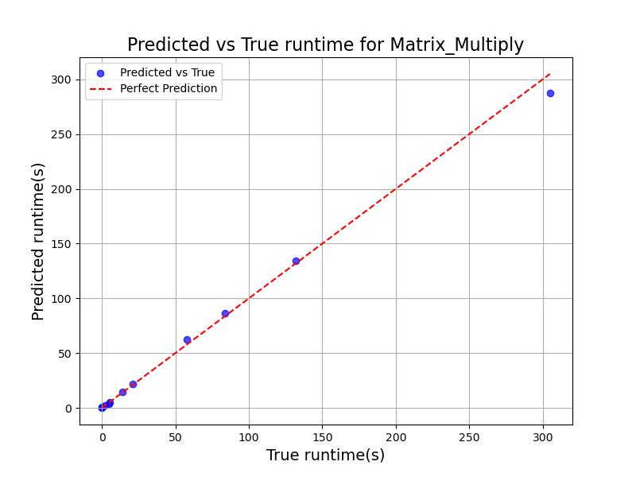
Hybrid Matrix_Multiply
MAPE: 3.2217
R²: 0.6639
RMSE: 199.3429
效果不佳，如上。
剔除运行时间不大于1秒的样本后，表现改善
Predicting runtime for Matrix_Multiply on Cortex-R5F
Test size: 0.3, Lower bound: 1.0
Method: hybrid
Seed 1: MAPE=0.0668 (优秀), R2=0.9983, RMSE=4.0440 (s), RMSE%_mean=3.78% (优秀), RMSE%_range=1.08% (优秀), N=27
Seed 2: MAPE=0.1348 (中等), R2=0.9978, RMSE=5.4996 (s), RMSE%_mean=5.69% (优秀), RMSE%_range=1.47% (优秀), N=27
Seed 6: MAPE=0.0879 (优秀), R2=0.9980, RMSE=3.9983 (s), RMSE%_mean=4.77% (优秀), RMSE%_range=1.13% (优秀), N=27
Seed 42: MAPE=0.1121 (中等), R2=0.9964, RMSE=5.9713 (s), RMSE%_mean=6.59% (优秀), RMSE%_range=1.79% (优秀), N=27
Seed 123: MAPE=0.0422 (优秀), R2=0.9987, RMSE=3.8817 (s), RMSE%_mean=3.16% (优秀), RMSE%_range=1.13% (优秀), N=27
Seed 2025: MAPE=0.1146 (中等), R2=0.9990, RMSE=3.3372 (s), RMSE%_mean=3.10% (优秀), RMSE%_range=1.00% (优秀), N=27
Seed 33550336: MAPE=0.1561 (中等), R2=0.9989, RMSE=3.3865 (s), RMSE%_mean=3.67% (优秀), RMSE%_range=0.91% (优秀), N=27
MAPE: 0.1021 ± 0.0393 (中等)
R2: 0.9982 ± 0.0009
RMSE: 4.3027 ± 1.0268 (s)
RMSE%_mean: 4.39% ± 1.34% (优秀)
RMSE%_range: 1.22% ± 0.31% (优秀)

Slide 25

Hybrid KF
MAPE: 625.5941
R²: 0.9993
RMSE: 4.9308
效果不佳，如上。
剔除运行时间不大于1秒的样本后，表现改善
Predicting runtime for KF on Cortex-R5F
Test size: 0.3, Lower bound: 1.0
Method: hybrid
Seed 1: MAPE=0.0691 (优秀), R2=0.9988, RMSE=7.6440 (s), RMSE%_mean=3.40% (优秀), RMSE%_range=1.02% (优秀), N=28
Seed 2: MAPE=0.2003 (差), R2=0.9969, RMSE=11.8150 (s), RMSE%_mean=6.59% (优秀), RMSE%_range=1.58% (优秀), N=28
Seed 6: MAPE=0.1352 (中等), R2=0.9977, RMSE=10.2747 (s), RMSE%_mean=5.32% (优秀), RMSE%_range=1.49% (优秀), N=28
Seed 42: MAPE=0.1009 (中等), R2=0.9997, RMSE=3.1256 (s), RMSE%_mean=1.86% (优秀), RMSE%_range=0.45% (优秀), N=28
Seed 123: MAPE=0.0602 (优秀), R2=0.9972, RMSE=10.8063 (s), RMSE%_mean=4.66% (优秀), RMSE%_range=1.62% (优秀), N=28
Seed 2025: MAPE=0.3489 (差), R2=0.9989, RMSE=7.6380 (s), RMSE%_mean=3.45% (优秀), RMSE%_range=1.02% (优秀), N=28
Seed 33550336: MAPE=0.2505 (差), R2=0.9992, RMSE=7.0094 (s), RMSE%_mean=3.31% (优秀), RMSE%_range=0.94% (优秀), N=28
MAPE: 0.1664 ± 0.1061 (中等)
R2: 0.9983 ± 0.0011
RMSE: 8.3305 ± 2.9393 (s)
RMSE%_mean: 4.08% ± 1.56% (优秀)
RMSE%_range: 1.16% ± 0.42% (优秀)

Slide 26

Hybrid FFT
MAPE: 0.9842
R²: 1.0000
RMSE: 0.5302
这么多实验结果显示：运行时间值很小的样本，对预测效果有很大的副作用！
效果不佳，如上。
剔除运行时间不大于0.0005秒的样本后，表现改善
Predicting runtime for FFT on Cortex-R5F
Test size: 0.3, Lower bound: 0.0005
Method: hybrid
Seed 1: MAPE=0.0391 (优秀), R2=1.0000, RMSE=0.3308 (s), RMSE%_mean=0.23% (优秀), RMSE%_range=0.04% (优秀), N=9
Seed 2: MAPE=0.0391 (优秀), R2=1.0000, RMSE=0.1386 (s), RMSE%_mean=0.20% (优秀), RMSE%_range=0.03% (优秀), N=9
Seed 6: MAPE=0.1340 (中等), R2=1.0000, RMSE=0.3902 (s), RMSE%_mean=0.39% (优秀), RMSE%_range=0.05% (优秀), N=9
Seed 42: MAPE=0.0208 (优秀), R2=1.0000, RMSE=0.1449 (s), RMSE%_mean=0.20% (优秀), RMSE%_range=0.04% (优秀), N=9
Seed 123: MAPE=0.0638 (优秀), R2=1.0000, RMSE=0.0099 (s), RMSE%_mean=0.55% (优秀), RMSE%_range=0.10% (优秀), N=9
Seed 2025: MAPE=0.0691 (优秀), R2=1.0000, RMSE=0.0506 (s), RMSE%_mean=0.14% (优秀), RMSE%_range=0.03% (优秀), N=9
Seed 33550336: MAPE=0.0458 (优秀), R2=1.0000, RMSE=0.3912 (s), RMSE%_mean=0.39% (优秀), RMSE%_range=0.05% (优秀), N=9
MAPE: 0.0588 ± 0.0369 (优秀)
R2: 1.0000 ± 0.0000
RMSE: 0.2080 ± 0.1605 (s)
RMSE%_mean: 0.30% ± 0.15% (优秀)
RMSE%_range: 0.05% ± 0.02% (优秀)
Test size: 0.3, Lower bound: 0.0001
MAPE: 0.2050 ± 0.0923 (差)
R2: 1.0000 ± 0.0000
RMSE: 0.1905 ± 0.1472 (s)
RMSE%_mean: 0.38% ± 0.25% (优秀)
RMSE%_range: 0.05% ± 0.04% (优秀)

Slide 27
Curve 和 Hybrid AES
Predicting runtime for AES on R5
Test size: 0.3, Lower bound: 0
Method: curve_fit
MAPE: 0.0177 ± 0.0123 (优秀)
R2: 0.9999 ± 0.0002
RMSE: 0.0000 ± 0.0000 (s)
RMSE%_mean: 0.56% ± 0.27% (优秀)
RMSE%_range: 0.31% ± 0.25% (优秀)
Predicting runtime for AES on R5
Test size: 0.3, Lower bound: 0
Method: hybrid
MAPE: 0.0196 ± 0.0120 (优秀)
R2: 0.9999 ± 0.0002
RMSE: 0.0000 ± 0.0000 (s)
RMSE%_mean: 0.58% ± 0.26% (优秀)
RMSE%_range: 0.33% ± 0.25% (优秀)
Predicting runtime for AES on A72
Test size: 0.3, Lower bound: 0
Method: curve_fit
MAPE: 0.0248 ± 0.0300 (优秀)
R2: 1.0000 ± 0.0000
RMSE: 0.0005 ± 0.0004 (s)
RMSE%_mean: 0.18% ± 0.06% (优秀)
RMSE%_range: 0.05% ± 0.02% (优秀)
Predicting runtime for AES on A72
Test size: 0.3, Lower bound: 0
Method: hybrid
MAPE: 0.0052 ± 0.0034 (优秀)
R2: 1.0000 ± 0.0000
RMSE: 0.0005 ± 0.0004 (s)
RMSE%_mean: 0.18% ± 0.07% (优秀)
RMSE%_range: 0.05% ± 0.02% (优秀)
Predicting runtime for AES on M7
Test size: 0.3, Lower bound: 0
Method: curve_fit
MAPE: 0.0248 ± 0.0300 (优秀)
R2: 1.0000 ± 0.0000
RMSE: 0.0005 ± 0.0004 (s)
RMSE%_mean: 0.18% ± 0.06% (优秀)
RMSE%_range: 0.05% ± 0.02% (优秀)
Predicting runtime for AES on M7
Test size: 0.3, Lower bound: 0
Method: hybrid
MAPE: 0.0052 ± 0.0034 (优秀)
R2: 1.0000 ± 0.0000
RMSE: 0.0005 ± 0.0004 (s)
RMSE%_mean: 0.18% ± 0.07% (优秀)
RMSE%_range: 0.05% ± 0.02% (优秀)

Slide 28
Curve 和 Hybrid MD5
Predicting runtime for MD5 on R5
Test size: 0.3, Lower bound: 0
Method: curve_fit
MAPE: 0.2809 ± 0.1202 (差)
R2: 0.8010 ± 0.2110
RMSE: 0.0000 ± 0.0000 (s)
RMSE%_mean: 29.00% ± 11.20% (差)
RMSE%_range: 18.08% ± 7.61% (中等)
Predicting runtime for MD5 on R5
Test size: 0.3, Lower bound: 0
Method: hybrid
MAPE: 0.2294 ± 0.1005 (差)
R2: 0.8237 ± 0.2214
RMSE: 0.0000 ± 0.0000 (s)
RMSE%_mean: 26.38% ± 11.65% (差)
RMSE%_range: 16.55% ± 8.22% (中等)
Predicting runtime for MD5 on A72
Test size: 0.3, Lower bound: 0
Method: curve_fit
MAPE: 0.0192 ± 0.0112 (优秀)
R2: 1.0000 ± 0.0000
RMSE: 0.0000 ± 0.0000 (s)
RMSE%_mean: 0.07% ± 0.03% (优秀)
RMSE%_range: 0.02% ± 0.01% (优秀)
Predicting runtime for MD5 on A72
Test size: 0.3, Lower bound: 0
Method: hybrid
MAPE: 0.0214 ± 0.0167 (优秀)
R2: 1.0000 ± 0.0000
RMSE: 0.0000 ± 0.0000 (s)
RMSE%_mean: 0.10% ± 0.06% (优秀)
RMSE%_range: 0.02% ± 0.01% (优秀)
Predicting runtime for MD5 on M7
Test size: 0.3, Lower bound: 0
Method: curve_fit
MAPE: 0.0192 ± 0.0112 (优秀)
R2: 1.0000 ± 0.0000
RMSE: 0.0000 ± 0.0000 (s)
RMSE%_mean: 0.07% ± 0.03% (优秀)
RMSE%_range: 0.02% ± 0.01% (优秀)
Predicting runtime for MD5 on M7
Test size: 0.3, Lower bound: 0
Method: hybrid
MAPE: 0.0214 ± 0.0167 (优秀)
R2: 1.0000 ± 0.0000
RMSE: 0.0000 ± 0.0000 (s)
RMSE%_mean: 0.10% ± 0.06% (优秀)
RMSE%_range: 0.02% ± 0.01% (优秀)

Slide 29
Curve 和 Hybrid SHA256
Predicting runtime for SHA256 on R5
Test size: 0.3, Lower bound: 0
Method: curve_fit
MAPE: 0.1227 ± 0.0916 (中等)
R2: 0.9784 ± 0.0373
RMSE: 0.0000 ± 0.0000 (s)
RMSE%_mean: 8.99% ± 4.23% (优秀)
RMSE%_range: 5.16% ± 3.73% (优秀)
Predicting runtime for SHA256 on R5
Test size: 0.3, Lower bound: 0
Method: hybrid
MAPE: 0.1367 ± 0.0550 (中等)
R2: 0.9792 ± 0.0373
RMSE: 0.0000 ± 0.0000 (s)
RMSE%_mean: 8.38% ± 4.49% (优秀)
RMSE%_range: 4.90% ± 3.89% (优秀)
Predicting runtime for SHA256 on A72
Test size: 0.3, Lower bound: 0.0
Method: curve_fit
MAPE: 0.5308 ± 0.4170 (差)
R2: 0.9990 ± 0.0004
RMSE: 0.0001 ± 0.0001 (s)
RMSE%_mean: 4.42% ± 1.31% (优秀)
RMSE%_range: 1.18% ± 0.29% (优秀)
Predicting runtime for SHA256 on A72
Test size: 0.3, Lower bound: 0
Method: hybrid
MAPE: 0.0838 ± 0.0089 (优秀)
R2: 0.9994 ± 0.0004
RMSE: 0.0001 ± 0.0001 (s)
RMSE%_mean: 3.26% ± 1.15% (优秀)
RMSE%_range: 0.88% ± 0.34% (优秀)
Predicting runtime for SHA256 on M7
Test size: 0.3, Lower bound: 0.0
Method: curve_fit
MAPE: 0.5308 ± 0.4170 (差)
R2: 0.9990 ± 0.0004
RMSE: 90.9086 ± 75.0311 (us)
RMSE%_mean: 4.42% ± 1.31% (优秀)
RMSE%_range: 1.18% ± 0.29% (优秀)
Predicting runtime for SHA256 on M7
Test size: 0.3, Lower bound: 0.0
Method: hybrid
MAPE: 0.0838 ± 0.0089 (优秀)
R2: 0.9994 ± 0.0004
RMSE: 79.6302 ± 79.4545 (us)
RMSE%_mean: 3.26% ± 1.15% (优秀)
RMSE%_range: 0.88% ± 0.34% (优秀)

Slide 30
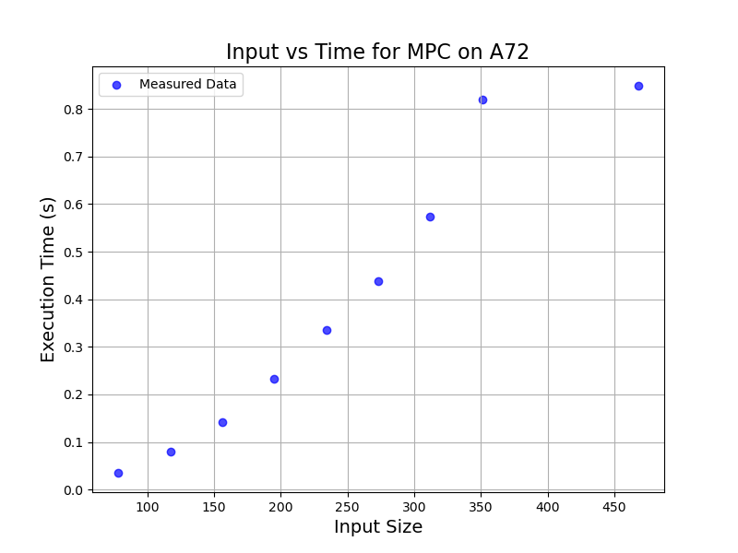
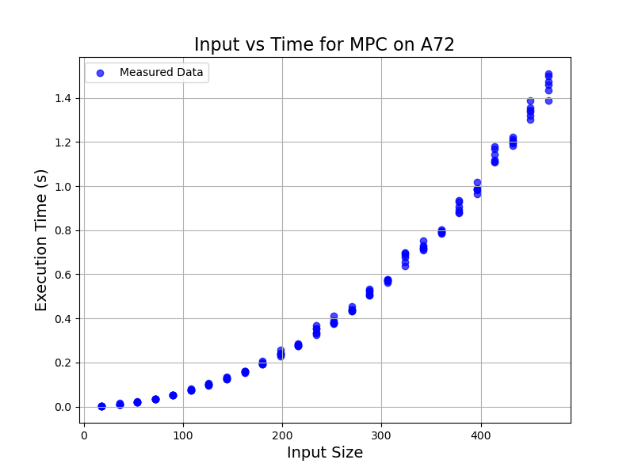
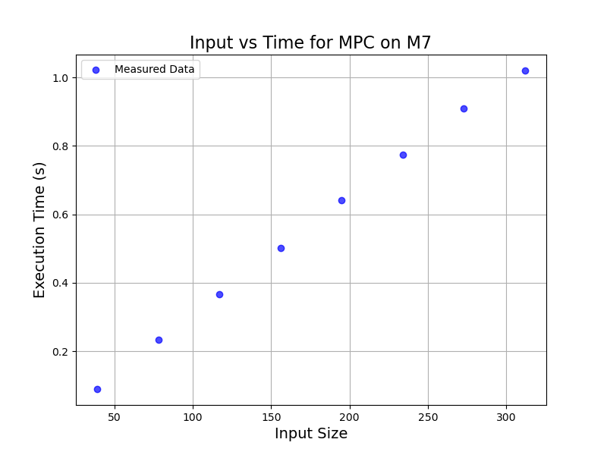
关于MPC
MPC算法步数与运行时间的关系在M7上是线性，但是在A72上是二次
采样了156组数据
方法：步数从18每次递增18至468，共在26个步数上采样，每个步数采样6次。
RF,CURVE,XGB,HYBRID方法效果明显改善
特征越复杂、数据波动越大，需要采样越多数据。
在相同输入特征下多次采样运行时间，可取均值，减少数据波动的影响

Slide 31
Hybrid MPC on M7
Predicting runtime for MPC on A72
Test size: 0.3, Lower bound: 0.0
Method: hybrid
Seed 1: MAPE=0.0268 (优秀), R2=0.9986, RMSE=0.0160 (s), RMSE%_mean=3.14% (优秀), RMSE%_range=1.12% (优秀), N=47
Seed 2: MAPE=0.0675 (优秀), R2=0.9981, RMSE=0.0173 (s), RMSE%_mean=3.90% (优秀), RMSE%_range=1.30% (优秀), N=47
Seed 6: MAPE=0.0498 (优秀), R2=0.9973, RMSE=0.0230 (s), RMSE%_mean=4.52% (优秀), RMSE%_range=1.53% (优秀), N=47
Seed 42: MAPE=0.0288 (优秀), R2=0.9983, RMSE=0.0176 (s), RMSE%_mean=3.50% (优秀), RMSE%_range=1.21% (优秀), N=47
Seed 123: MAPE=0.0776 (优秀), R2=0.9980, RMSE=0.0216 (s), RMSE%_mean=3.93% (优秀), RMSE%_range=1.56% (优秀), N=47
Seed 2025: MAPE=0.2295 (差), R2=0.9981, RMSE=0.0193 (s), RMSE%_mean=3.74% (优秀), RMSE%_range=1.28% (优秀), N=47
Seed 33550336: MAPE=0.0391 (优秀), R2=0.9988, RMSE=0.0150 (s), RMSE%_mean=3.27% (优秀), RMSE%_range=1.02% (优秀), N=47
MAPE: 0.0741 ± 0.0711 (优秀)
R2: 0.9982 ± 0.0005
RMSE: 0.0186 ± 0.0029 (s)
RMSE%_mean: 3.71% ± 0.47% (优秀)
RMSE%_range: 1.29% ± 0.20% (优秀)

Slide 32
关于 模型、样本量、参数的认识
对于要拟合的n与T，采样更多n能使模型更贴合数据，对同一个n采样更多T有助于降低噪声影响，提高精度。现在要拟合的关系大多数都是知道函数的形式的，因此可以更多地考虑后者。
当某个随机种子在当前数据上表现很好，能否推到别的数据上？
  不能保证，一次好的结果可能是随机性与样本噪声、具体数据划分、超参恰好“契合”。在其他的数据上未必如此。
随机种与其他参数的区别：
  模型参数（超参数）：如n_estimators, max_depth, learning_rate, hidden_layer_sizes；决定模型的结构、复杂度、学习能力等，直接影响性能。
  训练参数：决定训练过程的收敛路径，影响收敛效果
  随机种：控制随机过程（初始化、抽样、打乱），只影响随机性。
对一组固定超参，使用多个 seed 看指标的标准差能量化对随机性的敏感度。如果标准差大说明模型稳定性差，应该考虑更多数据或者调参，或者是某个特定的seed出现了极端情况。

Slide 33
数据量增大，在不同随机种下的表现差异减小
数据量47
Predicting runtime for SHA256 on A72
Test size: 0.3, Lower bound: 0.0
Method: hybrid
MAPE: 0.0034 ± 0.0022 (优秀)
R2: 1.0000 ± 0.0000
RMSE: 0.0001 ± 0.0001 (s)
RMSE%_mean: 0.27% ± 0.15% (优秀)
RMSE%_range: 0.15% ± 0.08% (优秀)
数据量4671
Predicting runtime for SHA256 on A72
Test size: 0.3, Lower bound: 0.0
Method: hybrid
MAPE: 0.0009 ± 0.0002 (优秀)
R2: 1.0000 ± 0.0000
RMSE: 0.0001 ± 0.0000 (s)
RMSE%_mean: 0.25% ± 0.04% (优秀)
RMSE%_range: 0.12% ± 0.02% (优秀)

Slide 34
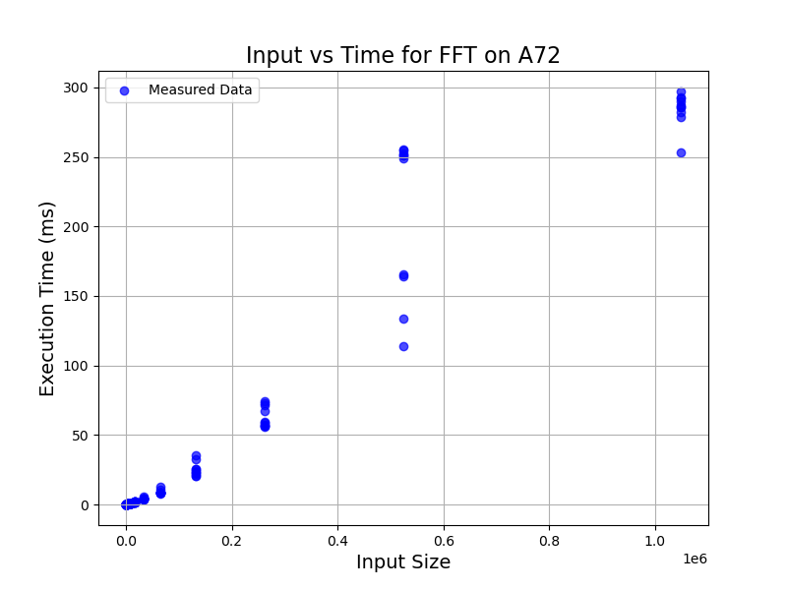
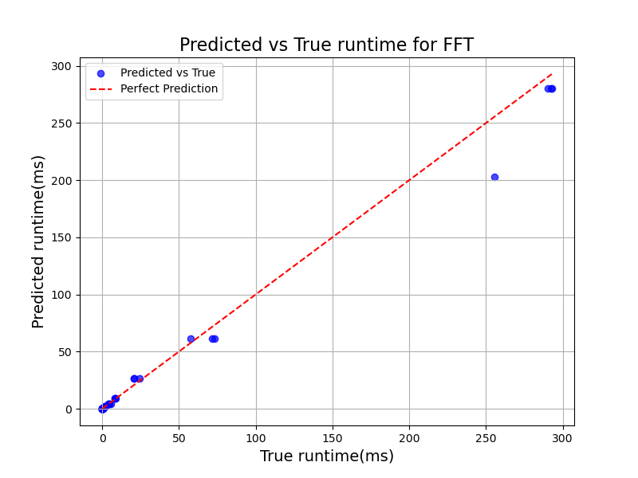
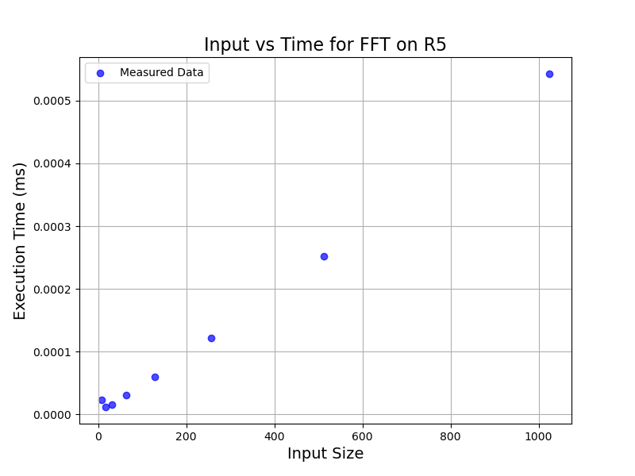
FFT在A72的样本数据波动大
FFT在A72平台（左）：
对一个输入规模n采样了10个运行时间T。
总体而言数据波动过大，尤其在n=2^19处。
完全无法拟合
原因之一：
时间激增应该是因为，数据量增多，存储的区域从访问较快的缓存区移到慢缓存区了
FFT在R5平台（右）：
可采样的数据点过少（2^3~2^10共8个），
对同一个规模多次测试，运行时间几乎没有波动
考虑使用查表表

Slide 35
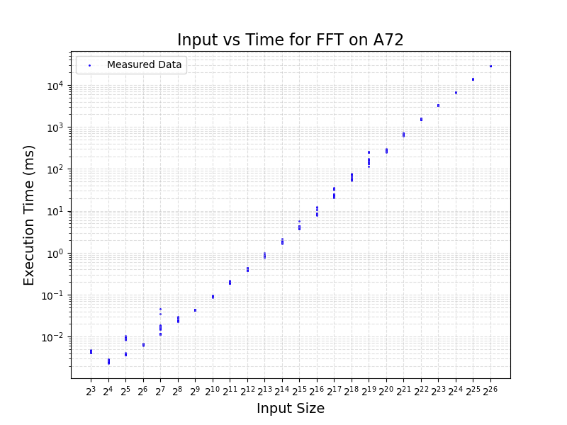
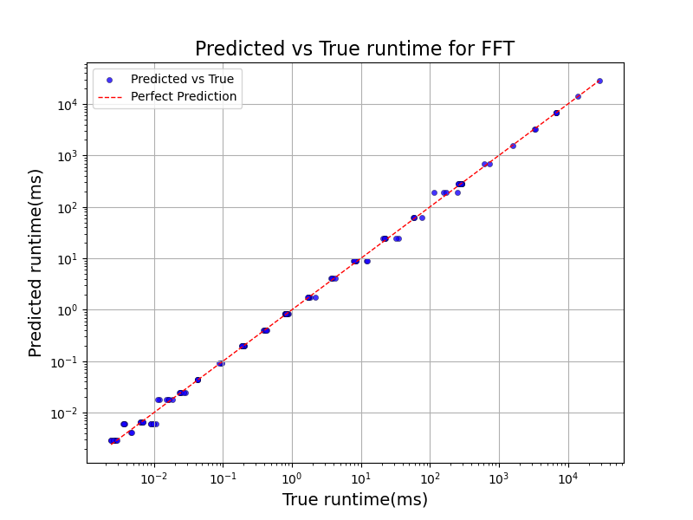
FFT在A72的样本数据波动大
11/12
扩大测试规模到2^26.可见总体符合nlogn规律，但在某些点上波动很大。
对于这些波动很大的点不可能做到误差很小（模型预测的点会比较靠近所有时间的平均值），只能保证在波动小的点上误差较小，使模型总体而言误差较小。

Slide 36
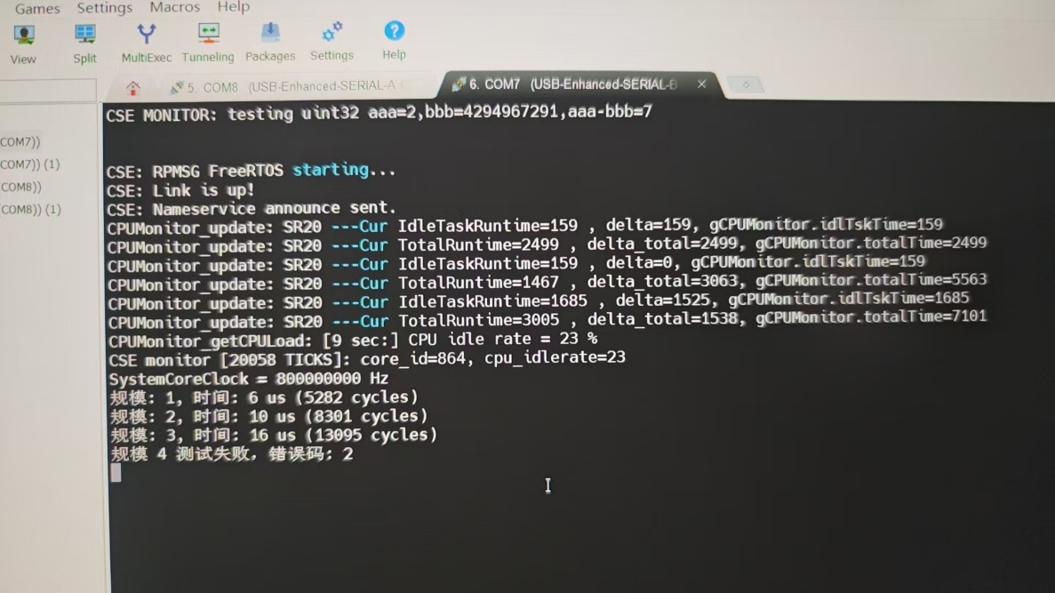
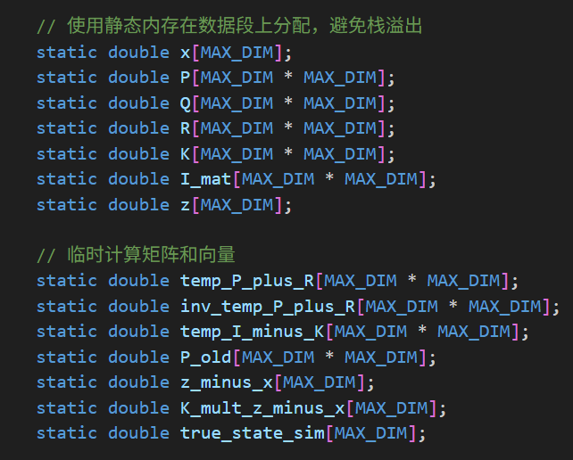
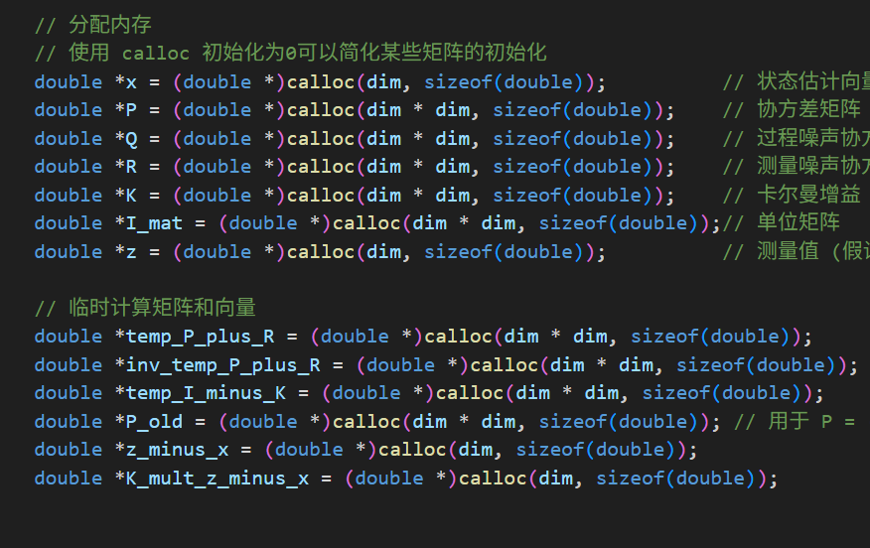
KF程序在M7上出错 calloc/free
错误码2——无法分配内存
原因：代码中内存动态分配超过可用heap内存
解决方法：改为静态分配
经测试MAX_DIM可开到40左右

